Slide 1
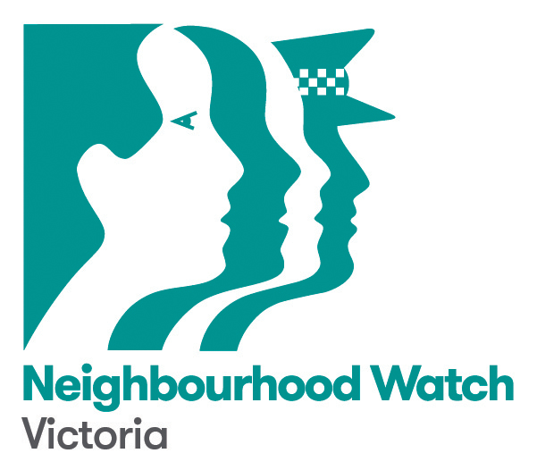
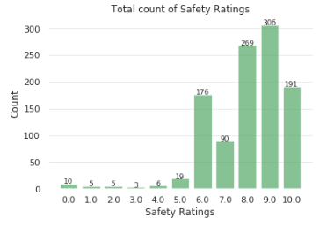
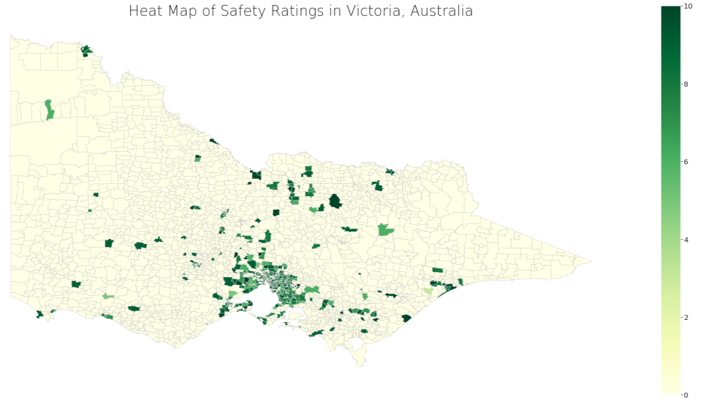
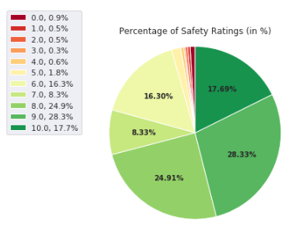
VICTORIA, AUSTRALIA – Nov 2019 – May 2020
Overview of safety ratings across Victoria, majority of respondents or 79.26% scored their suburbs with a high and moderately-high safety ratings between 10 to 7. The remaining 20.74% are suburbs considered unsafe with the lowest safety ratings between 6 to 1.
There are a total of 293 participating suburbs of howsafeismyplace.com.au survey. Most of which are from the inner-suburbs of Victoria and some from regional areas.
There are 1,080 respondents distributed across different safety ratings with 10 as the highest rating possible and 1 as the lowest.
The safety ratings were grouped into three categories:
10: highest-rated very safe suburbs or 17.69%.
9 to 7: moderately safe suburbs or 61.57%.
6 to 1: unsafe/least safe suburbs or 20.74%.
Note: There are originally 1,126 respondents, but 46 were excluded due to incorrect postcodes.
0.0 in safety rating means no response/blank response.

Slide 2
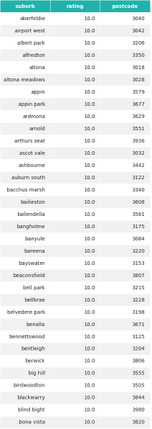
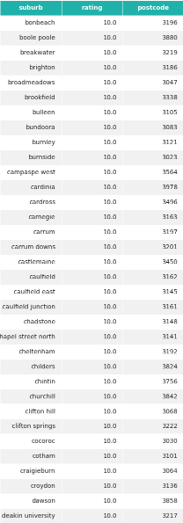
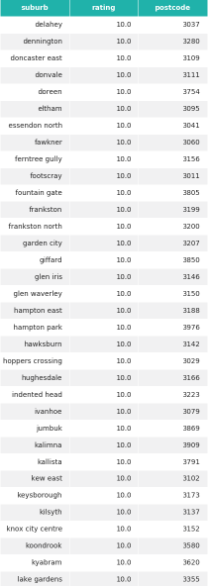
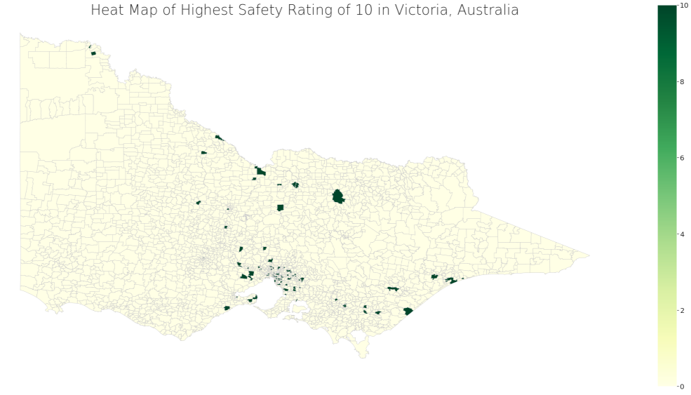

VICTORIA, AUSTRALIA – Nov 2019 – May 2020
Zooming in to the very safe suburbs with the perfect safety rating of 10; a total of 127 out of 292 participating suburbs in Victoria are deemed as the safest.
The safety ratings were grouped into three categories:
10: highest-rated very safe suburbs
9 to 7: moderately safe suburbs
6 to 1: unsafe/least safe suburbs
A portion of these highest-rated very safe suburbs are in the south-east of Melbourne, and regional areas of Northern Victoria.
Note: Only 102 out of 127 suburbs are displayed in the table.

Slide 3
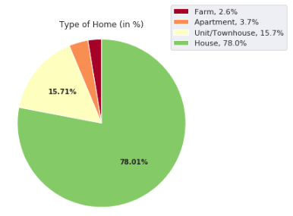
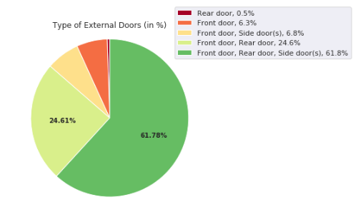
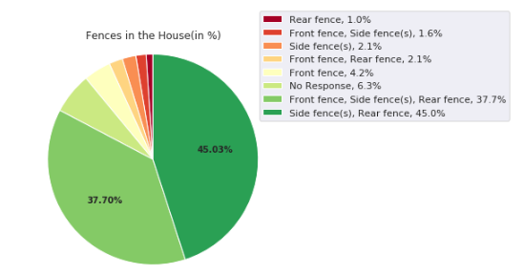
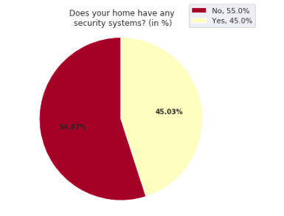
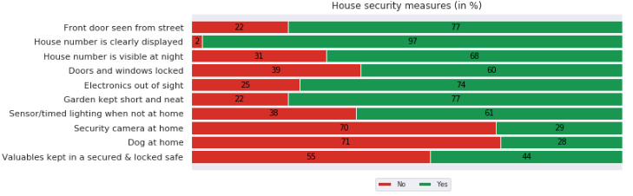
VICTORIA, AUSTRALIA – Nov 2019 – May 2020
78.01% of the very safe suburbs are composed of houses, most of these houses have a complete front, rear and side doors with rear and side fences only. However, half of them with 54.97% do not have any security systems at home.
As part of their best practices, the majority or 60% lock their doors, more than 70% said that electronics are out of sight, gardens are kept short and neat, sensor lighting is available. (in %)
Security cameras, pet dogs and locked safes are NOT a popular source of safety precautions in the very safe suburbs.

Slide 4
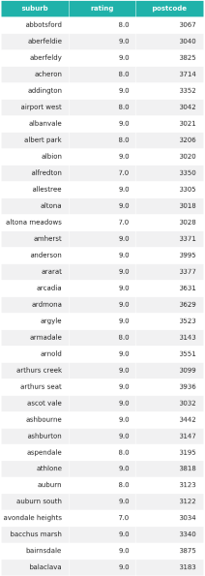
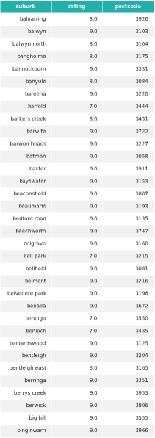
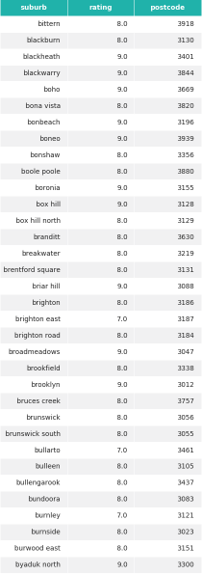
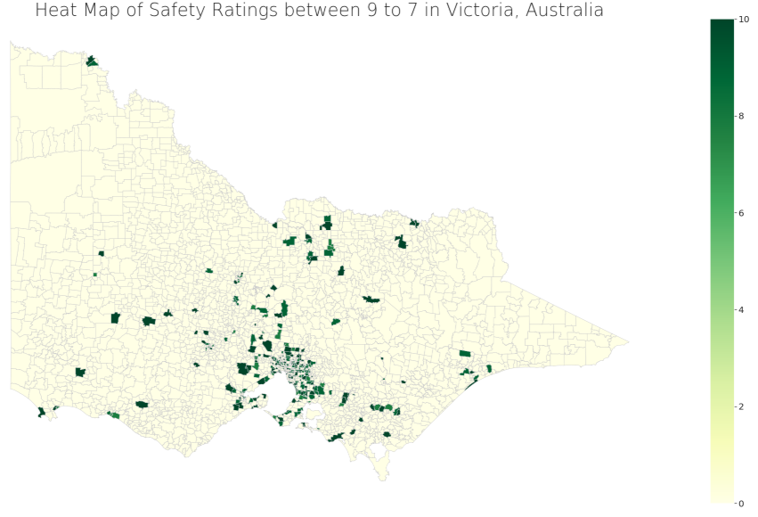
VICTORIA, AUSTRALIA – Nov 2019 – May 2020
Zooming in to the moderately safe suburbs with safety ratings between 9 to 7; a total of 247 out of 292 participating suburbs in Victoria are deemed as moderately safe.
The safety ratings were grouped into three categories:
10: highest-rated very safe suburbs
9 to 7: moderately safe suburbs
6 to 1: unsafe/least safe suburbs
Most of the participating suburbs are considered moderately safe, thus it is spread out across Victoria.
Note: Only 102 out of 247 suburbs are displayed in the table.
Some suburbs can be included in all, both or either very safe, moderately safe or unsafe rating depending on the respondent.

Slide 5
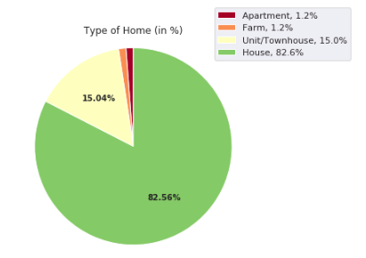
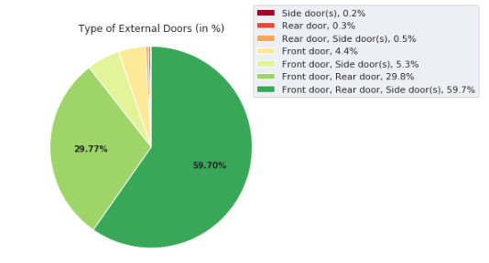
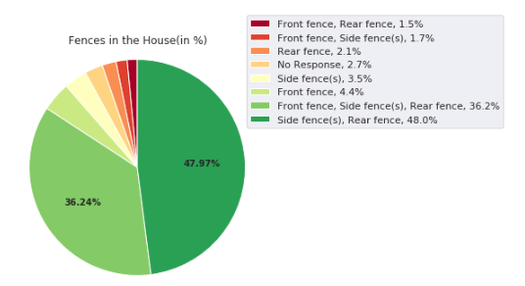
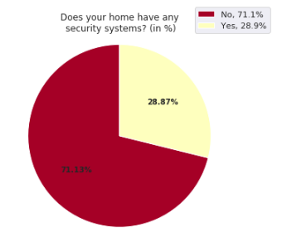
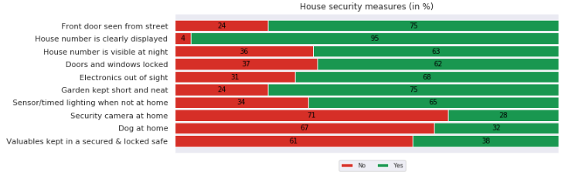
VICTORIA, AUSTRALIA – Nov 2019 – May 2020
82.56% of the moderately safe suburbs are also composed of houses, most of these houses have a complete front, rear and side doors with rear and side fences only. However, a higher percentage of 71.13% do not have any security systems at home.
The same results show that 62% or majority lock their doors, electronics are out of sight, gardens are kept short and neat, sensor lighting is available. (in %)
Security cameras, pet dogs and locked safes are STILL NOT a popular source of safety precautions in the moderately safe suburbs.

Slide 6
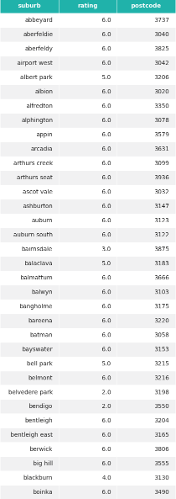
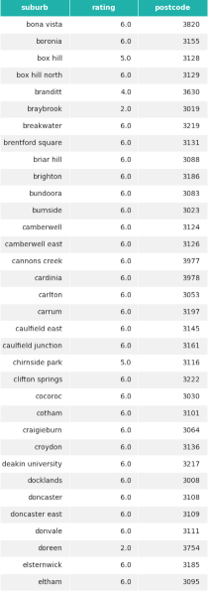
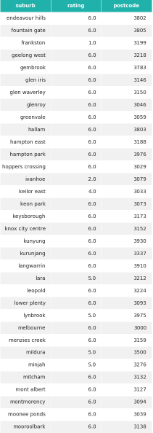
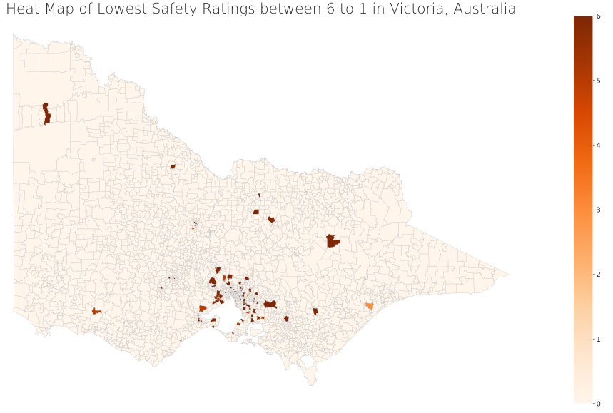
VICTORIA, AUSTRALIA – Nov 2019 – May 2020
Zooming in to the unsafe/least safe suburbs with the lowest safety ratings between 6 to 1; a total of 126 out of 292 suburbs in Victoria are deemed as the least safe/unsafe.
The safety ratings were grouped into three categories:
10: highly-rated safest suburbs
9 to 7: moderately safe suburbs
6 to 1: unsafe/least safe suburbs
A portion of the unsafe suburbs are in the inner-suburbs with a bigger concentration on the West side.
Note: Only 102 out of 126 suburbs are displayed in the table.
Some suburbs can be included in all, both or either very safe, moderately safe or unsafe rating
depending on the respondent.

Slide 7
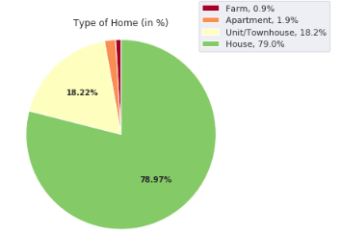
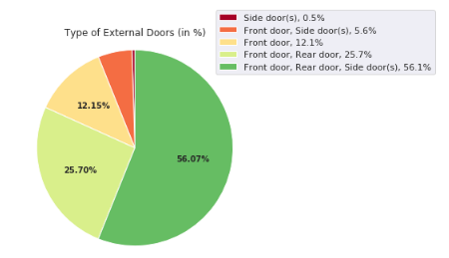
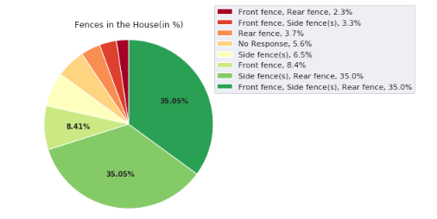
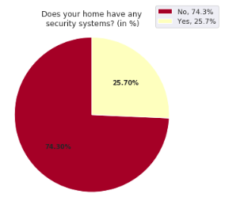
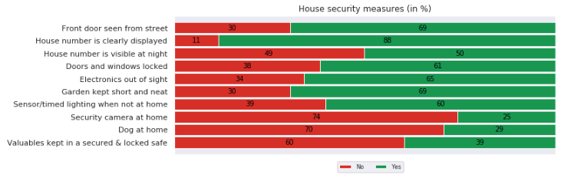
VICTORIA, AUSTRALIA – Nov 2019 – May 2020
78.97% of the unsafe/ least safe suburbs are also composed of houses, with a complete front, rear, and side doors. Apart from the usual rear and side fences, the majority also has front fences. Also, 74.3% do not have any security systems at home, which is the highest percentage compared to the very safe and moderately safe suburbs.
The same results show that the unsafe/least safe suburbs apply the same practices of the highly- rated suburbs. Wherein majority or 61% lock their doors, electronics are out of sight. gardens are kept short and neat, sensor lighting is available (in %)
Security cameras, pet dogs and locked safes are STILL NOT a popular source of safety precautions in the unsafe/least safe suburbs.

Slide 8
VICTORIA, AUSTRALIA – Nov 2019 – May 2020
Overall, regardless of the different safety ratings from 10 to 1 (very safe, moderately safe or unsafe), most of the participating suburbs in Victoria both apply and do not apply the same safety practices.
KEY TAKEAWAYS:
The safety ratings were grouped into three categories:
17.69% or 10 are the highest-rated very safe suburbs
61.57% or 9 to 7 are the moderately safe suburbs
20.74% or 6 to 1 are the unsafe/least safe suburbs
 | 10: highly-rated very safe suburbs | 9-7: moderately safe suburbs | 6-1: unsafe/least safe suburbs
Type of Home | House | House | House
Type of Doors | Front, rear, and side doors | Front, rear, and side doors | Front, rear, and side doors
Type of Fences | Rear and side fences | Rear and side fences | Front, rear and side fences
Security System | 54.97% do not have | 71.13% do not have | 74.3% do not have
The only difference in the type of home is that unsafe suburbs tend to have front fences compared to highly-rated suburbs with only rear and side fences. Perhaps due to added safety of a front fence.
Majority of the suburbs do not have any security system at home, with both 71.13% from moderately safe suburbs and 74.3% from unsafe suburbs.
All of the suburbs showed the same safety practices where majority lock their doors, electronics are out of sight, gardens are kept short and neat, sensor lighting is available.
Surprisingly, security cameras, pet dogs and locked safes are not a popular source of safety precautions across the participating suburbs in Victoria.

