Slide 1

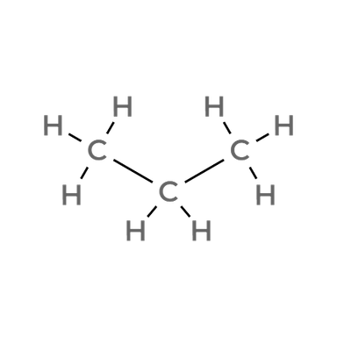

CARD 01 - Propane
C3H8
C3H8
Identity/Formula Check
Lewis Structure
CH3CH2CH3
Condensed Structural Formula
Bond-Line Structure (Ketcher)
ATOM COUNT VERIFIED
VALENCE CHECKED
BOND ORDER CHECKED
SAME CONNECTIVITY CONFIRMED

Slide 2
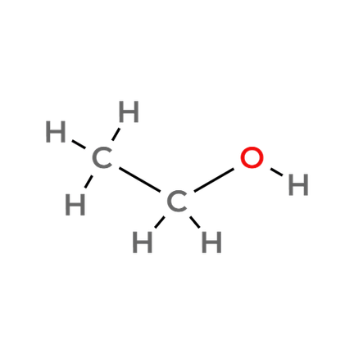


CARD 02 - Ethanol
C2H6O
C2H6O
Identity/Formula Check
Lewis Structure
CH3CH2OH
Condensed Structural Formula
Bond-Line Structure (Ketcher)
ATOM COUNT VERIFIED
VALENCE CHECKED
BOND ORDER CHECKED
SAME CONNECTIVITY CONFIRMED

Slide 3
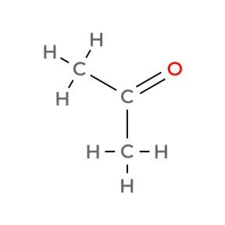

CARD 03 - Acetone (propan-2-one)
C3H6O
C3H6O
Identity/Formula Check
Lewis Structure
CH3COCH3
Condensed Structural Formula
Bond-Line Structure (Ketcher)
ATOM COUNT VERIFIED
VALENCE CHECKED
BOND ORDER CHECKED
SAME CONNECTIVITY CONFIRMED

Slide 4
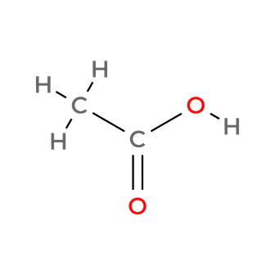

CARD 04 - Acetic acid (ethanoic acid)
C2H4O2
C2H4O2
Identity/Formula Check
Lewis Structure
CH3COOH
Condensed Structural Formula
Bond-Line Structure (Ketcher)
ATOM COUNT VERIFIED
VALENCE CHECKED
BOND ORDER CHECKED
SAME CONNECTIVITY CONFIRMED

Slide 5
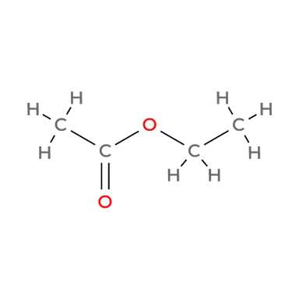

CARD 05 - Ethyl acetate (ethyl ethanoate)
C4H8O2
C4H8O2
Identity/Formula Check
Lewis Structure
CH3COOCH2CH3
Condensed Structural Formula
Bond-Line Structure (Ketcher)
ATOM COUNT VERIFIED
VALENCE CHECKED
BOND ORDER CHECKED
SAME CONNECTIVITY CONFIRMED

Slide 6
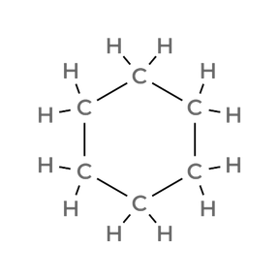
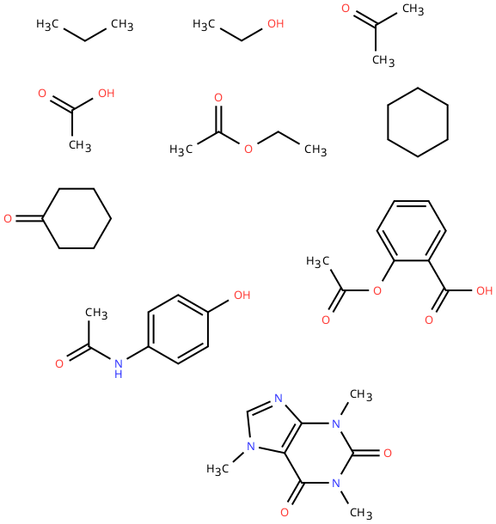
CARD 06 - Cyclohexane
C6H12
C6H12
Identity/Formula Check
Lewis Structure
(CH2)6
Condensed Structural Formula
Bond-Line Structure (Ketcher)
ATOM COUNT VERIFIED
VALENCE CHECKED
BOND ORDER CHECKED
SAME CONNECTIVITY CONFIRMED

Slide 7
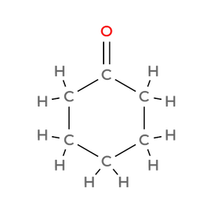
CARD 07 - Cyclohexanone
C6H10O
C6H10O
Identity/Formula Check
Lewis Structure
O=C(CH2)5
Condensed Structural Formula
Bond-Line Structure (Ketcher)
ATOM COUNT VERIFIED
VALENCE CHECKED
BOND ORDER CHECKED
SAME CONNECTIVITY CONFIRMED

Slide 8
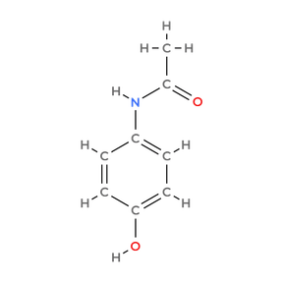
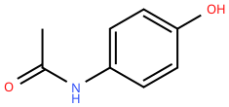
CARD 08 - Acetaminophen (paracetamol)
C8H9NO2
C8H9NO2
Identity/Formula Check
Lewis Structure
HOC6H4NHCOCH3
Condensed Structural Formula
Bond-Line Structure (Ketcher)
ATOM COUNT VERIFIED
VALENCE CHECKED
BOND ORDER CHECKED
SAME CONNECTIVITY CONFIRMED

Slide 9
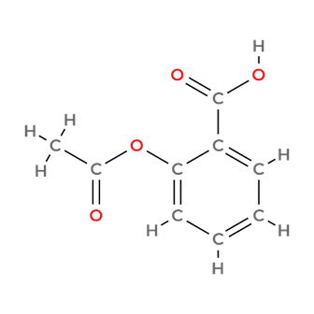
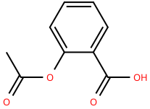
CARD 09 - Aspirin (acetylsalicylic acid)
C9H8O4
C9H8O4
Identity/Formula Check
Lewis Structure
CH3COOC6H4COOH
Condensed Structural Formula
Bond-Line Structure (Ketcher)
ATOM COUNT VERIFIED
VALENCE CHECKED
BOND ORDER CHECKED
SAME CONNECTIVITY CONFIRMED

Slide 10
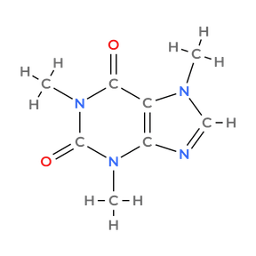
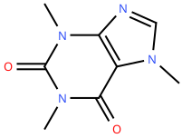
CARD 10 - Caffeine
C8H10N4O2
C8H10N4O2
Identity/Formula Check
Lewis Structure
C5HN4O2(CH3)3
Condensed Structural Formula
Bond-Line Structure (Ketcher)
ATOM COUNT VERIFIED
VALENCE CHECKED
BOND ORDER CHECKED
SAME CONNECTIVITY CONFIRMED

