Slide 1

Incorporating Aging Failures in Power System
Reliability Evaluation
Wenyuan Li, Fellow, IEEE
May 12th, 2005
ECE558 Power Systems Reliability
Kathleen E. Williams
1/27

Slide 2
Introduction
Definition and Calculation Approach
III. Using unavailability of aging failures in power system reliability evaluation
IV. Case Study
V. Conclusion
2/27

Slide 3
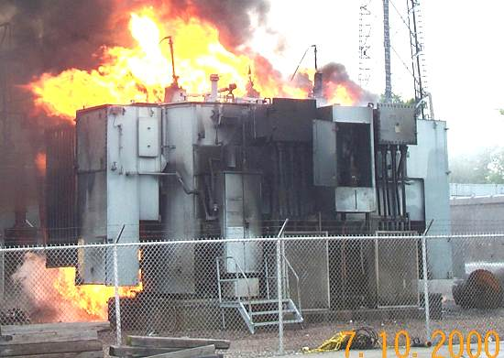
Introduction
Failure Modes
  Repairable
    Average Failure Frequency λ
    Repair Time r
  Non-Repairable
    Aging Failure
      Transformers
      Cable
      Breakers
      Capacitors
Transformer Failure due to fire
3/27

Slide 4
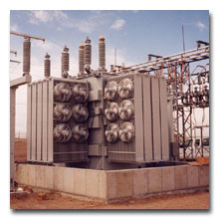
Introduction
Underestimation of System Risk
Traditional Reliability Theory
Probability of aging failure in given time period (Transitional)
Unavailability Calculation Undeveloped
4/27

Slide 5
Introduction
Paper Overview
  Incorporate aging failures in system reliability evaluation
  Definition and Calculation approach with two probability distribution models for unavailability of aging failures
  Implementation techniques in system reliability evaluation
  Example – Application to a Transmission System
5/27

Slide 6
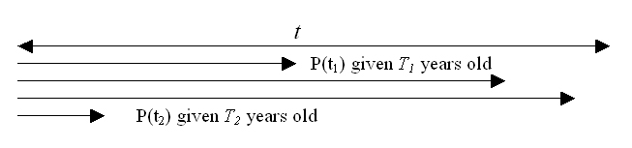
II. Definition and Calculation Approach
A. Definition
Probability to an aging failure – conditional probability that an aging failure of a component will take place within a specified time period t given that it has survived for T years (transition probability)
Unavailability of aging failure – average probability that a component is found unavailable due to aging failures in a specified time period t given that it has survived for T years. Conditional mathematical expectation of time length not available due to aging failures during t divided by the period considered (t). The condition is the age T
6/27

Slide 7


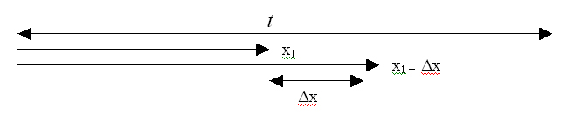
II. Definition and Calculation Approach
B. Calculation Approach
probability of transition to aging failure of a component in a subsequent period t after having survived T years can be calculated by :
f(t) is the failure probability density function (either normal or Weibull)
From (1) , the aging failure probability in a small interval Δx at any point x within t can be calculated by:
(1)
(2)
7/27

Slide 8
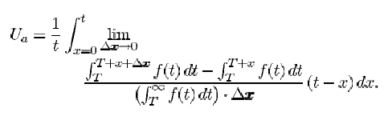

II. Definition and Calculation Approach
B. Calculation Approach
unavailable duration within t is t-x. x is any point within [0,t].
Average unavailability can be expressed as:
Mathematically accurate, but impossible to implement analytically
Discretization
period t is divided into N equal intervals each having a length Δx . Δx is small enough that the failure probability at any point within Δx is constant.
If the component fails within the ith interval, the average unavailable duration with t is given by
(3)
(4)
8/27

Slide 9
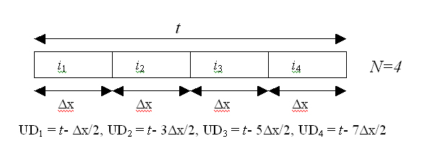

II. Definition and Calculation Approach
B. Calculation Approach
The continuous integral from x=0 to x=t in (3) becomes the following discrete sum:
(3)
(5)
9/27

Slide 10
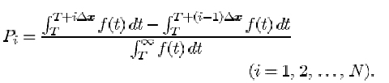
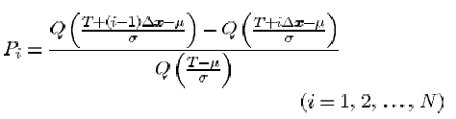
II. Definition and Calculation Approach
B. Calculation Approach
Where
If the aging failure is modeled by a posteriori normal distribution, the integration in (6) does not have an analytical expression. Polynomial approximation must be used:
μ and σ are the mean and standard deviation of of normal distribution
(6)
(7)
10/27

Slide 11
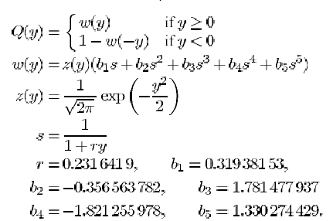
II. Definition and Calculation Approach
B. Calculation Approach
The function Q is calculated by:
11/27

Slide 12
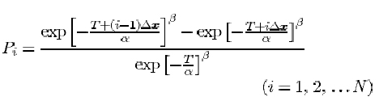
II. Definition and Calculation Approach
B. Calculation Approach
If the aging failure is modeled by a posteriori Weibull distribution, the integration in (8) becomes:
α and β are the scale and shape parameters for Weibull Distribution
(8)
12/27

Slide 13
III.Using unavailability of aging failures in power system reliability evaluation
Consider Transmission Reliability Evaluation.
Steps
Step 1 Select a system state. This includes a load level and states of all system components (up, down, or derated states).
Step 2 Conduct power flow and contingency analysis for the selected system state to check if there is a system problem (overloading, voltage limit violations, isolated buses, islands, etc.)
Step 3 If there is no system problem, go back to Step 1 to select a new system state. Otherwise, go to Step 4.
Step 4 Perform remedial actions. This is often an optimal power flow model. The purpose of the model is to reschedule generations, alleviate line overloading or voltage limit violations, and avoid load curtailments if possible, or minimize the total load curtailments if unavoidable.
Step 5 Update reliability indexes based on results in Step 4.
Step 6 Repeat steps 1-5 until a stopping rule is met.
13/27

Slide 14
III.Using unavailability of aging failures in power system reliability evaluation
Consider Transmission Reliability Evaluation.
Three basic methods for state selection
1.) state enumeration
2.) state sampling (nonsequential Monte-Carlo)
3.) state duration sampling (sequential Monte-Carlo)
1 & 2 use unavailability, but 3 uses failure and repair rates
The unavailability of aging failures now has a consistent form as that of the unavailability of repairable failures from the derivations.
Traditional Method – Unavailability of repairable failures considered
NEW! Method - now two unavailability parameters are considered, repairable failures and aging failures
STEP 1 of the Transmission Reliability Evaluation
14/27

Slide 15

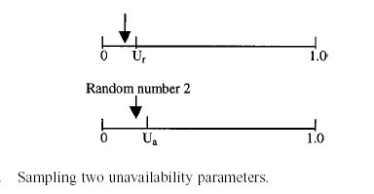
III.Using unavailability of aging failures in power system reliability evaluation
Consider Transmission Reliability Evaluation.
A.) Using unavailability of aging failures in the state enumeration technique
Calculate total equivalent unavailability using:
Ur and Ua is the unavailability for repairable and aging failures
B.) Using unavailability of aging failures in the Monte Carlo simulation technique
more flexible to simulate two unavailability parameters. Two random numbers drawn for each component, one for Ur and one for Ua. Union relation captured automatically
15/27

Slide 16
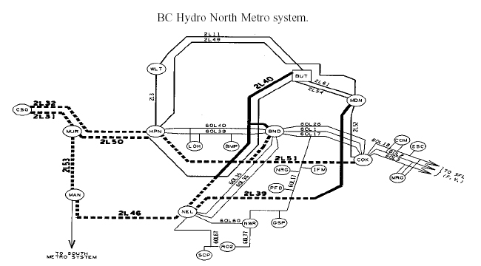
IV. Case Study
16/27

Slide 17
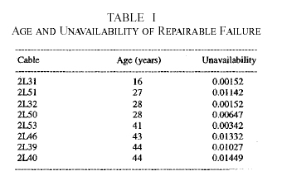
IV. Case Study
BC Hydro North Metro System
    8 underground cables
    4 cables near mean life and aging failures are a concern
    Repairable and aging failures considered in 8 cables
    Repairable failures considered in overhead
Unavailability of aging failures for cables
  The unavailability of repairable failures and the natural ages of 8 cables are given in Table 1. Repairable data is based off of statistics over the past 15 yrs. The mean life of the cable estimated at 45 yrs with a standard deviation of 15 yrs. μ = 45 yrs σ = 15 yrs
17/27

Slide 18
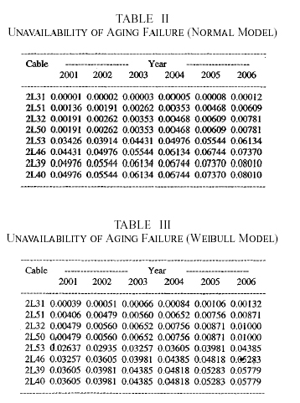
IV. Case Study
  Unavailability of aging failures of the eight cables from 2001 to 2006 using Normal and Weibull models are shown in Table II and Table III.
18/27

Slide 19
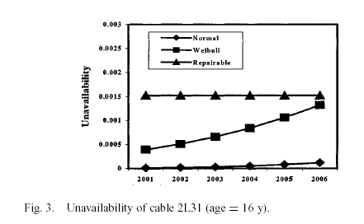
IV. Case Study
  Comparison between the unavailability of repairable failures and aging failures as well as those between Normal and Weibull models, annual unavailability values of the three cables with typical ages from 2001 to 2006 have been plotted in Figure 3-5
19/27

Slide 20
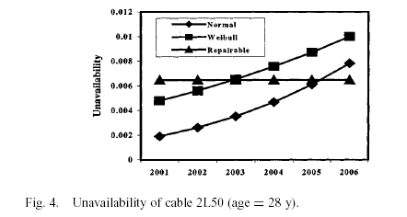
IV. Case Study
  Comparison between the unavailability of repairable failures and aging failures as well as those between Normal and Weibull models, annual unavailability values of the three cables with typical ages from 2001 to 2006 have been plotted in Figure 3-5
20/27

Slide 21
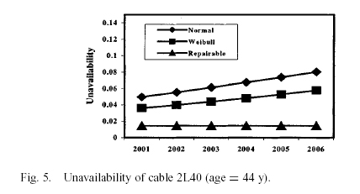
IV. Case Study
  Comparison between the unavailability of repairable failures and aging failures as well as those between Normal and Weibull models, annual unavailability values of the three cables with typical ages from 2001 to 2006 have been plotted in Figure 3-5
21/27

Slide 22
IV. Case Study
  Observations can be made from Table I,II,and III and Figures 3-5
  1) The unavailability of aging failures increases with the age while the unavailability of repairable failures keeps constant.
  2) The unavailability of aging failures at a “young” age is smaller than the unavailability of repairable failures. The unavailability of aging failures at a “midage” is in an order of magnitude comparable with the unavailability of repairable failures. The unavailability of aging failures at an “old age” is much larger than the unavailability of repairable failures.
  3) The normal distribution model provides a lower estimation of unavailability at a “young or midage” but a higher estimation at an “old age” compared to the Weibull model if they have the same mean life and standard deviation. However, more investigations indicate that when the age is “very old,” the situation will change; the Weibull model will lead to a higher estimation of unavailability than the normal model, particularly in the case of a small standard deviation. In otherwords, there are two intersection points on the two curves of unavailability vis-à-vis age for the normal and Weibull models. Further discussions on this are beyond the scope of this paper.
22/27

Slide 23
IV. Case Study
B.) Reliability of North Metro System
Monte Carlo state sampling
Uses separate random numbers for repairable and aging failures
Incorporated into the composite system reliability evaluation
Assumption: 2% annual load growth with annual load curve
EENS shown in Tables IV and V and Figure 6
Case 1 : Only repairable failures were considered
Case2 : Repairable and aging failures considered
EENS indices higher considering aging failures
Contributions to aging dominant in results because
    Main transmission links
    Close to end of life ( high aging failure unavailability)
23/27

Slide 24
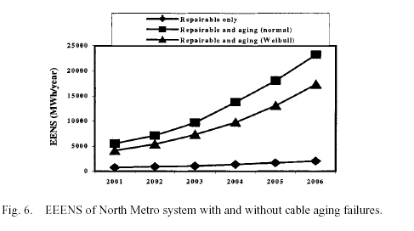
IV. Case Study
B.) Reliability of North Metro System
24/27

Slide 25
IV. Case Study
The EENS index for the case of only considering repairable failures has a slight increase with the years because of the assumption of 2% load growth each year. On the other hand, the EENS index for the case of incorporating cable aging failures increases dramatically as the time advances. This obviously is due to the fact that the unavailability of cable aging failures has a relatively large increase with the years.
25/27

Slide 26
V. Conclusion
Method to incorporate aging failures in power system reliability evaluation.
Development of the calculation approach
  two possible probability distribution models
  unavailability of aging failures
  implementation in reliability evaluation.
Normal model provides a lower estimation of unavailability at a young or midage and a higher estimation at an age around the mean life compared to the Weibull model.
Definition of unavailability of aging failures consistent with repairable failures
Simple to include it in system reliability assessment.
Easily added in existing reliability evaluation techniques and tools.
Results of BC Metro case study indicate that aging failures have significant impacts
on the system reliability, particularly for an “aged” system.
Ignoring aging failures in reliability evaluation of an aged power
system will result in an overly underestimation of system risk
and most likely a misleading conclusion in system planning.
26/27

Slide 27
Questions ?
27/27

