Slide 1
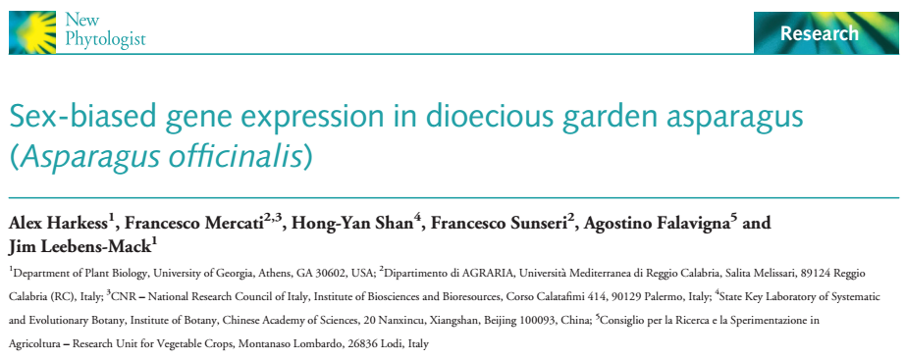
Team Valerin
Valeria, Katerina, and Devin
BCB 546X Group Project
April 27, 2017

Slide 2
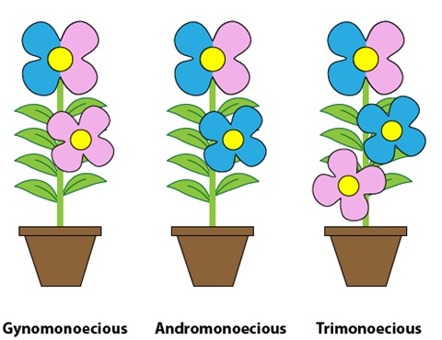
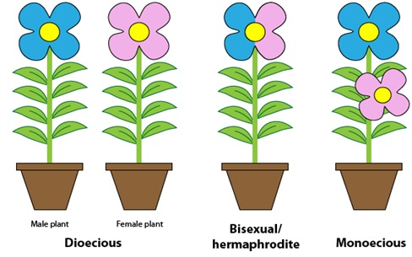
Background
Although most plants have hermaphroditic flowers, some have developed other means of mating, including:
Dichogamy
Monoecy
Gynomonoecy
Andromonoecy
Trinomoecy
Dioecy
http://plantbreeding.coe.uga.edu/index.php?title=4._Plant_Reproductive_Systems
Notes:
First picture= dianthus (http://dept.ca.uky.edu/PLS220/Flowerpollinationsystems.pdf) (dichogamy)
Second picture= maize (example of monoecy)
Third and fourth picture= http://plantbreeding.coe.uga.edu/index.php?title=4._Plant_Reproductive_Systems

Slide 3
Why study sex determination in plants?
Dioecy has evolved independently across 43% of angiosperm families at least 100 times
Understand the evolutionary mechanisms that underlie sexual reproduction as source of genetic diversity
Improve our understanding of the molecular events that give rise to the sexual differentiation

Slide 4
Current thinking for sex determination
Linkage between dominant genes that
Suppress female organogenesis
Promote male organogenesis
Difficult Identification
Complexity of floral development
Highly repetitive
Transposon rich
Notes:
Complex: hormonal controls, small RNAs, epigenetic marks all interact to result in proper flower development.
In nonrecombining sex determination regions

Slide 5
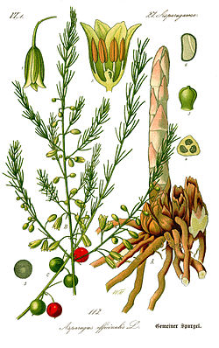
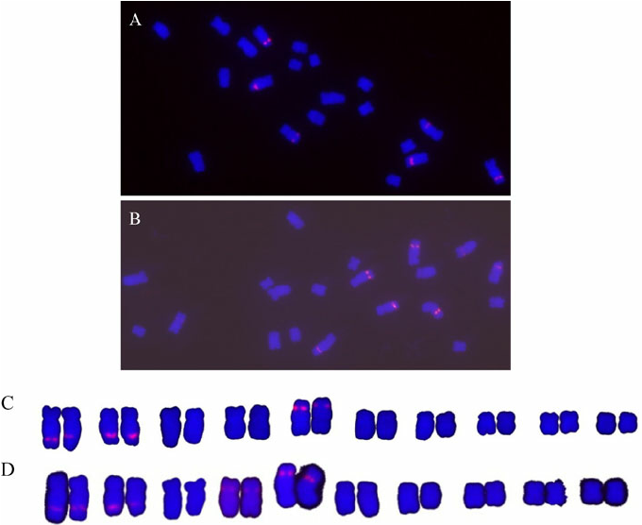
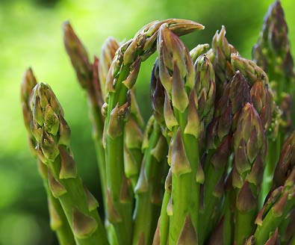
Why asparagus?
Recently evolved XX/XY sex chromosomes
Cytologically homomorphic
YY supermale is viable
https://en.wikipedia.org/wiki/Asparagus
Deng et al, 2012
www.degroot-inc.com/product_info.php?products_id=525
Notes:
the karyotype of asparagus using 5S rDNA
Asparagus is useful for the study of early stages of sex chromosome evolution in plants.
Picture: https://en.wikipedia.org/wiki/Asparagus
http://www.ias.ac.in/article/fulltext/jgen/091/02/0209-0212<--Deng et al, 2012

Slide 6
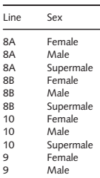
Methods
RNAseq
Spear tips
Male, Female, Super Male
De novo assembly
Quality control
Trimming
Differential expression analysis
Alignment
Transcript abundance estimation
(NCBI) BioProject 259909
Functional annotation
Assembly
Differential expression analysis in edgeR
Experimental design:
4 lines, 3 sexes

Slide 7
Workflow
Transcriptome profiling
Differential Expression analysis

Slide 8
Overview of documentation
Overall README.md file
Paper, Supplementary tables from paper
Presentation
FASTQC analysis folder
README.md file with the script
Output files
Alignment_counting folder
README.md file with the script
Output counting files
Summaries of the RSEM statistical models
Expression analysis folder
README file with the description of the notebooks for each figure
Input files
README files for figures

Slide 9
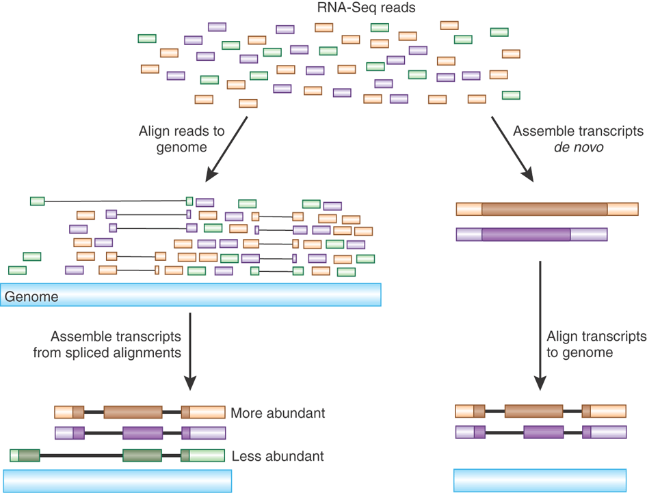
Transcriptome Profiling

Slide 10
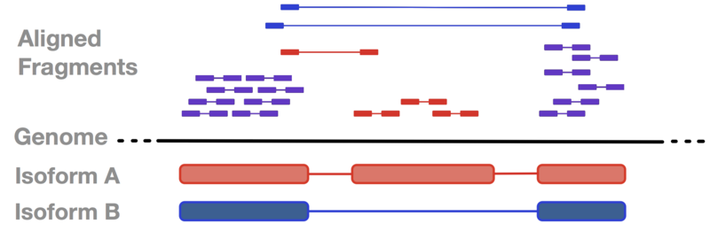
Calculating transcript abundance for differential expression
https://cgrlucb.wikispaces.com/Isoform+Deconvolution+and+Unannotated+Species

Slide 11
Transcriptome Profiling
Input
Raw reads
Source: ncbi
Raw reads based
on FASTQC
Trimmed reads
transcriptome file
Trimmed reads
transcriptome references
Quality assessment
Trimming reads
Alignment
Expression counting calculation
Sratoolkit
FASTQC
MULTIQC
Cutadapt
RSEM, bowtie2
RSEM
Software

Slide 12
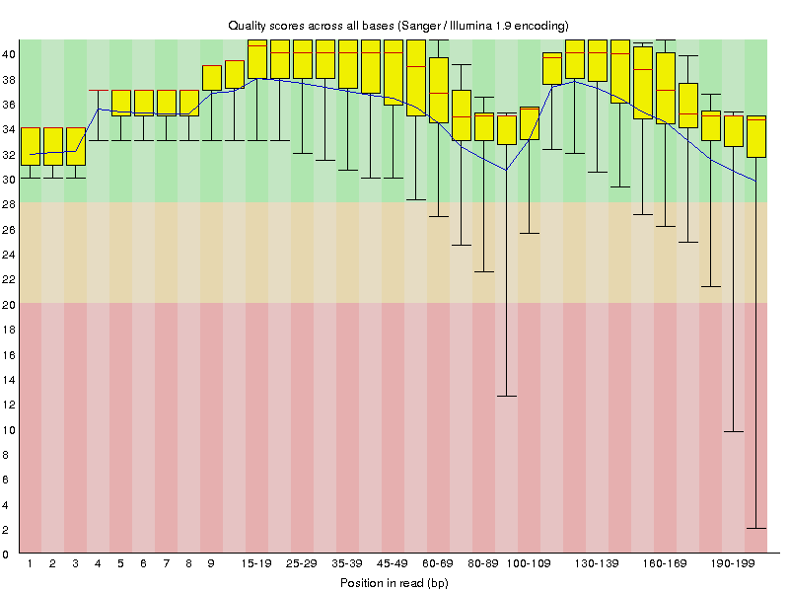
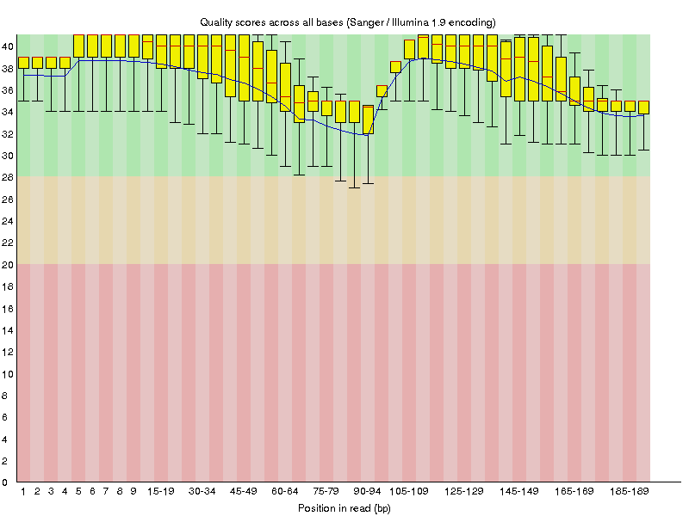
Results
Transcriptome profiling: trimming
Asparagus officinalis line 2 XX female postmeiotic bud (SRR1642915)
Removing adapters before aligning to a reference

Slide 13
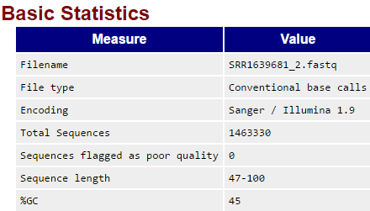
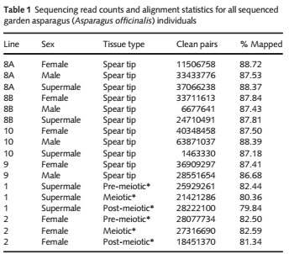
Results
Transcriptome profiling: trimming

Slide 14
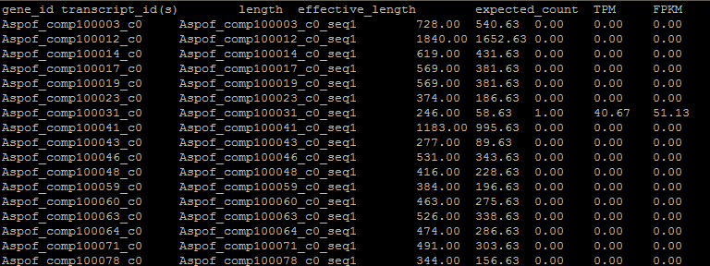
Results
Transcriptome profiling: counting data

Slide 15
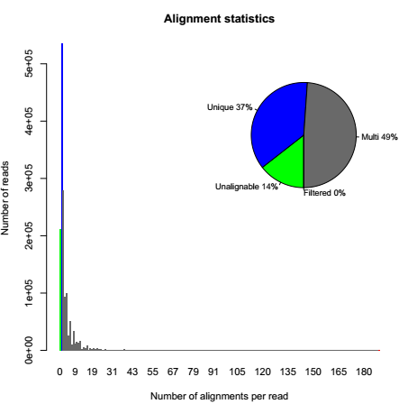
Results
Transcriptome profiling: counting data
RSEM model

Slide 16
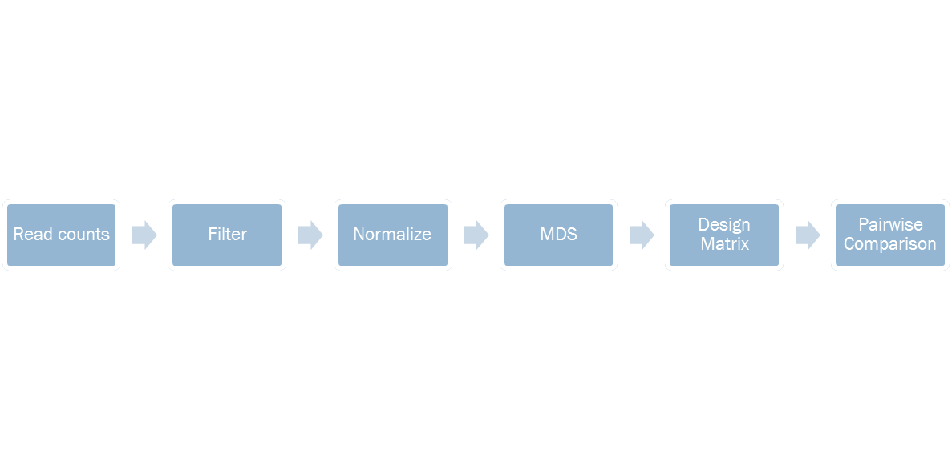
Differential Expression Analysis

Slide 17
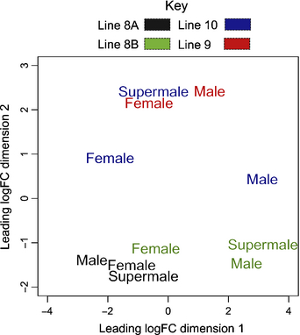
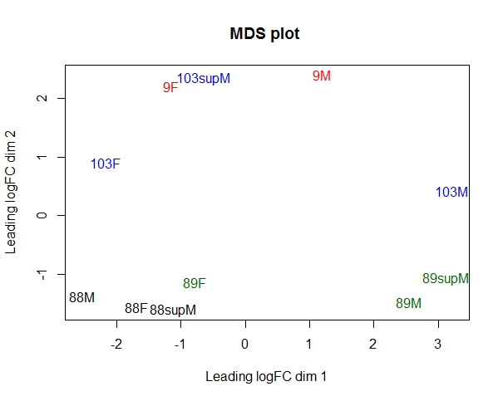
Figure 1
Multidimensional scaling (MDS) plot
Paper
Our Analysis

Slide 18
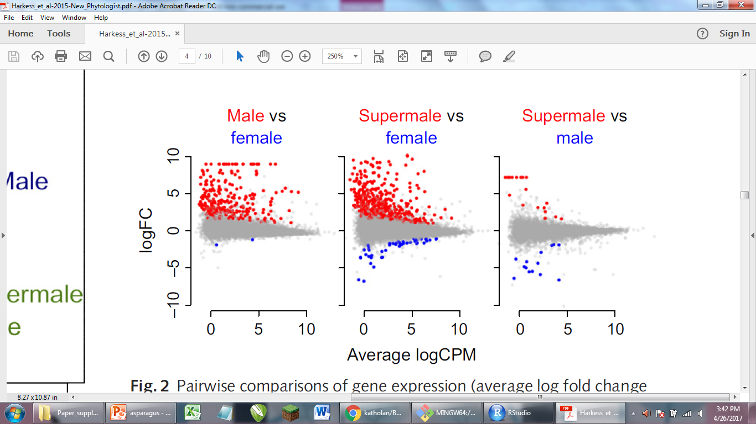
Figure 2
Pairwise comparisons of gene expression among female, male and supermale garden asparagus (Asparagus officinalis) genes across line replicates

Slide 19
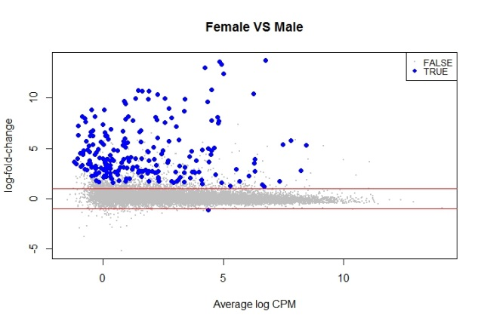
Figure 2, Male vs Female

Slide 20
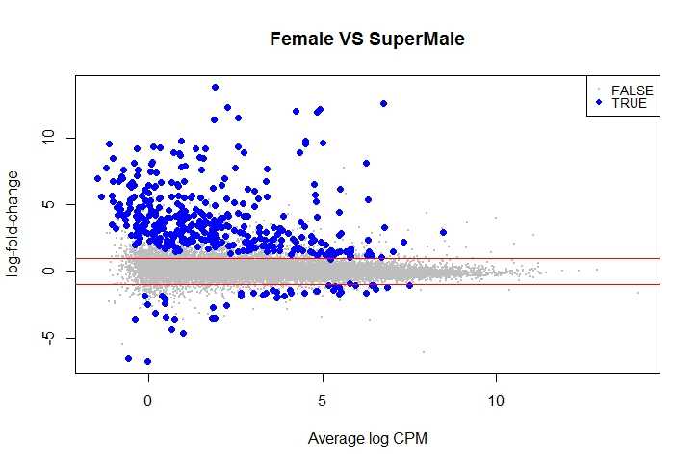
Figure 2, Supermale vs Female

Slide 21
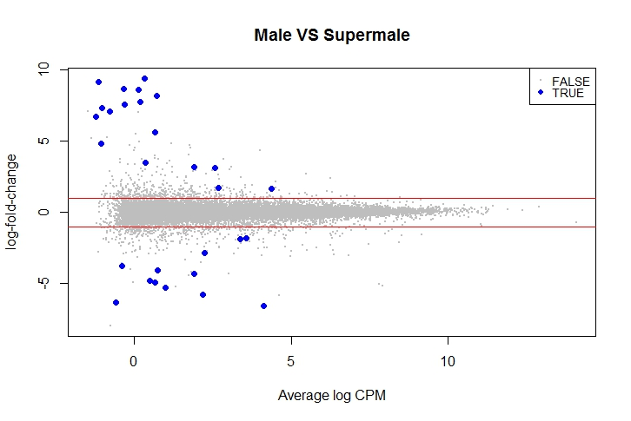
Figure 2, Supermale vs Male

Slide 22
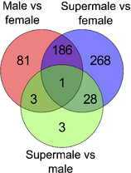
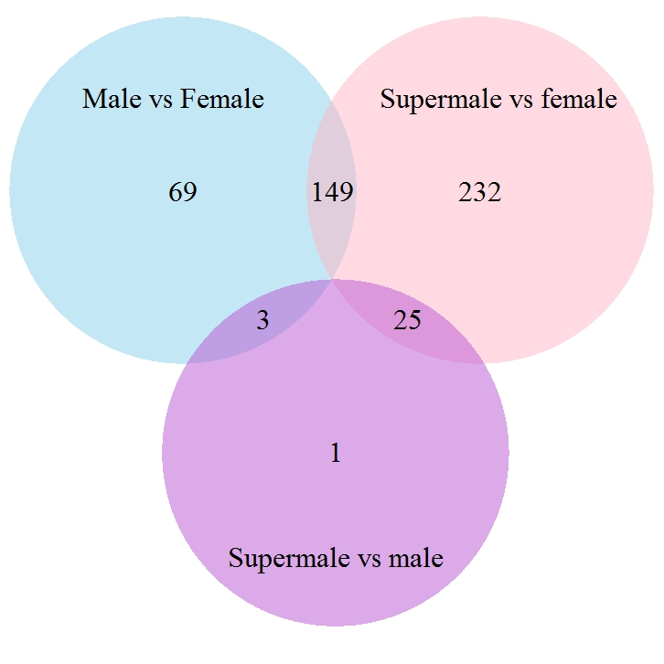
Figure 3
Venn diagram showing the overlap of differentially expressed garden asparagus genes (Asparagus officinalis) between the three pairwise comparisons
Paper
Our Analysis

Slide 23
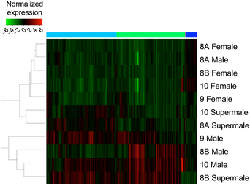
Figure 4
Heatmap clustering of the 570 differentially expressed garden asparagus (Asparagus officinalis) genes in all spear tip tissues

Slide 24
Figure 4

Slide 25
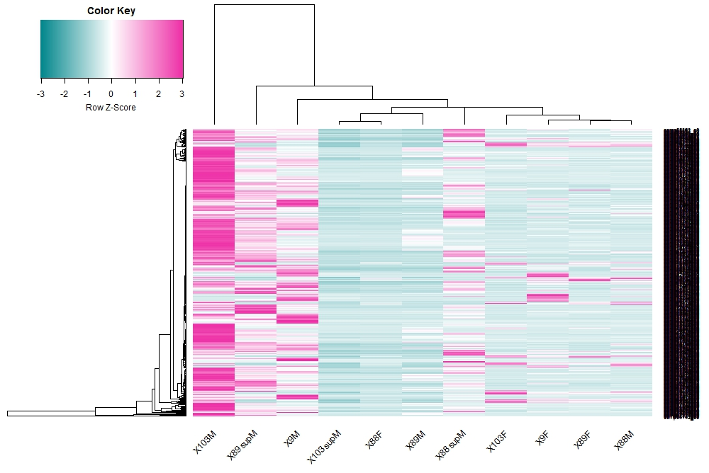
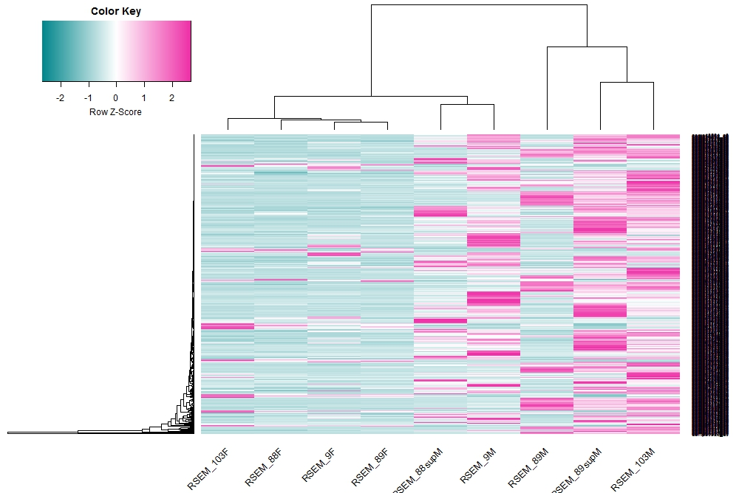
Figure 4

Slide 26
Results
Figure 4:Heatmap clustering of the 570 differentially expressed garden asparagus (Asparagus officinalis) genes in all spear tip tissues

Slide 27
heatmap

Slide 28
Conclusions
It is very important to understand the experimental design and method selection before starting any data analysis.
Documentation should be sufficient enough to allow that any other person can be able to understand the analysis workflow and replicate the pipeline

Slide 29
Bibliography
Deng C-L, Qin R-Y, Wang N-N, Cao Y, Gao J, Gao W-J, Lu L-D. 2012. Karyotype of asparagus by physical mapping of 45S and 5S rDNA by FISH. Journal of Genetics 91: 209–212.
Harkess, A., Mercati, F., Shan, H.-Y., Sunseri, F., Falavigna, A. and Leebens-Mack, J. (2015), Sex-biased gene expression in dioecious garden asparagus (Asparagus officinalis). New Phytol, 207: 883–892. doi:10.1111/nph.13389

Slide 30
Questions?

