Slide 1
Sex-biased gene expression in dioecious garden asparagus (Asparagus officinalis)
Valeria, Katerina, and Devin
BCB 546X Group Project

Slide 2
Why studying sex determination important?
Understand the evolutionary mechanisms that undelie sexual reproduction as source of genetic diversity
Contrary to most of animals, dioecious plants are quite rare
Improve our understanding of the molecular events that give rise to the sexual differentiation

Slide 3
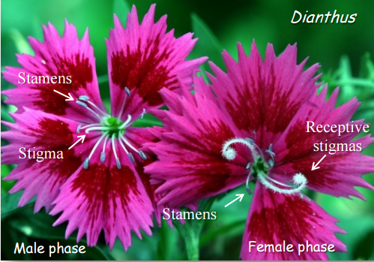
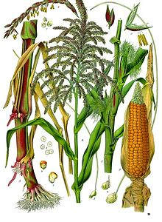
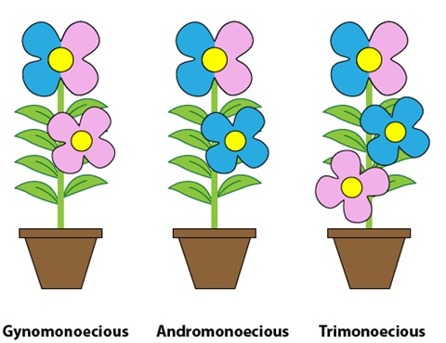
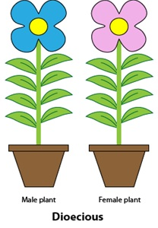
Background
90% of angiosperms are bisexual
Of the other 10%
Dichogamy (temporally separated bisexual)
Monoecy (spatially separated unisexual)
Andromonoecy/Gynomonoecy (bisexual + unisexual)
Dioecy (unisexual plant)
Notes:
First picture= dianthus (http://dept.ca.uky.edu/PLS220/Flowerpollinationsystems.pdf) (dichogamy)
Second picture= maize (example of monoecy)
Third and fourth picture= http://plantbreeding.coe.uga.edu/index.php?title=4._Plant_Reproductive_Systems

Slide 4
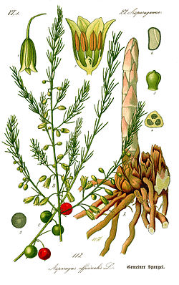

Why asparagus?
Recently evolved XX/XY sex chromosomes
Cytologically homomorphic
Deng et al, 2012
YY supermale is viable
Notes:
Asparagus is useful for the study of early stages of sex chromosome evolution in plants.
Picture: https://en.wikipedia.org/wiki/Asparagus
http://www.ias.ac.in/article/fulltext/jgen/091/02/0209-0212<--Deng et al, 2012

Slide 5
Current thinking for sex determination
Linkage between dominant genes that
Suppress female organogenesis
Promote male organogenesis
Identification difficult
Complexity of floral development
Highly repetitive
Transposon rich
Notes:
Complex: hormonal controls, small RNAs, epigenetic marks all interact to result in proper flower development.
In nonrecombining sex determination regions

Slide 6
Approach
RNA-seq
Transcriptomes for XY, XX, and YY
Objective:
Identify expression differences
Determine when genes act
Notes:
One approach is to do the whole-genome and then to identify gender specific nonrecombining and hemizygous regions, annotate genes in these regions and experimentally test those functions. → difficult because of those regions of interest are transposon rich and repetitive
Alternative is with RNA-seq
ID SNPs that are gender specific within coding regions and genes that are show gender expression bias.
Compare genes that exhibit gender biased expression against known anther and ovule development → determine when genes act to suppress

Slide 7
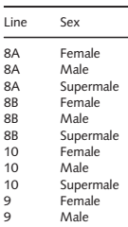
Methods
RNAseq
Spear tips
Male, Female, Super Male
De novo assembly
Quality control
Trimming
Differential expression analysis
Alignment
Transcript abundance estimation
(NCBI) BioProject 259909
Functional annotation
Assembly
Differential expression analysis in edgeR
Experimental design:
3 lines, 3 sexes

Slide 8
Workflow
Transcriptome profiling
Differential Expression analysis

Slide 9
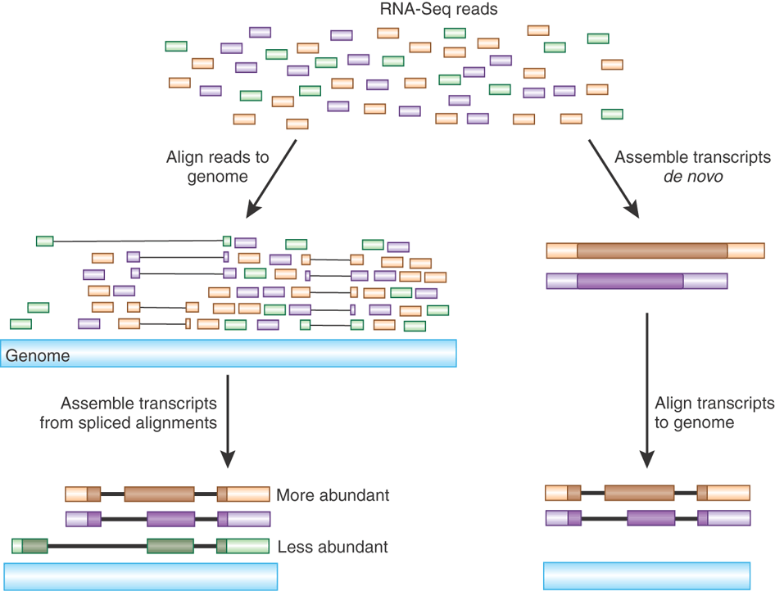
Transcriptome Profiling

Slide 10
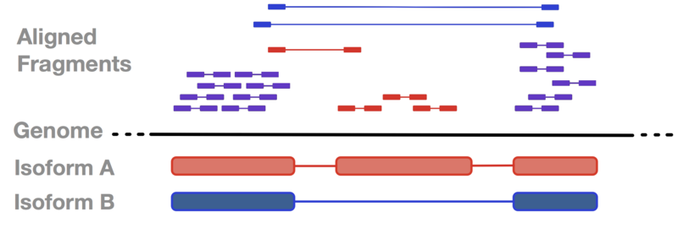
Calculating transcript abundance for differential expression
https://cgrlucb.wikispaces.com/Isoform+Deconvolution+and+Unannotated+Species

Slide 11
Transcriptome Profiling
Input
raw reads
Source: ncbi
raw reads Based
on FASTQC
Trimmed reads
Transcriptome file
Trimmed reads
Transcriptome references
Quality assessment
Trimming reads
Alignment
Expression counting calculation
Sratoolkit
FASTQC
MULTIQC
Cutadapt
RSEM, bowtie2
RSEM
Software

Slide 12
Overview of documentation
FASTQC-files
Asparagus powerpoint
Paper
README.md
Supplementary tables from paper
Gene count expression data

Slide 13
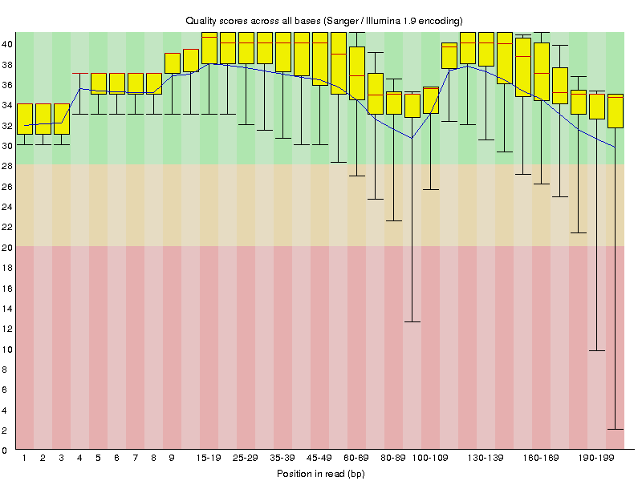
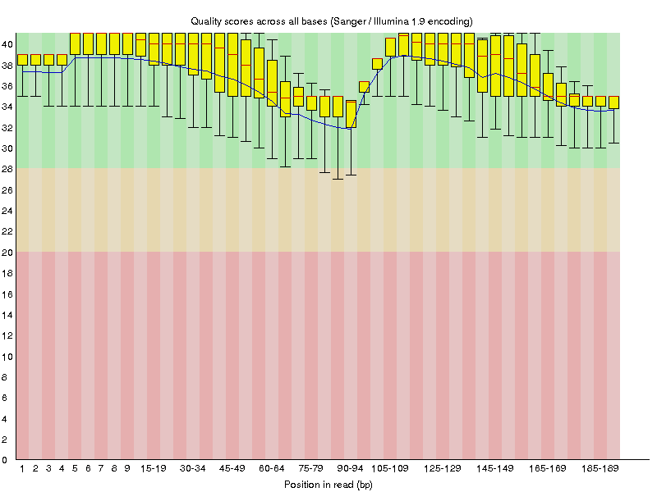
Results
Transcriptome profiling: trimming
Asparagus officinalis line 2 XX female postmeiotic bud (SRR1642915)
Removing adapters before align to a reference

Slide 14
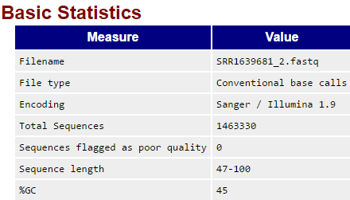
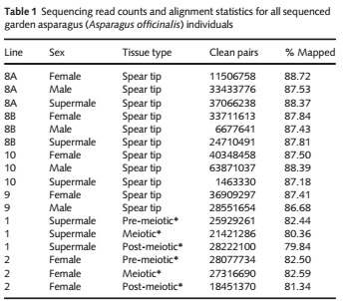
Results
Transcriptome profiling: Trimming

Slide 15
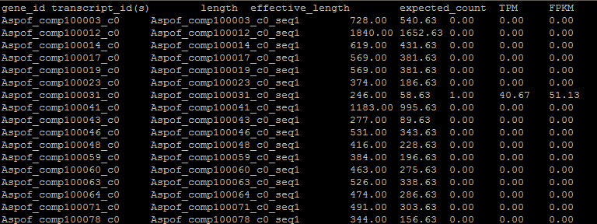
Results
Transcriptome profiling: counting data

Slide 16
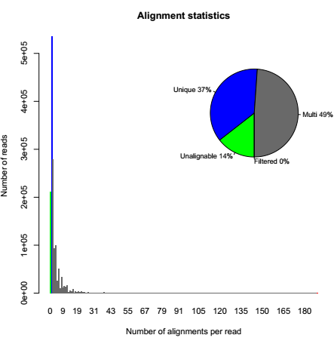
Results
RSEM model

Slide 17
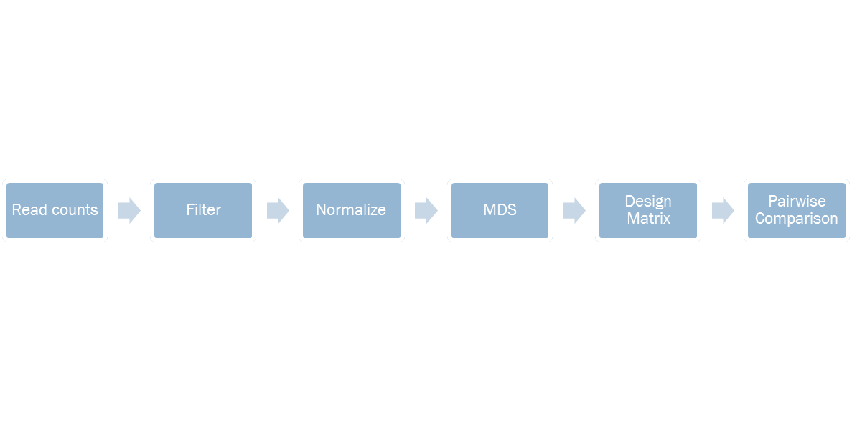
Differential Expression Analysis

Slide 18
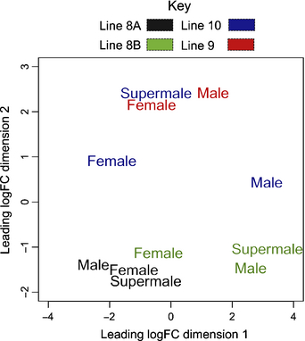
Results
Figure 1: Multidimensional scaling (MDS) plot

Slide 19
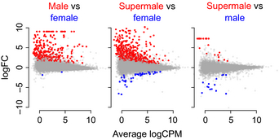
Results
Figure 2: Pairwise comparisons of gene expression among female, male and supermale garden asparagus (Asparagus officinalis) genes across line replicates

Slide 20
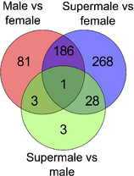
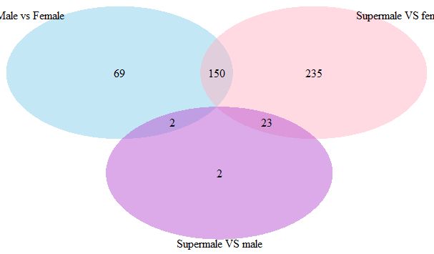
Results
Figure 3: Venn diagram showing the overlap of differentially expressed garden asparagus genes (Asparagus officinalis) between the three pairwise comparisons

Slide 21
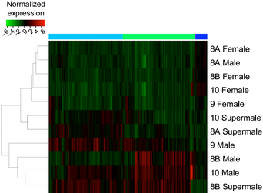
Results
Figure 4:Heatmap clustering of the 570 differentially expressed garden asparagus (Asparagus officinalis) genes in all spear tip tissues

Slide 22
Conclusions
It is very important to understand the experimental design and method selection before starting any data analysis.
Documentation should be sufficient enough to allow that any other person can be able to understand the analysis workflow and replicate the pipeline

Slide 23
Bibliography
Deng C-L, Qin R-Y, Wang N-N, Cao Y, Gao J, Gao W-J, Lu L-D. 2012. Karyotype of asparagus by physical mapping of 45S and 5S rDNA by FISH. Journal of Genetics 91: 209–212.
Harkess, A., Mercati, F., Shan, H.-Y., Sunseri, F., Falavigna, A. and Leebens-Mack, J. (2015), Sex-biased gene expression in dioecious garden asparagus (Asparagus officinalis). New Phytol, 207: 883–892. doi:10.1111/nph.13389

