Slide 1
Data Science Midseason Assignment
Katerina Chochou

Slide 2
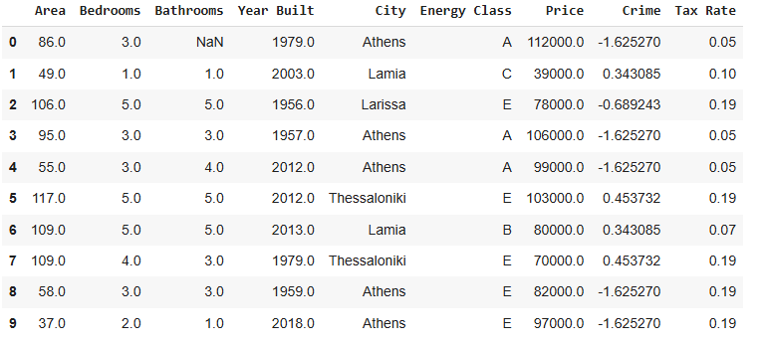
Abstract
The project focuses on analyzing real estate data stored in an SQLite database to predict house prices. The dataset includes information about house features like bedrooms – year built, crime rates and energy class.
After preprocessing and analyzing the data, 2 models were developed to predict housing prices : a linear regression and a decision tree. Performance was evaluated using RMSE and R² metrics, along with 10-fold cross-validation.
The results indicate that the Linear Regression model outperformed the Decision Tree model in both accuracy and generalization.

Slide 3
Source the Data
This project aims to evaluate how various features (e.g., number of bedrooms, city, energy class, taxes, and crime) impact house prices and to develop regression models for price prediction.
Data was sourced from three tables: houses, cities, and energy classes.
I used SQL queries to extract the data from these tables and converted them into DataFrames using Pandas.
Then, I combined (joined) these tables:
First, I merged the houses table with the cities table, so each house would include the crime rate of its city.
Then, I merged that result with the energy_classes table, so each house would also include its energy tax rate.
At the end of this step, I had one complete table (DataFrame) where each house had all its information, plus extra columns about crime and taxes — ready for analysis.

Slide 4
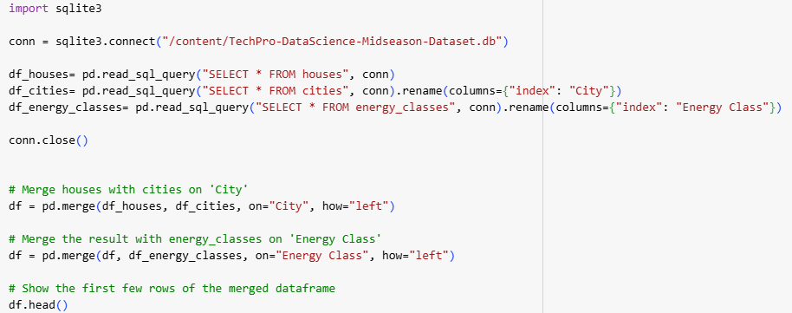
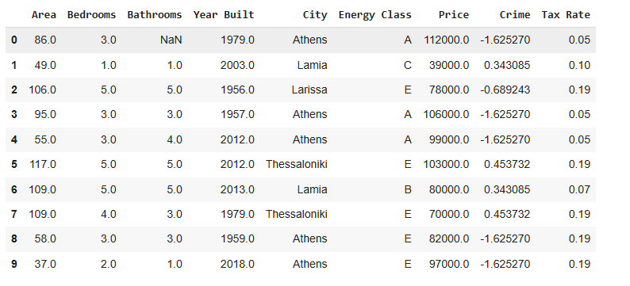

Slide 5
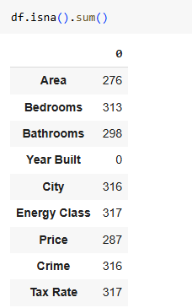
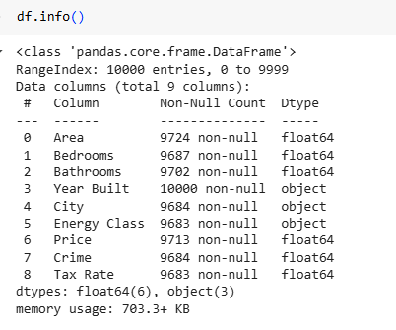
Pre-process the data
- Explore the DataFrame - Handle missing values - Search for duplicates - Cast string values to their proper types - Encode categorical variables - Search for outliers
1. Explore the Dataframe

Slide 6
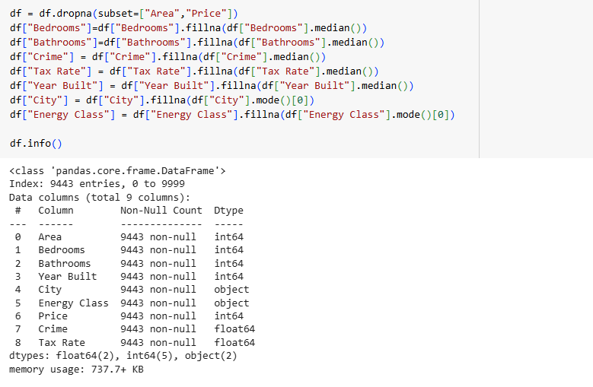
2. Handle missing values
- Redundant columns were dropped
- Missing values were handled with median or mode imputation.

Slide 7

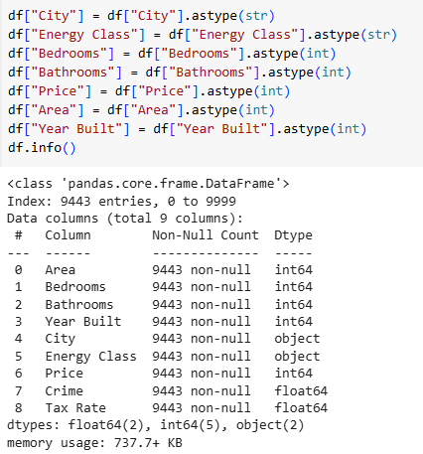
3. Search for duplicates rows
4. Ensure Categorical and Numerical columns has the right type

Slide 8
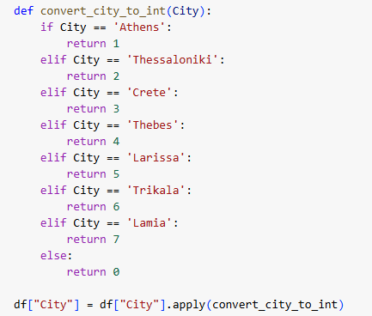
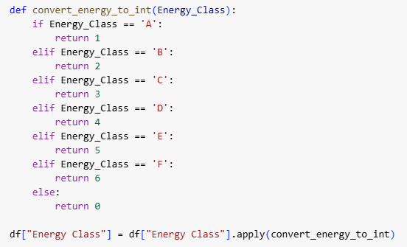
5. Encode categorical variables like City and Energy Class

Slide 9
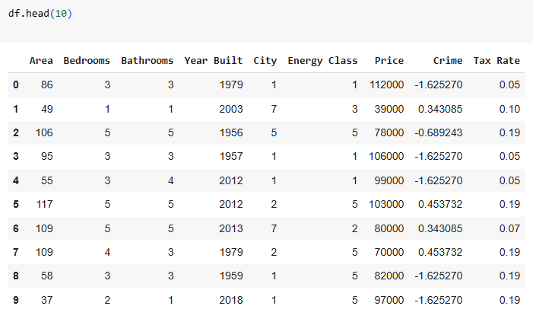

Slide 10
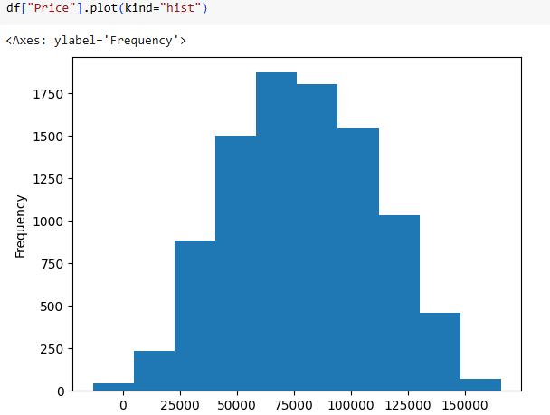
6. check for outliers using plots

Slide 11
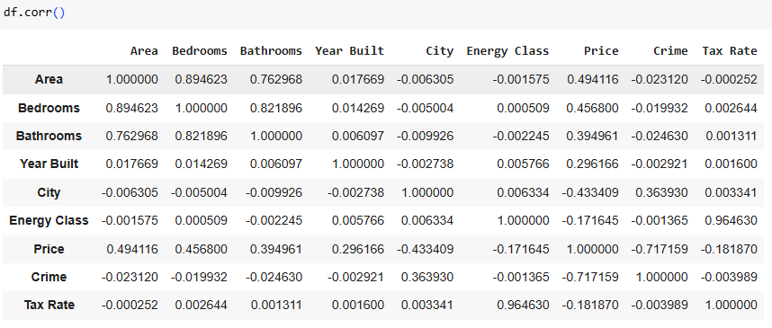
Perform an analysis on the dataset showing how each of the 8 features affects the final price
Correlation Findings: - Strongest positive correlations with price: Area, Bedrooms, and Bathrooms. - Negative influence was observed for Crime

Slide 12
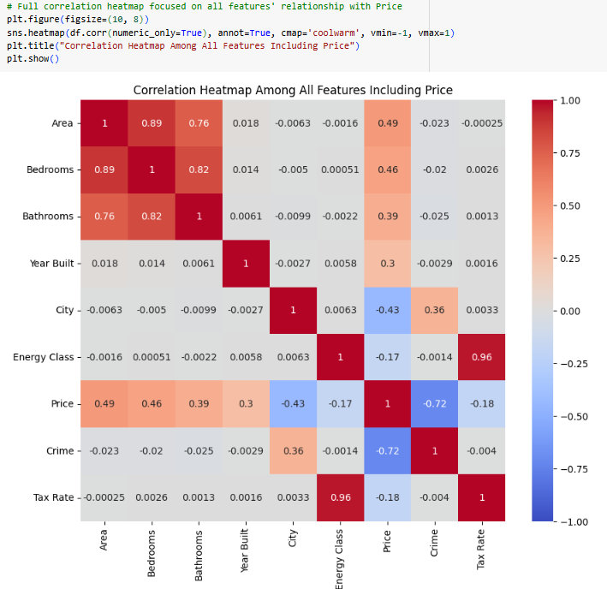

Slide 13
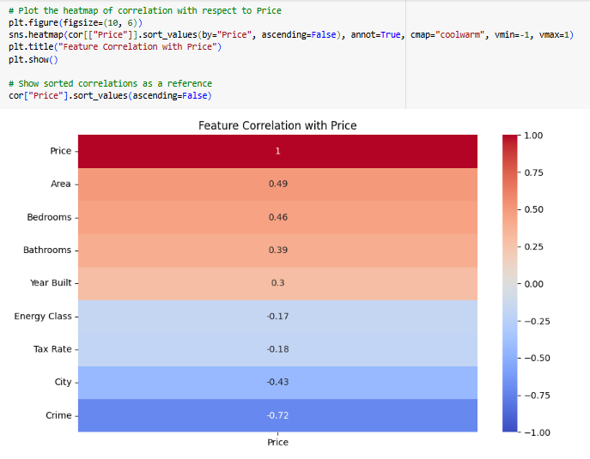
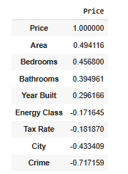

Slide 14
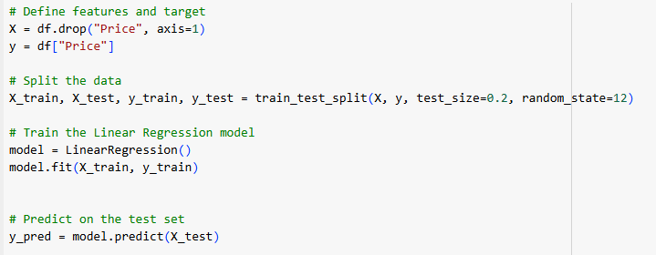
Train a linear regression model to predict the price according to the rest of the features.
A Linear Regression model was trained using 80% of the data and tested on the remaining 20%.

Slide 15
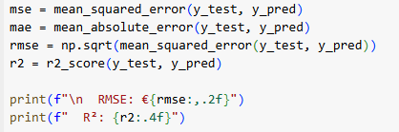
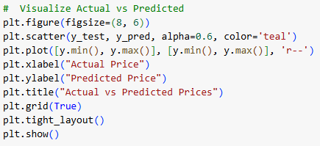

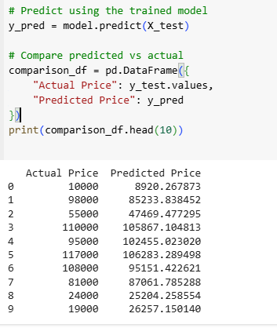
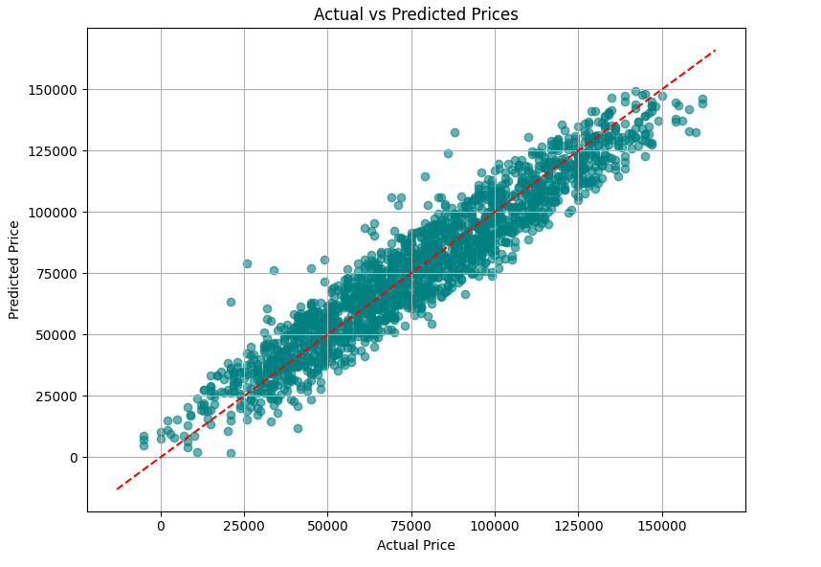
Evaluate the model
On average, your model’s predictions are off by about 10K€. Your model explains 90.25% of the variance in housing prices.

Slide 16
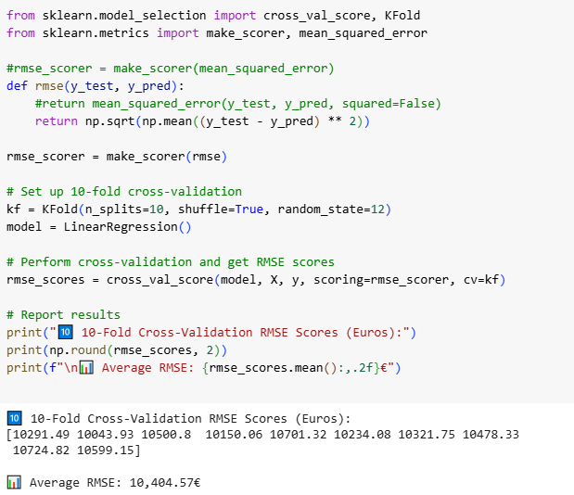
Perform 10-fold cross-validation to the model.
10-Fold Cross-Validation is a method to evaluate how well your model will generalize to unseen data.
This shows the model has good generalization and isn’t overfitting to specific parts of the dataset.

Slide 17
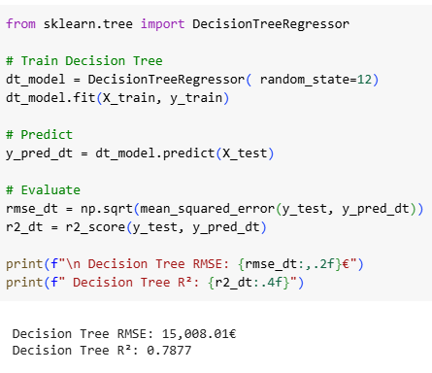
Train a DecisionTree regression model to predict the price according to the rest of the features.

Slide 18
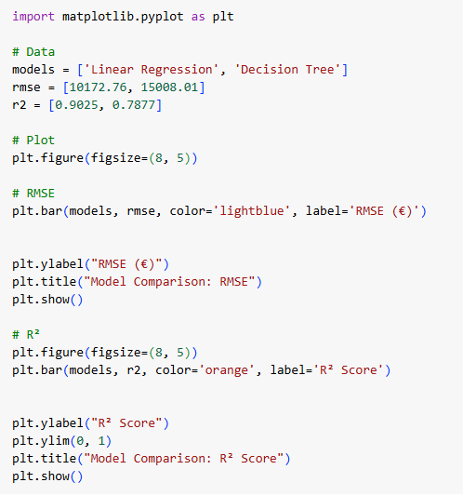
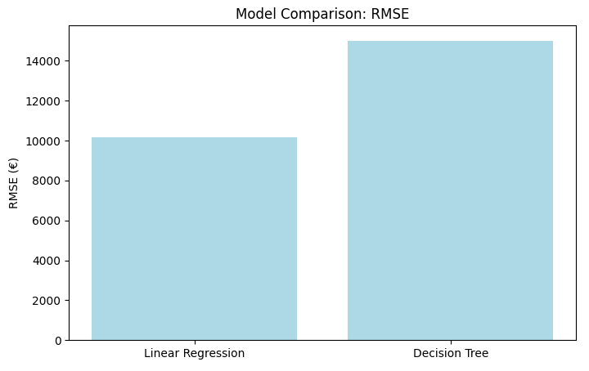
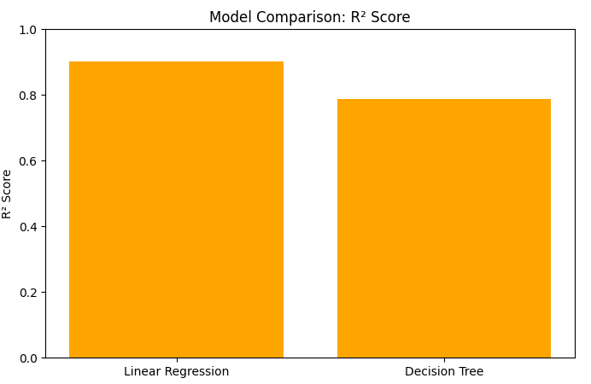
Evaluate the regression model using RMSE and compare it with the linear regression

Slide 19
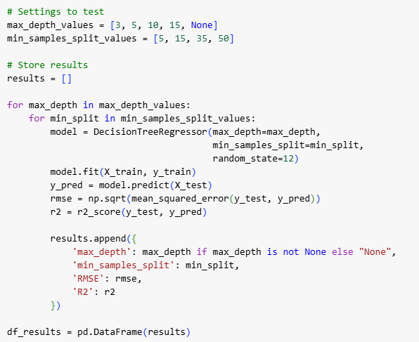
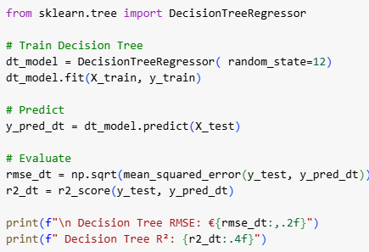
Try out different settings for the decission tree (`max_depth`, `min_samples_split`) to reduce overfitting
Hyperparameter Tuning: - Decision Tree parameters (max_depth, min_samples_split) were adjusted to mitigate overfitting. - Heatmaps were used to visualize model performance across parameter combinations

Slide 20
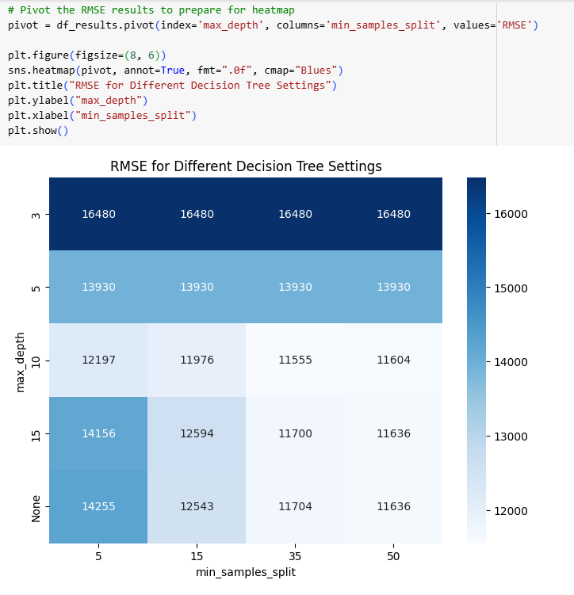

Slide 21
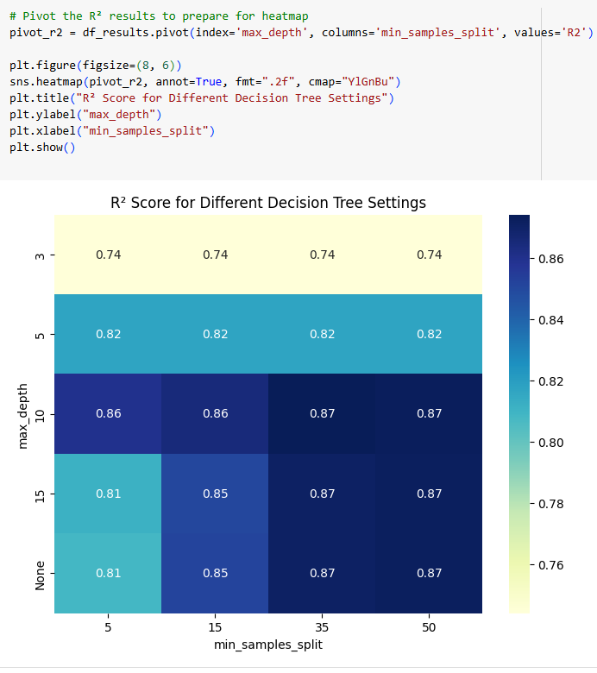

Slide 22
Results
Correlation Findings: - Strongest positive correlations with price: Area, Bedrooms, and Bathrooms. - Negative influence was observed for Crime. Model Evaluation: Linear Regression: RMSE = €10,172.76, R² = 0.9025 Decision Tree: RMSE = €15,008.01, R² = 0.7877
Linear Regression performs better overall.
The Decision Tree model might be overfitting. Trees tend to fit noise unless tuned properly (e.g., with max_depth).
Cross-validation: The average RMSE across 10 folds for the Linear Regression model confirmed its stability and performance. There's not much overfitting, since the performance is solid on the test set Hyperparameter Tuning: - Tuning improved Decision Tree performance slightly but it still lagged behind Linear Regression. - Best tuning combinations reduced overfitting but at a cost of lower interpretability.

Slide 23
Conclusions
The Linear Regression model worked very well for predicting house prices in this project.
It gave better results than the Decision Tree model, both in terms of accuracy and how well it worked on new data.
The relationships in the data were mostly linear, which is why the linear model performed so well.
The Decision Tree model is more flexible, but it can easily overfit (learn the noise in the data instead of the patterns) if not carefully adjusted.

