Slide 1

MachineLearning Fundamentals
Capstone Project: Date-A-Scientist
Kathrin Aurelio

Slide 2
The dataset
Data from OKCupid, a dating app focusing on using multiple choice and short answers to match users
The dataset contains multiple choice answers to:
Body type | Offspring
Diet | Orientation
Drinking habits | Pets
Drug habits | Religion
Education | Sex
Ethnicity | Zodiac sign
Height | Smoking habits
Income | Languages
Job | Relationship status

Slide 3
The dataset
The dataset contains a set of short-answer responses to:
My self summary
What I’m doing with my life
I’m really good at
The first thing people usually notice about me
Favorite books, movies, show, music, and food
The six things I could never do without
I spend a lot of time thinking about
On a typical Friday night I am
The most private thing I am willing to admit
You should message me if…

Slide 4
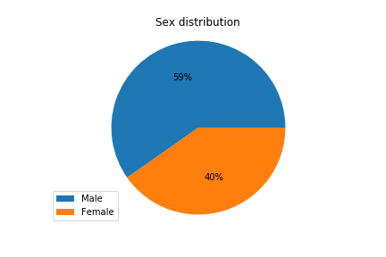
The dataset
The dataset contains data of 59 946 people
There are more mal participants than female

Slide 5
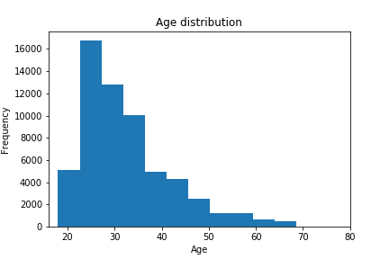
The dataset
As additional information we know there age, there location and the time they went last online
The participants are on average 32,3 years old

Slide 6
The questions
With such a big dataset and so many features there are lots of interesting questions to ask. Due to my limited time I focused on these for the beginning:
Can we predict the zodiac sign using drinking, smoking, drugs, the average word length and the length of the essays? In other words: Zodiac signs are said to have an influence on different character attributes. Can we find prove by using our features?
Can we predict the gender with the essay length and income? So is there a general difference between men and women in the way they write and the amount of their income (gender pay gap)?
Can we predict age with average word length in essays? Are people with more life experience more prone to using more sophisticated language and thus to longer words?

Slide 7
Augmenting the data
To be able to use some of the categorical data not only as labels but also for features, I needed to create some new columns in the DataFrame to transform the categories into numbers.
Columns I created are:
“drinks_code”: mapped the “drinks” values to these numbers: "not at all": 0, "rarely": 1, "socially": 2, "often": 3, "very often": 4, "desperately": 5
“smokes_code”: mapped the “smokes” values to these numbers: "no": 0, "sometimes": 1, "when drinking": 2, "yes": 3, "trying to quit": 4
“drugs_code”: mapped the “drugs” values to these numbers: "never": 0, "sometimes": 1, "often": 2
“sex_code”: mapped the “sex” values to these numbers: "f": 0, "m": 1

Slide 8
Augmenting the data
“signs_code”:
cumulated the “signs” values to these numbers:
All Capricorn related answers to 1
All Aquarius related answers to 2
All Pisces related answers to 3
All Aries related answers to 4
All Taurus related answers to 5
All Gemini related answers to 6
All Cancer related answers to 7
All Leo related answers to 8
All Virgo related answers to 9
All Libra related answers to 10
All Scorpio related answers to 11
All Sagittarius related answers to 12
By writing a function which checks the first word of a string and returns the corresponding number and applying this function with a lambda on the column “signs”

Slide 9
Augmenting the data
Additional columns by transforming the essays in numerical data:
Combined all essays into one string
Took out the ‘Nan’s
Applied a lambda function which:
Computed the length on this string to create “essay_len”
Computed the average word length in this string to create “avg_word_length”
Computed the frequency of the words “I”, “me”, and “Me” in this string to create “frequency”

Slide 10
Classification
In order to answer my questions:
Can we predict the zodiac sign using drinking, smoking, drugs, the average word length and the length of the essays?
Can we predict the gender with the essay length and income?
I used the following classification models:
K-Nearest Neighbor
Support Vector Machines (with the default “rbf” kernel)
Simplicity
In terms of simplicity both models are equally good. The data has to be prepared in the same way and there is not really a difference in applying the scikit-learn steps to finally predict the values for the test-set. There might actually be a difference when not using a library. But I can’t compare it in this case because I’ve only worked with the library.

Slide 11
Classification
Time to run the model
In terms of time to run the model, I would have expected the SVM to be faster, because they only use the support vectors. In practice I couldn’t really identify a difference between the both models. But I strongly suspect that this is down to my not-so-young-anymore laptop which struggled with this amount of data. To be able to work with an enormous loss of time, I built my models with a subset of the whole data. As soon as this worked, I used the whole dataset.

Slide 12
Classification
Validation
I valdidated the KNN-models for both questions by computing the accuracy.
I also built a loop to check the accuracy for different ks and finally visualized this values against the accuracy value you would get by randomly predicting a value.
I tried to do the same for both questions with the SVM models, but for whatever reason the accuracy didn’t change when changing the parameters for C and gamma. There’s obviously a bug in my code – unfortunately not so obvious for me.

Slide 13
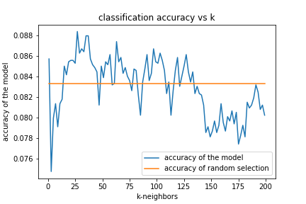
Classification
Validation: Can we predict the zodiac sign using drinking, smoking, drugs, the average word length and the length of the essays?
In comparison, the constant value for accuracy for the SVM model was 0.089
If this value was true, the SVM would work slightly better in this case.

Slide 14
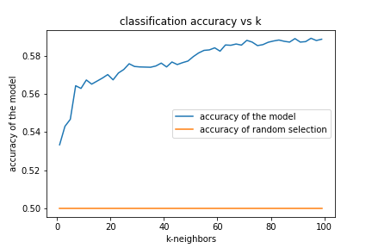
Classification
Validation: Can we predict the gender with the essay length and income?
In comparison, the constant value for accuracy for the SVM model was 0.60
If this value was true, the SVM would work slightly better in this case.

Slide 15
Regression
In order to answer my question:
Can we predict age with average word length in essays?
I used the following regression models:
Linear Regression
K-Nearest Neighbor Regressor
Simplicity
This is the same as simplicity for classification. I can’t really experience a difference in simplicity between both models.

Slide 16
Regression
Time to run the model
In comparison to the classification models, both regression models worked incredibly fast. Also I couldn’t experience a big difference between the two regression models. Linear Regression might have been slightly faster than the K-Nearest Neighbor Regressor.
With this datasize for me this wouldn’t have any influence on the model selection.

Slide 17
Regression
Validation
As opposed to the requirements for this presentation, I wasn’t able to validate my regression models with accuracy. Down to the scikit.learn documentation accuracy is not a regression metric. That’s why I used the score method.
The score for linear regression was around 0.000005
The score for KNNR was 0.4
So KNNR worked better, but still not good enough.

Slide 18
Conclusion
Coming back to my initial questions:
Can we predict the zodiac sign using drinking, smoking, drugs, the average word length and the length of the essays?
It doesn’t seem so. Both models reached no significantly better accuracy than you would get by guessing. So the chosen features obviously can’t predict the zodiac sign satisfactorily.
It might be a possibility to put some research into the different character attributes which are said to be characteristic for the different signs. Maybe we could translate some of those into features which might get better results.
Can we predict the gender with the essay length and income
The accuracy I reached with both models is better than just guessing. But still, it’s not very high.
A better accuracy might be possible with other features. In a next step I would reformulate the question and rerun the model with focusing on the essays. A combination of essay length and maybe the frequency of special words could work better.
Can we predict age with average word length in essays? Are people with more life experience more prone to using more sophisticated language and thus to longer words?
The answer here is ‘no’ as well. The score of both models is far away from being good. Average word length in this case is no feature to predict age.
In a next step I would have a another go with Multilinear Regression and try to transform more of the answers into numerical data and see, which of those might have stronger influence on the score.

Slide 19
Conclusion
And what are the next steps besides the initial questions:
work on my ability to visualize datasets to better choose a model (or kernel),
Figure out why the accuracy did not change?
Read up on things I’ve struggled with during the process

