Slide 1
Studying unique methylation patterns in BRCA pathogenesis
By Antonia Eisenhofer, Irena Dikic, Kathrin Kreischer, Marie Sanders
Notes:
In 2022 2.3million woman were diagnosed with breastcancer
Breast cancer is the most common malignant tumor in woman and one of the main causes of deaths in woman worldwide
https://www.who.int/news-room/fact-sheets/detail/breast-cancer
https://pubmed.ncbi.nlm.nih.gov/27165206/
https://www.researchgate.net/figure/Estimated-number-of-cancer-related-deaths-in-2018-among-women-around-the-world_fig2_335057938
In this project our goal is to investigate breast cancer epigenetis and trying to see if there are unique cpg methylation patterns in BRCA pathogenesis

Slide 2
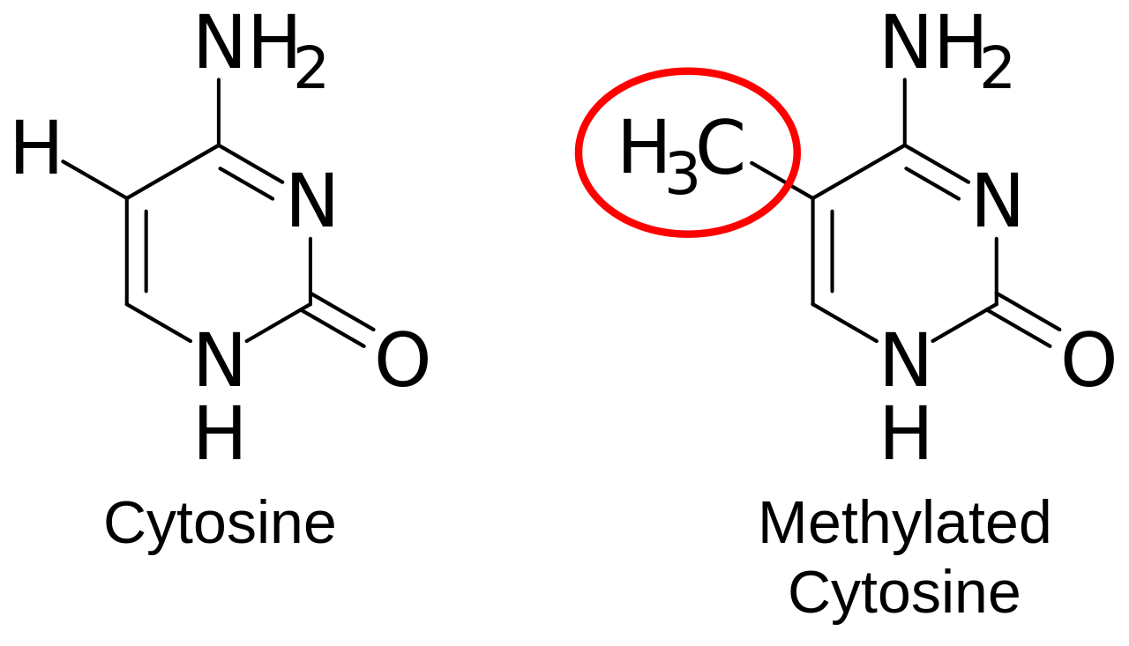
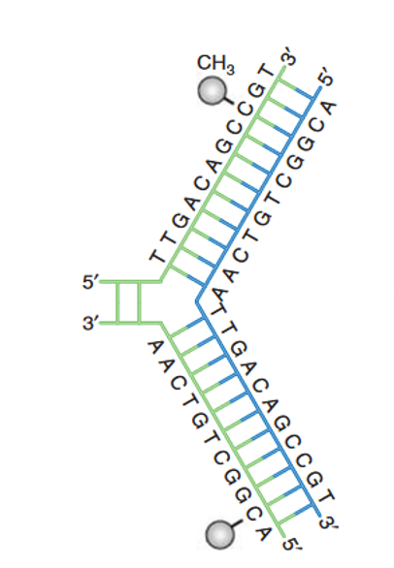
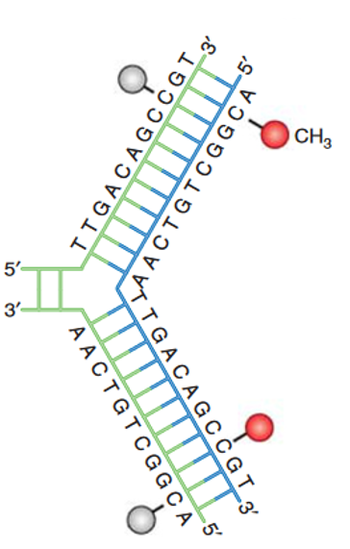
DNA Methylation
epigenetic mechanism
addition of a methyl group to carbon 5 of the cytosine
catalyzed by DNA methyltransferase
CpG Islands: higher CpG density
DNA methyltransferase
Lisa D Moore et all, DNA Methylation and Its Basic Function 2013
life-epigenetics-methylprep.readthedocs
Notes:
Lets quickly take a closer look at DNA methylation
DNA methylation is an epigenetic mechanism in which a methyl group is added to the 5th carbon of cytosin (which we can see here)
This reaction is catalyzed by DNA methyltransferase and mainly occures in CG sequences also reffered to as CpG dinucleotides(which we can see here)
This constellation allows the myelination pattern of the mother strand to be copied to the daugther strands in DNA replication
CpG islands are DNA regions typically around 1000 base pairs in length and characterized by a higher density of CpG
Ca 60% of gene promotors are located in CpG island including important house keeping genes

Slide 3
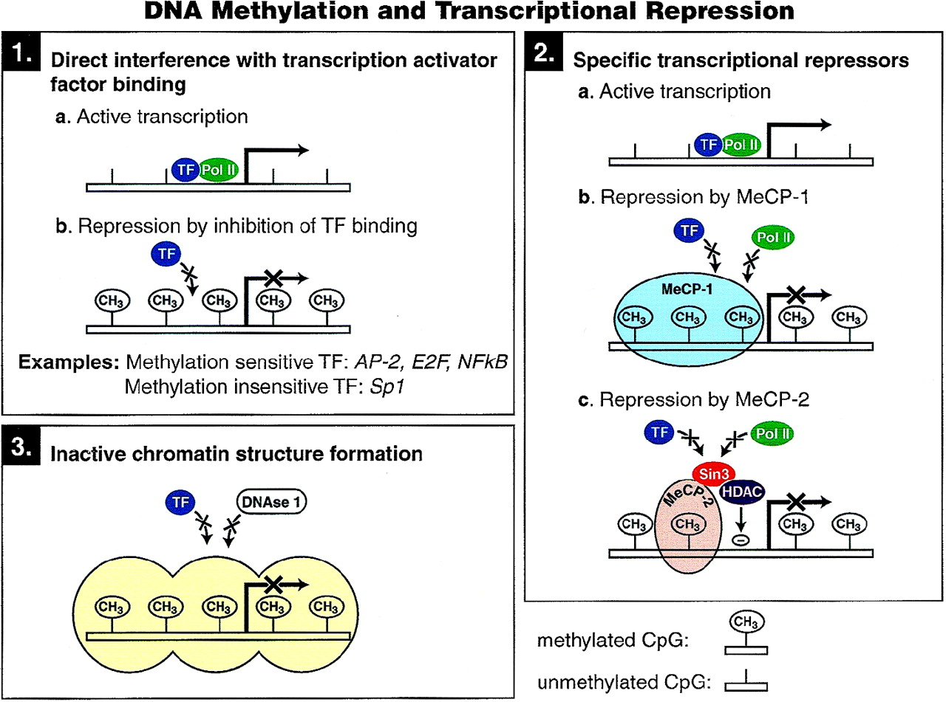
Function
DNA methylation necessary for gene regulation
Hypermethylation of promotor
→gene silencing
Genome-wide Hypomethylation
→chromosomal instability
Alterations of DNA methylation
  cancer development
Alberts B., Molecular biology of the cell, 6th edition 2015
Notes:
DNA methylation is necessary for proper gene regulation
Methylation of promotor and first exon cause gene silence
As I said before many promotors are located in CpG island which are mainly unmethylated, but if they are (in a rare case)methylated the gens are
scilenced(repressen of transcription)
The driving force in DNA methylation research, particu-
larly as it relates to cancer, has, until now, been particularly
focused on CpG island promoter methylation
First mechanism is direct interference with binding of TF
2nd mechanism direct binding of spesific transcriptional repressors
Altering chromatin structure
Gene body methylation leads to higher gene expression in dividing cells(exact mechanism unknown)
Widespread aberrations in DNA methylation are a well-established hallmark of many cancers
Methylation of gene body
→transcription activation

Slide 4
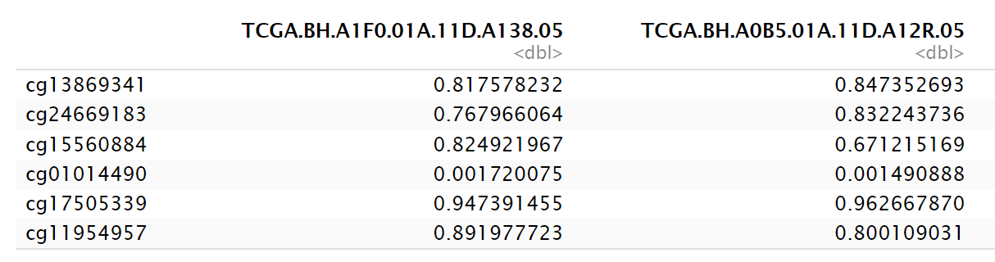
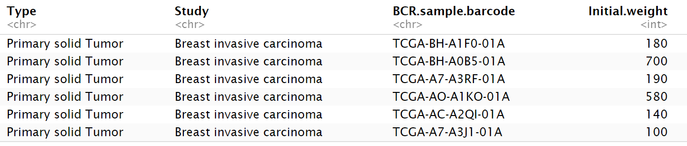
TCGA - The Cancer Genome Atlas
Methylation data
30 BRCA patients, 30 normal patients,
ca. 450,000 CpG sites
Methylation analysis via Illumina HumanMethylation450 BeadChip
ß-value: Proportion of DNA methylation at particular CpG site
Annotation sheet
Notes:
We were provided with this Data from the Cancer Genome Atlas, a programme designed to catalogue the genetic and epigenetic characteriscits of 33 different cancers to help in develping better tools for diagnostics, treatment and causes of cancer. Quality standards for sample are: primary, untreated tumor with a source of matched normal tissue or blood sample.
Frozen, sufficiently sized samples
Samples composed of at least 60% tumor nuclei. Our cancer type was ductal invasive carcinoma, the most common type of breast cancer.
Sequencing took place via Illumina Infinium Human Methylation 450 Bead Chips. they focus on around 450k. Bisulphite treatment is performed, which leaves 5mC unaffected, but unmethylated cytosine is turned into T, which can be measued.

Slide 5
Overview
Project proposal
Dataexploration
DMA
DMR
Literatur comparison
Hallmark gene set enrichment analysis
Notes:
Lets quickly take a closer look at DNA methylation
DNA methylation is an epigenetic mechanism in which a methyl group is added to the 5th carbon of cytosin (which we can see here)
This reaction is catalyzed by DNA methyltransferase and mainly occures in CG sequences also reffered to as CpG dinucleotides(which we can see here)
This constellation allows the myelination pattern of the mother strand to be copied to the daugther strands in DNA replication
CpG islands are DNA regions typically around 1000 base pairs in length and characterized by a higher density of CpG
Ca 60% of gene promotors are located in CpG island including important house keeping genes

Slide 6
DMA - minfi
Notes:
Lets quickly take a closer look at DNA methylation
DNA methylation is an epigenetic mechanism in which a methyl group is added to the 5th carbon of cytosin (which we can see here)
This reaction is catalyzed by DNA methyltransferase and mainly occures in CG sequences also reffered to as CpG dinucleotides(which we can see here)
This constellation allows the myelination pattern of the mother strand to be copied to the daugther strands in DNA replication
CpG islands are DNA regions typically around 1000 base pairs in length and characterized by a higher density of CpG
Ca 60% of gene promotors are located in CpG island including important house keeping genes

Slide 7
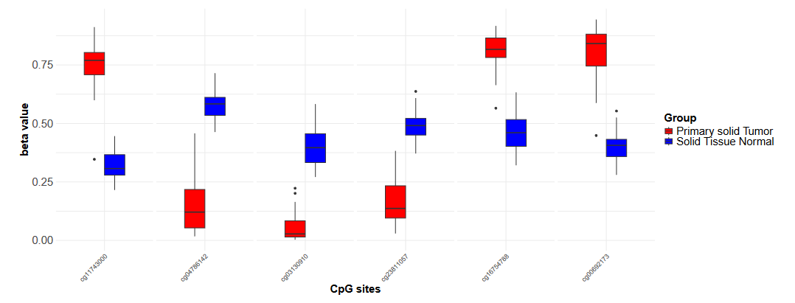
DMA - limma
Notes:
Lets quickly take a closer look at DNA methylation
DNA methylation is an epigenetic mechanism in which a methyl group is added to the 5th carbon of cytosin (which we can see here)
This reaction is catalyzed by DNA methyltransferase and mainly occures in CG sequences also reffered to as CpG dinucleotides(which we can see here)
This constellation allows the myelination pattern of the mother strand to be copied to the daugther strands in DNA replication
CpG islands are DNA regions typically around 1000 base pairs in length and characterized by a higher density of CpG
Ca 60% of gene promotors are located in CpG island including important house keeping genes

Slide 8
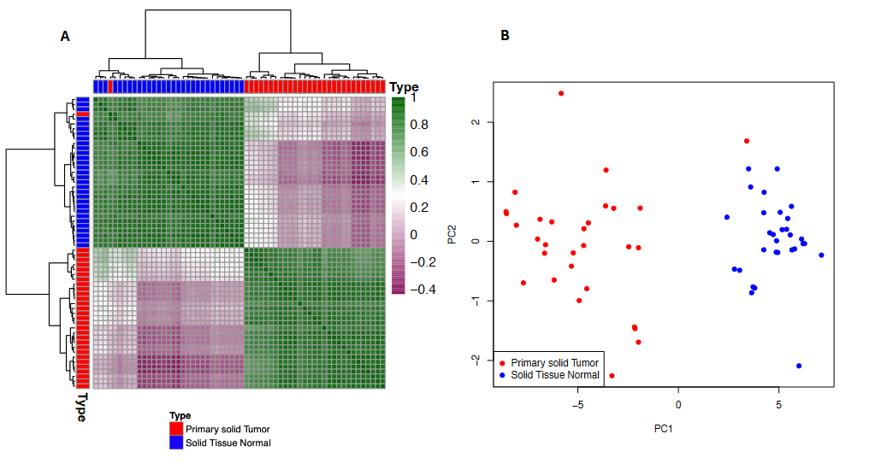
DMA visualization
Notes:
Lets quickly take a closer look at DNA methylation
DNA methylation is an epigenetic mechanism in which a methyl group is added to the 5th carbon of cytosin (which we can see here)
This reaction is catalyzed by DNA methyltransferase and mainly occures in CG sequences also reffered to as CpG dinucleotides(which we can see here)
This constellation allows the myelination pattern of the mother strand to be copied to the daugther strands in DNA replication
CpG islands are DNA regions typically around 1000 base pairs in length and characterized by a higher density of CpG
Ca 60% of gene promotors are located in CpG island including important house keeping genes

Slide 9
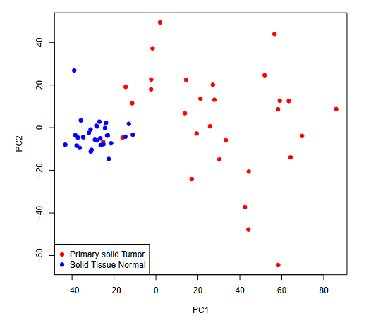
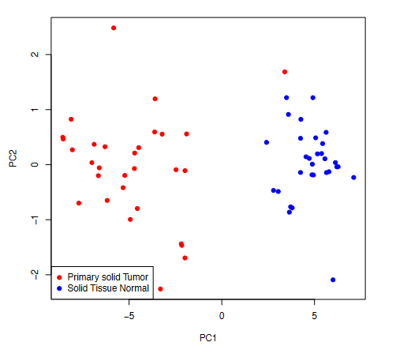
DMA visualization
Notes:
Lets quickly take a closer look at DNA methylation
DNA methylation is an epigenetic mechanism in which a methyl group is added to the 5th carbon of cytosin (which we can see here)
This reaction is catalyzed by DNA methyltransferase and mainly occures in CG sequences also reffered to as CpG dinucleotides(which we can see here)
This constellation allows the myelination pattern of the mother strand to be copied to the daugther strands in DNA replication
CpG islands are DNA regions typically around 1000 base pairs in length and characterized by a higher density of CpG
Ca 60% of gene promotors are located in CpG island including important house keeping genes

Slide 10
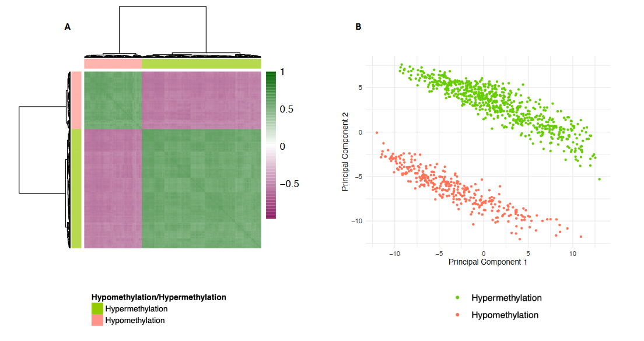
DMA visualization
Notes:
Lets quickly take a closer look at DNA methylation
DNA methylation is an epigenetic mechanism in which a methyl group is added to the 5th carbon of cytosin (which we can see here)
This reaction is catalyzed by DNA methyltransferase and mainly occures in CG sequences also reffered to as CpG dinucleotides(which we can see here)
This constellation allows the myelination pattern of the mother strand to be copied to the daugther strands in DNA replication
CpG islands are DNA regions typically around 1000 base pairs in length and characterized by a higher density of CpG
Ca 60% of gene promotors are located in CpG island including important house keeping genes

Slide 11
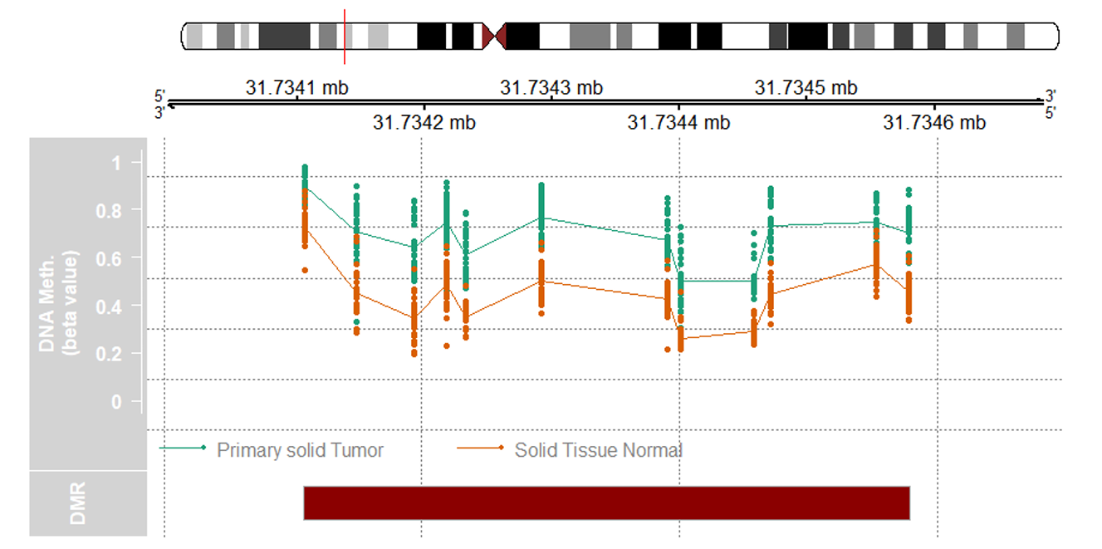
DMR
DMRcate package
GenomeAxisTrack and IdeogramTrack to reference the genomic location on a chromosom
op 5000 CpG sites -->642 significant regions
visualization of the most significant DMR
Notes:
Lets quickly take a closer look at DNA methylation
DNA methylation is an epigenetic mechanism in which a methyl group is added to the 5th carbon of cytosin (which we can see here)
This reaction is catalyzed by DNA methyltransferase and mainly occures in CG sequences also reffered to as CpG dinucleotides(which we can see here)
This constellation allows the myelination pattern of the mother strand to be copied to the daugther strands in DNA replication
CpG islands are DNA regions typically around 1000 base pairs in length and characterized by a higher density of CpG
Ca 60% of gene promotors are located in CpG island including important house keeping genes

Slide 12
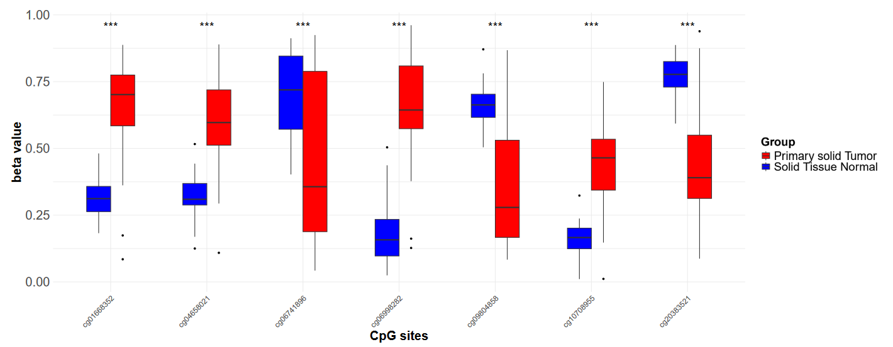
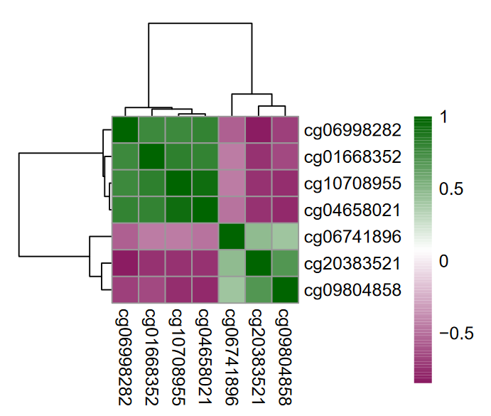
Diagnostic markers identified by Zhang at el.
High significance and high correlation
Results align with existing literature reinforce and validate given data
Correlation could indicate influence BRCA pathogenesis

Slide 13
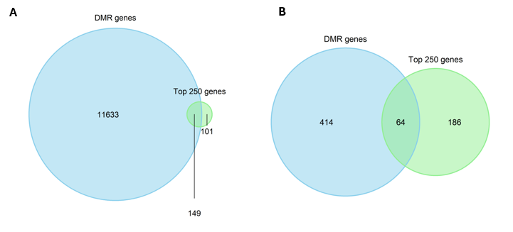
Overlap with Panagopoulou et al.'s top 250 genes
Our findings are robust and reproducible
Partial overlap due to different DMA methods, sample sizes, and data processing.
Confirms our DMR analysis reliability and highlights key genomic regions in BRCA pathogenesis

Slide 14
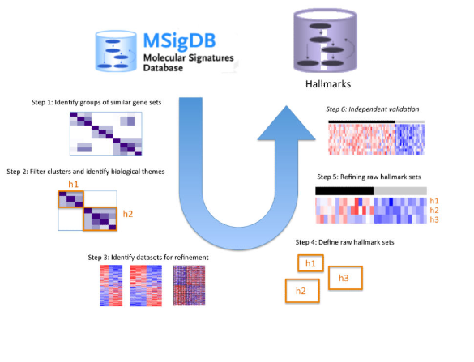
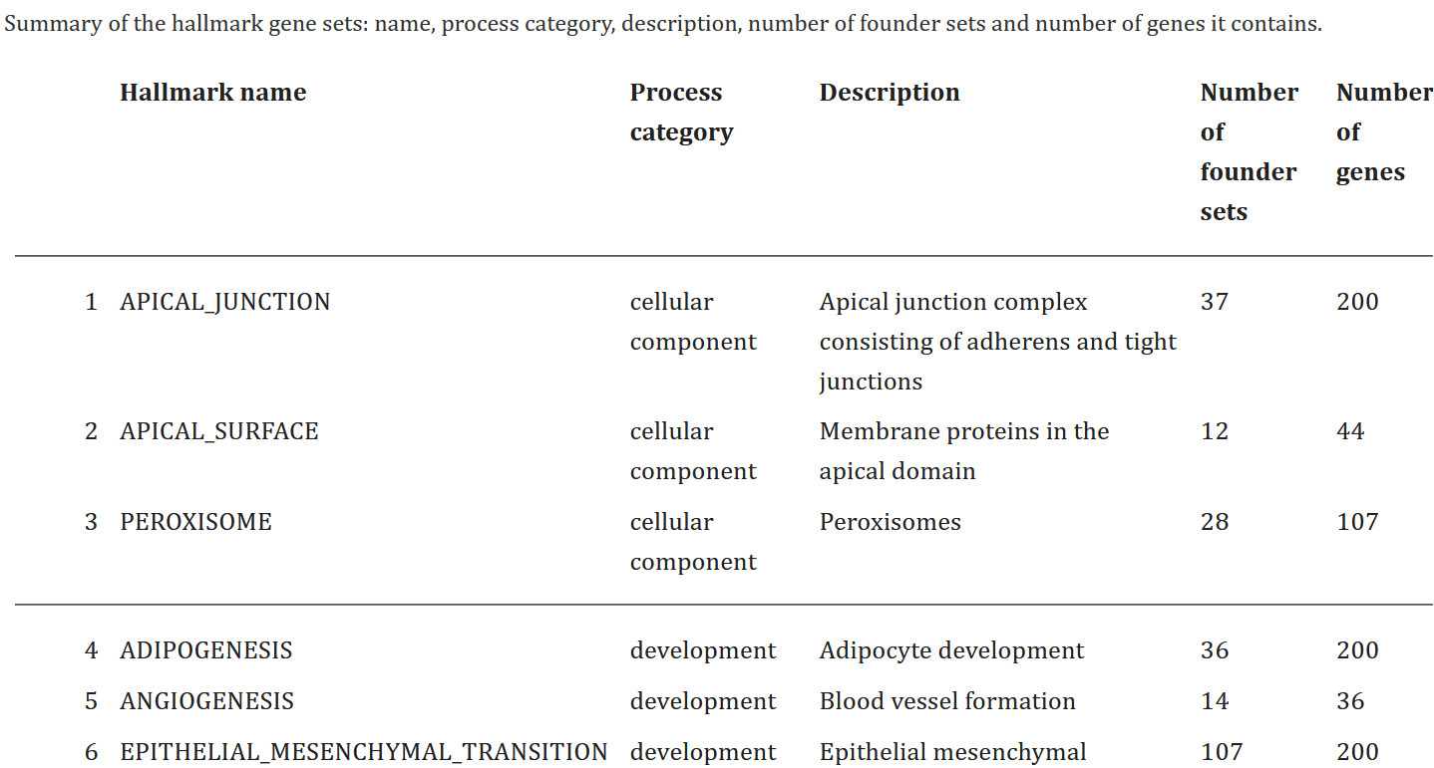
Hallmark gene set enrichment
https://www.ncbi.nlm.nih.gov/pmc/articles/PMC4707969/pdf/nihms-743907.pdf
Notes:
Lets quickly take a closer look at DNA methylation
DNA methylation is an epigenetic mechanism in which a methyl group is added to the 5th carbon of cytosin (which we can see here)
This reaction is catalyzed by DNA methyltransferase and mainly occures in CG sequences also reffered to as CpG dinucleotides(which we can see here)
This constellation allows the myelination pattern of the mother strand to be copied to the daugther strands in DNA replication
CpG islands are DNA regions typically around 1000 base pairs in length and characterized by a higher density of CpG
Ca 60% of gene promotors are located in CpG island including important house keeping genes

Slide 15
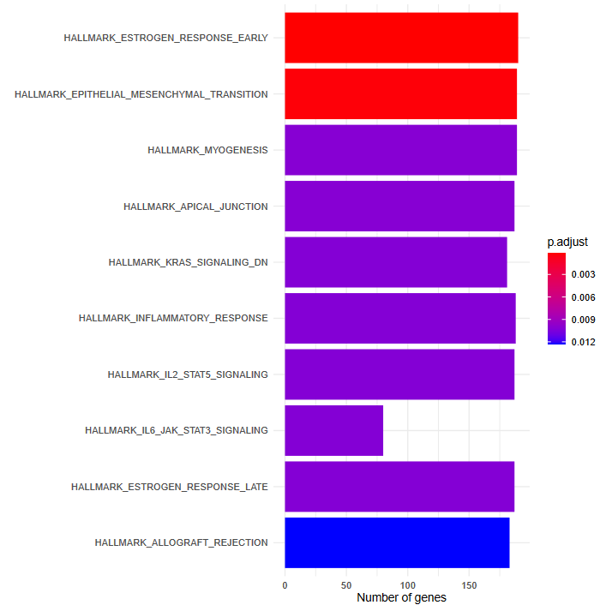
Hallmark gene set enrichment
Notes:
Lets quickly take a closer look at DNA methylation
DNA methylation is an epigenetic mechanism in which a methyl group is added to the 5th carbon of cytosin (which we can see here)
This reaction is catalyzed by DNA methyltransferase and mainly occures in CG sequences also reffered to as CpG dinucleotides(which we can see here)
This constellation allows the myelination pattern of the mother strand to be copied to the daugther strands in DNA replication
CpG islands are DNA regions typically around 1000 base pairs in length and characterized by a higher density of CpG
Ca 60% of gene promotors are located in CpG island including important house keeping genes

Slide 16
Outlook
Notes:
Lets quickly take a closer look at DNA methylation
DNA methylation is an epigenetic mechanism in which a methyl group is added to the 5th carbon of cytosin (which we can see here)
This reaction is catalyzed by DNA methyltransferase and mainly occures in CG sequences also reffered to as CpG dinucleotides(which we can see here)
This constellation allows the myelination pattern of the mother strand to be copied to the daugther strands in DNA replication
CpG islands are DNA regions typically around 1000 base pairs in length and characterized by a higher density of CpG
Ca 60% of gene promotors are located in CpG island including important house keeping genes

Slide 18
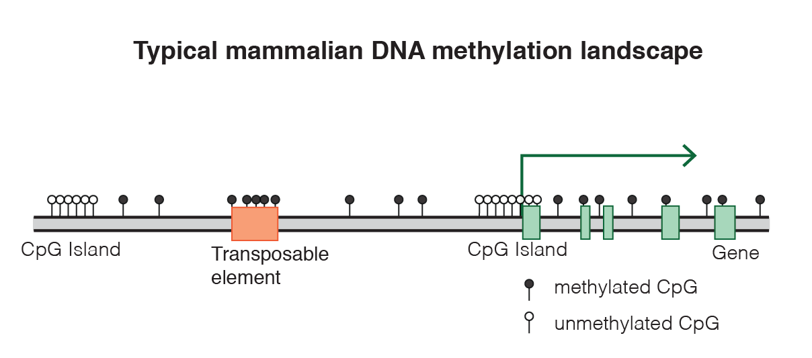
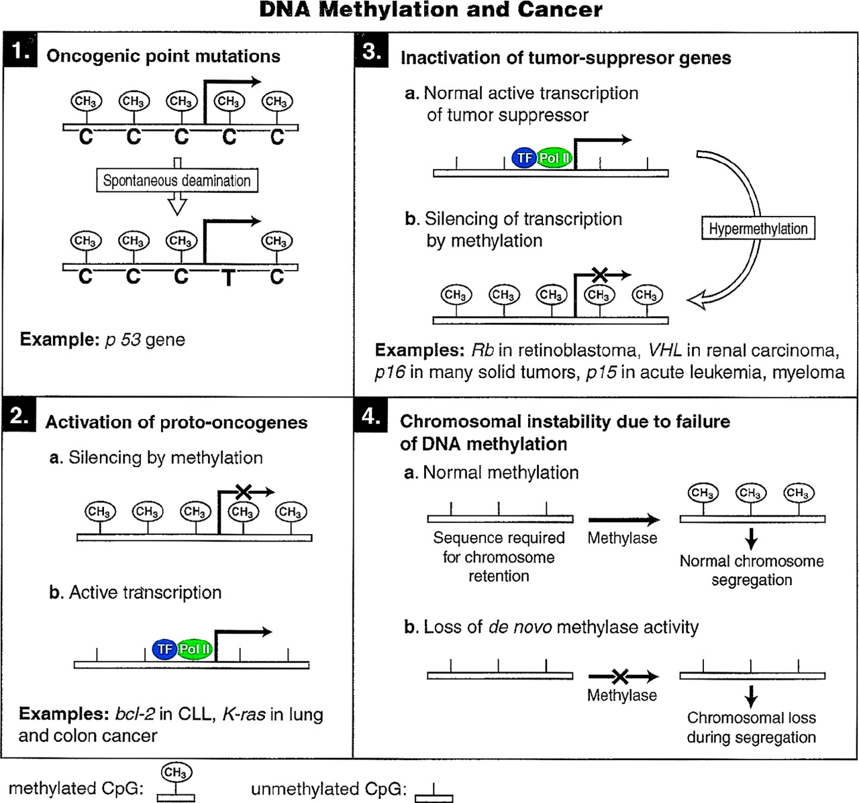
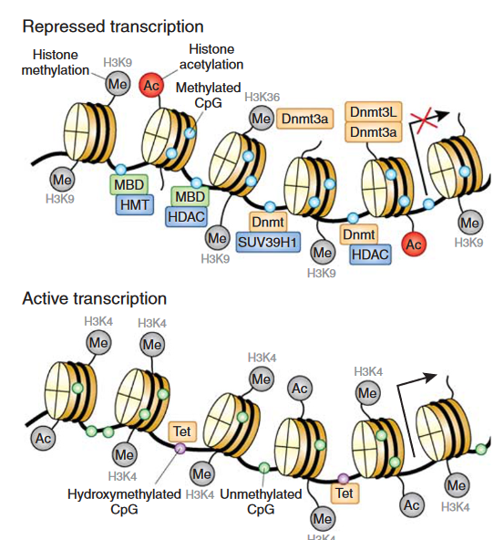
DNA methylation
Notes:
DNA methylation works in conjunction with histone modifications and microRNAs (miRNAs) to regulate transcription.Histone proteins help package DNA, and chemical modifications like methylation, acetylation, ubiquitination, and phosphorylation influence both DNA packaging and transcriptional activity.

Slide 19
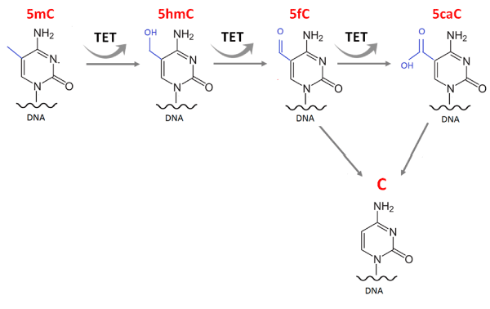
Demethylation
Notes:
Typically, 70% of CpGs in the human genome are methylated. But: Global loss of 5-20% of 5mC in 50% of BC: Oncogenes often hypomethylated, either because of absence of methylation or because of demethylation via TET oxidizing it to 5-hydroxymethylcytosine

Slide 20
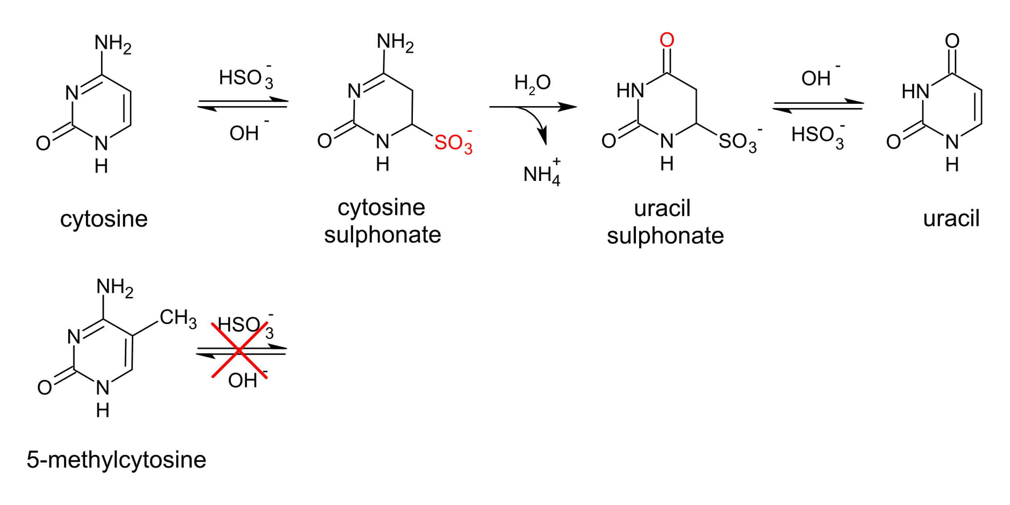
Bisulphite Conversion
Notes:
We were provided with this Data from the Cancer Genome Atlas, a programme designed to catalogue the genetic and epigenetic characteriscits of 33 different cancers to help in develping better tools for diagnostics, treatment and causes of cancer. Quality standards for sample are: primary, untreated tumor with a source of matched normal tissue or blood sample.
Frozen, sufficiently sized samples
Samples composed of at least 60% tumor nuclei
C is converted to U, which is replaced by T in a PCR via bisulphite treatment. 5mC is unaffected.
A bead can bind to these DNA fragments and depending on wether the CpG was converted or not, it will show up differently photometrically.
These is also a Bead Tpe I, but thats too complicated for now

Slide 21
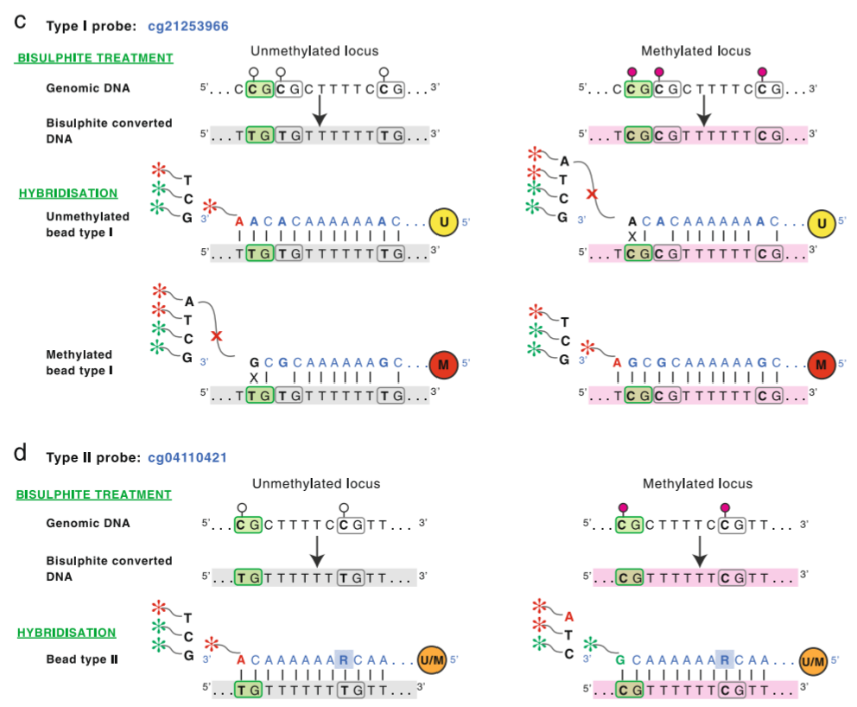
Notes:
We have 28 Million CpGs, but they focus on around 450k:
CpG islands, the 5′UTR, 3′UTR, the MHC region and some enhancer regions.
Type I probes have two separate probe sequences per CpG site (one each for methylated and unmethylated CpGs), whereas Type II probes have just one probe sequence per CpG site. This means that, per CpG site assayed, Type II probes use half the physical space on the BeadChip compared with Type I. However, Type I probes are still necessary as their design characteristics mean they can measure methylation at more CpG dense regions than Type II probes

Slide 22
The Dataset
β=intensity of methylated signal/
(intensity of methylated signal + intensity of unmethylated signal+100)
Notes:
The intensity can be measured photmetrically and compared to the unmethylated and methylated signal. This allows for inference of methylated portion of DNA – but confounding factors matter, the tissue sample wasnt perfect.
We also have general informatin on the patients such as age, gender and race.

Slide 23
Überschrift 1
Überschrift 2
Überschrift 3
Text

Slide 24
Grobe Outline unserer Präsentation
Einführung – Biologie Irena
Einstieg – Relevanz von Brustkrebs
Was ist Methylierung in DNA (CpG,..)
Marie:
Rolle von Methylierung in Brustkrebs
II. Was sind unsere Werte (ß-Werte: unbedingt anmerken: nicht 100% Tumorgewebe) → Beschreibung des Datensatzes, micro-Array
→ Überleitung zu unserer Fragestellung/Hypothese: „Identifikation von DMR‘s, die spezifisch für Brustkrebs sind“
Antonia:
III. Methoden
Density Plot
PCA/UMAP
Heatmap

Slide 25
Grobe Outline unserer Präsentation
III. Ausblick Kathi
Timeline mit weiteren Methoden und Zielführung

Slide 26
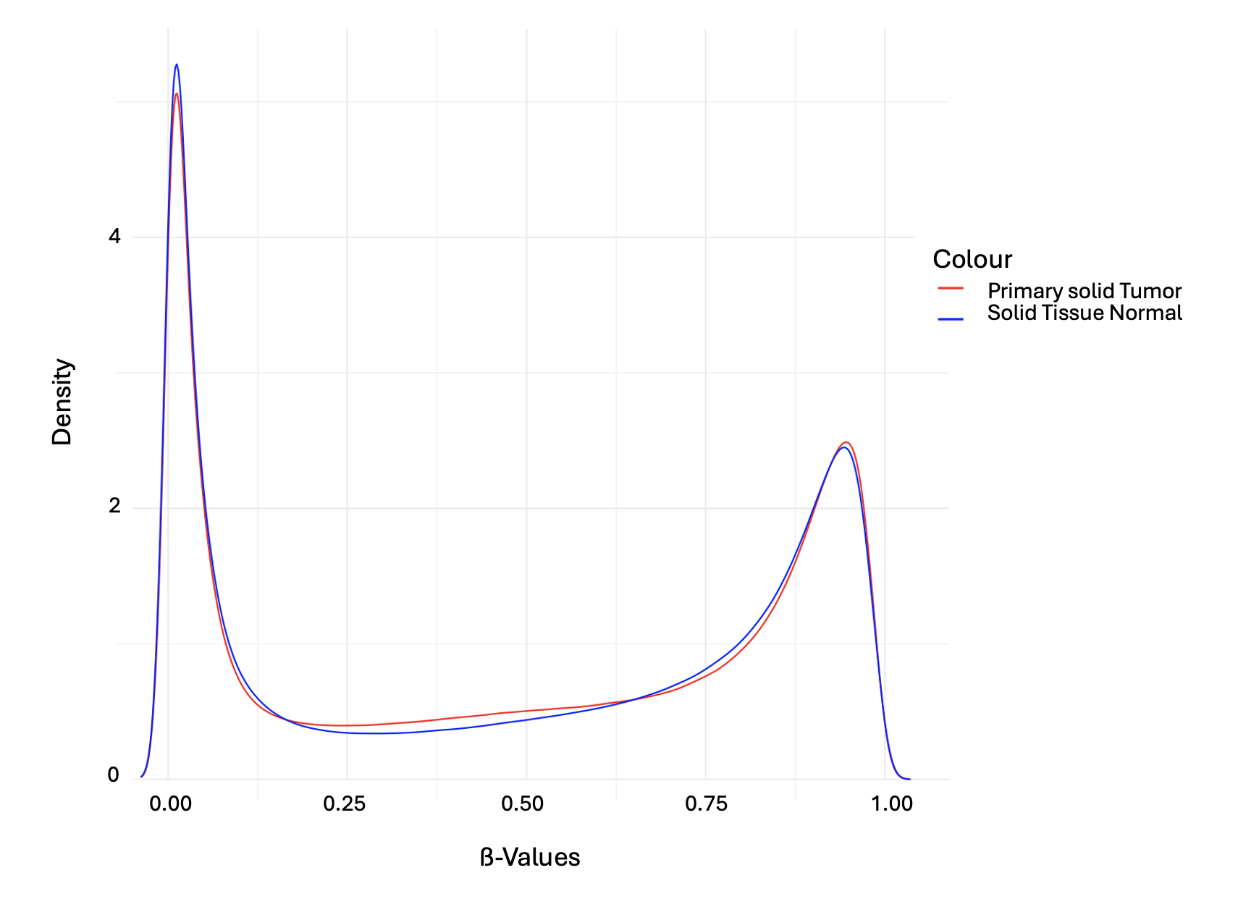
Data
Visualization
Density plot: Tumor vs. Solid Tissue
Highest density at the
ß-Values 0 and 1
No big difference between Primary solid Tumor and Solid Tissue Normal
Notes:
Introduction:
First did Data Visualization -> started with the patients -> wanted to define trends in patient subgroups -> divided them into subgroups according to the given annotation data frame
We focused on the Tumor Type: Primary Solid Tumor and Solid tissue normal
Let’s have a look at the distribution of ß-Values and the density
We can observe 2 things: highest density are either at ß-Value = 0 or ß-Value = 1 -> which is expected:
We either have no methylation or methylation
Second thing: there is no big difference between the two groups
(Bimodal distribution)
Code:
ggplot2
We did two density plots for each patient group (with the function density) and then combined the plots with the ggplot function

Slide 27
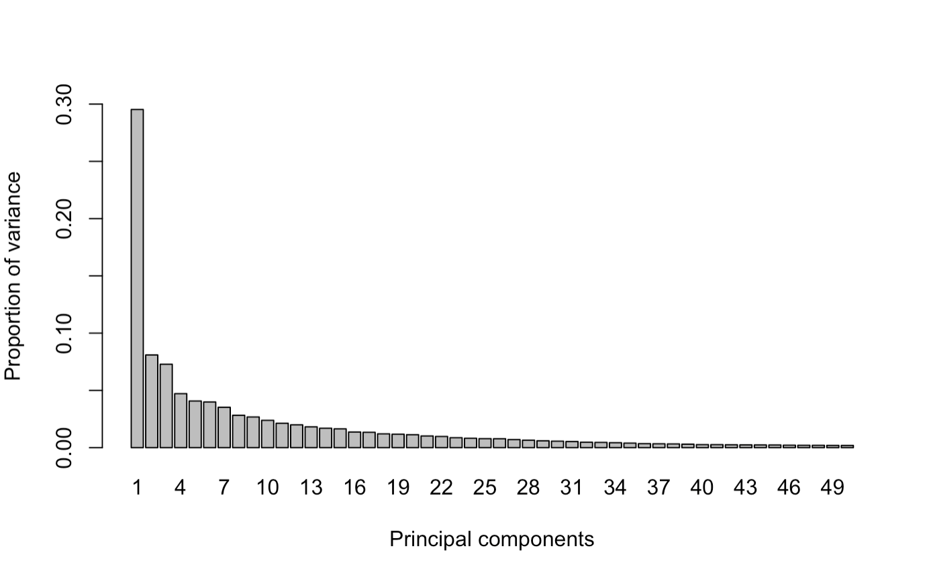
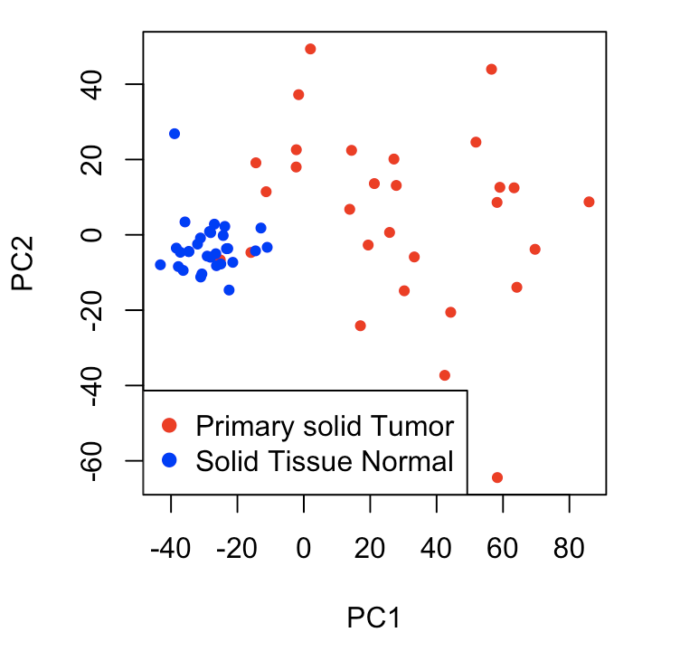
Data
Visualization
PCA Biplot for PC1and PC2
Group for Solid Tissue Normal is clustered more tightly than primary solid Tumor
Notes:
Dimension Reduction -> the data set is high dimensional -> we used a PCA
Here we can see the principle components and the proportion of variance they explain
PC1 and PC2 together. Explain about 38 % of Variance of the Dataset
Biplot for the first two PC
Observe 2 things:
There is a difference between the two groups -> show clusters
Group for Solid Tissue Normal is clusterd more tighly than the other group

Slide 28
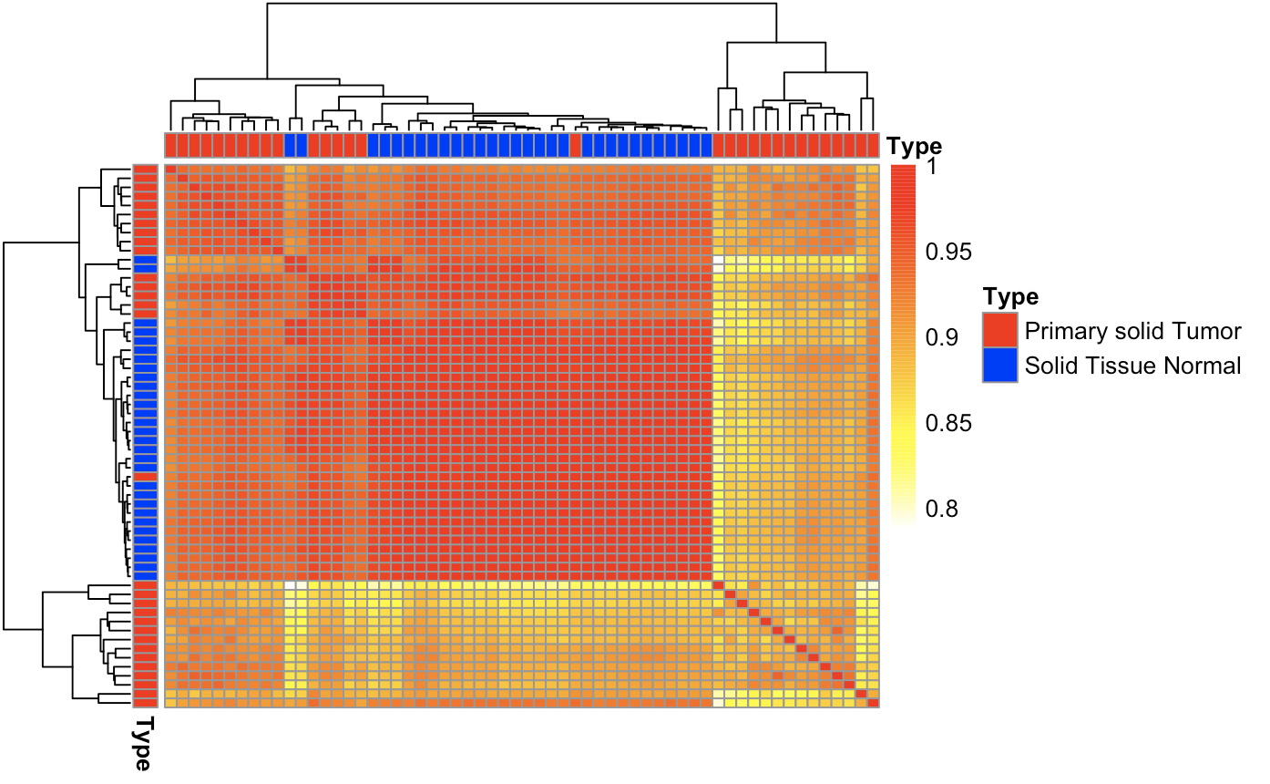
Data
Visualization
Heatmap: Pearson Correlation for each patient
Solid Tissue Normal exhibit a higher correlation than Primary solid Tumor
Notes:
We also looked at the Pearson Correlation between the patients and visulaised it with a heatmap which can be seen here
High correlation in this area in the Solid Tissue Normal group
Compared to the Primary solid Tumor group with lower correlation
But it is important to say, that even a correlation of 0,8 is relatively high
Conclusion:
That was the first part, which covered the data visualization in subgroups in Patients
Now its time to look in the future and talk about future project planning
Complete linkage and Euclidian distance

