Slide 1
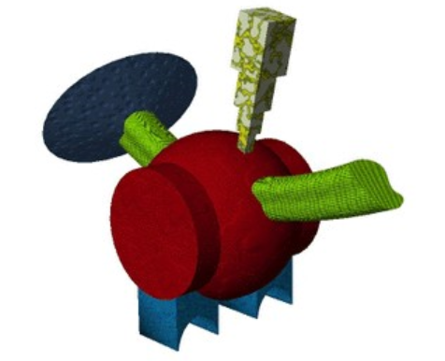

Contigency judgement task
+
keeb
«How much likely do you think it’s his name?»
500 ms
1000 ms
-10
0
+10
4000 ms
1000 ms + random ISI

Slide 2
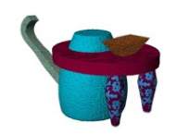
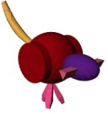
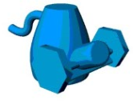
Generalization task
+
«Select the fribble that best matches the name»
keeb
500 ms
3500 ms
1000 ms + random ISI

Slide 3
Magnitude estimation task
+
«How many dots?»
500 ms
- - - -
500 ms
2000 ms + random ISI

