Slide 1
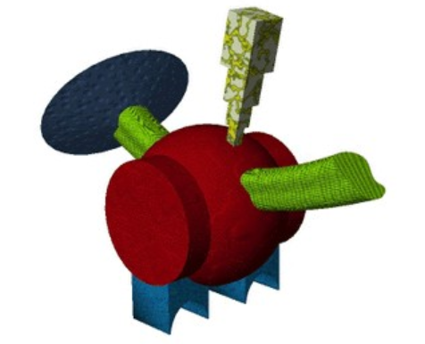

Contigency judgement task
+
«To what extent this label is correct for this alien??»
keeb
500 ms
+100: It’s the correct label
0: I don’t know
+100: It’s NOT the correct label
1000 ms
-100
0
+100
4000 ms
1000 ms + random ISI

Slide 2
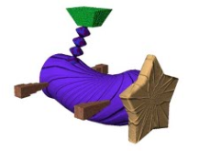
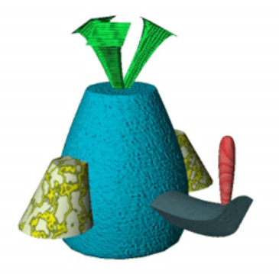
Generalization tasks
Low frequency exemplars
+
«Select the fribble that best matches the label»
+
«Select the label that best matches the fribble»
wug
500 ms
500 ms
wug
tob
dep
3500 ms
3500 ms
1000 ms + random ISI
1000 ms + random ISI

Slide 3
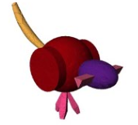
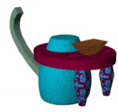
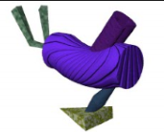
Generalization tasks
High frequency exemplars
+
«Select the fribble that best matches the label»
+
«Select the label that best matches the fribble»
wug
500 ms
500 ms
wug
tob
dep
3500 ms
3500 ms
1000 ms + random ISI
1000 ms + random ISI

Slide 4
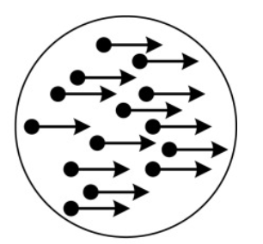

Random dot motion task
+
«If the dots move left press the left arrow key
if the dots move right press the right arrow key.»
+
500 ms
200 ms
2000 ms + random ISI

