Slide 1
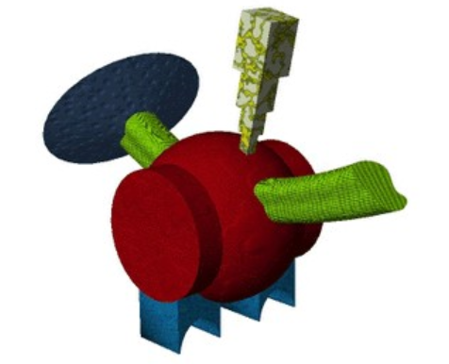
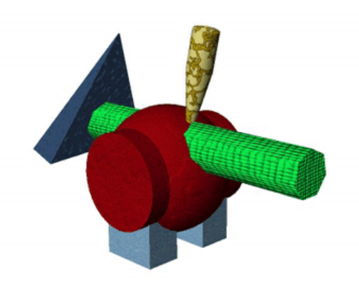

Timeline of item knowledge test
+
keeb
500 ms
2AFC
1000 ms
/
+
2000 ms
1000 ms + random ISI

