Slide 1
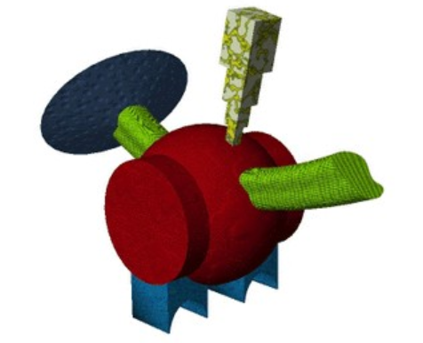
Timeline of Label-to-Feature learning
keeb
1000 ms
150 ms
+
175 ms
1000 ms + random ISI

Slide 2
Timeline of Feature-to-Label learning
175 ms
keeb
150 ms
+
1000 ms
1000 ms + random ISI

Slide 3
