Slide 1
✨
⭐
Content Analysis
- A Research Method for Social Science
🔬 Online Emotional Communities · OwlKitty Case Study
Example Research Question:
"How do YouTube commenters construct emotional
communities around cat-centered parody content?"
🐱 Undergraduate Social Science | Research Methods 🐱
Notes:
Sample undergraduate teaching lesson developed by Yingzi (Kathryn) Kong. Revised for teaching portfolio. Practice comments are illustrative examples; their provenance has not been verified, and they are not presented as a research dataset.
Sources: Papacharissi, Z. (2015). Affective Publics: Sentiment, Technology, and Politics. Oxford University Press.
Krippendorff, K. (2004). Reliability in content analysis: Some common misconceptions and recommendations. Human Communication Research, 30(3), 411–433. https://doi.org/10.1111/j.1468-2958.2004.tb00738.x
Zakrajsek, T., & Nilson, L. B. (2023). Teaching at Its Best (5th ed.). Jossey-Bass.
Media screenshots: OwlKitty on YouTube, https://www.youtube.com/@OwlKitty . Third-party media shown for teaching analysis.
AI assistance: Original deck acknowledged Claude (Anthropic). Portfolio revision assisted by OpenAI Codex.
Reliability note: Percentage agreement is not equivalent to Krippendorff’s alpha. Choose and report a measure suited to the data; this classroom activity is not a formal reliability assessment.

Slide 2
🎯 LEARNING OBJECTIVES
😺
By the end of this presentation, you will be able to:
01
02
EXPLAIN
APPLY
Explain how content analysis can examine online community-building.
Apply a two-dimensional codebook to comments and justify your coding decisions.
Notes:
Sample undergraduate teaching lesson developed by Yingzi (Kathryn) Kong. Revised for teaching portfolio. Practice comments are illustrative examples; their provenance has not been verified, and they are not presented as a research dataset.
Sources: Papacharissi, Z. (2015). Affective Publics: Sentiment, Technology, and Politics. Oxford University Press.
Krippendorff, K. (2004). Reliability in content analysis: Some common misconceptions and recommendations. Human Communication Research, 30(3), 411–433. https://doi.org/10.1111/j.1468-2958.2004.tb00738.x
Zakrajsek, T., & Nilson, L. B. (2023). Teaching at Its Best (5th ed.). Jossey-Bass.
Media screenshots: OwlKitty on YouTube, https://www.youtube.com/@OwlKitty . Third-party media shown for teaching analysis.
AI assistance: Original deck acknowledged Claude (Anthropic). Portfolio revision assisted by OpenAI Codex.
Reliability note: Percentage agreement is not equivalent to Krippendorff’s alpha. Choose and report a measure suited to the data; this classroom activity is not a formal reliability assessment.

Slide 3
🔬 WHAT IS CONTENT ANALYSIS?
😺
📖 Content Analysis = a systematic, replicable method for identifying and interpreting patterns in text, images, or media — used to answer social science research questions.
The Most Important Distinction: 🔑
📄 MANIFEST CONTENT
🔍 LATENT CONTENT
Surface level — what is literally said or shown
Deeper meaning — what is implied or constructed
💬 "This cat is so cute!!"
💬 "This cat is so cute!!"
→ Simple: positive sentiment, uses 'cute'
→ Possible shared affection; context matters
Basic — what words are used
Interpreting meaning in context
Content analysis can examine both manifest content and latent content.
Notes:
Sample undergraduate teaching lesson developed by Yingzi (Kathryn) Kong. Revised for teaching portfolio. Practice comments are illustrative examples; their provenance has not been verified, and they are not presented as a research dataset.
Sources: Papacharissi, Z. (2015). Affective Publics: Sentiment, Technology, and Politics. Oxford University Press.
Krippendorff, K. (2004). Reliability in content analysis: Some common misconceptions and recommendations. Human Communication Research, 30(3), 411–433. https://doi.org/10.1111/j.1468-2958.2004.tb00738.x
Zakrajsek, T., & Nilson, L. B. (2023). Teaching at Its Best (5th ed.). Jossey-Bass.
Media screenshots: OwlKitty on YouTube, https://www.youtube.com/@OwlKitty . Third-party media shown for teaching analysis.
AI assistance: Original deck acknowledged Claude (Anthropic). Portfolio revision assisted by OpenAI Codex.
Reliability note: Percentage agreement is not equivalent to Krippendorff’s alpha. Choose and report a measure suited to the data; this classroom activity is not a formal reliability assessment.

Slide 4
THE HOOK 🐾
"You are a Barbie fan. I am a Barbie fan.
We both just watched a cat replace Margot Robbie.
Now we feel like we know each other. Why?"
📚 AFFECTIVE PUBLICS
🎬 FOR OWLKITTY BARBIE
Viewers may share affection for Lizzy and familiarity with Barbie. We can look for language that invites other viewers to connect around these references.
Zizi Papacharissi (2015)
Affective publics offers a lens for examining how shared feelings and networked expression connect people online. Shared emotion may support affiliation; it does not by itself prove a lasting community.
Question to explore: When do shared cultural references become signals of belonging?
Notes:
Sample undergraduate teaching lesson developed by Yingzi (Kathryn) Kong. Revised for teaching portfolio. Practice comments are illustrative examples; their provenance has not been verified, and they are not presented as a research dataset.
Sources: Papacharissi, Z. (2015). Affective Publics: Sentiment, Technology, and Politics. Oxford University Press.
Krippendorff, K. (2004). Reliability in content analysis: Some common misconceptions and recommendations. Human Communication Research, 30(3), 411–433. https://doi.org/10.1111/j.1468-2958.2004.tb00738.x
Zakrajsek, T., & Nilson, L. B. (2023). Teaching at Its Best (5th ed.). Jossey-Bass.
Media screenshots: OwlKitty on YouTube, https://www.youtube.com/@OwlKitty . Third-party media shown for teaching analysis.
AI assistance: Original deck acknowledged Claude (Anthropic). Portfolio revision assisted by OpenAI Codex.
Reliability note: Percentage agreement is not equivalent to Krippendorff’s alpha. Choose and report a measure suited to the data; this classroom activity is not a formal reliability assessment.

Slide 5
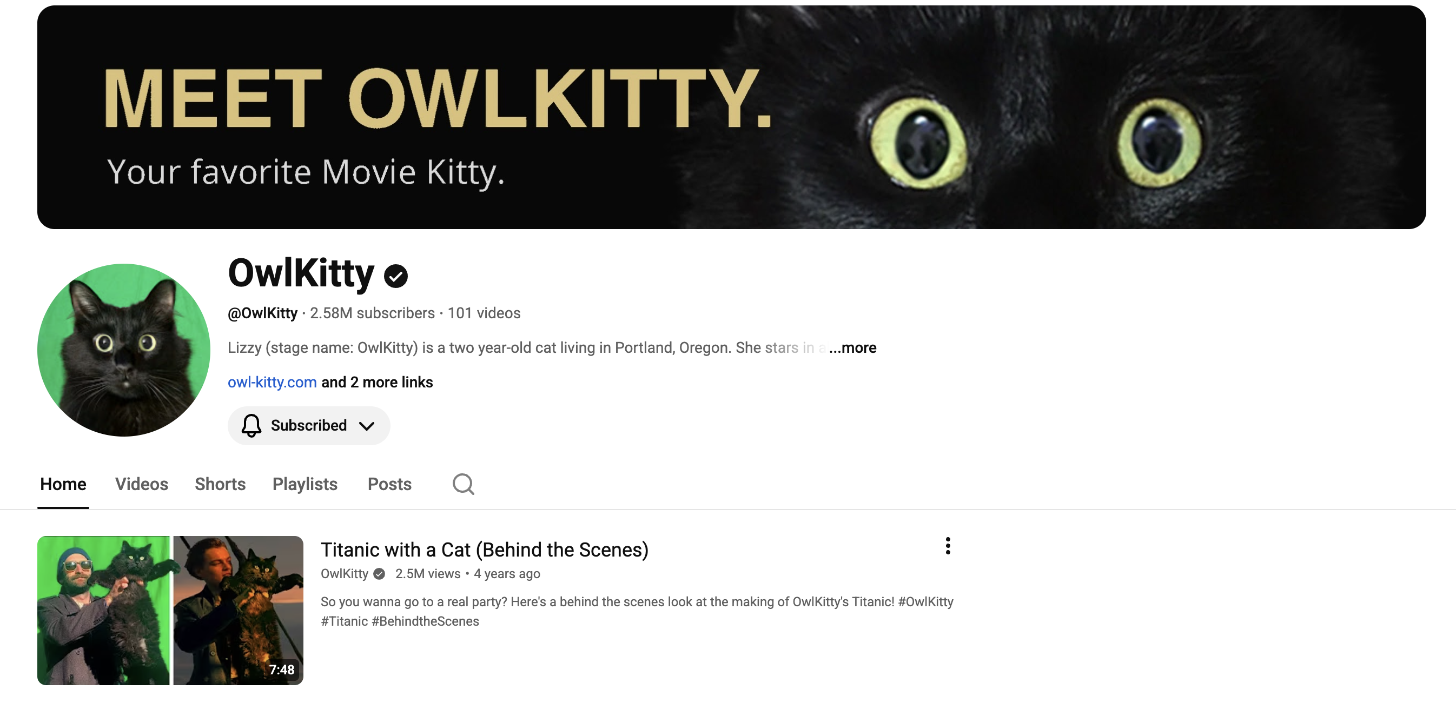
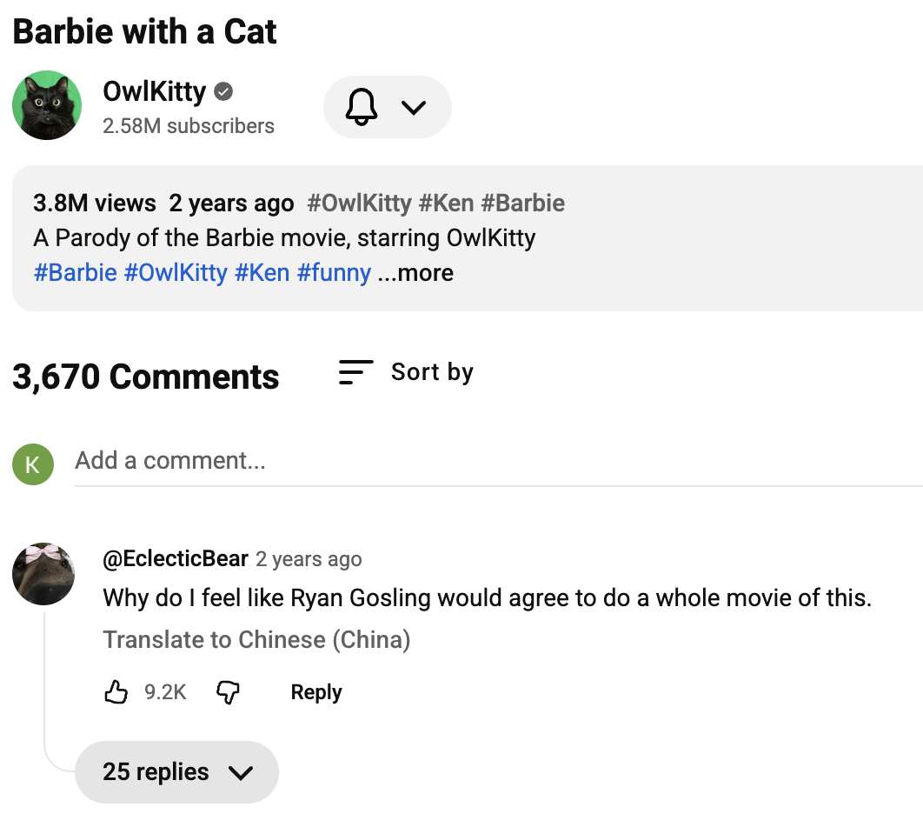
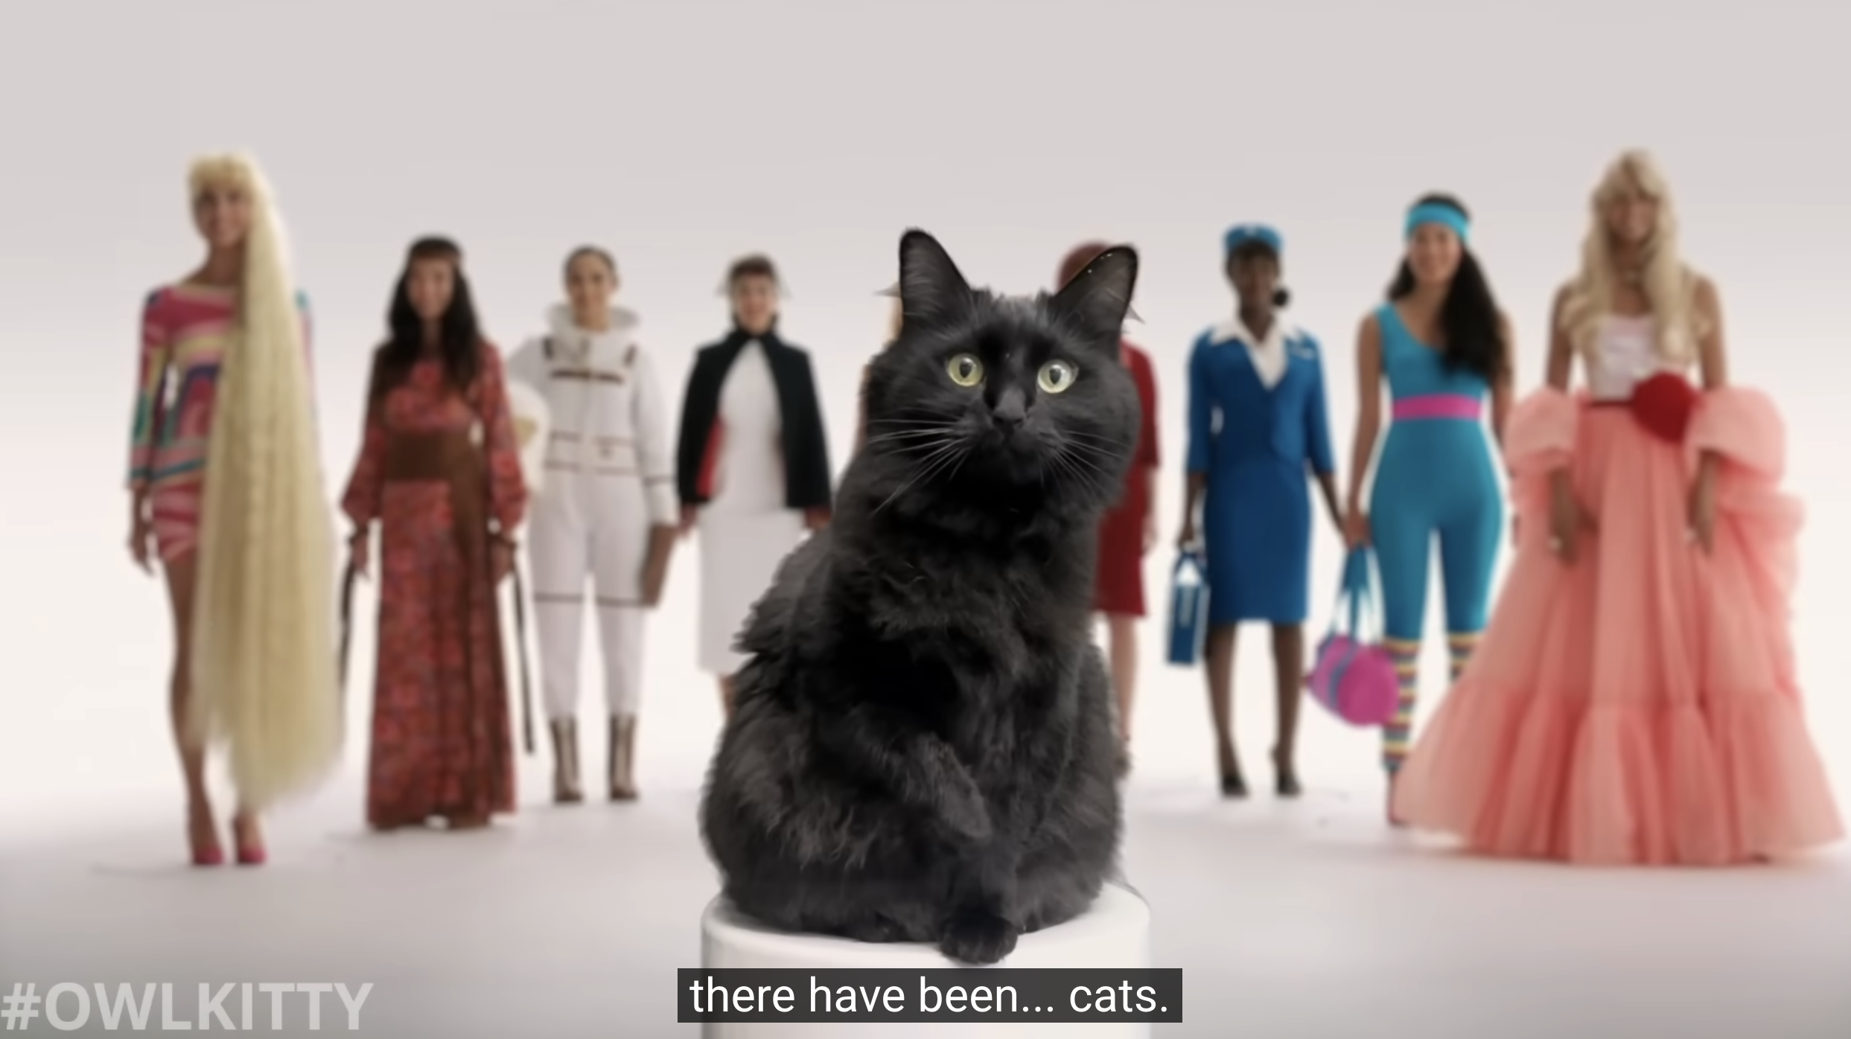
🎓 Owlkitty 🐾
😺
Notes:
Sample undergraduate teaching lesson developed by Yingzi (Kathryn) Kong. Revised for teaching portfolio. Practice comments are illustrative examples; their provenance has not been verified, and they are not presented as a research dataset.
Sources: Papacharissi, Z. (2015). Affective Publics: Sentiment, Technology, and Politics. Oxford University Press.
Krippendorff, K. (2004). Reliability in content analysis: Some common misconceptions and recommendations. Human Communication Research, 30(3), 411–433. https://doi.org/10.1111/j.1468-2958.2004.tb00738.x
Zakrajsek, T., & Nilson, L. B. (2023). Teaching at Its Best (5th ed.). Jossey-Bass.
Media screenshots: OwlKitty on YouTube, https://www.youtube.com/@OwlKitty . Third-party media shown for teaching analysis.
AI assistance: Original deck acknowledged Claude (Anthropic). Portfolio revision assisted by OpenAI Codex.
Reliability note: Percentage agreement is not equivalent to Krippendorff’s alpha. Choose and report a measure suited to the data; this classroom activity is not a formal reliability assessment.

Slide 6
🎲 STEP 1: SAMPLING — WHICH COMMENTS DO WE STUDY?
Before coding, define the population and decide whether to study all eligible comments or a sample.
Document your selection rules, collection date, and treatment of replies.
🎯 WHICH VIDEO(S)?
💬 WHICH COMMENTS?
📅 WHAT TIME FRAME?
One viral video? Multiple videos? Specific channel?
Top comments? Random sample? First 100?
All-time? Last month? First week of posting?
Scope shapes interpretation. More videos do not automatically make a sample representative.
Affects representativeness — top comments ≠ typical commenter
Affects temporal validity — early comments ≠ current community norms
Illustrative case: OwlKitty Barbie, selected for its cat-centered film parody.
e.g. Random sample of 50 comments per video
e.g. Comments posted within first 30 days
Notes:
Sample undergraduate teaching lesson developed by Yingzi (Kathryn) Kong. Revised for teaching portfolio. Practice comments are illustrative examples; their provenance has not been verified, and they are not presented as a research dataset.
Sources: Papacharissi, Z. (2015). Affective Publics: Sentiment, Technology, and Politics. Oxford University Press.
Krippendorff, K. (2004). Reliability in content analysis: Some common misconceptions and recommendations. Human Communication Research, 30(3), 411–433. https://doi.org/10.1111/j.1468-2958.2004.tb00738.x
Zakrajsek, T., & Nilson, L. B. (2023). Teaching at Its Best (5th ed.). Jossey-Bass.
Media screenshots: OwlKitty on YouTube, https://www.youtube.com/@OwlKitty . Third-party media shown for teaching analysis.
AI assistance: Original deck acknowledged Claude (Anthropic). Portfolio revision assisted by OpenAI Codex.
Reliability note: Percentage agreement is not equivalent to Krippendorff’s alpha. Choose and report a measure suited to the data; this classroom activity is not a formal reliability assessment.

Slide 7
🏷️ STEP 2: CODING — SETTING A CODING SCHEME
😽
Practice codebook: assign one code per dimension to each comment. Explain your evidence.
DIMENSION 1 🤝 Community-Building Language
DIMENSION 2 🐱 Anthropomorphization
Does the comment signal shared identity, cultural references, or an invitation to other viewers?
Does this comment project human thoughts, feelings, personality, or inner life onto the cat?
YES
Explicit address to other viewers, shared identity ("we/us"), or invitation to connect
YES
Clearly gives the cat human thoughts, intentions, personality, or a human performance role
PARTIAL
Implicit shared cultural reference or in-joke, without explicit address or shared identity
PARTIAL
Tentative human comparison; a human trait is suggested but remains ambiguous
NO
Purely individual expression — no reference to shared experience or community
NO
Treats cat as animal — describes behaviors without projecting human inner life
📝 Model: "Why does he look like he's judging all our life choices 😂" → D1: YES (shared humor/community) | D2: YES (human inner life projected)
Notes:
Sample undergraduate teaching lesson developed by Yingzi (Kathryn) Kong. Revised for teaching portfolio. Practice comments are illustrative examples; their provenance has not been verified, and they are not presented as a research dataset.
Sources: Papacharissi, Z. (2015). Affective Publics: Sentiment, Technology, and Politics. Oxford University Press.
Krippendorff, K. (2004). Reliability in content analysis: Some common misconceptions and recommendations. Human Communication Research, 30(3), 411–433. https://doi.org/10.1111/j.1468-2958.2004.tb00738.x
Zakrajsek, T., & Nilson, L. B. (2023). Teaching at Its Best (5th ed.). Jossey-Bass.
Media screenshots: OwlKitty on YouTube, https://www.youtube.com/@OwlKitty . Third-party media shown for teaching analysis.
AI assistance: Original deck acknowledged Claude (Anthropic). Portfolio revision assisted by OpenAI Codex.
Reliability note: Percentage agreement is not equivalent to Krippendorff’s alpha. Choose and report a measure suited to the data; this classroom activity is not a formal reliability assessment.

Slide 8
⚡ YOUR TURN! 😸 60 SECONDS — WORK IN PAIRS!
Comment
D1: Community
D2: Anthro
😸
"Lizzy understood the assignment better than most of the actual cast 😭"
Y / P / N
Y / P / N
1
😼
"I came here after watching the real movie and honestly this is more satisfying"
Y / P / N
Y / P / N
2
😺
"Anyone else think Lizzy has more screen presence than Margot Robbie?? asking for a friend 👀"
Y / P / N
Y / P / N
3
🙀
"The editing on this is incredible, I have watched it 4 times already"
Y / P / N
Y / P / N
4
Practice comments are illustrative examples, not a verified research sample. Explain your evidence.
Notes:
Sample undergraduate teaching lesson developed by Yingzi (Kathryn) Kong. Revised for teaching portfolio. Practice comments are illustrative examples; their provenance has not been verified, and they are not presented as a research dataset.
Sources: Papacharissi, Z. (2015). Affective Publics: Sentiment, Technology, and Politics. Oxford University Press.
Krippendorff, K. (2004). Reliability in content analysis: Some common misconceptions and recommendations. Human Communication Research, 30(3), 411–433. https://doi.org/10.1111/j.1468-2958.2004.tb00738.x
Zakrajsek, T., & Nilson, L. B. (2023). Teaching at Its Best (5th ed.). Jossey-Bass.
Media screenshots: OwlKitty on YouTube, https://www.youtube.com/@OwlKitty . Third-party media shown for teaching analysis.
AI assistance: Original deck acknowledged Claude (Anthropic). Portfolio revision assisted by OpenAI Codex.
Reliability note: Percentage agreement is not equivalent to Krippendorff’s alpha. Choose and report a measure suited to the data; this classroom activity is not a formal reliability assessment.

Slide 9
🐱 DEBRIEF — SUGGESTED CODES
😹
"Lizzy understood the assignment..."
D1: PARTIAL
D2: YES
D1: implicit meme reference. D2: human competence attributed to the cat.
1
"...more satisfying than real movie"
D1: PARTIAL
D2: NO
D1: shared film reference, no direct address. D2: no human trait assigned to the cat.
2
"Anyone else think Lizzy has more screen presence..."
D1: YES
D2: YES
D1: "Anyone else" addresses viewers. D2: human performance quality assigned to the cat.
3
"The editing is incredible..."
D1: NO
D2: NO
D1: purely individual reaction to craft — no address to others. D2: cat not present as character here
4
Compare independent codes, discuss disagreements, and refine definitions. Formal research needs an appropriate reliability measure.
Notes:
Sample undergraduate teaching lesson developed by Yingzi (Kathryn) Kong. Revised for teaching portfolio. Practice comments are illustrative examples; their provenance has not been verified, and they are not presented as a research dataset.
Sources: Papacharissi, Z. (2015). Affective Publics: Sentiment, Technology, and Politics. Oxford University Press.
Krippendorff, K. (2004). Reliability in content analysis: Some common misconceptions and recommendations. Human Communication Research, 30(3), 411–433. https://doi.org/10.1111/j.1468-2958.2004.tb00738.x
Zakrajsek, T., & Nilson, L. B. (2023). Teaching at Its Best (5th ed.). Jossey-Bass.
Media screenshots: OwlKitty on YouTube, https://www.youtube.com/@OwlKitty . Third-party media shown for teaching analysis.
AI assistance: Original deck acknowledged Claude (Anthropic). Portfolio revision assisted by OpenAI Codex.
Reliability note: Percentage agreement is not equivalent to Krippendorff’s alpha. Choose and report a measure suited to the data; this classroom activity is not a formal reliability assessment.

Slide 10
💡 STEP 3: INTERPRETING THE PRACTICE
What can these examples suggest, and what would require further evidence?
1
Illustrative Patterns
Our suggested codes identify one explicit community cue, two implicit cues, and one comment without such cues. These four practice examples cannot estimate how common the patterns are.
2
A Hypothesis to Explore
Shared references and humanized portrayals of a cat may support affiliation. These examples do not establish that parody causes community formation.
3
What We Need Next
Use a defined sample, contextual reading, and independent coding. Testing a parody effect would also require a suitable comparison and research design.
Notes:
Sample undergraduate teaching lesson developed by Yingzi (Kathryn) Kong. Revised for teaching portfolio. Practice comments are illustrative examples; their provenance has not been verified, and they are not presented as a research dataset.
Sources: Papacharissi, Z. (2015). Affective Publics: Sentiment, Technology, and Politics. Oxford University Press.
Krippendorff, K. (2004). Reliability in content analysis: Some common misconceptions and recommendations. Human Communication Research, 30(3), 411–433. https://doi.org/10.1111/j.1468-2958.2004.tb00738.x
Zakrajsek, T., & Nilson, L. B. (2023). Teaching at Its Best (5th ed.). Jossey-Bass.
Media screenshots: OwlKitty on YouTube, https://www.youtube.com/@OwlKitty . Third-party media shown for teaching analysis.
AI assistance: Original deck acknowledged Claude (Anthropic). Portfolio revision assisted by OpenAI Codex.
Reliability note: Percentage agreement is not equivalent to Krippendorff’s alpha. Choose and report a measure suited to the data; this classroom activity is not a formal reliability assessment.

Slide 11
🐾 WHAT YOU NOW KNOW
Content Analysis:
A Method With Real Depth 🐱
✅
Content analysis can examine manifest content and latent meaning using explicit, documented coding rules.
✅
Sampling decisions come before coding — which comments, which videos, which time frame?
✅
Two coding dimensions let us compare community cues with anthropomorphization in the same comments.
✅
Affective publics provides a theoretical lens. Claims about community formation need evidence beyond this exercise.
💬 How would you adapt this codebook for another online community? 🐾
😸
😻
😺
😹
😽
Notes:
Sample undergraduate teaching lesson developed by Yingzi (Kathryn) Kong. Revised for teaching portfolio. Practice comments are illustrative examples; their provenance has not been verified, and they are not presented as a research dataset.
Sources: Papacharissi, Z. (2015). Affective Publics: Sentiment, Technology, and Politics. Oxford University Press.
Krippendorff, K. (2004). Reliability in content analysis: Some common misconceptions and recommendations. Human Communication Research, 30(3), 411–433. https://doi.org/10.1111/j.1468-2958.2004.tb00738.x
Zakrajsek, T., & Nilson, L. B. (2023). Teaching at Its Best (5th ed.). Jossey-Bass.
Media screenshots: OwlKitty on YouTube, https://www.youtube.com/@OwlKitty . Third-party media shown for teaching analysis.
AI assistance: Original deck acknowledged Claude (Anthropic). Portfolio revision assisted by OpenAI Codex.
Reliability note: Percentage agreement is not equivalent to Krippendorff’s alpha. Choose and report a measure suited to the data; this classroom activity is not a formal reliability assessment.

Slide 12
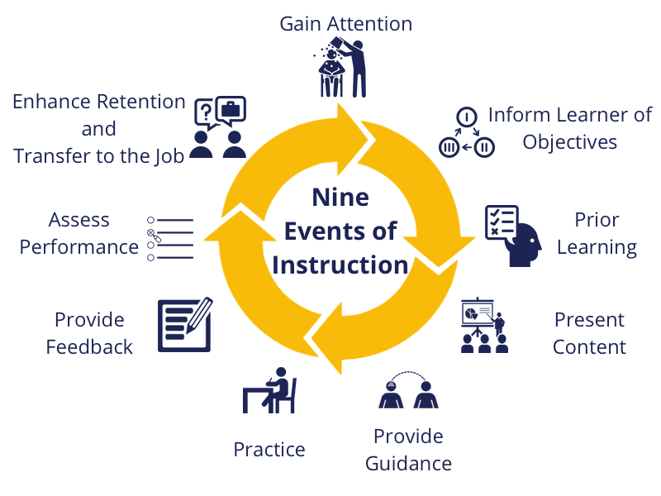
🎓 TEACHING STRATEGIES USED 🐾
😺
Gagné's Nine Events of Instruction
⚡
Stimulus-Based Interpretive Exercise
🧠
Constructivism
Built on students' existing social media literacy, then scaffolded upward through manifest to latent distinction, sampling decisions, and theory connection — each step adding analytical complexity
Sources: Zakrajsek & Nilson (2023), Teaching at Its Best (5th ed.); Papacharissi (2015), Affective Publics.
Reliability: Krippendorff (2004), doi:10.1111/j.1468-2958.2004.tb00738.x. Media: OwlKitty, YouTube.
AI assistance: Claude (Anthropic), acknowledged in the original deck. Full references in speaker notes.
Notes:
Sample undergraduate teaching lesson developed by Yingzi (Kathryn) Kong. Revised for teaching portfolio. Practice comments are illustrative examples; their provenance has not been verified, and they are not presented as a research dataset.
Sources: Papacharissi, Z. (2015). Affective Publics: Sentiment, Technology, and Politics. Oxford University Press.
Krippendorff, K. (2004). Reliability in content analysis: Some common misconceptions and recommendations. Human Communication Research, 30(3), 411–433. https://doi.org/10.1111/j.1468-2958.2004.tb00738.x
Zakrajsek, T., & Nilson, L. B. (2023). Teaching at Its Best (5th ed.). Jossey-Bass.
Media screenshots: OwlKitty on YouTube, https://www.youtube.com/@OwlKitty . Third-party media shown for teaching analysis.
AI assistance: Original deck acknowledged Claude (Anthropic). Portfolio revision assisted by OpenAI Codex.
Reliability note: Percentage agreement is not equivalent to Krippendorff’s alpha. Choose and report a measure suited to the data; this classroom activity is not a formal reliability assessment.

