Slide 1
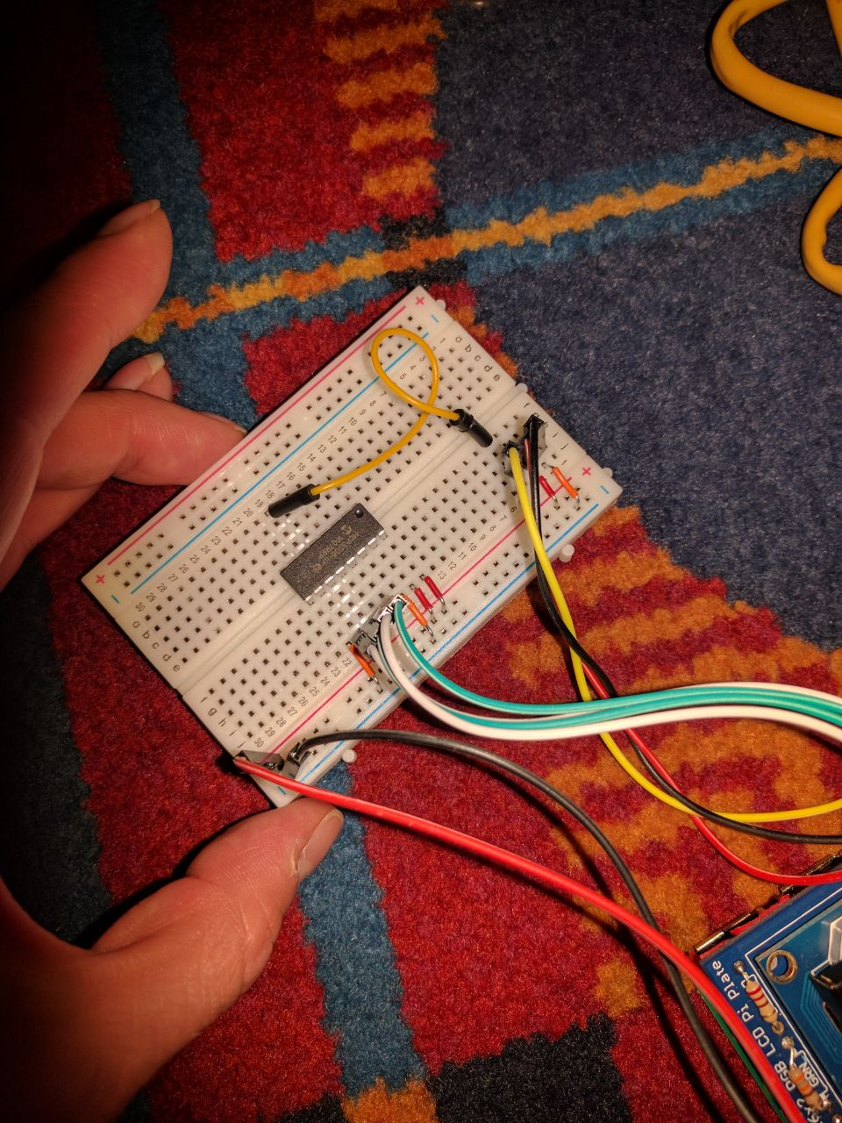
Power comes in this outer row
Picks up the analog reading from
the sensor wires
Analog gets converted to
digital by MCP3008 chip
Digital reading gets sent to pi

