Slide 1
ECDC v JHU data
Comparison over 12 weeks
21 Dec 2020 to 15 March 2021

Slide 2
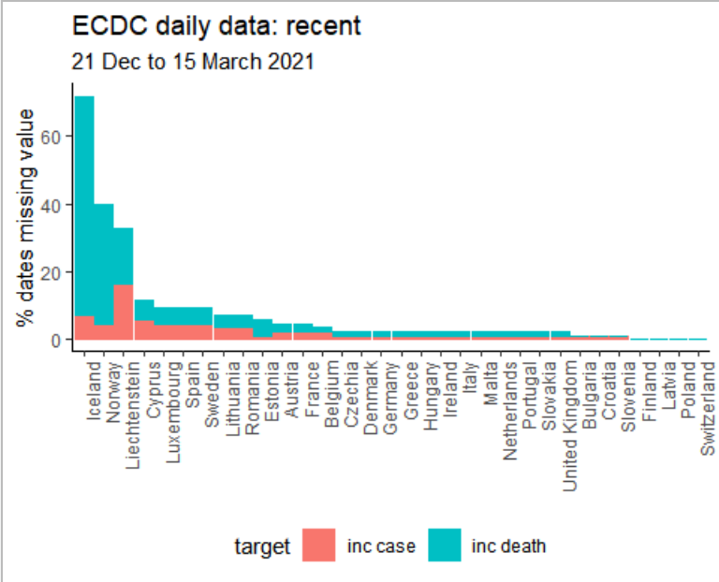
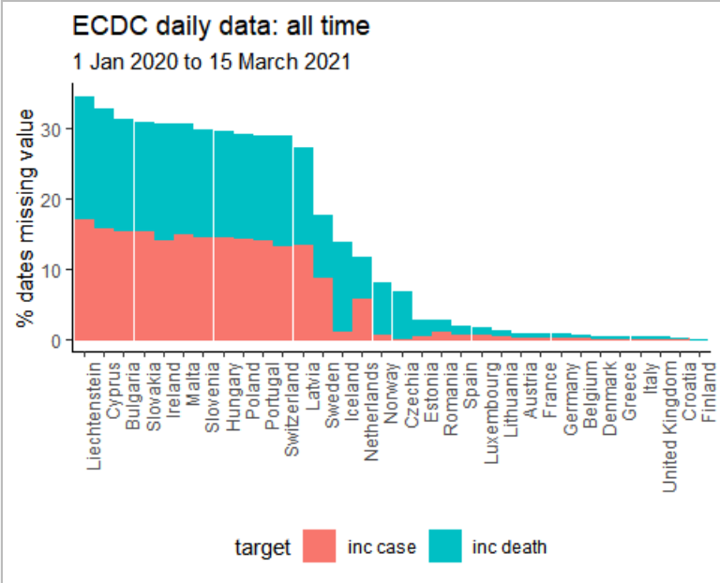
Implicit missing data in ECDC daily data

Slide 3
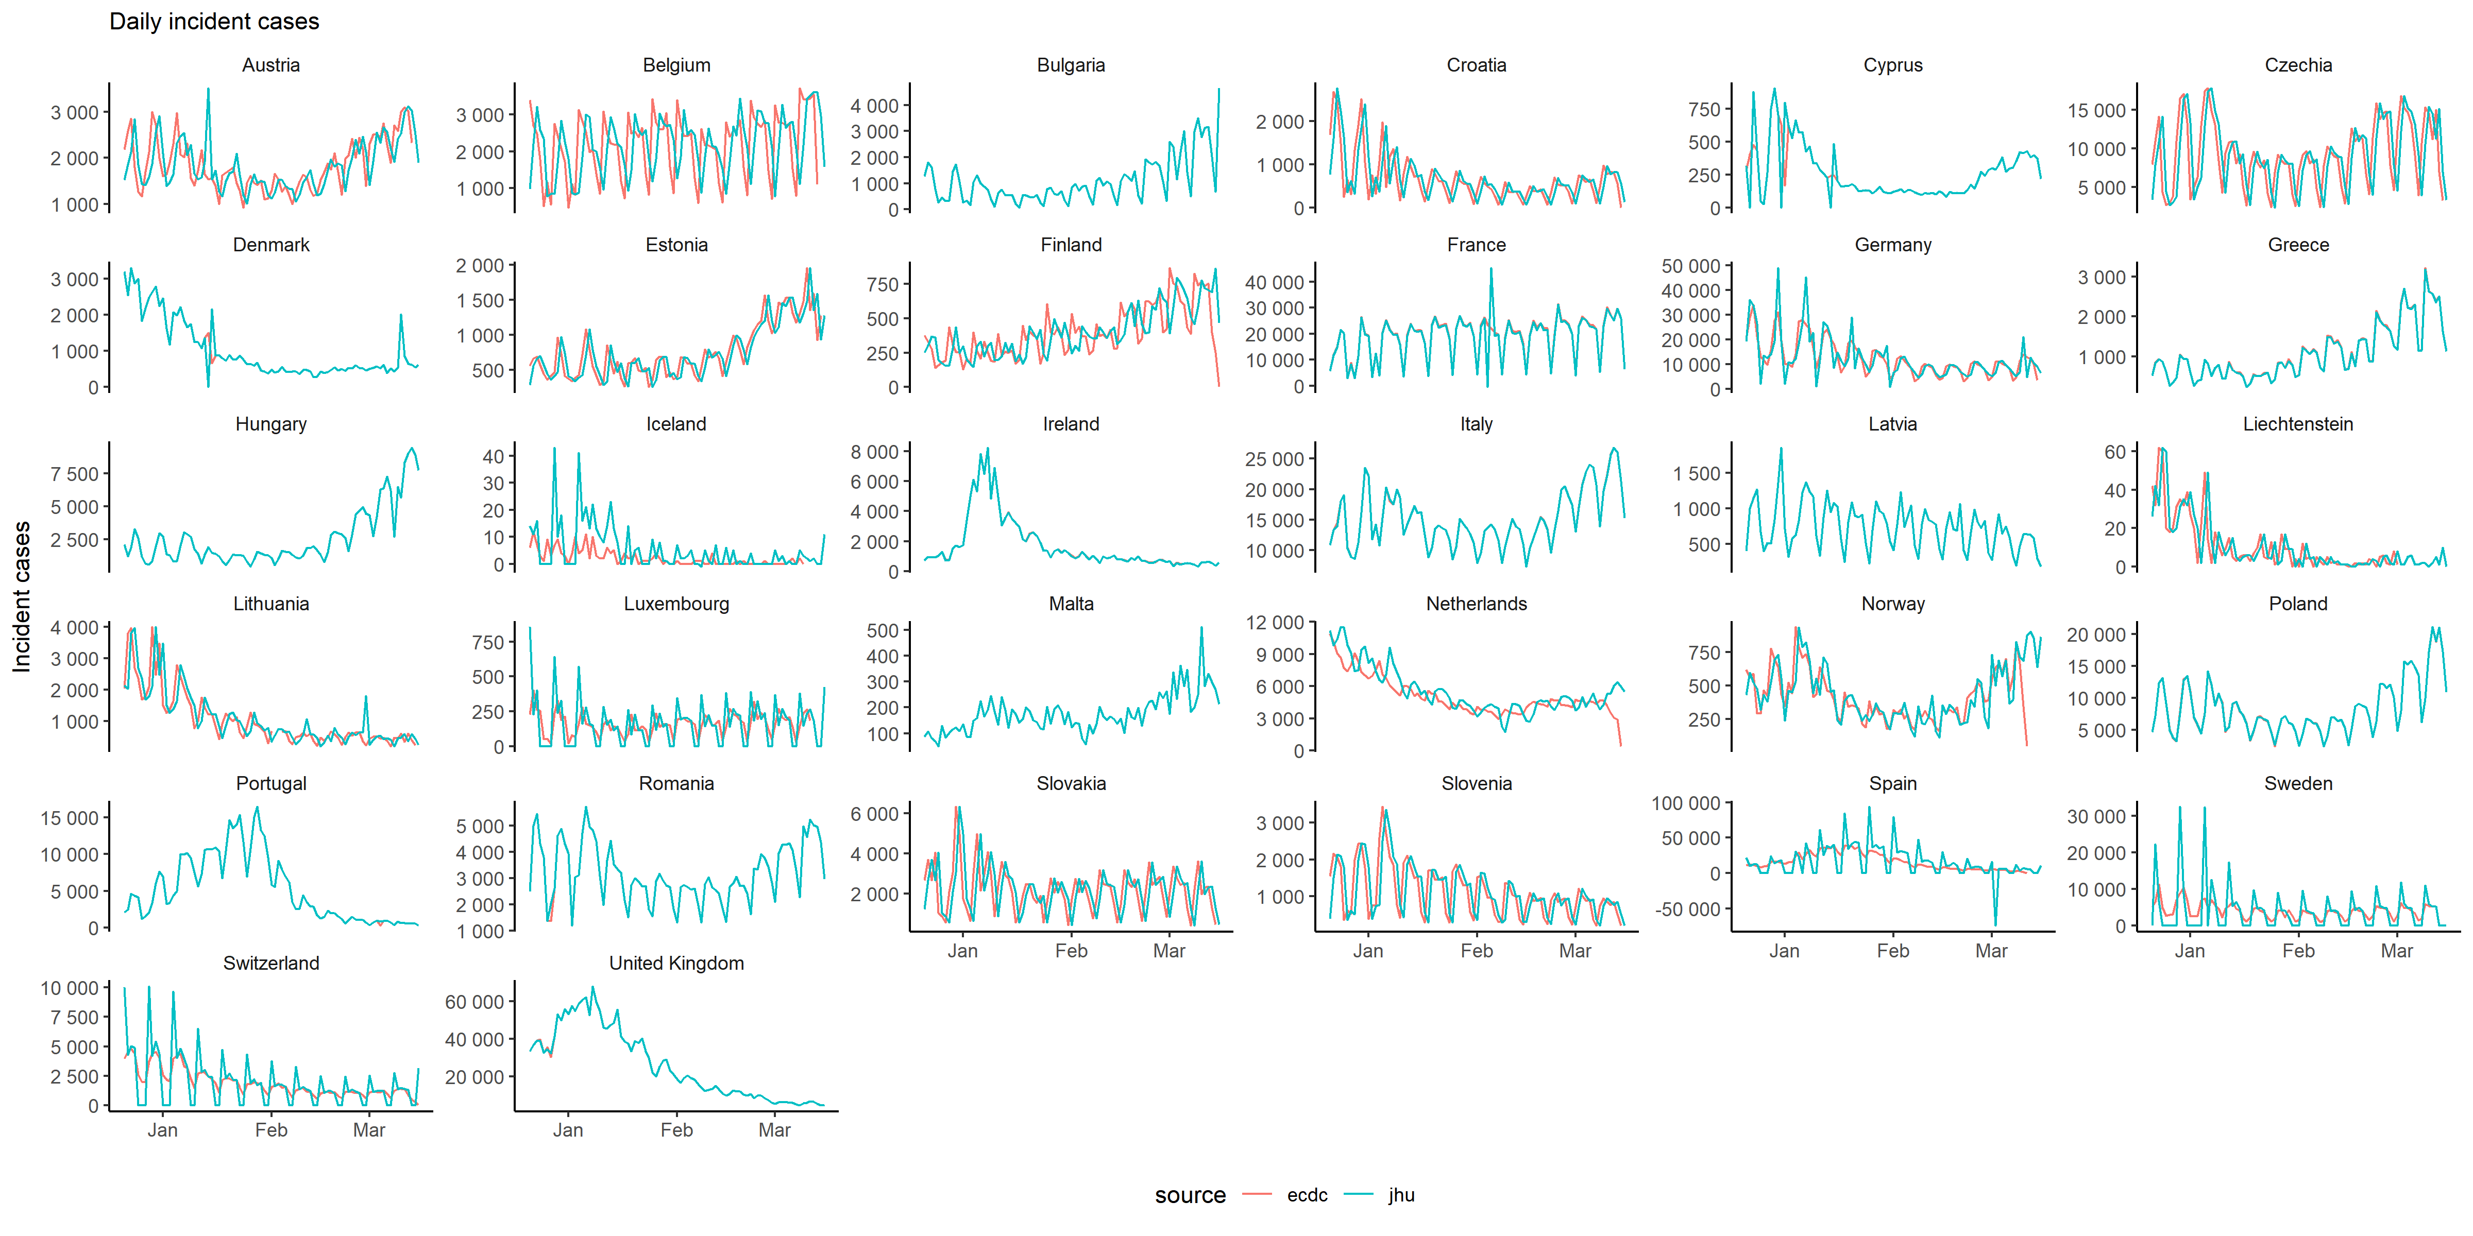

Slide 4
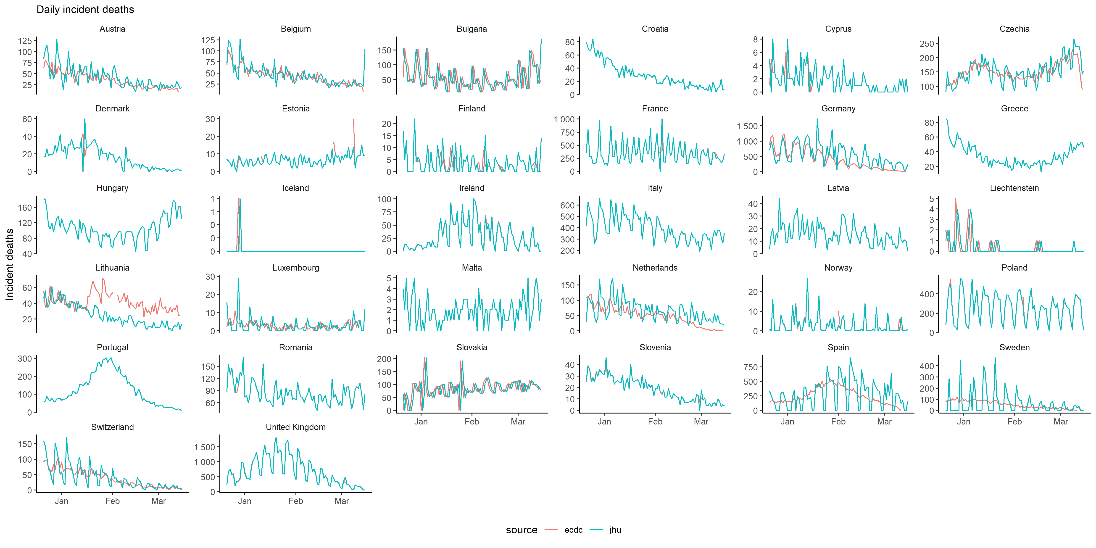

Slide 5
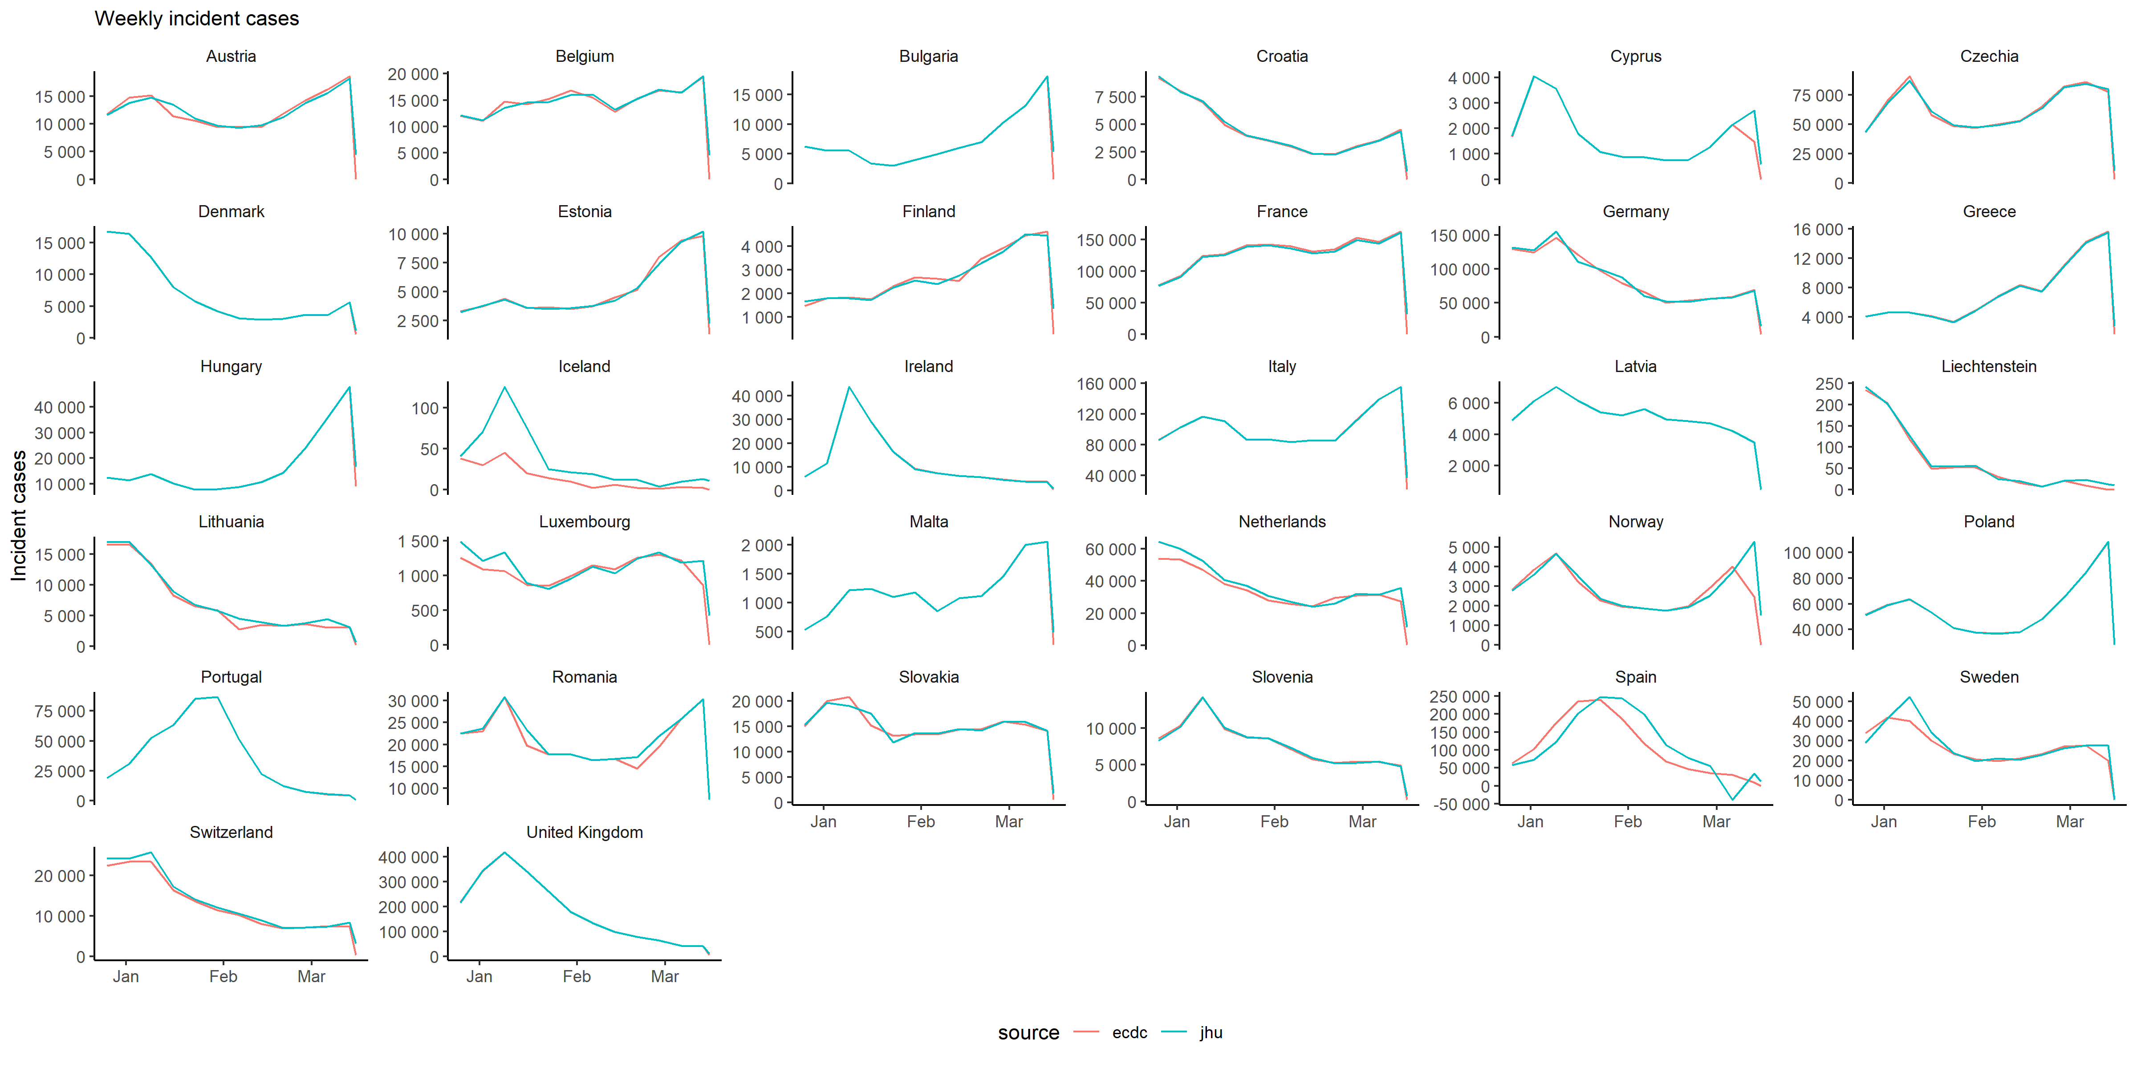

Slide 6
