Slide 1
Comparing European data sources:
Cases & deaths;
Hospitalisations & ICU

Slide 2
European data sources: cases and deaths
6 sources compared for Covid-19 cases and deaths
Provider | Referenced as | Data available at | Data sources from
European Commission Joint Research Centre | JRC | https://github.com/ec-jrc/COVID-19 | https://covid-statistics.jrc.ec.europa.eu/QlikDashboard?sheet=multidim
World Health Organisation | WHO | https://covid19.who.int/info/ | https://worldhealthorg.shinyapps.io/euro-covid19/
Johns Hopkins University | JHU | https://github.com/CSSEGISandData/COVID-19 | https://github.com/CSSEGISandData/COVID-19#covid-19-data-repository-by-the-center-for-systems-science-and-engineering-csse-at-johns-hopkins-university
European Centre for Disease Control | ECDC – public | https://www.ecdc.europa.eu/en/publications-data/data-daily-new-cases-covid-19-eueea-country | https://www.ecdc.europa.eu/en/publications-data/sources-eueea-regional-data-covid-19 https://www.ecdc.europa.eu/en/covid-19/data-collection
Our World in Data | OWID | https://github.com/owid/covid-19-data/tree/master/public/data/ | https://ourworldindata.org/coronavirus-source-data

Slide 3
Cases and deaths: reporting process
Public official statistics
JRC
Self report under International Health Regulations
The European Surveillance System (TESSy)
WHO
ECDC
Early Warning and Response System (EWRS)
JHU
Our World in Data

Slide 4
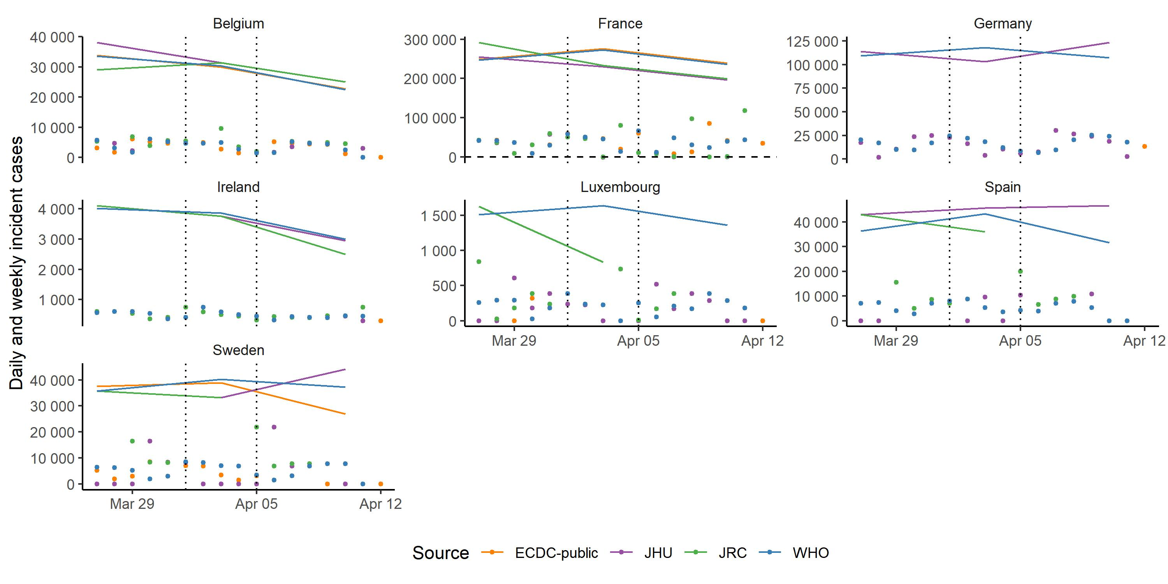
JHU differs from WHO in some countries: cases
Daily and weekly incidence cases
Countries where JHU has named an alternative public country data source

Slide 5
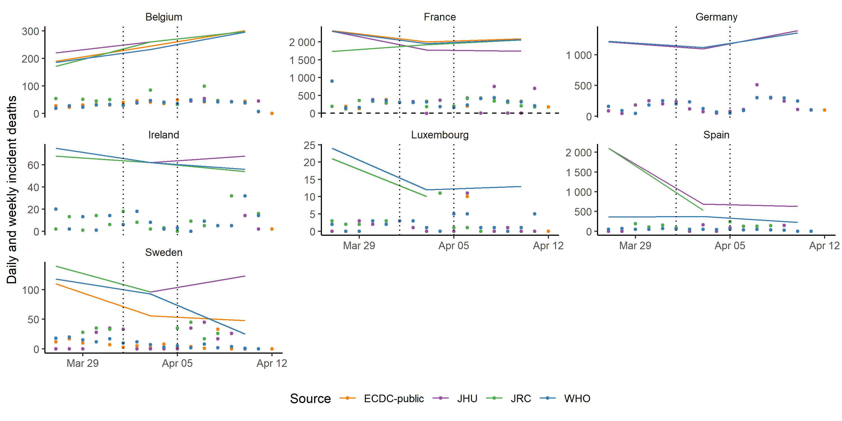
JHU differs from WHO in some countries: deaths
Daily and weekly incidence deaths
Countries where JHU has named an alternative public country data source

Slide 6
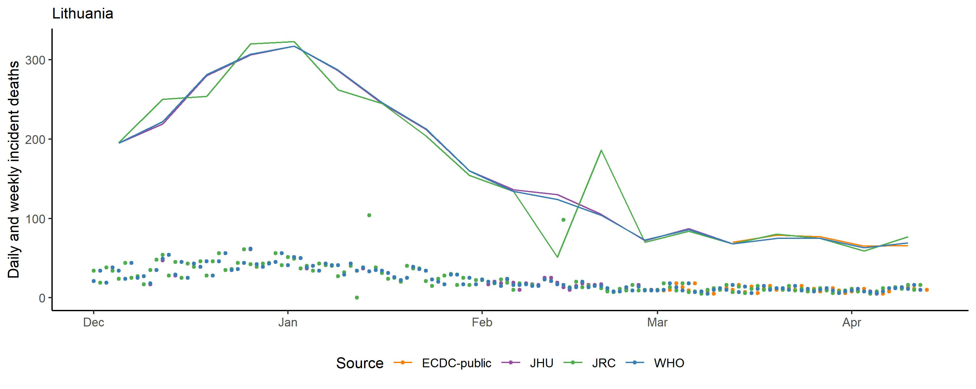
Example: Lithuania, incident deaths, Dec - Mar
1 December 2020 – 15 March 2021
See all data, 1-15-March
Weekly data
ECDC, WHO, JHU match;
JRC leads by 1 day
ECDC spikes - perhaps using old data source
JHU switches to country source
JRC has zero & NA dates;
adds to next day
Daily data
ECDC start publishing public daily data

Slide 7
Cases and deaths: summary
 | Source | Missingness | Revisions | Negative values | Overall
JRC | Public country data | Missing: 8% deaths 7% cases Added next day: large outliers | Claim to update with revisions Data suggests this doesn’t always happen | Negative values: 0.4% deaths 0.3% cases | + Timely (leads WHO by 1 day) - Large anomalies, missing + negative values
WHO | JRC ECDC Country self-report (IHR) Public country data | No missing values Missing set to zero | Updates with revisions | Negative values: 0.03% deaths 0.03% cases | + Smoother version of JRC data (more consistent revision) + Fewer negative values
JHU | WHO Public country data | No missing values Missing set to zero | Updates with revisions from source data | Negative values: 0.4% deaths 0.2% cases | - Negative values + Public
ECDC – public | ? No data for Switzerland, UK | Missing: 3% deaths 3% cases | ? | Negative values: 0.1% deaths 0.1% cases | - Some missingness - Appears lagged on WHO/JHU data

Slide 8
Country detail:
Cases & deaths

Slide 9
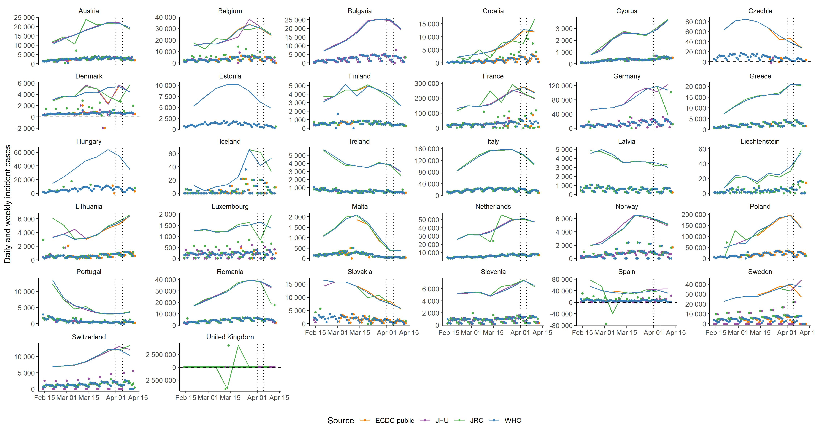
Cases by source, 15 Feb – now

Slide 10
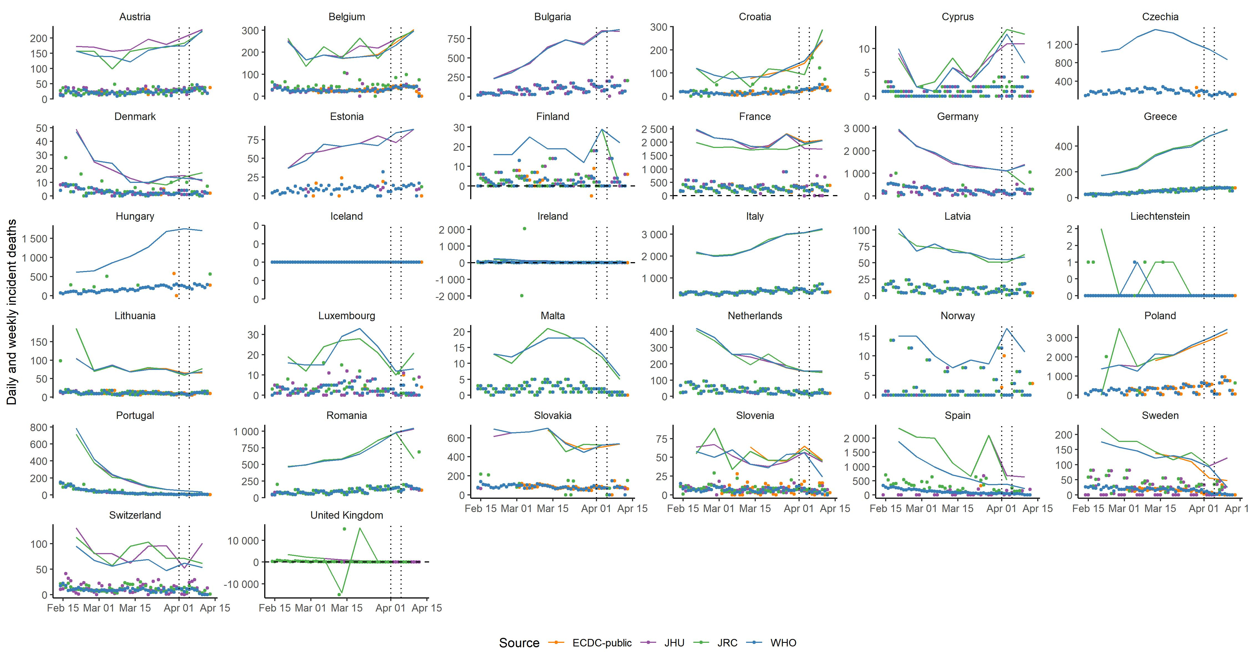
Deaths by source, 15 Feb - now

Slide 11
JHU: country public sources
Country | Source
Belgium | https://datastudio.google.com/embed/reporting/c14a5cfc-cab7-4812-848c-0369173148ab/page/giyUB
Czechia | https://onemocneni-aktualne.mzcr.cz/covid-19
France | https://dashboard.covid19.data.gouv.fr/ https://www.data.gouv.fr/en/datasets/donnees-relatives-a-lepidemie-de-covid-19-en-france-vue-densemble/ https://github.com/opencovid19-fr
Germany | https://interaktiv.morgenpost.de/corona-virus-karte-infektionen-deutschland-weltweit/
Iceland | https://www.covid.is/data
Ireland | https://covid19ireland-geohive.hub.arcgis.com/
Italy | http://www.salute.gov.it/nuovocoronavirus https://github.com/pcm-dpc/COVID-19/tree/master/dati-regioni
Kosovo | https://corona-ks.info/?lang=en and https://raw.githubusercontent.com/bgeVam/Kosovo-Coronatracker-Data/master/data.json
Lithuania | https://osp.maps.arcgis.com/apps/MapSeries/index.html?appid=c6bc9659a00449239eb3bde062d23caa
Luxembourg | https://data.public.lu/fr/datasets/covid-19-rapports-journaliers/#_
Netherlands | https://experience.arcgis.com/experience/ea064047519040469acb8da05c0f100d
Serbia | https://covid19.rs/homepage-english/
Slovakia | https://korona.gov.sk/
Spain | https://www.rtve.es/noticias/20200514/mapa-del-coronavirus-espana/2004681.shtml
Sweden | https://experience.arcgis.com/experience/09f821667ce64bf7be6f9f87457ed9aa
Turkey | https://covid19.saglik.gov.tr/EN-69532/general-coronavirus-table.html
UK | https://coronavirus.data.gov.uk/#category=nations&map=rate

