Slide 1
European forecast hub: 22 June 2021
Sweden data issue
No published data since 15 June
Reporting from 17 June: data published “in the next few days”
Forecasts removed from evaluation until data updated
Forecast values now integers
Updating all previous forecasts to integers over the next week
Healthcare: potential new forecast target
Looking for comprehensive source for healthcare data (32 countries)

Slide 2
European hospitalisation data

Slide 3
Forecasting healthcare data
Public data sources
European Centre for Disease Control (ECDC)
Aggregates national datasets
Adds TESSy – EU reporting system
Published weekly with lag
Our World in Data (OWID)
ECDC data + United Kingdom
Joint Research Centre (JRC), European Commission
Aggregates national datasets
Published daily
Healthcare data
Healthcare settings
General hospital patients
Intensive care unit (ICU) patients
Admissions
New patients admitted
Only published by ECDC
Occupancy
Total occupied beds
Published by ECDC and JRC

Slide 4
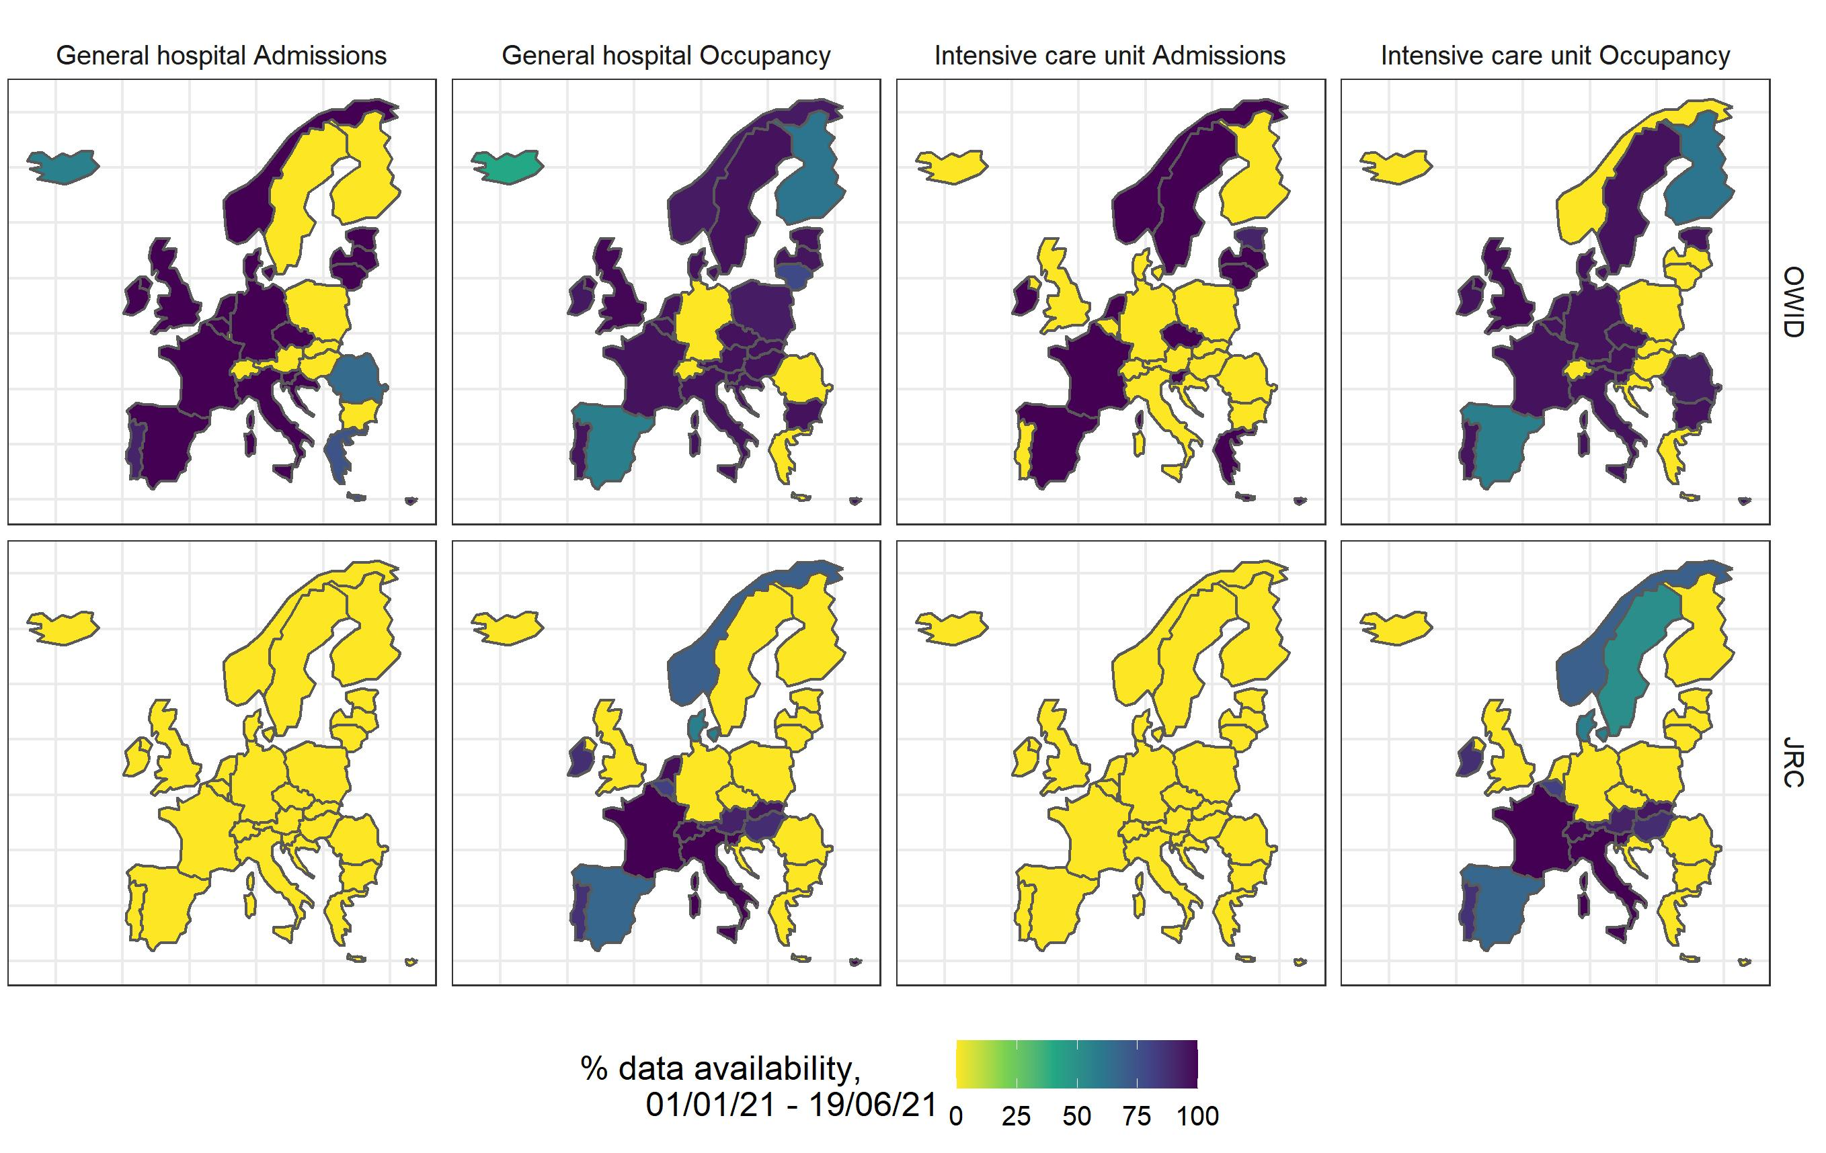
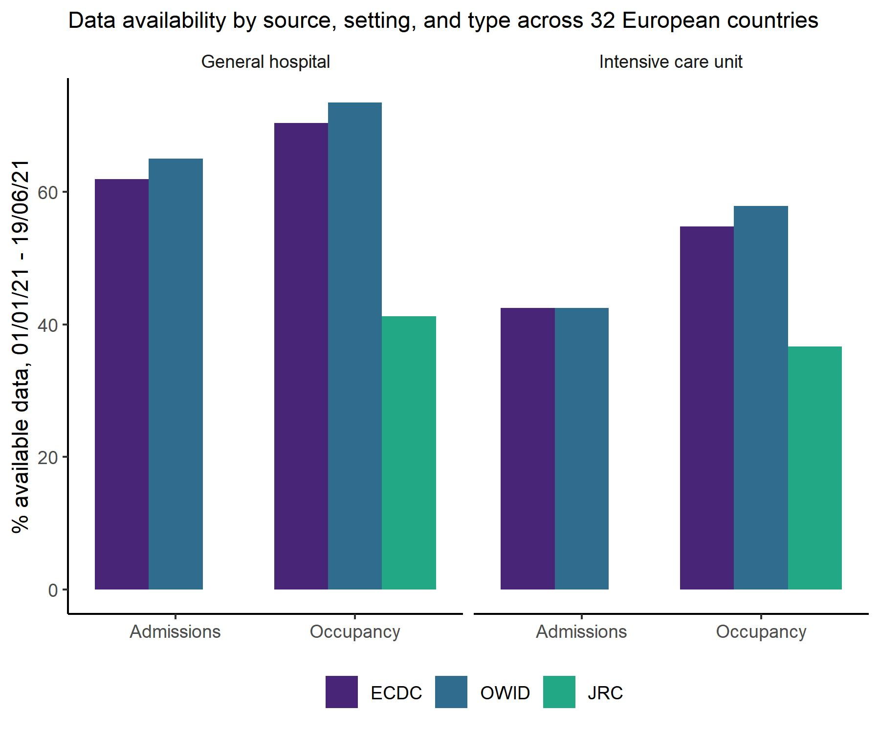
Data availability over 2021
All sources have some missing data by location and date
One hub location not covered at all (Liechtenstein)
Several rarely covered (Iceland, Finland, Switzerland)

Slide 5
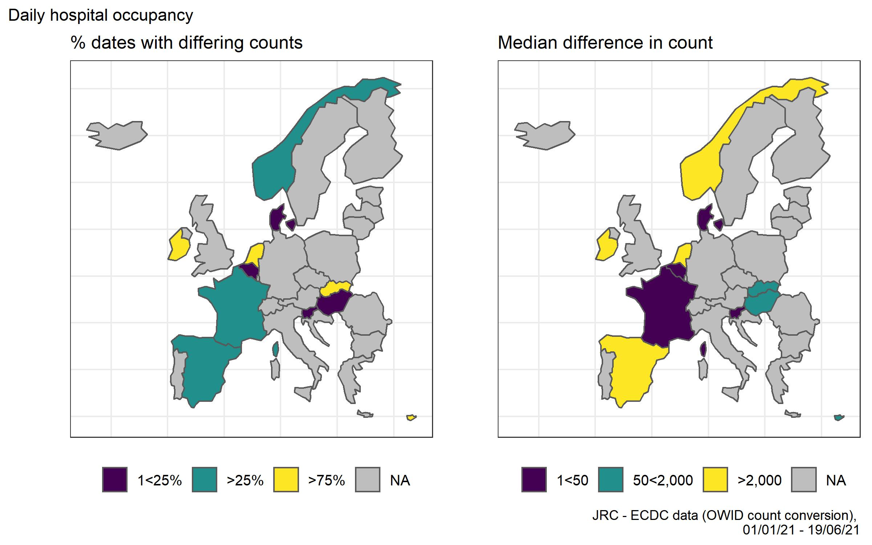
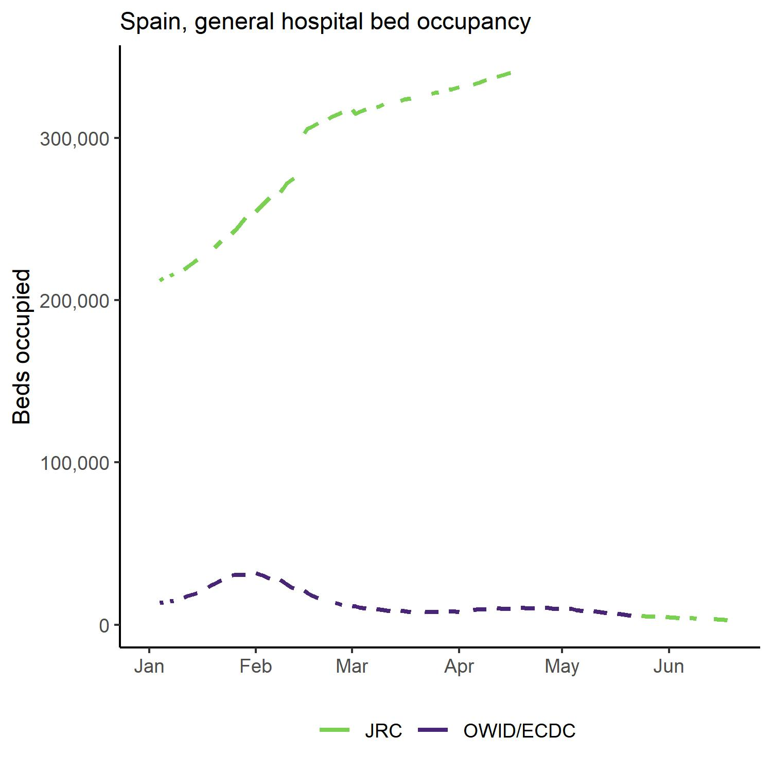
JRC v ECDC data differences
Counts of occupancy data (hospital and ICU) can vary
JRC and ECDC reported different data for the same date in 12 locations in 2021
JRC less likely to be updated after missing data or data reporting effects

Slide 6
Hub decisions:
Adapting for healthcare targets

Slide 7
Data types
All other hub targets are weekly sums of daily counts of incidence
Healthcare data do not fit this pattern:
New admissions
Raw data (ECDC):
Incidence rate per 100,000
OWID convert to count
Options:
Forecast the rate
Use OWID conversion
Beds occupied
Raw data:
Count of prevalence
Options:
Forecast weekly mean occupancy
Forecast end of week occupancy

Slide 8
Forecasting vs. data publication timeline
ECDC/OWID
Data: occupancy & admissions
Collected: Monday – Sunday
Published: following Thursday
JRC
Data: occupancy only
Collected: daily
Published: following day
Implications for forecasting
Most recent 4-10 days: missing in ECDC/OWID data, present in JRC data
ECDC/OWID data = forecasting from 2 weeks ahead from last data publication
Admissions: week definitions Monday-Sunday, with Sunday target end date

Slide 9
Summary
JRC
Need a weekly summary measure for occupancy
Data are daily, so weeks would match current hub definition (Sun-Sat)
Higher % missing across locations
No admissions data
ECDC/OWID
More complete across locations/dates; OWID adds UK
Occupancy data continuously lags JRC data by 4-10 days
Forecasting 2 weeks ahead from data to match the hub 1 week ahead target end date
Weeks defined Mon-Sun; target end date (week end) = Sunday
Daily
JRC
ECDC/OWID
Admissions
Occupancy
ECDC/OWID
summary measure
Weekly

Slide 10
New forecast target
 | Recommendation | Rationale
Truth data | OWID | Converts ECDC data to count Includes UK data
Target setting | General hospital | Most reliable data availability
Target count | Admissions | Avoids lag between occupancy data sources Matches other hub targets for incidence
Issues
Horizon: should 6 days after forecast date be 2 week ahead horizon?
Target end date validation: change to Sundays

Slide 11
Extra detail:
Missing data

Slide 12
ECDC / OWID data coverage across 32 hub locations
 | Locations covered
Hospital occupancy | 26
ICU occupancy | 20
Hospital admissions | 22
ICU admissions | 14

Slide 13
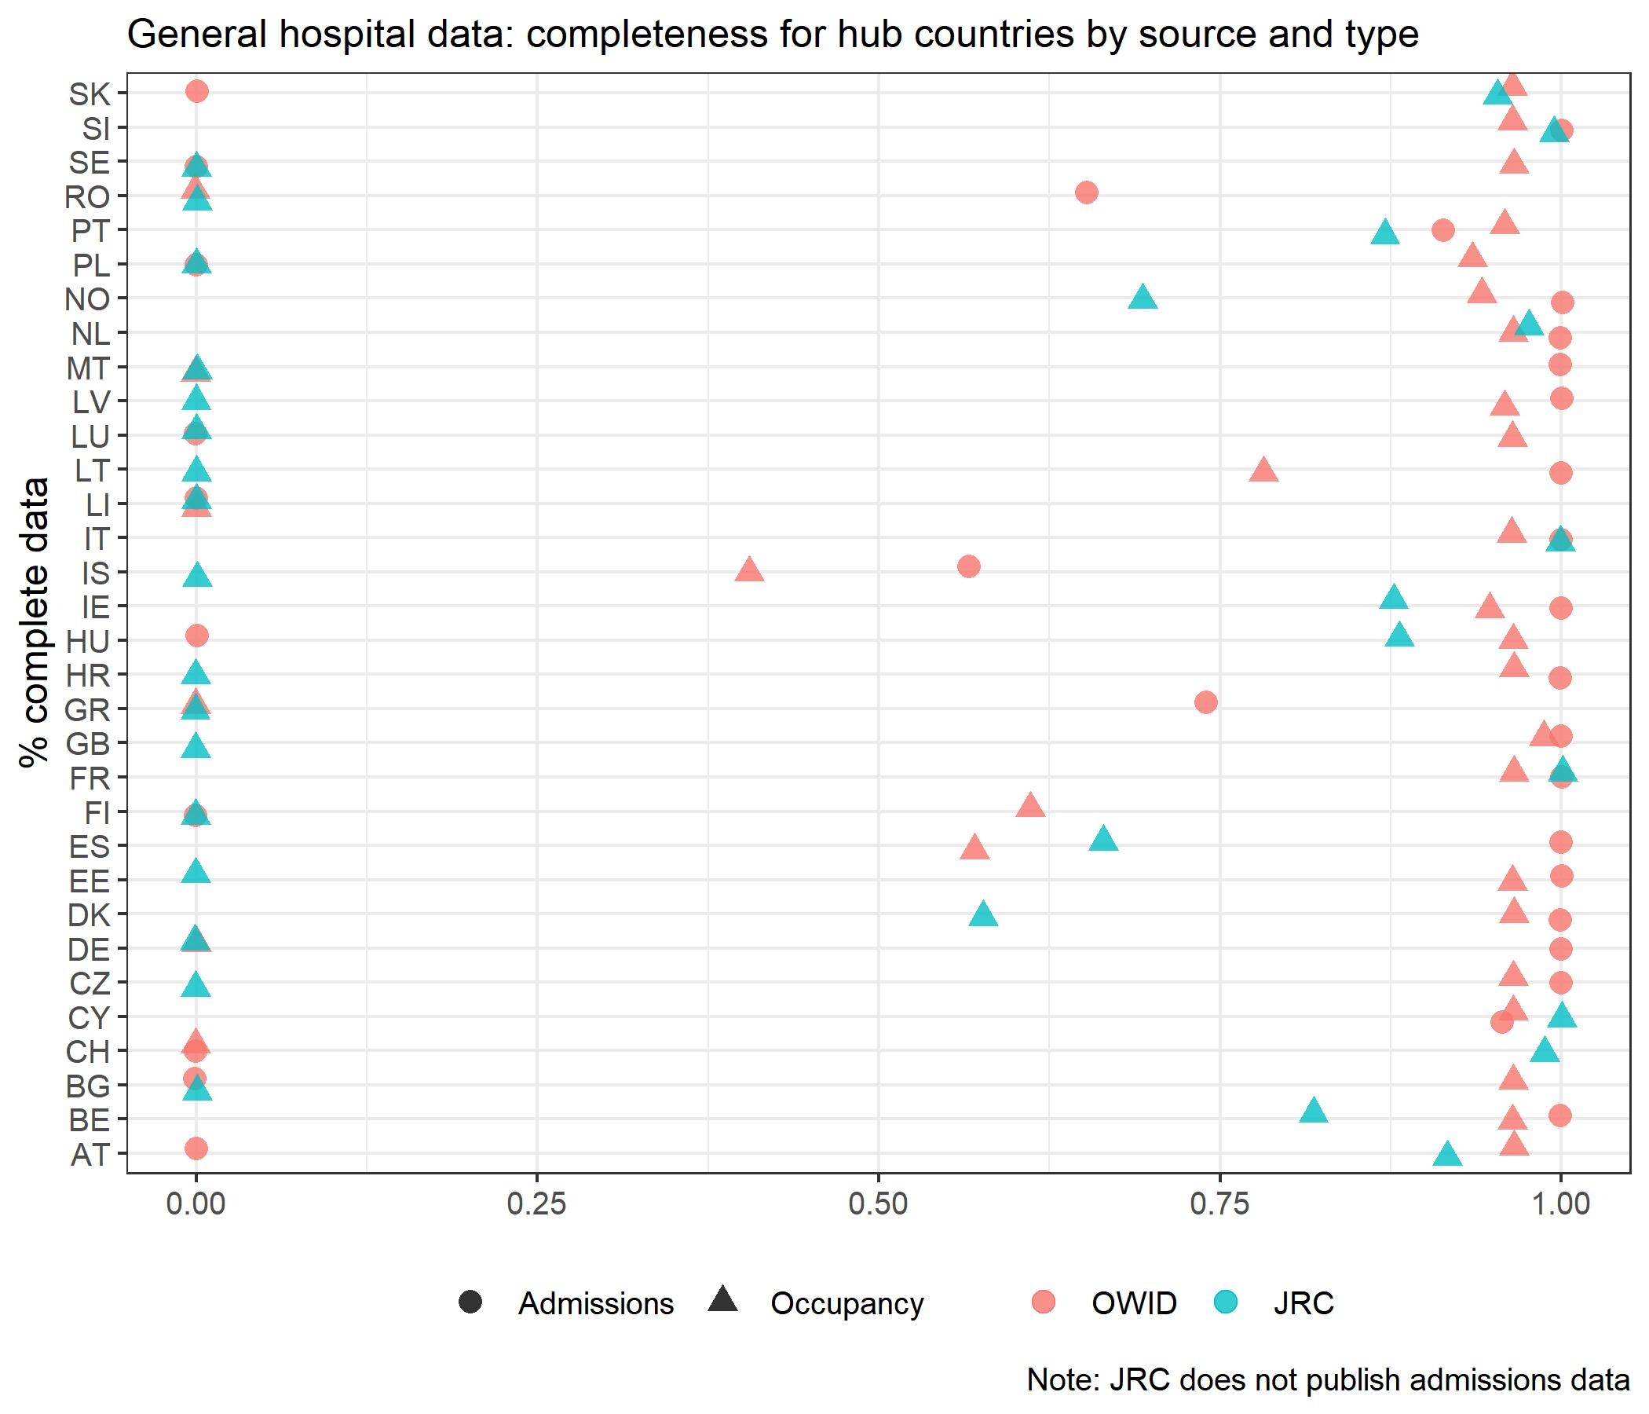
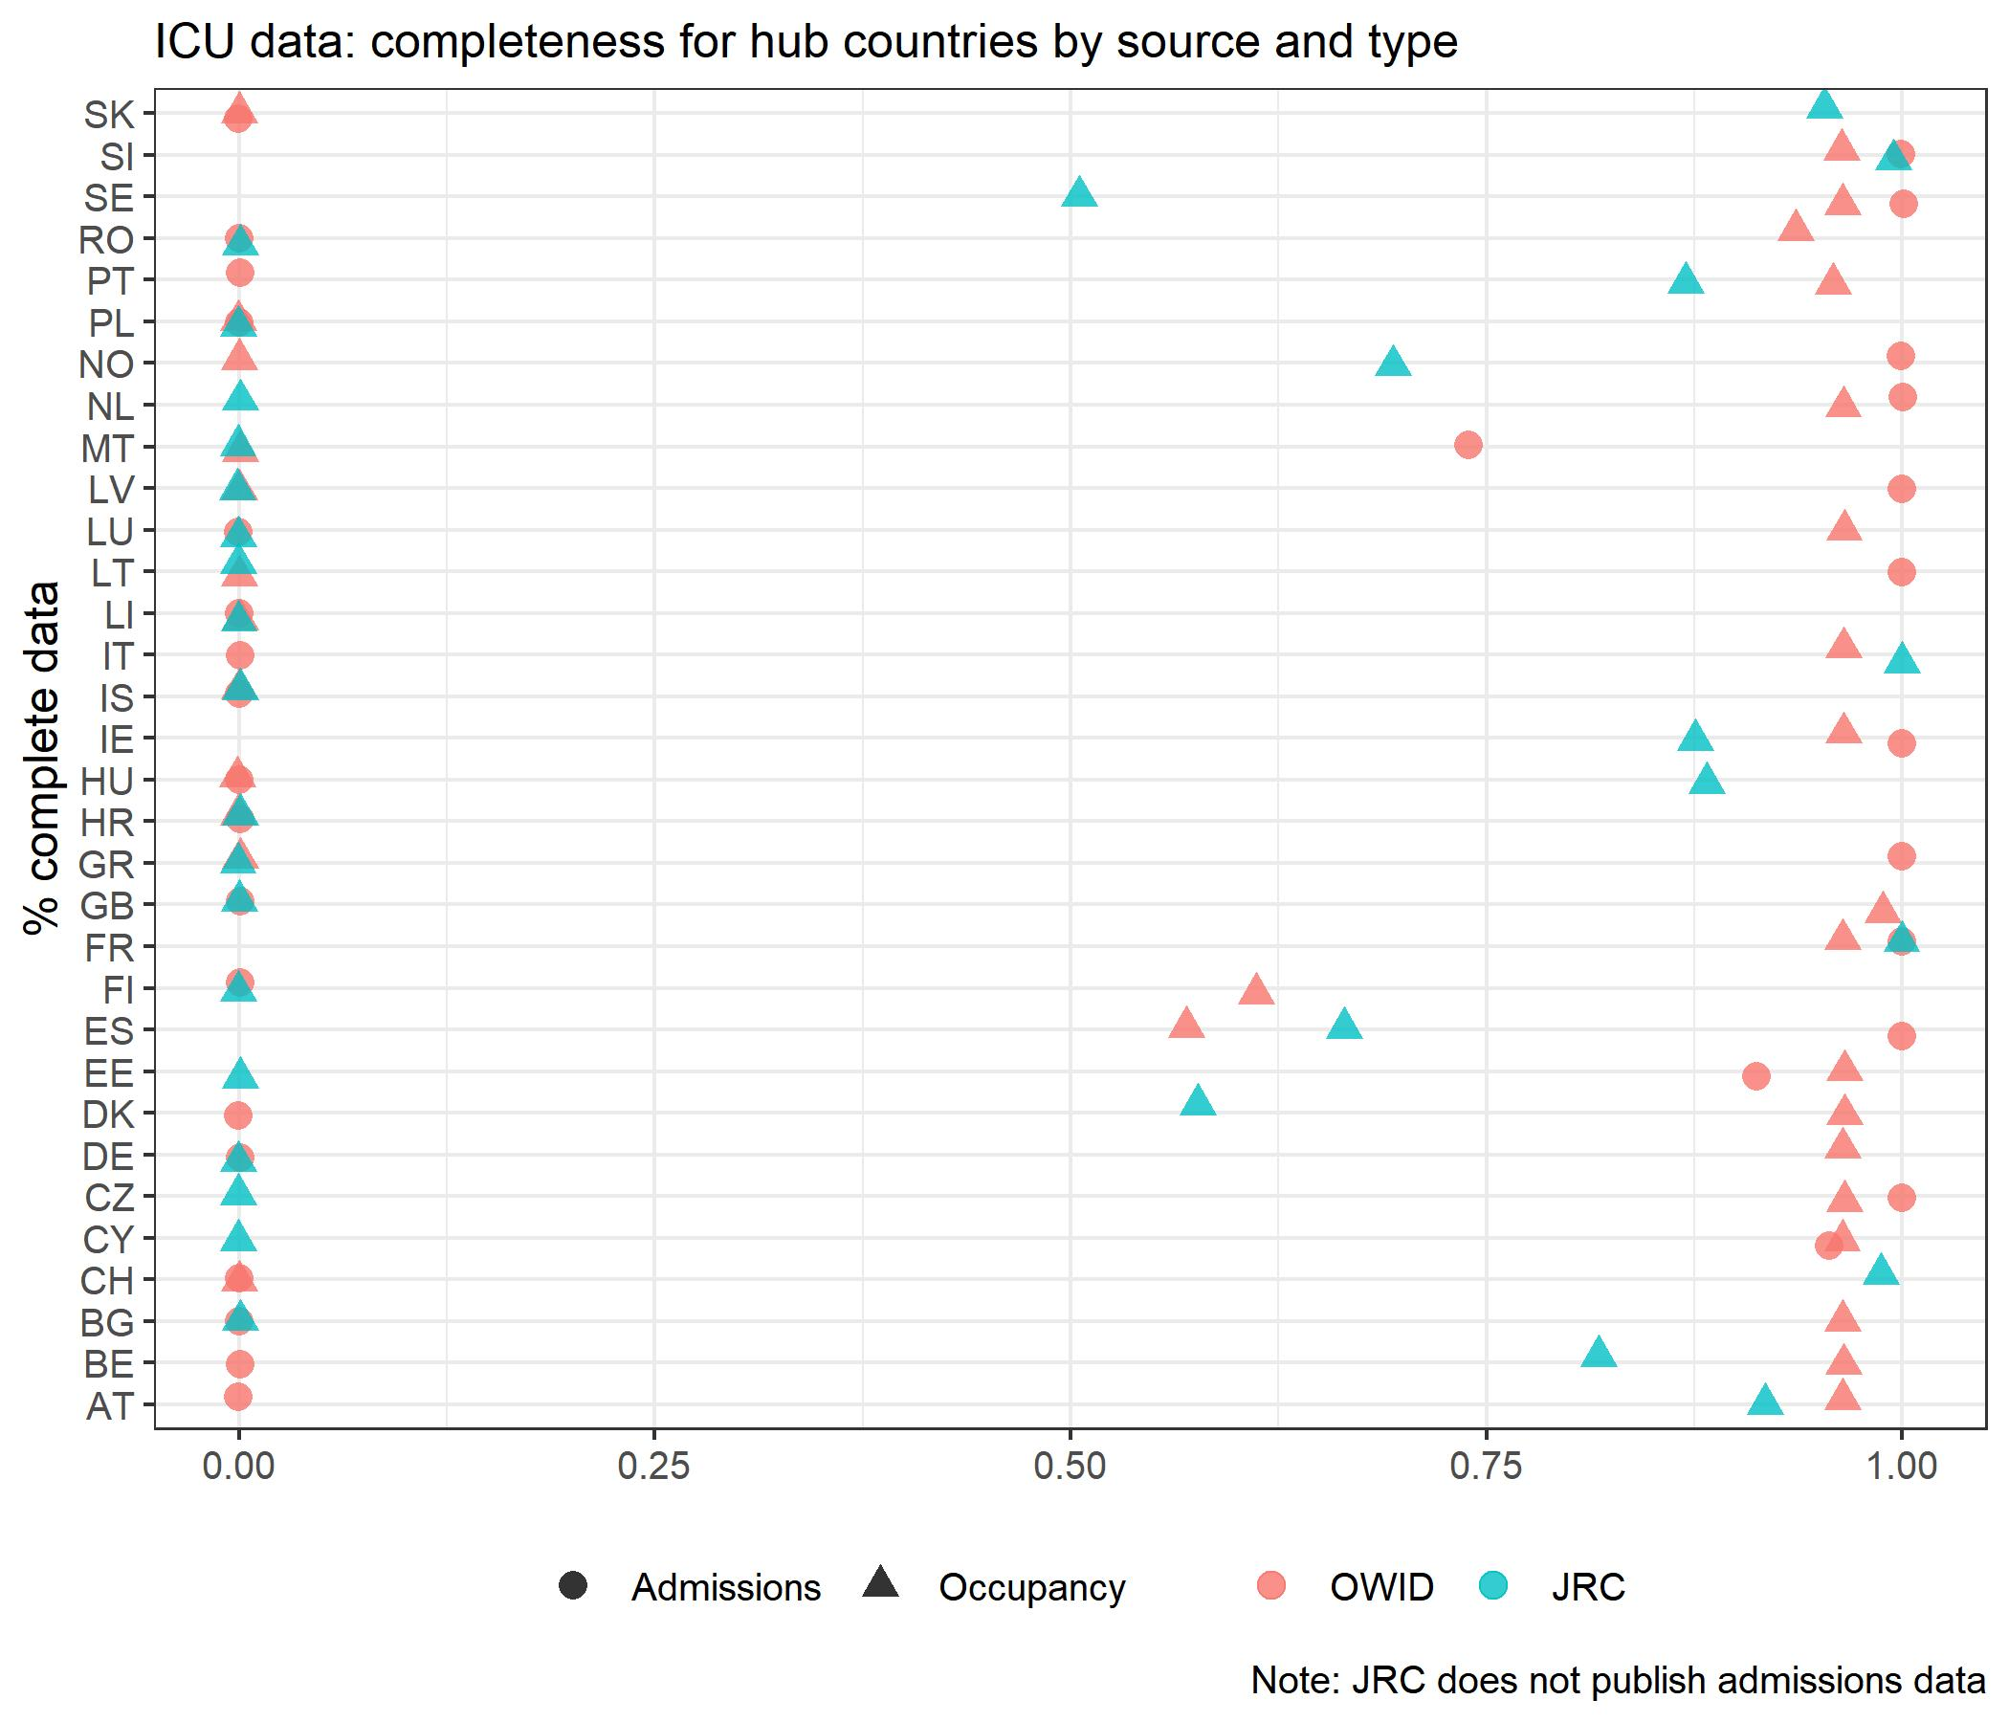
Missing data lookup by location

