Slide 1
Comparing European data sources:
Cases & deaths;
Hospitalisations & ICU

Slide 2
European data sources: cases and deaths
6 sources compared for Covid-19 cases and deaths
Provider | Referenced as | Data available at | Data sources from
European Commission Joint Research Centre | JRC | https://github.com/ec-jrc/COVID-19 | https://covid-statistics.jrc.ec.europa.eu/QlikDashboard?sheet=multidim
World Health Organisation | WHO | https://covid19.who.int/info/ | https://worldhealthorg.shinyapps.io/euro-covid19/
Johns Hopkins University | JHU | https://github.com/CSSEGISandData/COVID-19 | https://github.com/CSSEGISandData/COVID-19#covid-19-data-repository-by-the-center-for-systems-science-and-engineering-csse-at-johns-hopkins-university
European Centre for Disease Control | ECDC – public | https://www.ecdc.europa.eu/en/publications-data/data-daily-new-cases-covid-19-eueea-country | https://www.ecdc.europa.eu/en/publications-data/sources-eueea-regional-data-covid-19 https://www.ecdc.europa.eu/en/covid-19/data-collection
ECDC – data shared privately | ECDC – private | N/A | Unknown
Our World in Data | OWID | https://github.com/owid/covid-19-data/tree/master/public/data/ | https://ourworldindata.org/coronavirus-source-data

Slide 3
European data sources: healthcare
4 sources compared for Covid-19 hospitalisations and ICU
Provider | Referenced as | Data available at | Data sources from
European Commission Joint Research Centre | JRC | https://github.com/ec-jrc/COVID-19 | https://covid-statistics.jrc.ec.europa.eu/QlikDashboard?sheet=multidim
European Centre for Disease Control | ECDC – public | https://www.ecdc.europa.eu/en/publications-data/download-data-hospital-and-icu-admission-rates-and-current-occupancy-covid-19 | https://www.ecdc.europa.eu/sites/default/files/documents/2021-01-13_Variable_Dictionary_and_Disclaimer_hosp_icu_all_data.pdf
ECDC – data shared privately | ECDC – private | N/A | Unknown
Our World in Data | OWID | https://github.com/owid/covid-19-data/tree/master/public/data/ | https://ourworldindata.org/coronavirus-source-data

Slide 4
Cases and deaths: reporting process
Public official statistics
The European Surveillance System (TESSy)
Early Warning and Response System (EWRS)
Self report under International Health Regulations
JRC
ECDC
Public/private
WHO
JHU
Our World in Data

Slide 5
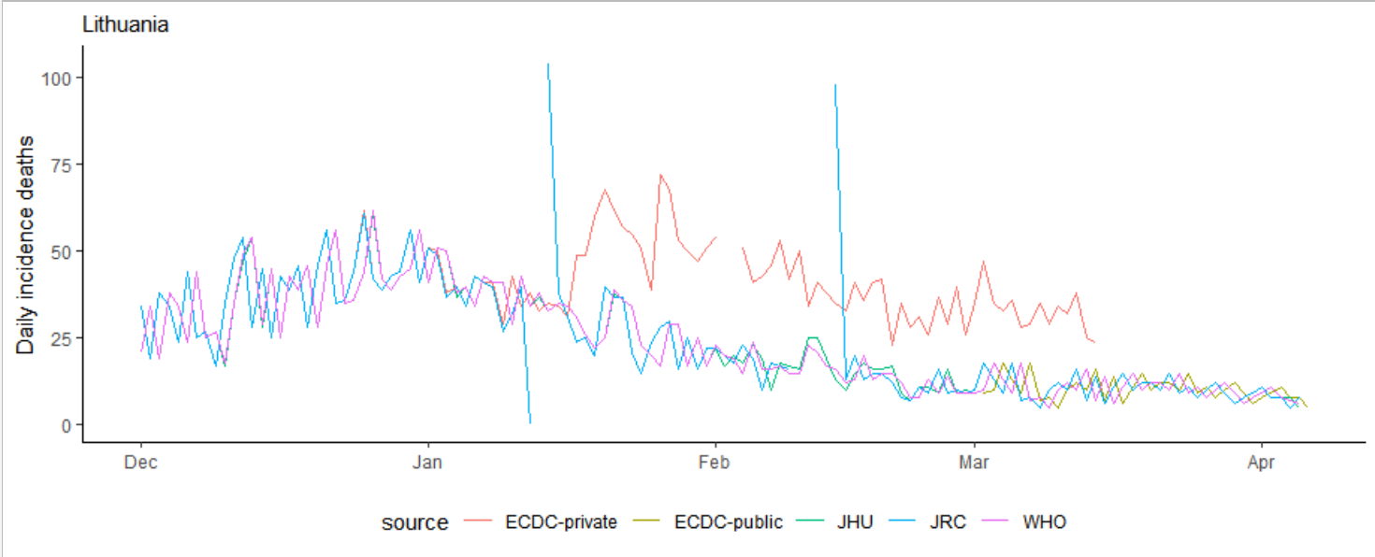
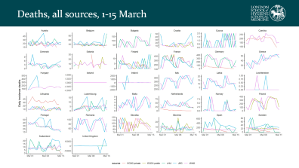
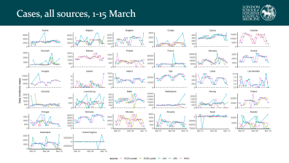
Example: Lithuania, incident deaths
See all data, 1-15-March
JRC has zero & NA dates;
Adds to next day
ECDC spikes - perhaps using old data source
ECDC, WHO, JHU match;
JRC leads by 1 day
JHU switches to official source; diverges from WHO
ECDC start publishing public daily data

Slide 6
Cases and deaths: summary
 | Source | Missingness | Revisions | Negative values | Overall
JRC | Public country data | Missing: 2% deaths 0.3% cases Added next day: large outliers | Claim to update with revisions Data suggests this doesn’t always happen | Negative values: 0.4% deaths 0.3% cases | + Timely (leads WHO by 1 day) - Large anomalies, missing + negative values
WHO | JRC ECDC Country self-report (IHR) Public country data | No missing values Missing set to zero | Updates with revisions | Negative values: 0.03% deaths 0.03% cases | + Smoother version of JRC data (more consistent revision) + Fewer negative values
JHU | WHO Public country data | No missing values Missing set to zero | Updates with revisions from source data | Negative values: 0.4% deaths 0.2% cases | - Negative values + Public
ECDC – private | TESSy Public country data JRC | Missing: 10% deaths 9% cases | ? | Negative values: 0.01% deaths 0.01% cases | + Better data quality (few negatives) - Extensive missingness
ECDC – public | ? No data for Switzerland, UK | Missing: 3% deaths 3% cases | ? | Negative values: 0.1% deaths 0.1% cases | - Some missingness - Appears lagged on WHO/JHU data

Slide 7
Hospitalisation & ICU: reporting process
Public official statistics
The European Surveillance System (TESSy)
JRC
ECDC
Prevalence
Incidence
ECDC - public
ECDC - private
Prevalence
Incidence
Our World in Data

Slide 8
Hospitalisation & ICU: summary
JRC
Prevalence only
Covers nearly all locations but not on all dates
Only covers around half of all date/location combinations
One location missing altogether: Czechia
Hospital & ICU prevalence far higher than ECDC data
ECDC – private
Incidence and prevalence
Covers all locations but not on all dates
ECDC – public
Prevalence only
Hospital prevalence identical to private ECDC data
Covers nearly all locations but not on all dates
Five locations missing altogether:
Greece, Malta, United Kingdom, Liechtenstein, Switzerland

Slide 9
Summary – best picks
Cases and deaths:
JHU
More stable than JRC; more consistent (not missing) than ECDC
Little difference compared to WHO
Pro: JHU issues are public and maintainers are responsive
Con: WHO may have better correction for negative data
Hospitalisation and ICU:
ECDC public data
Best coverage for hospital occupancy
Coverage more consistent across the timeseries than JRC
No good option for ICU or European healthcare data in general

Slide 10
Country detail

Slide 11
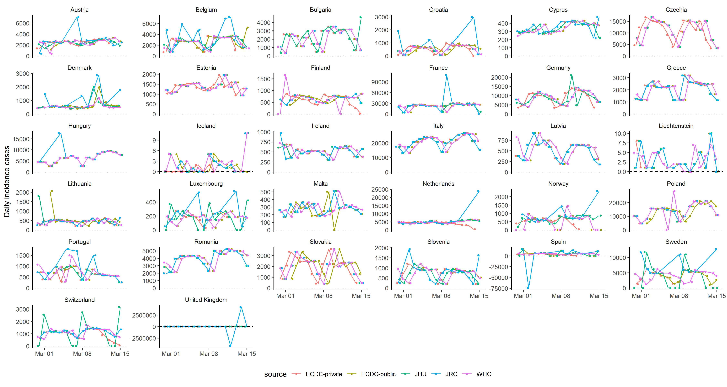
Cases, all sources, 1-15 March

Slide 12
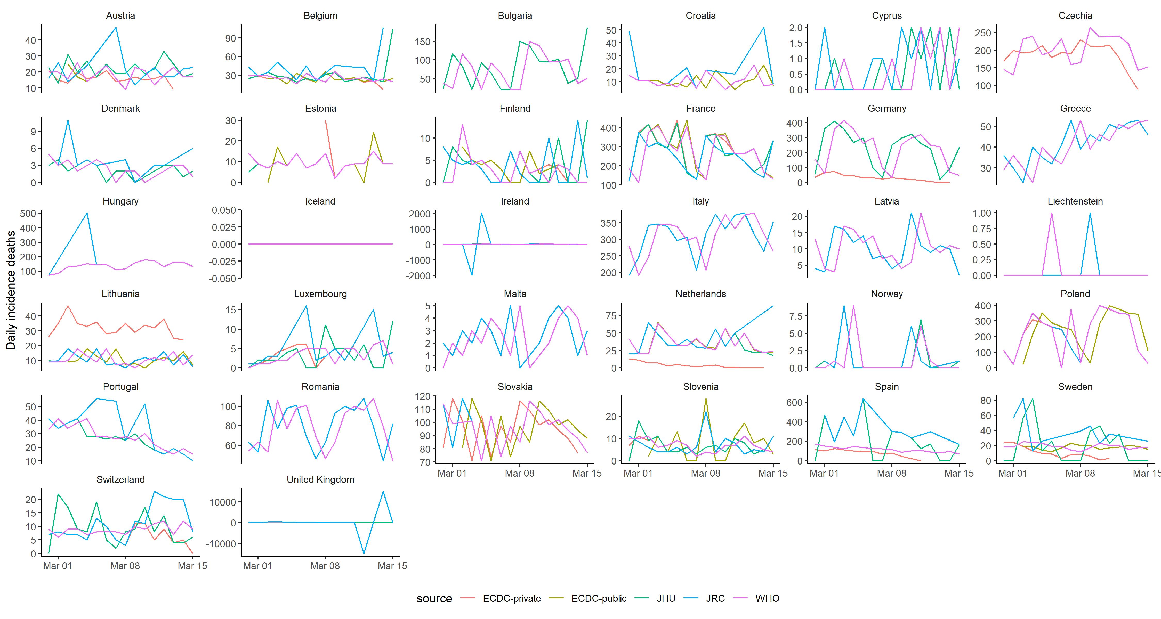
Deaths, all sources, 1-15 March

Slide 13
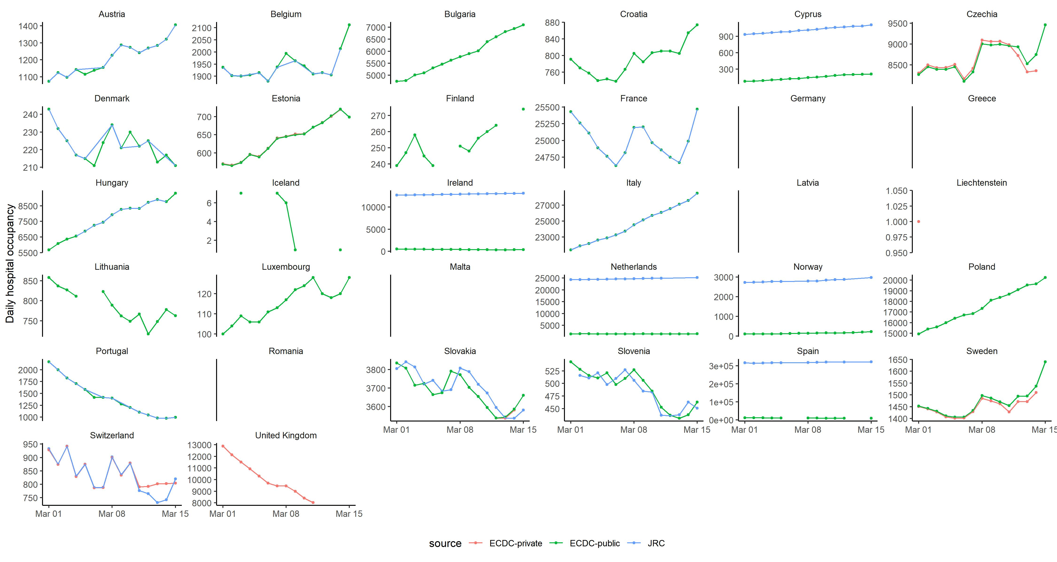
Hospital occupancy, all sources, 1-15 March

Slide 14
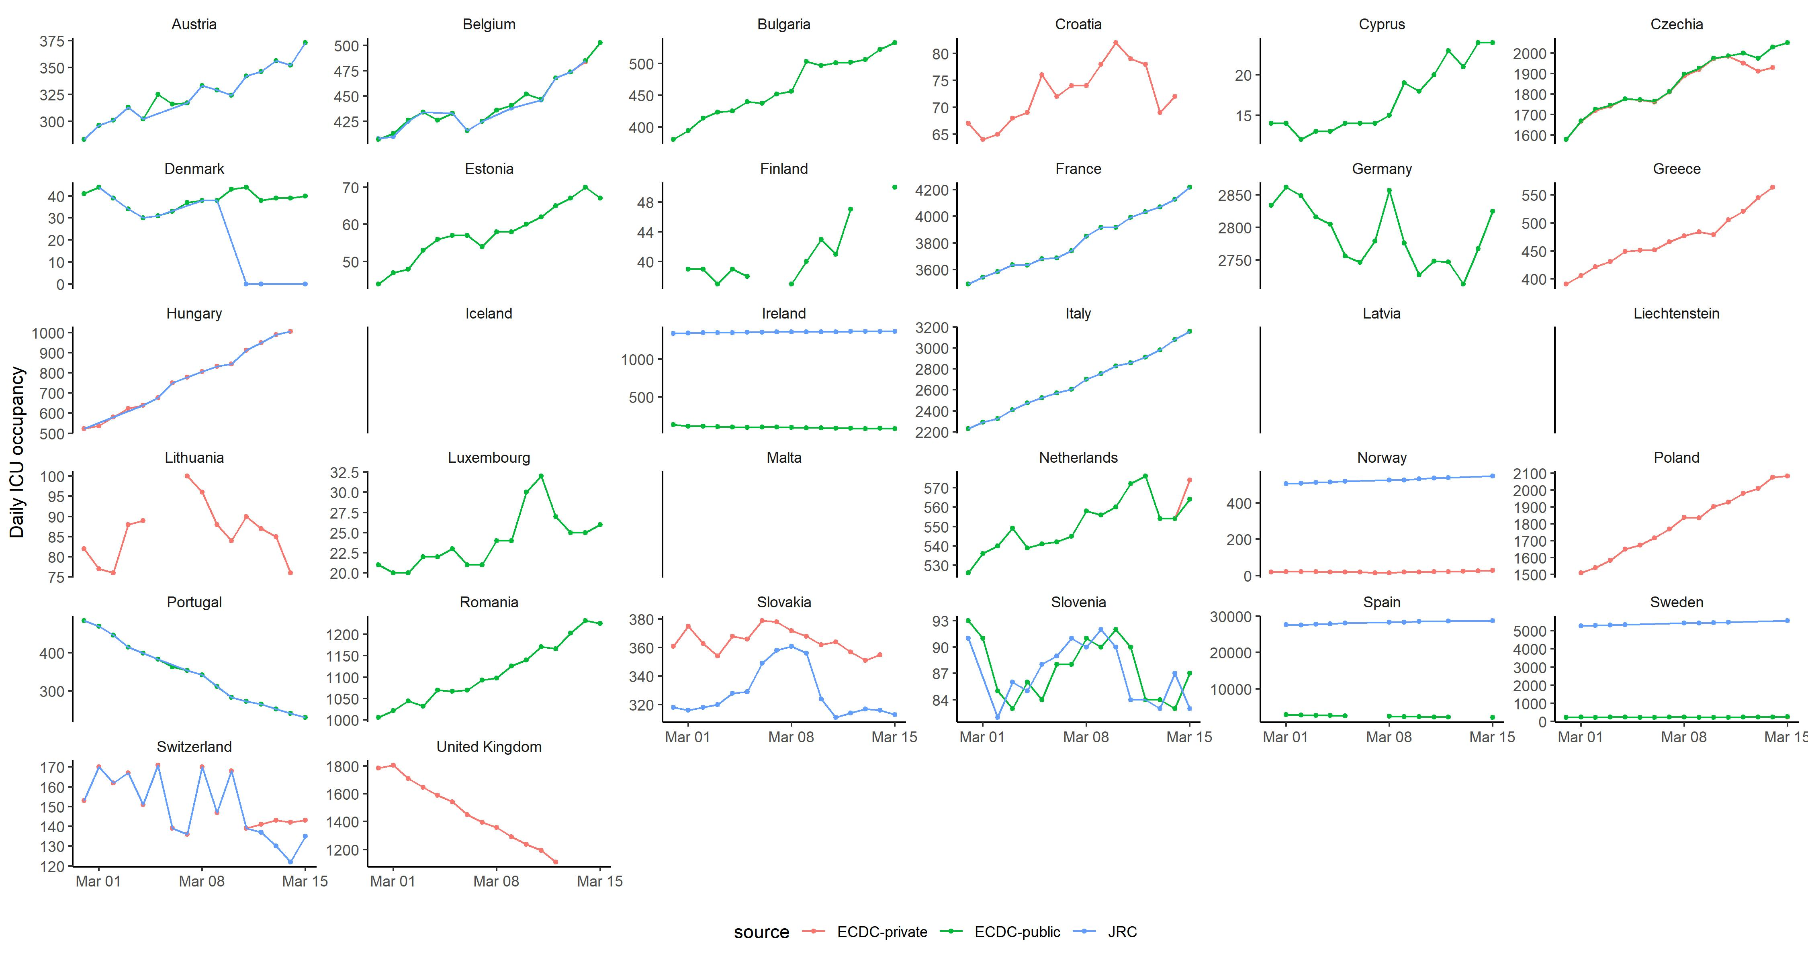
ICU occupancy, all sources, 1-15 March

