Slide 1
Fraudulent account closing
Team Members:
1.KATHIRESAN.S
2.MARIMUTHU.K
3.PRABU.M
Industrial Guide:
MS.PAVITHRA
Faculty Guide:
Mrs. LANITHA B
Department of CSE, KGiSL Institute of Technology, Coimbatore

Slide 2
Abstract
Accounts pertaining to banks, organizations, applications and accounts - all of these need to be monitored during the creation of accounts and suspicious creation ought to be reported using data comparison. Doing such a process manually going through logs on a continuous basis is not a viable option for an individual to do so and hence yet another scenario that was made for an RPA based software robot to take up.
Department of CSE, KGiSL Institute of Technology, Coimbatore

Slide 3
Existing system
The existing system faces few problems for accessing the account by the user and generation fake accounts.
Automatically enters the details of by user for each and every account.
Have to send the mail manually after the creation of the new account to the particular client and for illegal account.
Department of CSE, KGiSL Institute of Technology, Coimbatore

Slide 4
Proposed System
The Humans are under the era of committing the mathematical and parallax errors while in terms of the RPA the errors are very low.
The work can be done faster and efficient from man-hours and man-years to Minutes and Seconds
The removal of duplicate and checking whether the details are valid is automatic.
Department of CSE, KGiSL Institute of Technology, Coimbatore

Slide 5
Literature Review
In Robotic Process Automation (RPA) is the use of software with capabilities to handle high-volume, repeatable tasks that previously required a human to perform.
This technology increases the productivity for human employees who no longer are tasked with boring work.
Department of CSE, KGiSL Institute of Technology, Coimbatore

Slide 6
The Humans are under the era of committing the mathematical and parallax errors while in terms of the RPA the errors are very low.
The work can be done faster and efficient from man-hours and man-years to Minutes and Seconds
The removal of duplicate and checking whether the details are valid is automatic.

Slide 7
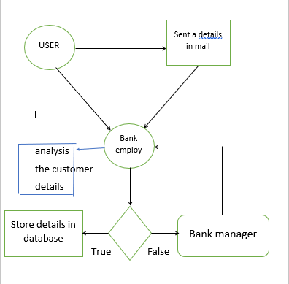
Architectural Design DFD and/or ER diagram
Department of CSE, KGiSL Institute of Technology, Coimbatore

Slide 8
Data Flow Diagram-Level 0
Open browser
Click create account
Enter the details
Details are stored in db
Department of CSE, KGiSL Institute of Technology, Coimbatore

Slide 9
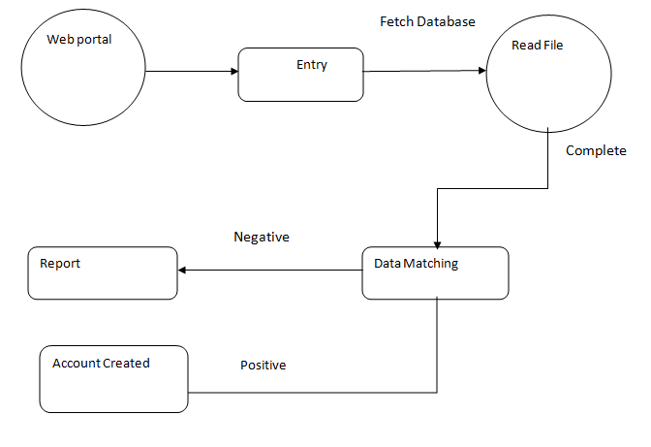
Data Flow Diagram-Level 1

Slide 10
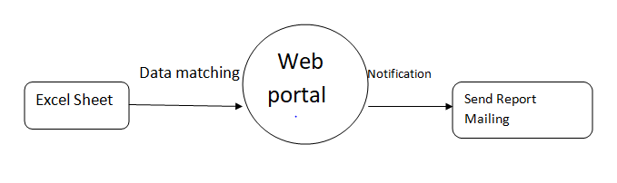
Data Flow Diagram-Level 2

Slide 11
Module Split-up
Designing the clone Web page of Particular Organization.
Pattern matching (Data sets).
Data entry.
Reporting and sending the mail.
Department of CSE, KGiSL Institute of Technology, Coimbatore

Slide 12
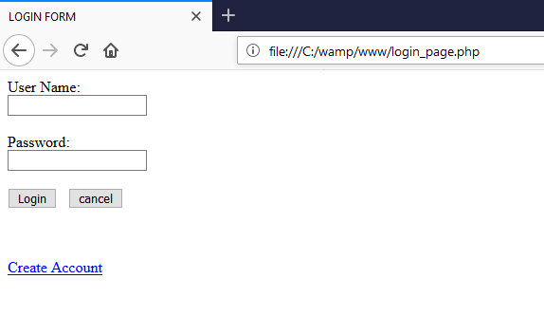
Snapshots
Department of CSE, KGiSL Institute of Technology, Coimbatore

Slide 13
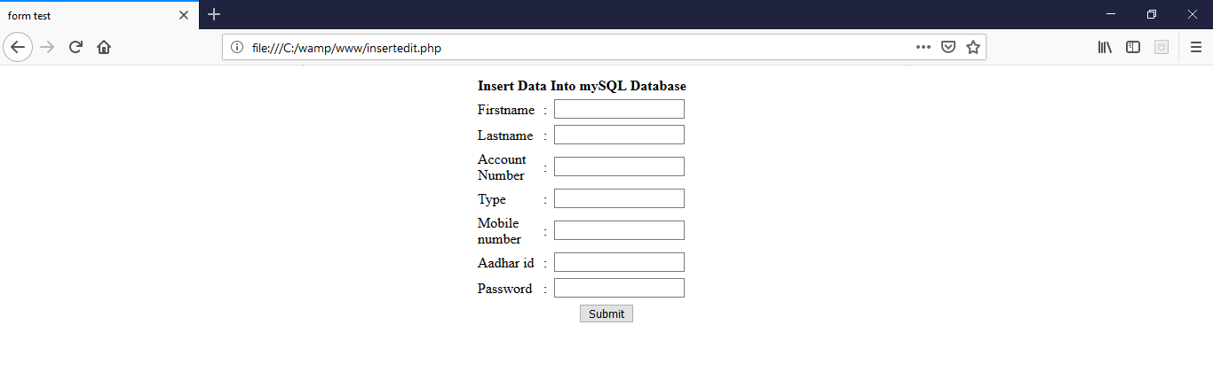

Slide 14
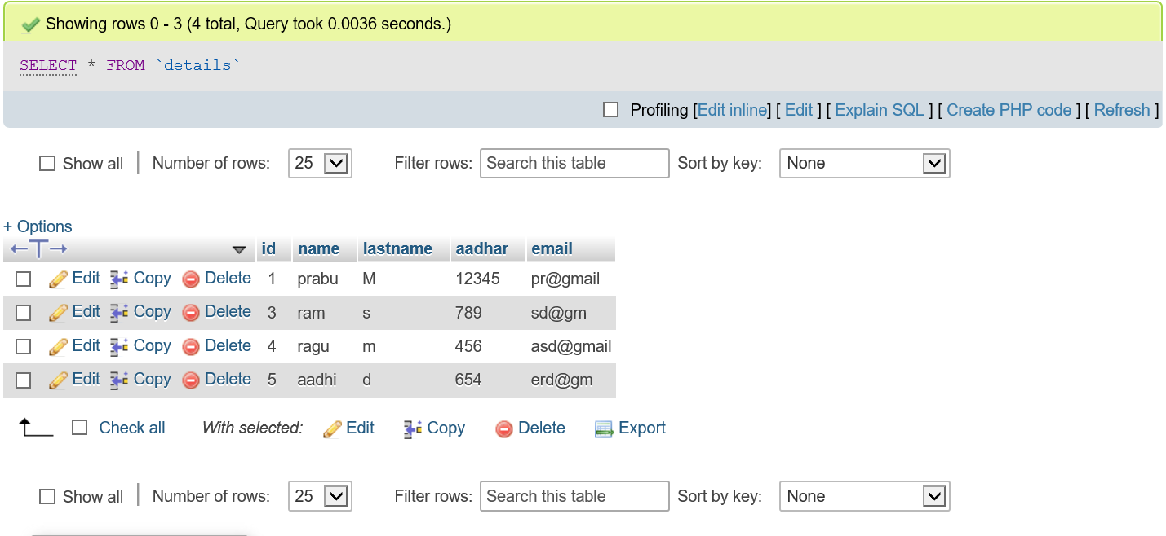

Slide 15
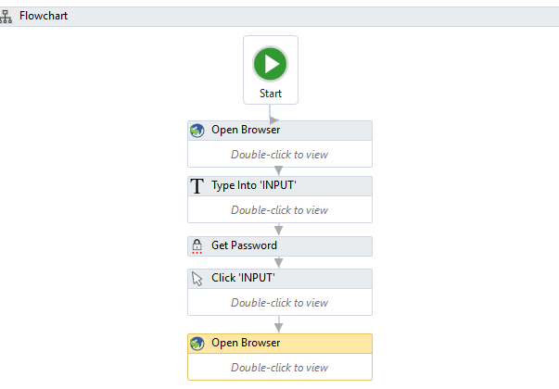

Slide 16
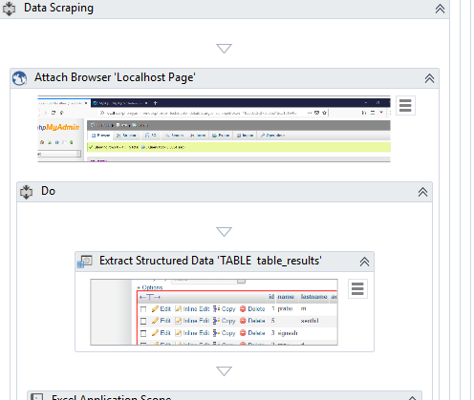

Slide 17
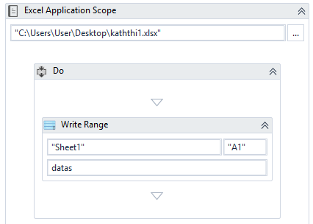

Slide 18
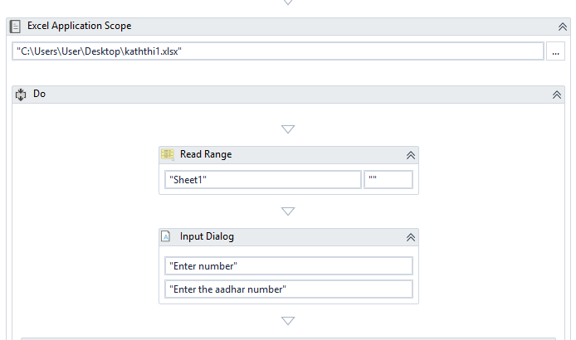

Slide 19
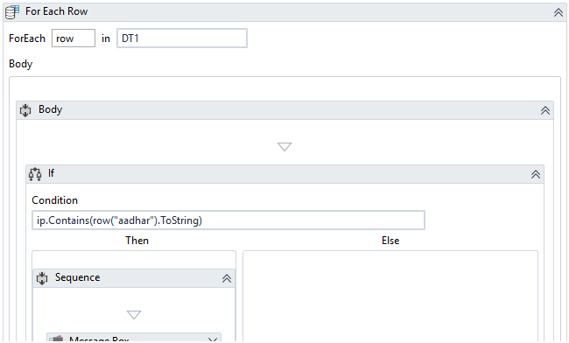

Slide 20
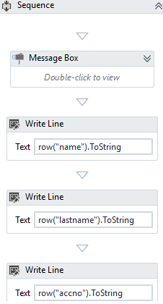

Slide 21
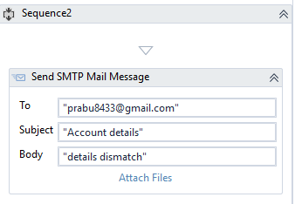

Slide 22
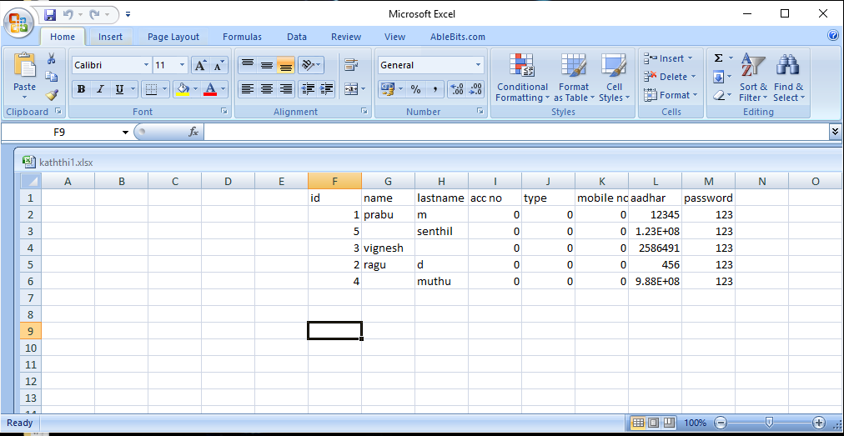

Slide 23
THANK YOU
Department of CSE, KGiSL Institute of Technology, Coimbatore

