Slide 1


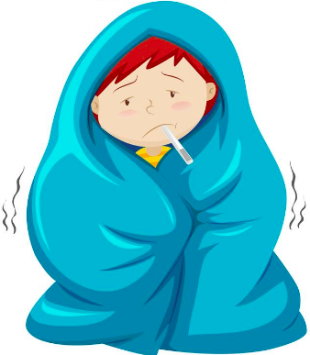
Susceptible
Population
Infected
Population
Infection Process
Virus Production

Slide 2
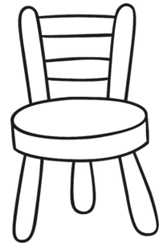
Basic Epidemiological Model
Contact between susceptible and virus
Susceptible
Population
Infected
Population
Vicious Cycle of virus production and infection
Virus Production
Virus Concentration in the room

Slide 3
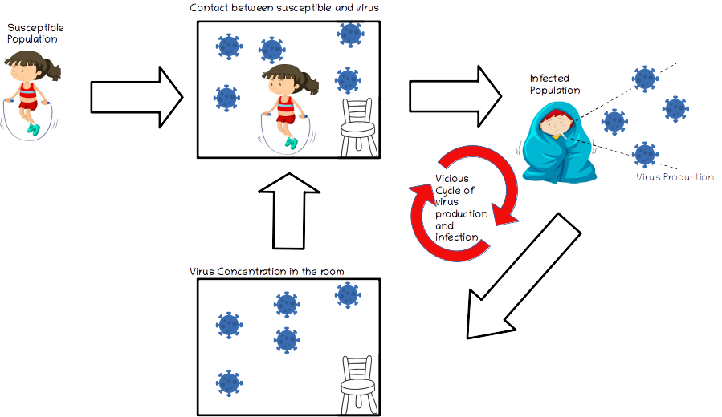
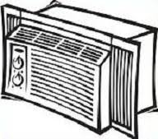
Virus lost due to filters and air exchange
Ventilation System
Modified Epidemiological Model
Virus lost due to settling and deactivation

