Slide 1

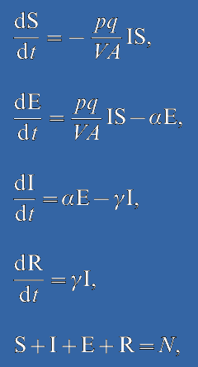
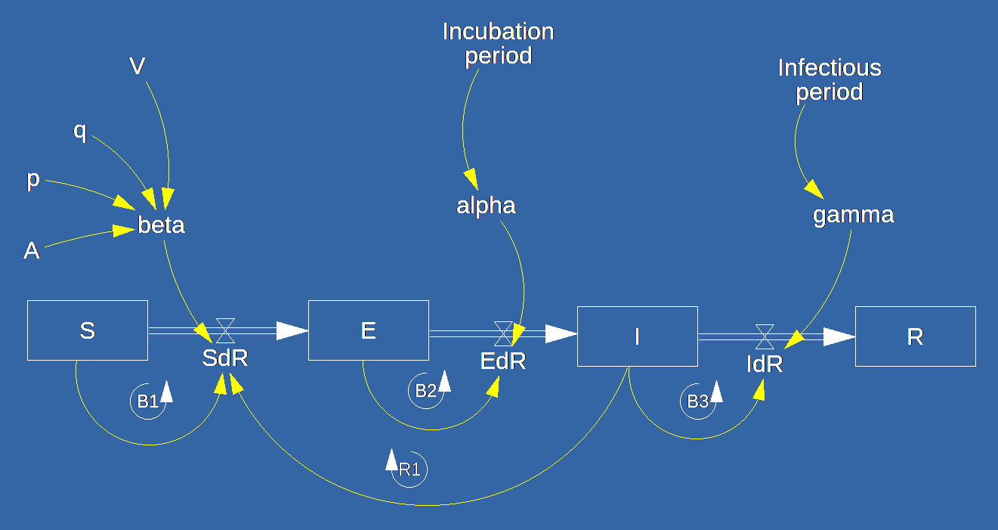
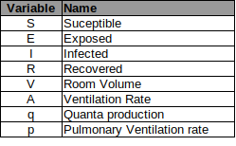
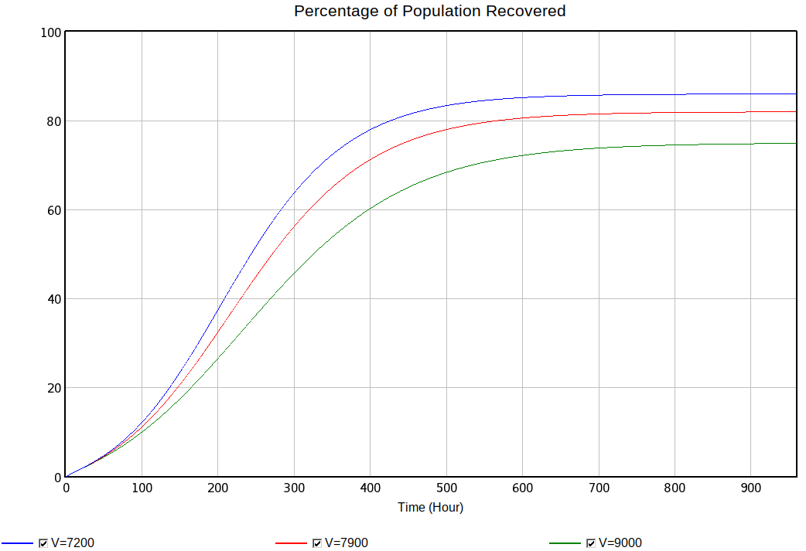
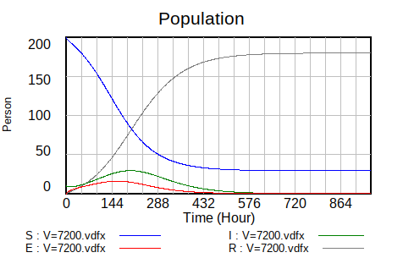
System Dynamics representation of SEIR Model
Differential Equations
Model Representation
Model Source: Noakes, C.J., Beggs, C.B., Sleigh, P.A. and Kerr, K.G., 2006. Modelling the transmission of airborne infections in enclosed spaces. Epidemiology & Infection, 134(5), pp.1082-1091.
Dynamic Simulation
  Sensitivity
  Phase Diagrams
SEIR dynamics
Explicit Representation of
  Accumulations (Inertia)
  Causal Relationships
  Exogenous vs Endogenous Variables
  Feedback Loop visibility (R,B)
Sensitivity Analysis:
Percentage of Population Recovered with different room Volumes, 7200, 7900 and 9000 m3

