Slide 1

System Dynamics Model for Ventilation effect on COVID-19 transmission

Slide 2
Agenda
Presentation
SEIR Model
System Dynamics representation
SEIR + Ventilation
Potential research directions

Slide 3


Presentation
Daniel Sepulveda Estay
PhD, Operations Management, DTU
System Dynamics Modelling for:
  Supply Systems
    Stock fluctuations
    Bullwhip effects & Hoarding
    Cyber-resilience
  Healthcare
    Compliance Behaviour of Diabetes patients
    Return patients to Emergency care
Christian Sørup
PhD, Operations Management, DTU
System Dynamics Modelling for:
  Healthcare
    Return patients to Emergency care
    Policy analysis for COVID-19 Spread

Slide 4
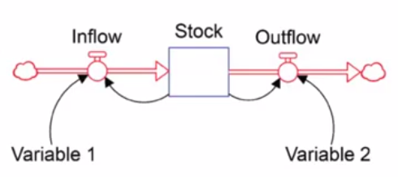
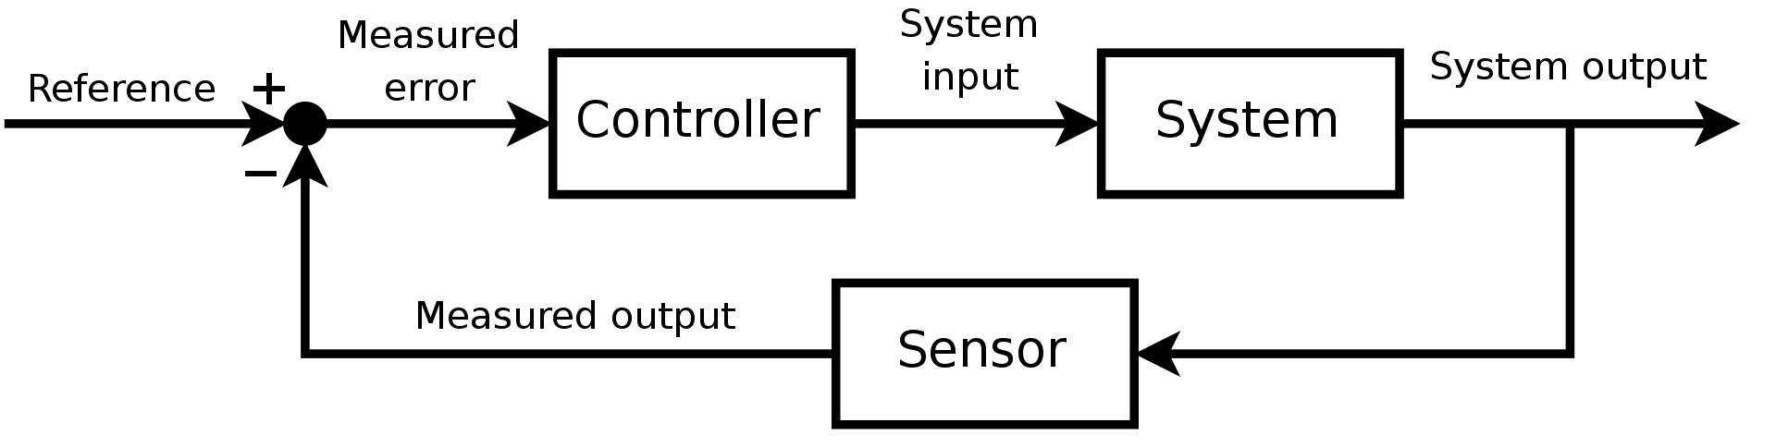
System Dynamics versus traditional control
Stock and Flow representation
States as Accumulations
Focus on Relationships
Important variables not necessarily quantified
Frequency Analysis
Control Theory
System Dynamics
States
Dynamic modelling (over time)
Polarity (Pos.&Neg.)
Feedback (Pos. & Neg.)

Slide 5
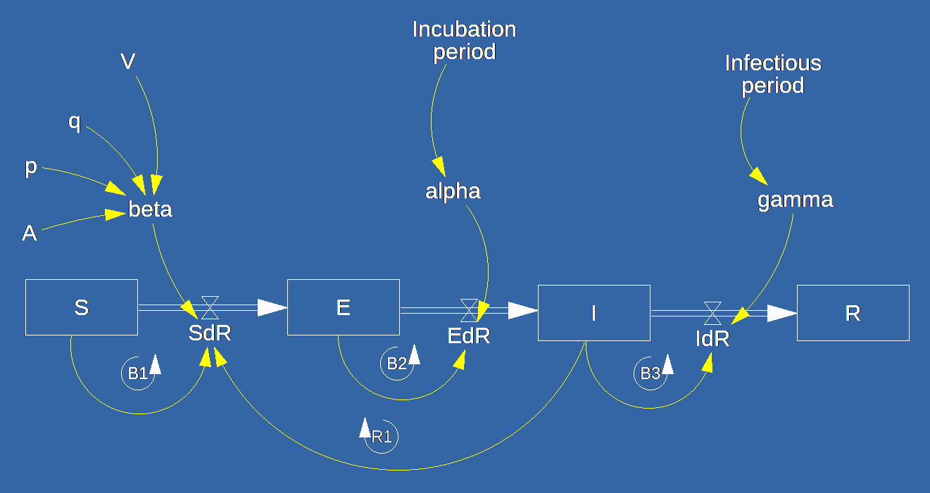
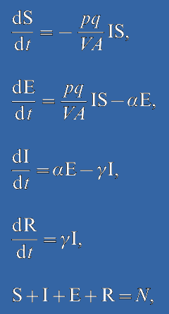


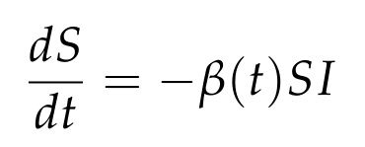
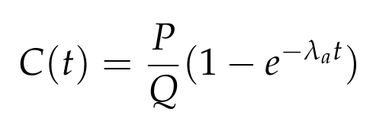
COVID-19 Model Equations
Model Source: Noakes, C.J., Beggs, C.B., Sleigh, P.A. and Kerr, K.G., 2006. Modelling the transmission of airborne infections in enclosed spaces. Epidemiology & Infection, 134(5), pp.1082-1091.

Slide 6
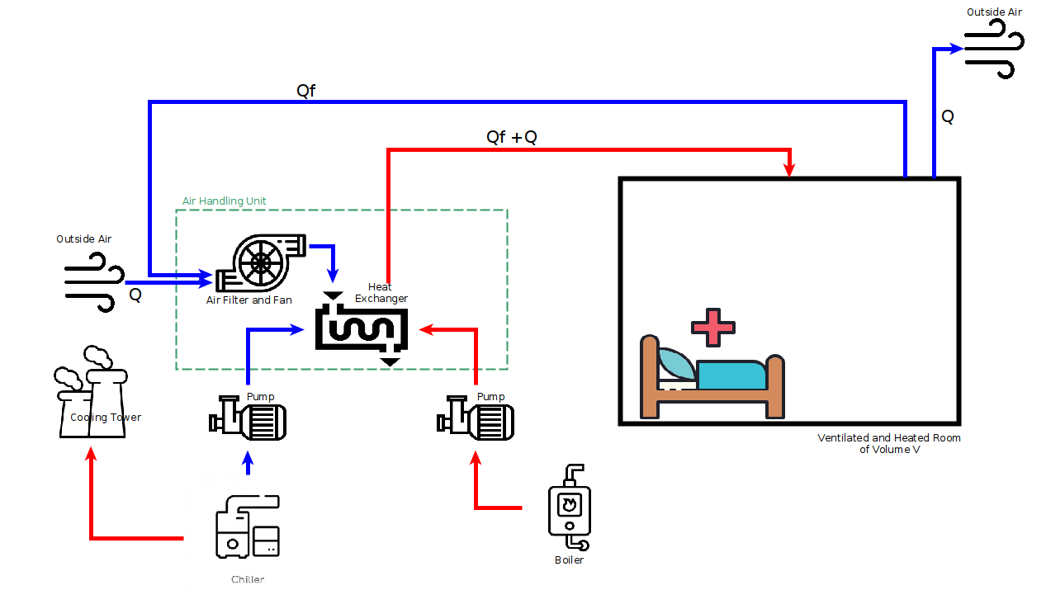
Ventilation : Simple Ventilation System

Slide 7
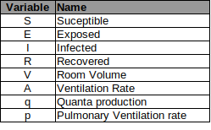
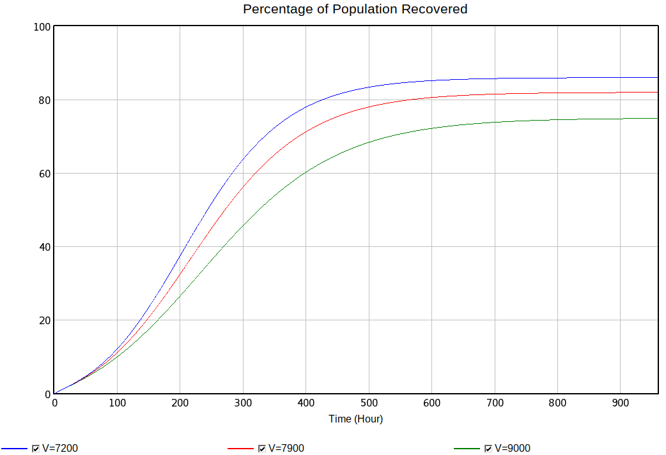
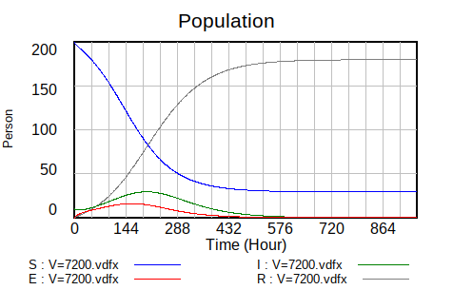
System Dynamics representation of SEIR Model
Differential Equations
Model Representation
Model Source: Noakes, C.J., Beggs, C.B., Sleigh, P.A. and Kerr, K.G., 2006. Modelling the transmission of airborne infections in enclosed spaces. Epidemiology & Infection, 134(5), pp.1082-1091.
Dynamic Simulation
  Sensitivity
  Phase Diagrams
SEIR dynamics
Explicit Representation of
  Accumulations (Inertia)
  Causal Relationships
  Exogenous vs Endogenous Variables
  Feedback Loop visibility (R,B)
Sensitivity Analysis:
Percentage of Population Recovered with different room Volumes, 7200, 7900 and 9000 m3

Slide 8
Potential Research Direction Ideas
HVAC Efficiency vs. Transmission rate
HVAC Energy Use vs. Transmission rate

