Slide 1
Project Presentation
on
Heart Attack Prediction
Presented
by
Deepak(1811981097)
Under the supervision
of
Dr. Manish Jain

Slide 2
SUMMARY
Problem Statement
Introduction
Overview of Dataset
Tools/Methods
Models
GUI
Result
Future Scope

Slide 3
Problem Statement
To Develop a Machine Learning Project that can Predict Heart Attack with Good Accuracy.

Slide 4
Introduction
Medical diagnosis is an intrinsic and complicated task that demands being carried out with acute precision while taking into consideration various factors. ML techniques allow the use of intelligent methods across different datasets to reveal useful insights. This model gives us the accuracy up to 88%.

Slide 5
Overview of Dataset
In this Project I have used Heart.csv dataset which I have taken from Kaggle. This Dataset has 14 Numeric Variables. The Size of Dataset is 303 columns and 14 Rows.

Slide 6
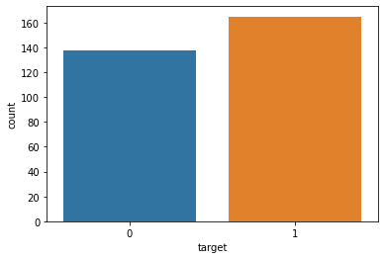
Dataset Visualization
This is the Count of values present in the Target column.

Slide 7
Tools/Methods
Data Pre-processing
Plotting Graphs using Seaborn library
Feature Scaling
GUI using Tkinter

Slide 8
Models
Logistic Regression
SVM
Decision Tree
Random Forest
K Nearest Neighbour
XgBoost
Randomized Search

Slide 9
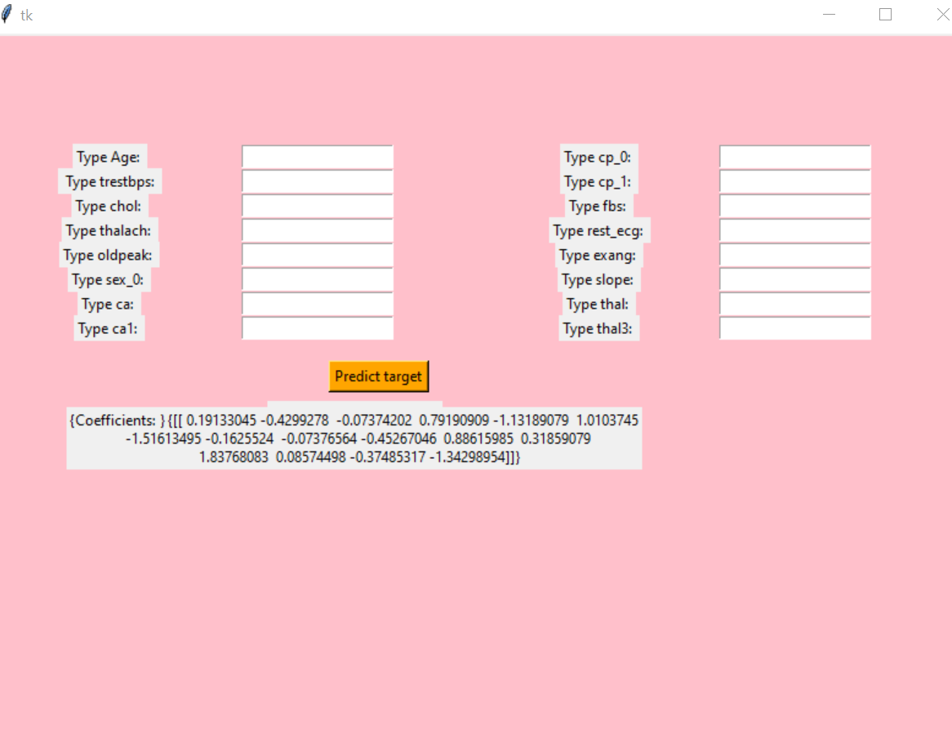
GUI
GUI of this Project is prepared by the help of Tkinter.

Slide 10
Result
Our model is giving the accuracy up to 88% and it is working good.

Slide 11
Future Scope
In this project we are making gui with the help of Tkinter but in future we can try to make a website or an application.
In Future we can increase the size of dataset.

Slide 12
Reference
https://towardsdatascience.com/
https://www.researchgate.net/publication/335094208_Prediction_of_Coronary_Heart_Disease_using_Machine_Learning_An_Experimental_Analysis
https://www.kaggle.com/

Slide 13


