Slide 1

Readings
Data & SQL - Final Project
Catalina Ramírez Guerra

Slide 2





Project
Project: DB from Kaggle about Goodreads data.

Slide 3



Motivation
We could answer questions from the point of view of:
Readers Authors Publishers

Slide 4
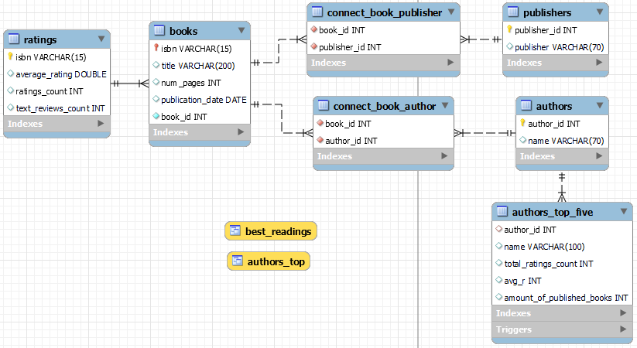
ER DB diagram

Slide 5

Joins -View
*Looking for books with a 5-rate, title and author
CREATE VIEW best_readings
AS
SELECT average_rating AS avg_r, title, name
FROM ratings r
INNER JOIN books b
ON r.isbn = b.isbn
INNER JOIN connect_book_author cba
ON b.book_id = cba.book_id
INNER JOIN authors a
ON cba.author_id =a.author_id
WHERE average_rating = 5
WHIT CHECK OPTION;
SELECT *
FROM best_readings
LIMIT 3;

Slide 6
Function (1)
* Creating the function to determine the interval of how many text reviews has a book
DELIMITER //
CREATE FUNCTION text_reviews_interval(text_reviews_count INTEGER)
RETURNS VARCHAR(50)
DETERMINISTIC
BEGIN
DECLARE r_interval VARCHAR(50);
IF text_reviews_count < 500 THEN
SET r_interval = 'less than 500 text reviews';
ELSEIF (text_reviews_count >= 500 AND text_reviews_count < 1000) THEN
SET r_interval = 'between 500 and 1000 text reviews';
ELSEIF text_reviews_count >= 1000 THEN
SET r_interval = 'more than 1000 text reviews';
END IF;
RETURN (r_interval);
END//
DELIMITER ;

Slide 7

Function (2)
* Using the function for books related to Harry Potter
SELECT title, text_reviews_interval(text_reviews_count) AS r_interval
FROM ratings r
INNER JOIN books b
ON r.isbn = b.isbn
WHERE title LIKE "%Harry Potter%";

Slide 8


Subquery
* Thinking as a publisher, looking for authors who have more than 10000 reviews, rate average greater than 4.5, whose name starts with S and also, we wan to know the book title.
SELECT a.name, average_rating AS avg_rating, ratings_count, publication_date, title
FROM authors a
INNER JOIN connect_book_author cba
ON a.author_id =cba.author_id
INNER JOIN books b
ON cba.book_id = b.book_id
INNER JOIN ratings r
ON b.isbn = r.isbn
WHERE name IN (SELECT name
FROM authors
WHERE name LIKE "S%")
AND average_rating > 4.5
AND ratings_count >10000
ORDER BY avg_rating DESC;

Slide 9
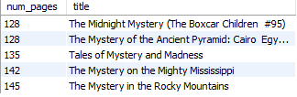
Stored procedure
* Find boos which pages amount is in [pages_min, pages_max] and their titles contain a key_word
DELIMITER //
CREATE PROCEDURE books_pages( pages_min INTEGER, pages_max INTEGER, key_word VARCHAR(50))
BEGIN
SELECT num_pages, title
FROM books
WHERE num_pages BETWEEN pages_min AND pages_max
AND title IN (SELECT title
FROM books
WHERE title LIKE key_word)
ORDER BY num_pages
LIMIT 10;
END //
DELIMITER ;
-- Call Stored Procedure:
-- books_pages(pages_min, pages_max, key_word)
CALL books_pages(100, 150, '%stery%');

Slide 10
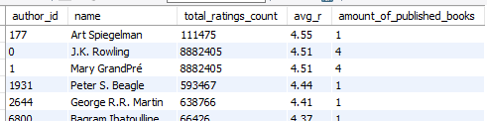
View
* We want to create a view to know some statistics for author whose average-rating average is greater than four, we are taking into account that some of them have written more than one book, and we want to know how many ratings_count they have for all their books
CREATE VIEW authors_top
AS
SELECT a.author_id, a.name, SUM(ratings_count) AS total_ratings_count, AVG(average_rating) AS avg_r, COUNT(a.name) AS amount_of_published_books
FROM authors a
INNER JOIN connect_book_author cba
ON a.author_id = cba.author_id
INNER JOIN books b
ON cba.book_id = b.book_id
INNER JOIN ratings r
ON b.isbn = r.isbn
WHERE average_rating > 4
AND ratings_count > 23000
AND text_reviews_count > 5000
GROUP BY author_id
ORDER BY avg_r DESC;
SELECT *
FROM authors_top;

Slide 11
Trigger (1)
1. Creating a table using the first 5 records from autors_top VIEW and round the avg_r value to 4 or 5
2. Using a trigger before to insert to round the avg_r value
-- TABLE
CREATE TABLE authors_top_five(
author_id INTEGER,
name VARCHAR(100),
total_ratings_count INTEGER,
avg_r INTEGER,
amount_of_published_books INTEGER,
FOREIGN KEY (author_id)
REFERENCES authors(author_id)
);
1
2
-- TRIGGER
DELIMITER //
CREATE TRIGGER new_before_insert
BEFORE INSERT ON authors_top_five
FOR EACH ROW
BEGIN
IF NEW.avg_r < 4.5 THEN
SET NEW.avg_r = 4;
ELSEIF NEW.avg_r >=4.5 THEN
SET NEW.avg_r = 5;
END IF;
END //
DELIMITER ;

Slide 12
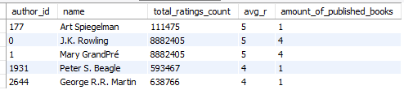
Trigger (2)
-- Inserting data in authors_top_five
INSERT INTO authors_top_five (author_id, name, total_ratings_count, avg_r, amount_of_published_books)
VALUES
(177, 'Art Spiegelman', 111475, 4.55, 1),
(0, 'J.K. Rowling', 8882405, 4.51, 4),
(1, 'Mary GrandPré', 8882405, 4.51, 4),
(1931, 'Peter S. Beagle', 593467, 4.44, 1),
(2644, 'George R.R. Martin', 638766, 4.41, 1);
SELECT *
FROM authors_top_five;

Slide 13
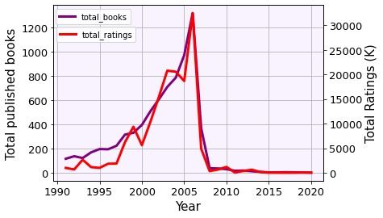

Query
* As a publisher we want to know some statistics for a given book collection. We want to know how many published books per year, and how many ratings they have until 2020
SELECT YEAR(publication_date) AS year, COUNT(*) AS total_books, SUM(ratings_count) AS total_ratings
FROM books b
INNER JOIN ratings r
ON b.isbn = r.isbn
GROUP BY YEAR(publication_date)
HAVING year >= 1990
ORDER BY year;

Slide 14
Thank you

Slide 15
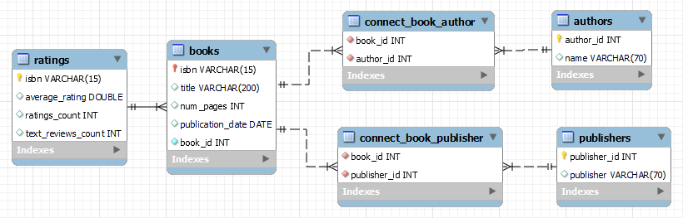
Initial ER diagram

