Slide 1






10. Heart Disease Diagnostic Analysis 15. Analysing Swiggy- Bengaluru Outlet
- P. Kathyayini
Internship Id: CRIN2302045

Slide 2


1. Heart Disease Diagnostic Analysis

Slide 3

Introduction
Currently, heart disease remains a global health challenge
Diagnosis often relies on traditional methods, including subjective assessments and limited data
Challenges:
Limited diagnostic accuracy
Potential for misdiagnosis and delayed treatment
Lack of comprehensive data analysis in real time
Opportunity:
Leveraging advanced technologies to enhance heart disease diagnosis
Data analytics, machine learning, and visualisation as game-changers

Slide 4
Details of Data
Age
Sex
Chest pain type (4 values)
Resting blood pressure
Serum cholestoral in mg/dl
Fasting blood sugar > 120 mg/dl
Resting electrocardiographic results (values 0,1,2)
Maximum heart rate achieved
Exercise induced angina
Oldpeak = ST depression induced by exercise relative to rest
The slope of the peak exercise ST segment
Number of major vessels (0-3) colored by flourosopy
Thal: 0 = normal; 1 = fixed defect; 2 = reversable defect

Slide 5
Main KPIs
Age
Sex
Chest pain type (4 values)
Thal: 0 = normal; 1 = fixed defect; 2 = reversable defect
Target

Slide 6
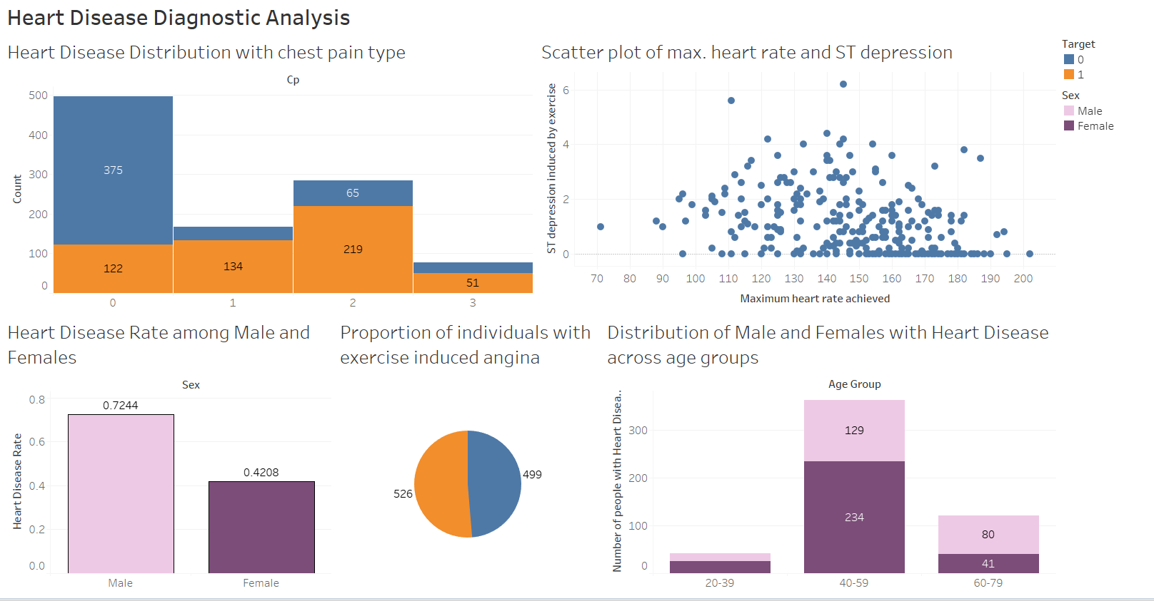
Tableau Dashboard

Slide 7
Links to Python code and Tableau Dashboard
Python Code
https://colab.research.google.com/drive/11KRGpGjIVEzNR7XACF8yNhTi_H4XGOHW?usp=sharing
2) Tableau Dashboard-
Heart_disease_analysis | Tableau Public

Slide 8

2. Analysing Swiggy Bangalore Outlet

Slide 9
Introduction
Objective: Extract actionable insights from Swiggy data to enhance business operations and customer satisfaction.
Background: Swiggy is a leading food delivery platform, and analyzing its data can provide valuable information for optimizing various aspects of the business.
Scope: This data science project aims to explore customer behavior, delivery patterns, and restaurant performance to make data-driven decisions.
Key Components:
Data Collection: Gathering data from Swiggy's platform and partners.
Data Analysis: Exploratory Data Analysis (EDA) to uncover trends and patterns.
Business Impact: Leveraging insights to enhance customer experience, streamline operations, and improve profitability.

Slide 10
Details of Data
Shop Name – Name of the restaurant/hotel
Cuisine – Name of the cuisione available in that restaurant
Location – Address of the shop/restaurant/hotel
Cost_for_two – Average cost to be paid by the customers eating food from that hotel
Rating – Rating of the hotel/restaurant

Slide 11
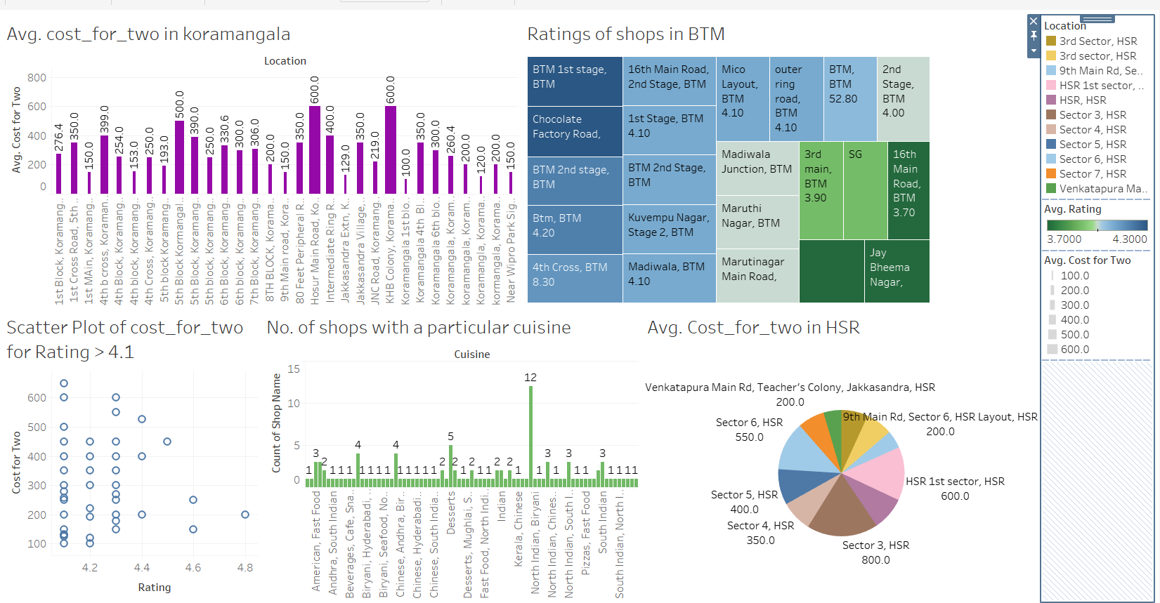
Tableau Dashboard

Slide 12
Links to Python code and Tableau Dashboard
Python Code
https://colab.research.google.com/drive/13-G2ex2aOz4AgggFNSJyaiJLooVW1EjW?usp=sharing
2) Tableau Dashboard-
Swiggy Data Analysis | Tableau Public

Slide 13
Thank you

