Slide 1


Mushroom Edibility Classification
Yanfeiyun Wu (Kathy)
Data Science Institutes at Brown University
Dec. 6th 2023
HTTPS://GITHUB.COM/KATHYWU1201/MUSHROOM_EDIBILITY_CLASSIFICATION_ML_PROJECT

Slide 2

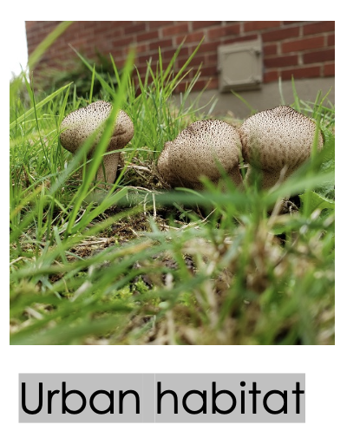
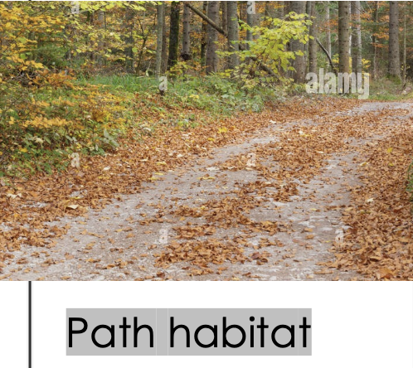
Recap
Question: If there exists a mushroom that has never seen before, will it be edible or it is poisonous?
Why important: Help them to identify if the mushroom is safe to consume; Reduce the risk of death and intoxication due to poisonous mushrooms.
Problem type: Classification
Source: Kaggle, collected from Patrick Hardin’s Mushrooms & Toadstools, and inspired by Jeff Schlimmer’s Mushroom Data Set.
Preprocessing: Most features are categorical data, number of features changes from 20 to 124
EDA: 100% of urban grown mushroom is edible and 100% of path grown mushroom is poisonous (fig1)

Slide 3
Splitting
Data Splitting: use general train_test_split to set 20% of the dataset as test set and the rest 80% as other set, then use Kfold with 4 splits for Cross Validation.
Preprocessor: Standard Scalar & onehot encoder
Chosen Models: 1. Logistic Regression 2. Random Forest 3. KNN 4. XGBoost 5. Support Vector Classification

Slide 4
Model & parameters
Model | Parameter(s)
Logistic Regression | C = 1/alpha: [1/0.001, 1/0.01, 1/0.1, 1/1.0]
Random Forest | max_depth: [5, 10, 20, 30] max_features: [0.25, 0.5, 0.75, 1.0] n_estimators: [20, 50, 100]
KNN | n_neighbors: [3,9,12,15,30,50,100]
XGBoost | max_depth: [3, 5, 7, 10] min_child_weight: [1, 3, 5] learning_rate: [0.1] lambda: [0.01, 0.1, 1] # reduce overfitting alpha: [0.01, 0.1, 1] # Used for high dimensionality
SVC | gamma: [1e-2, 1e-1, 1e1, 1e3] C: [1e-1, 1e0, 1e1, 1e2]

Slide 5
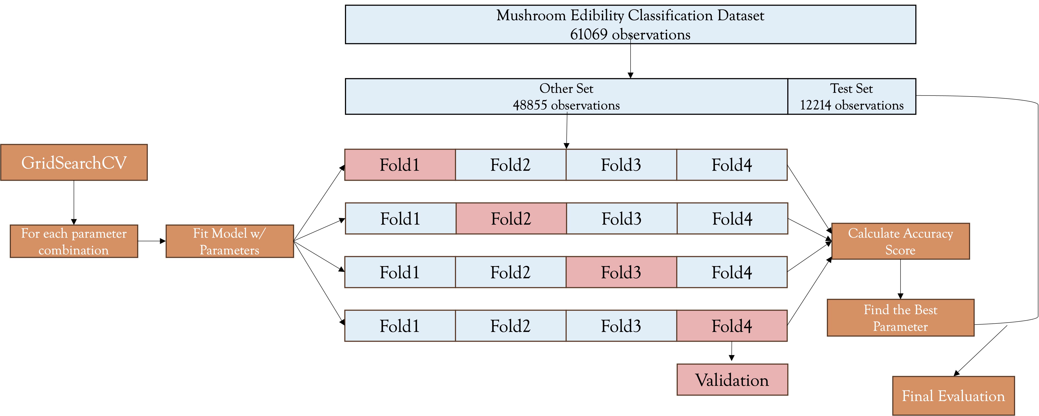
Pipeline
For Each Random State:
Step 1: Split data into 20% of test set and 80% of other set
Step 2: Use kfold with 4 splits to do cross validation on the other set
Step 3: Loop through each possible combination of the parameters, and do CV with 4 splits on each combination
Step 4: Find the Best Parameter(s) by evaluating the accuracy score
Step 5: Save the Best Parameter(s) and the related test score for each random state

Slide 6
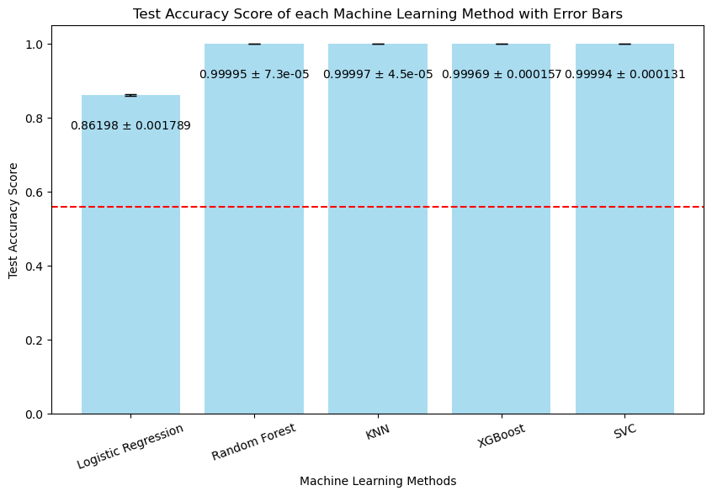
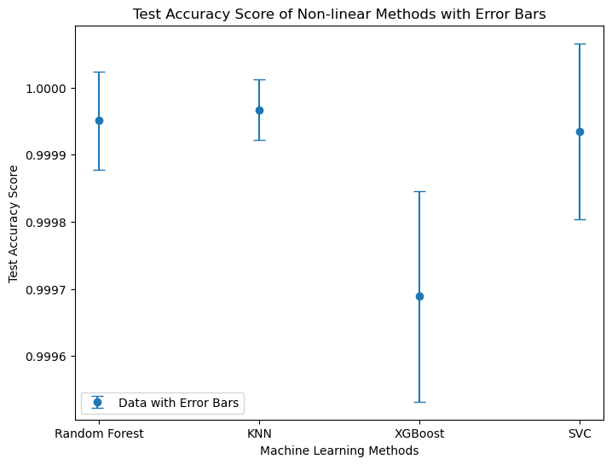
Results
Baseline Accuracy = 0.56001 (predicting all points as 1: poisonous)

Slide 7
Best Parameter(s) and Test Scores
Model | Best Parameter(s) | Mean Test Scores | Std of Test Scores
Logistic Regression | {'logisticregression__C’: [100.0,1000.0]} | 0.861978 | 0.001789
Random Forest | {'randomforestclassifier__max_depth': 20, 'randomforestclassifier__max_features': 0.25, 'randomforestclassifier__n_estimators’: [50,20]} | 0.999951 | 0.000073
KNN | {'kneighborsclassifier__n_neighbors': 3} | 0.999967 | 0.000045
XGBoost | {'xgbclassifier__max_depth': 10, 'xgbclassifier__min_child_weight': 1 'xgbclassifier__learning_rate': 0.1, 'xgbclassifier__lambda': 1, 'xgbclassifier__alpha': 1} | 0.999689 | 0.000157
SVC | {'svc__C': 10.0, 'svc__gamma': 0.1} | 0.999935 | 0.000131

Slide 8
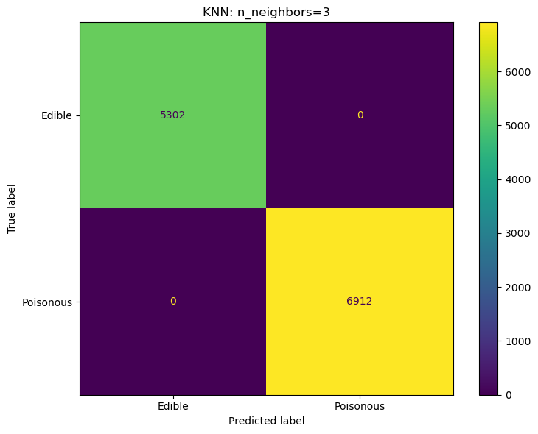
Confusion matrix – (best model)
Baseline Accuracy: 0.56001
KNN: n_neighbors=3
Test_accuracy = 1.0 F1_score = 1.0
For safety, please do not pick and eat any mushroom you see in the nature！！

Slide 9
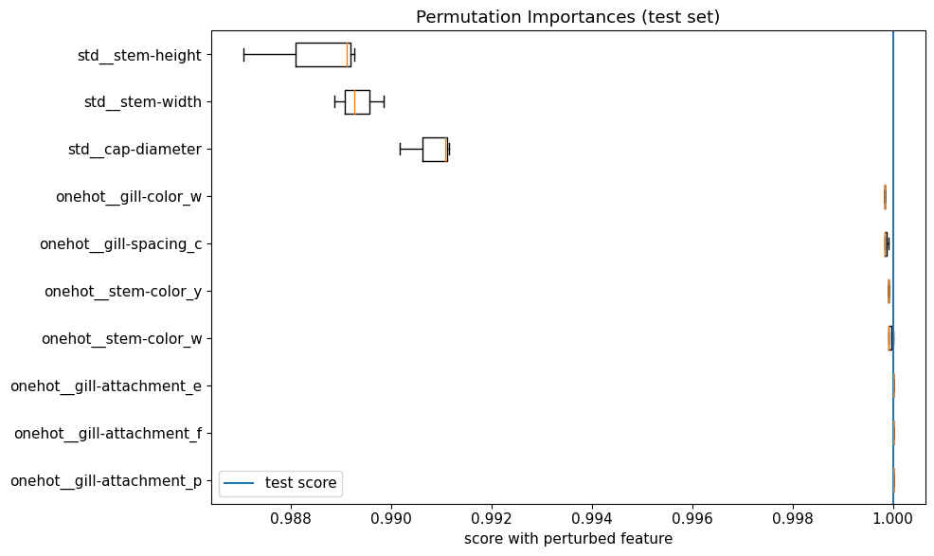
Importance features (Global)
Permutation Importance
Stem-height
Stem-width
Cap-diameter
Gill-color: white
Gill-spacing: close
Stem-color: white, yellow
Notes:
In calculate this permutation importance, since the KNN model is really computationally heavy in calculating the scores, so I only do number of runs equal to 3 to reduce the runtime.

Slide 10
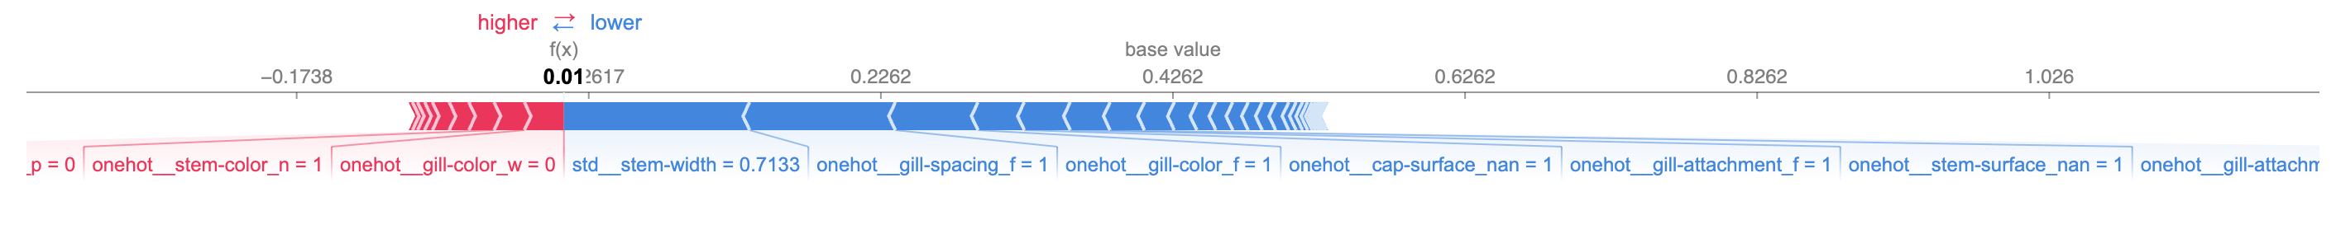
Local Feature Importance
Index=0
Index=99

Slide 11
outlooks
Feature Selection
Reduce the number of features (124 features)
Less features, easier to interpret

Slide 12
Thanks for listening!

Slide 13
Mushroom Edibility Classification Dataset
61069 observations
Other Set
48855 observations
Test Set
12214 observations
GridSearchCV
Fold1
Fold2
Fold3
Fold4
Fold1
Fold2
Fold3
Fold4
For each parameter combination
Fit Model w/ Parameters
Calculate Accuracy Score
Fold1
Fold2
Fold3
Fold4
Find the Best Parameter
Fold1
Fold2
Fold3
Fold4
Validation
Final Evaluation

Slide 14
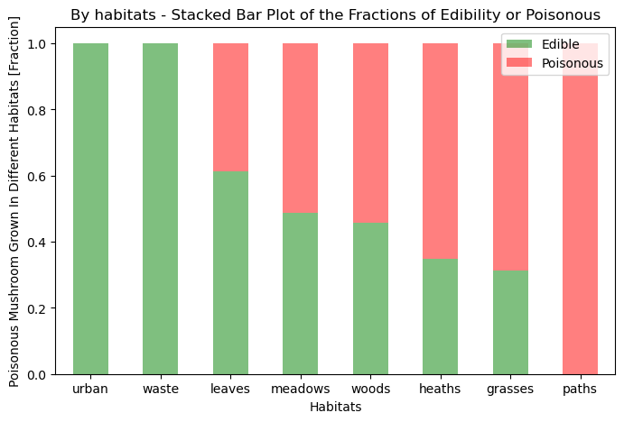
Appendix.
fig1

Slide 15
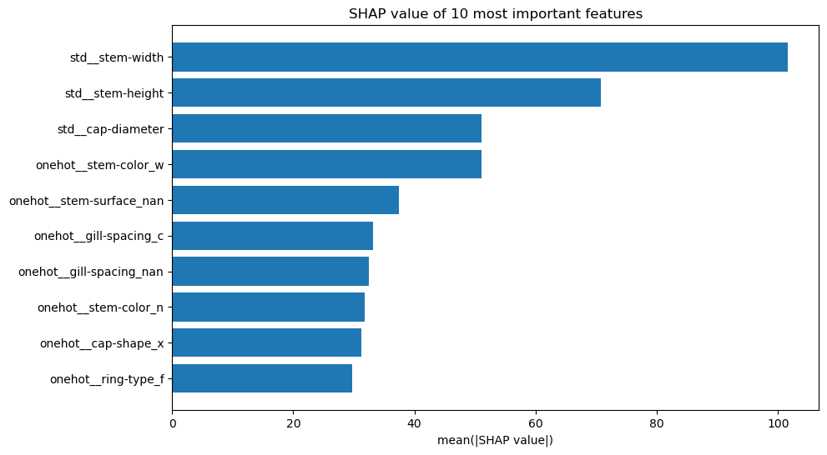
SHAP

Slide 16
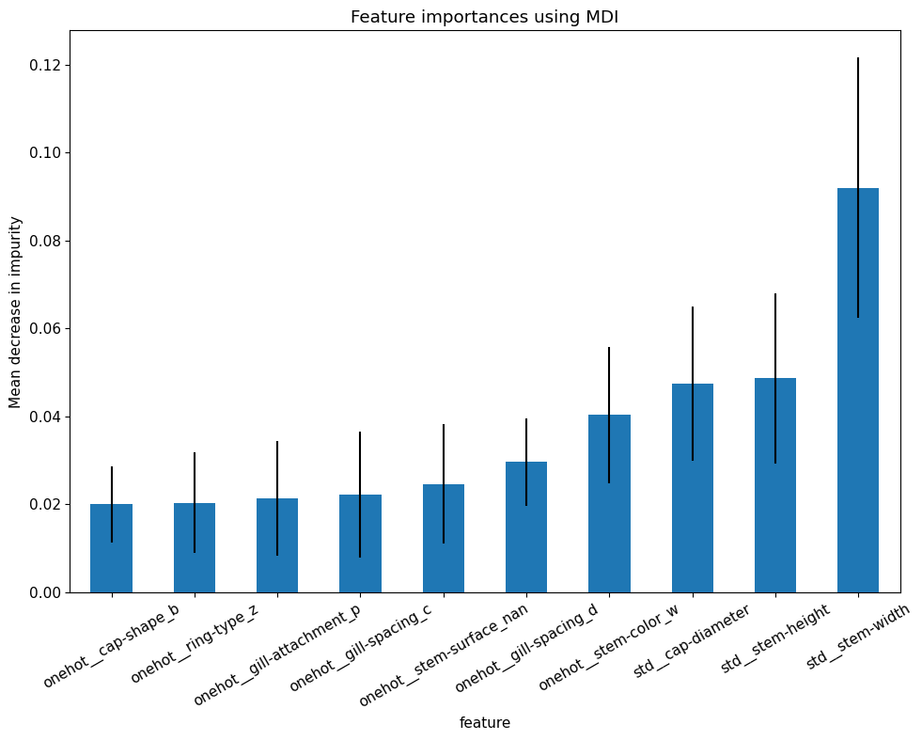
Random forest: feature importance

