Slide 1


Slide 2
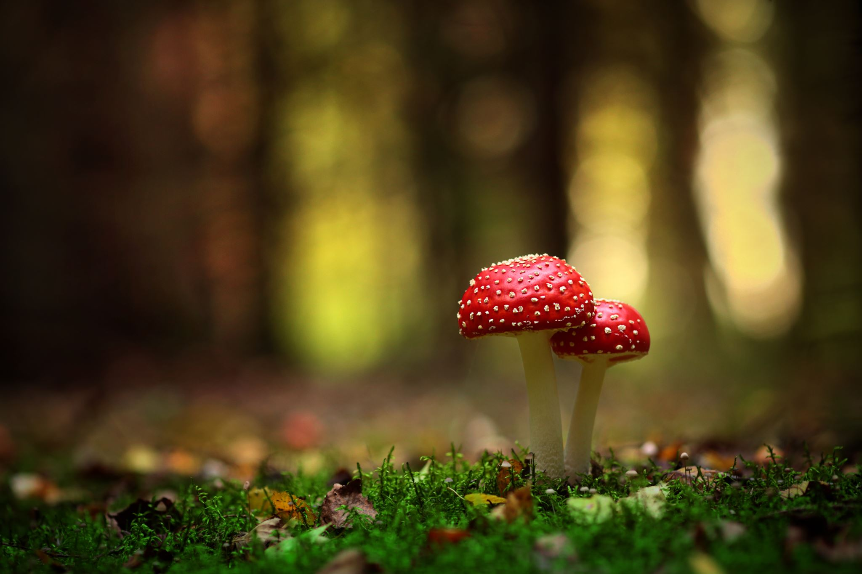
I want to know…
If there exists a mushroom that has never seen before, will it be edible or it is poison?
I find it very important because the nature is evolving, it is possible that one day in the future there comes a new type of fungi, but how do we know if we are safe to eat it?
This dataset will be a classification problem identifying if a new fungi is poisonous or not.
I get this data from Kaggle, and it was includes 61069 hypothetical mushrooms with caps based on 173 species.

