Slide 1

Mushroom Edibility Classification
Kathy Wu
Data Science Institute at Brown University
Oct 19th, 2023
https://github.com/kathywu1201/Mushroom_Edibility_Classification_ML_Project

Slide 2
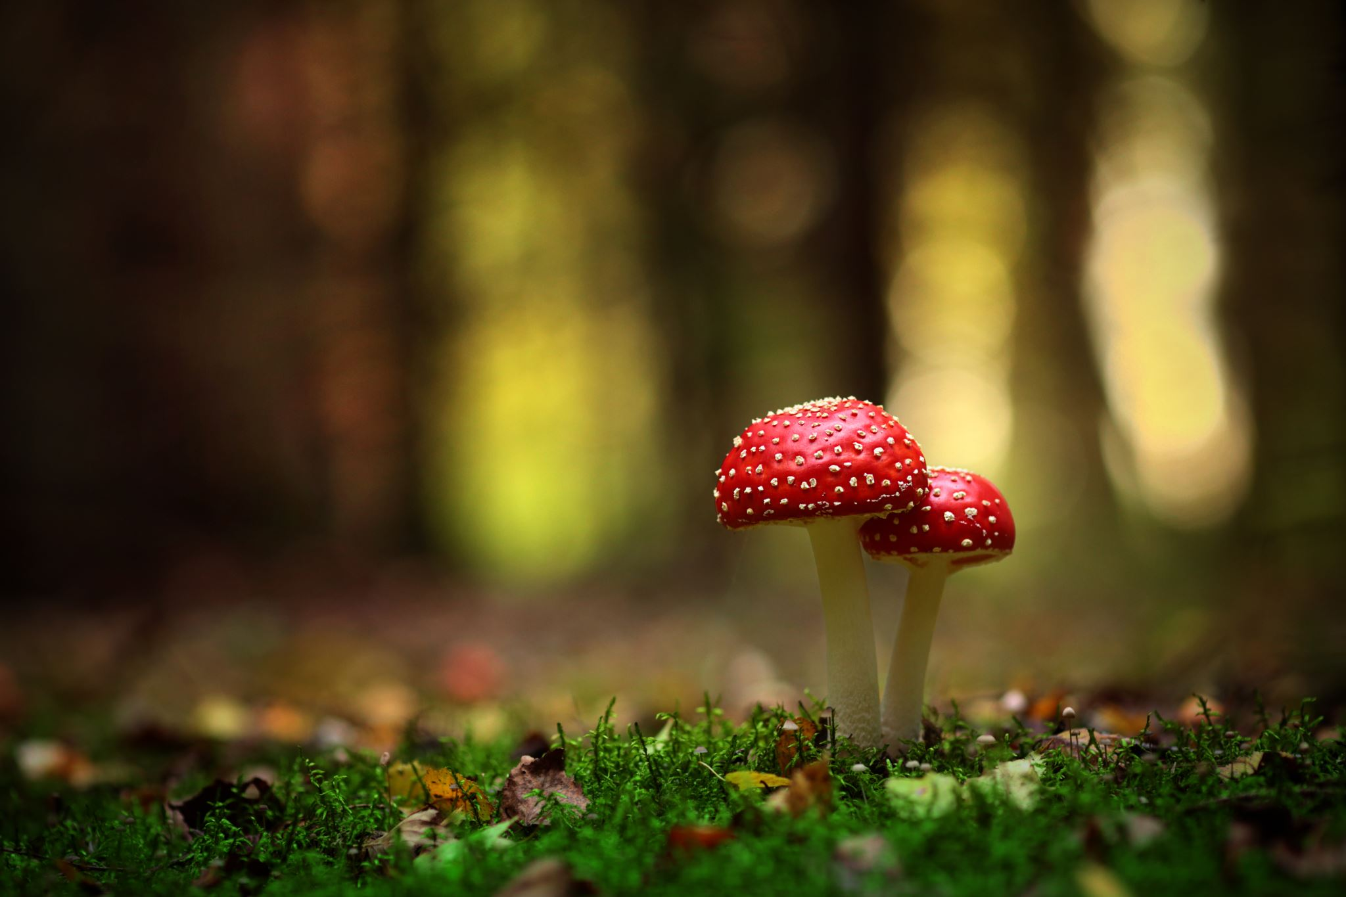
I want to know…
If there exists a mushroom that has never seen before, will it be edible or it is poisonous?
I find it very important because as the nature is evolving, it is possible that one day in the future there comes a new type of fungi, but how do we know if we are safe to eat it?
Create an app for people who are interested in picking wild mushroom themselves.
Help them to identify if the mushroom is safe to consume.
Notes:
I would like to use this ML model to reduce the dangerous of people who are trying to identify the edibility of an unseen type of mushroom. Before the arising of technology, the people who discovered new mushroom can only identify them by tasting them which is high risk.

Slide 3

Data Descriptions
This dataset will be a classification problem identifying if a new fungi is poisonous or not.
I get this data from Kaggle, and it was includes 61069 hypothetical mushrooms with caps based on 173 species.

Slide 4
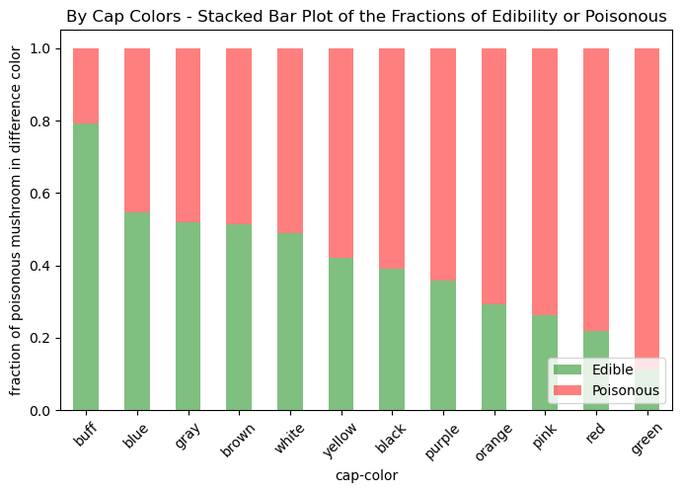
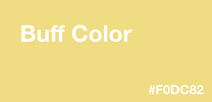
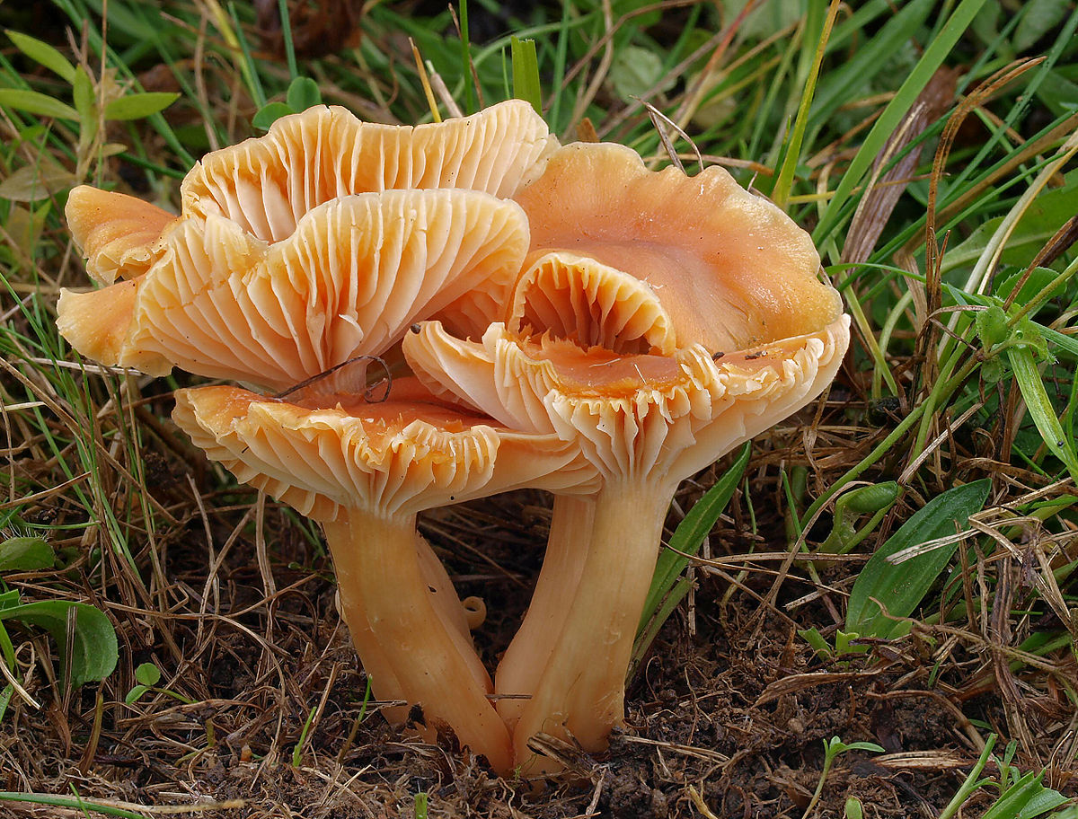
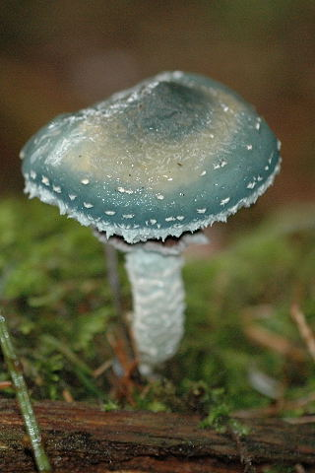
By Cap Colors - Stacked Bar Plot

Slide 5
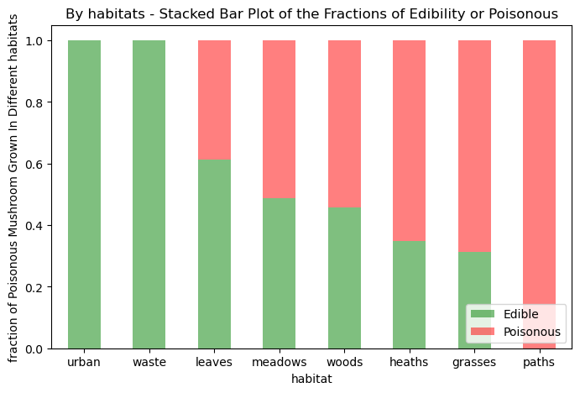
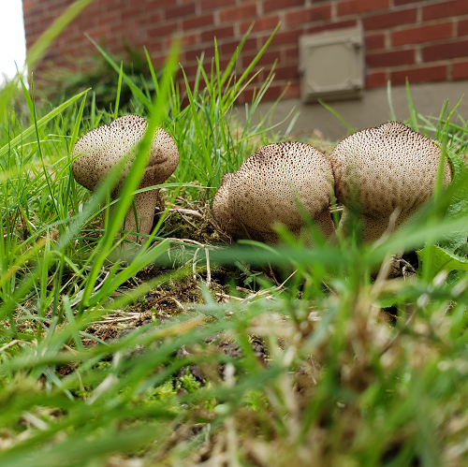
By Habitats - Stacked Bar Plot

Slide 6
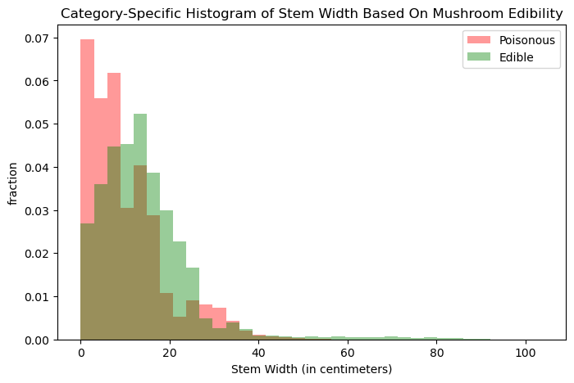
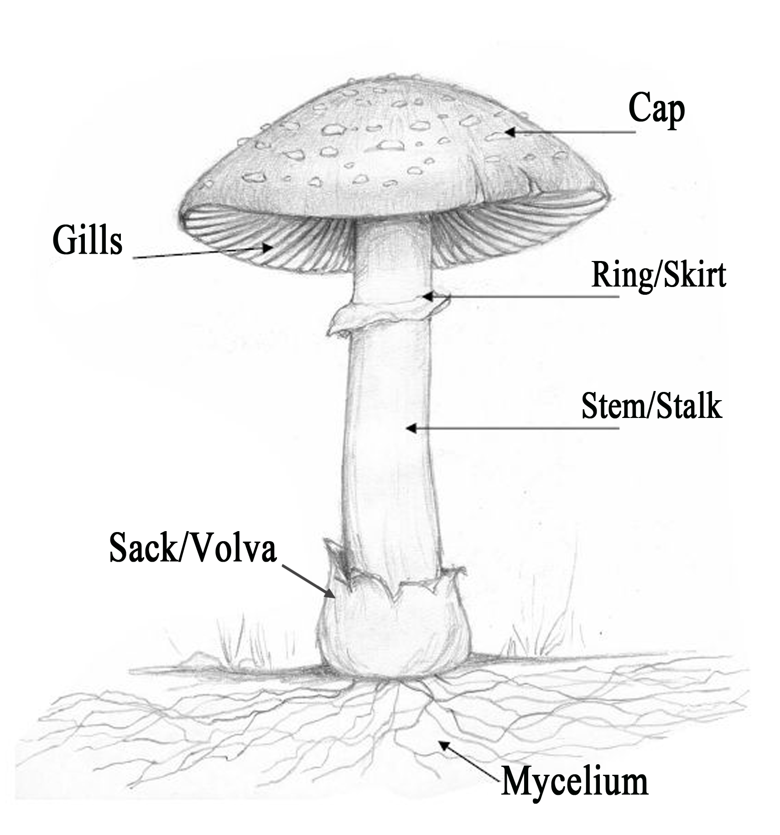
Category-Specific Histogram of Stem Width

Slide 7
Splitting
The ratio of target variable (classification) is about 4:6 for edible and poisonous respectively.
Use general train_test_split to set 15% of the dataset as test set and the rest 85% as other for Kfold Cross Validation.
The shape of each train, val, and test set are the following: X_other: (51908, 20), X_test: (9161, 20) y_other: (51908,) , y_test: (9161,)

Slide 8
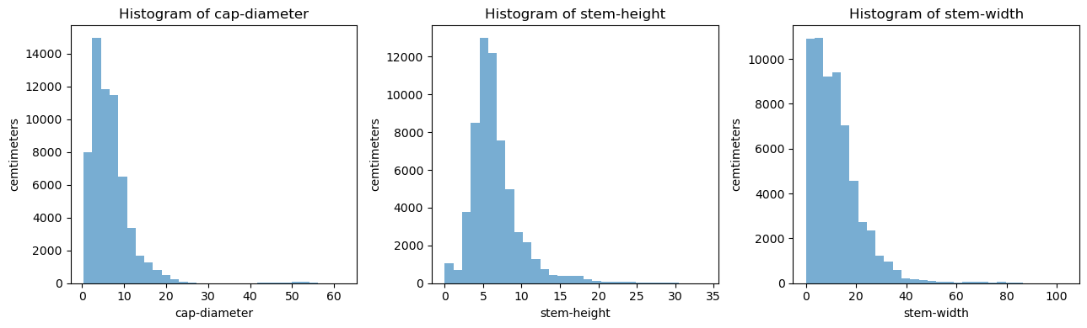
Preprocessing
2 preprocessors are used: (i) Unorder categorical data: one-hot encoder (ii) Continuous features: Standard Scalar
The continuous features are heavy tailed, thus choose standard scalar

Slide 9
After Splitting and Preprocessing…
Shape of X_other before transformation: (51908, 20) Shape of X_other after transformation: (51908, 124)
Most of the features are categorical data, thus the number of features after preprocessing increases
Decide not to drop any features

