Slide 1

Mushroom Edibility Classification
Kathy Wu
Data Science Institute at Brown University
Oct 19th, 2023
https://github.com/kathywu1201/Mushroom_Edibility_Classification_ML_Project

Slide 2

I want to know…
If there exists a mushroom that has never seen before, will it be edible or it is poisonous?
As the nature is evolving, new type of fungi come out, but how do we know if we are safe to eat it?
Create an app for people who are interested in picking wild mushroom themselves.
Help them to identify if the mushroom is safe to consume.
Notes:
I would like to use this ML model to reduce the dangerous of people who are trying to identify the edibility of an unseen type of mushroom. Before the arising of technology, the people who discovered new mushroom can only identify them by tasting them which is high risk.

Slide 3

Data Descriptions
Classification problem identifying if a new fungi is poisonous or not.
‘class’ feature as target variable.
Data from Kaggle, collected from Patrick Hardin’s Mushrooms & Toadstools, and inspired by Jeff Schlimmer’s Mushroom Data Set.
Original Data: 61069 rows, 21 columns.

Slide 4
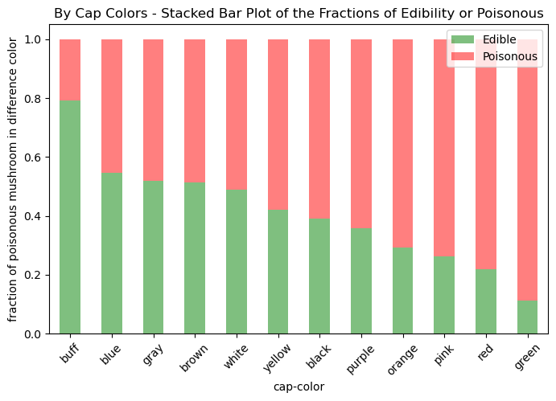
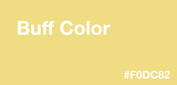
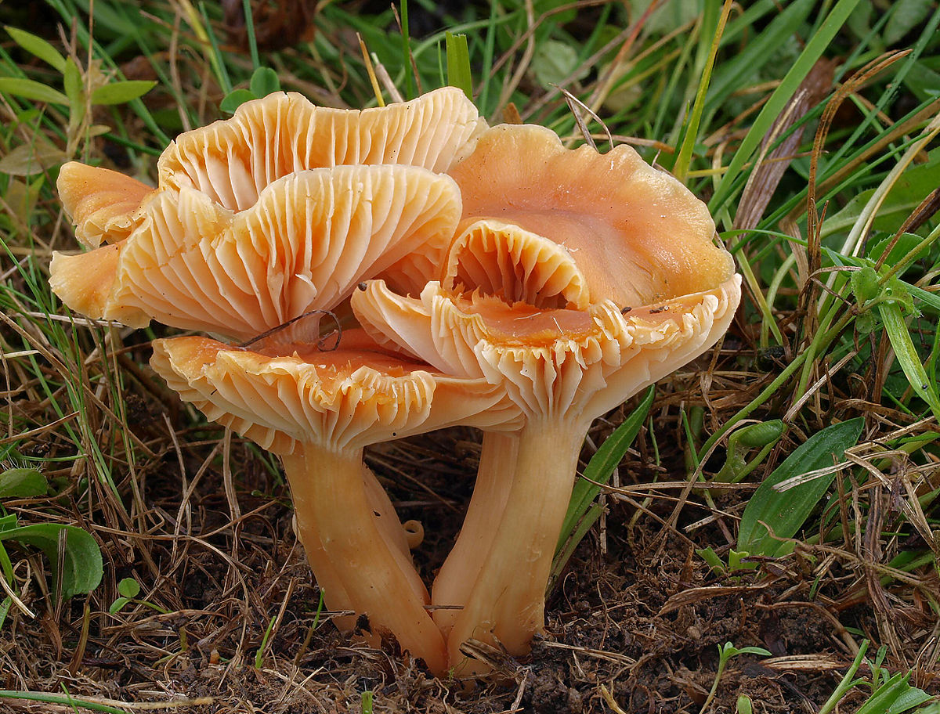
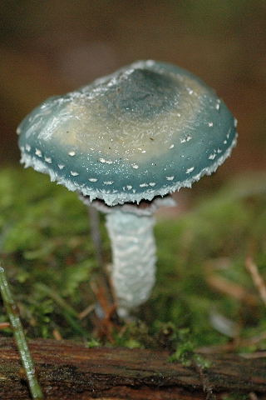
By Cap Colors - Stacked Bar Plot

Slide 5
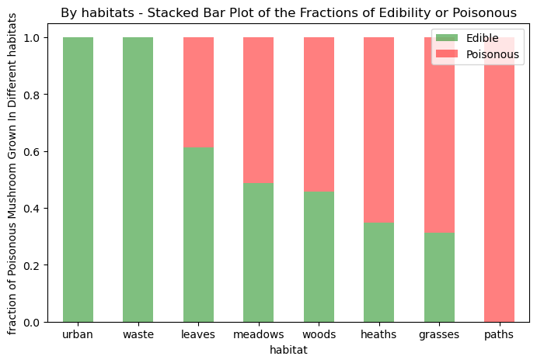
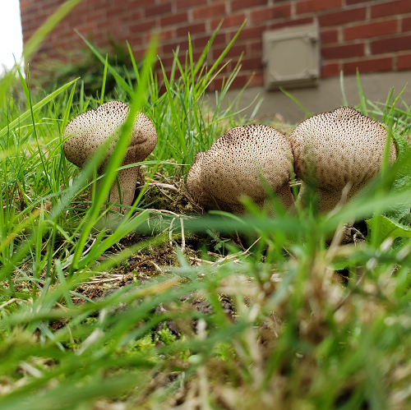
By Habitats - Stacked Bar Plot

Slide 6
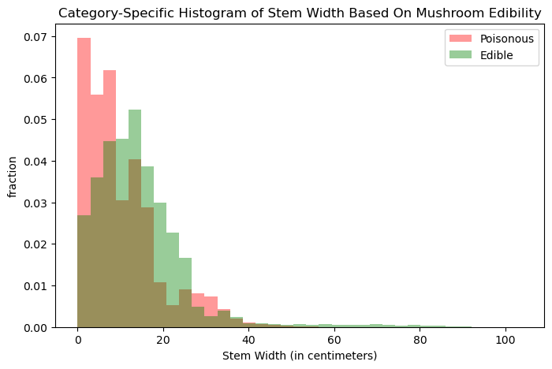
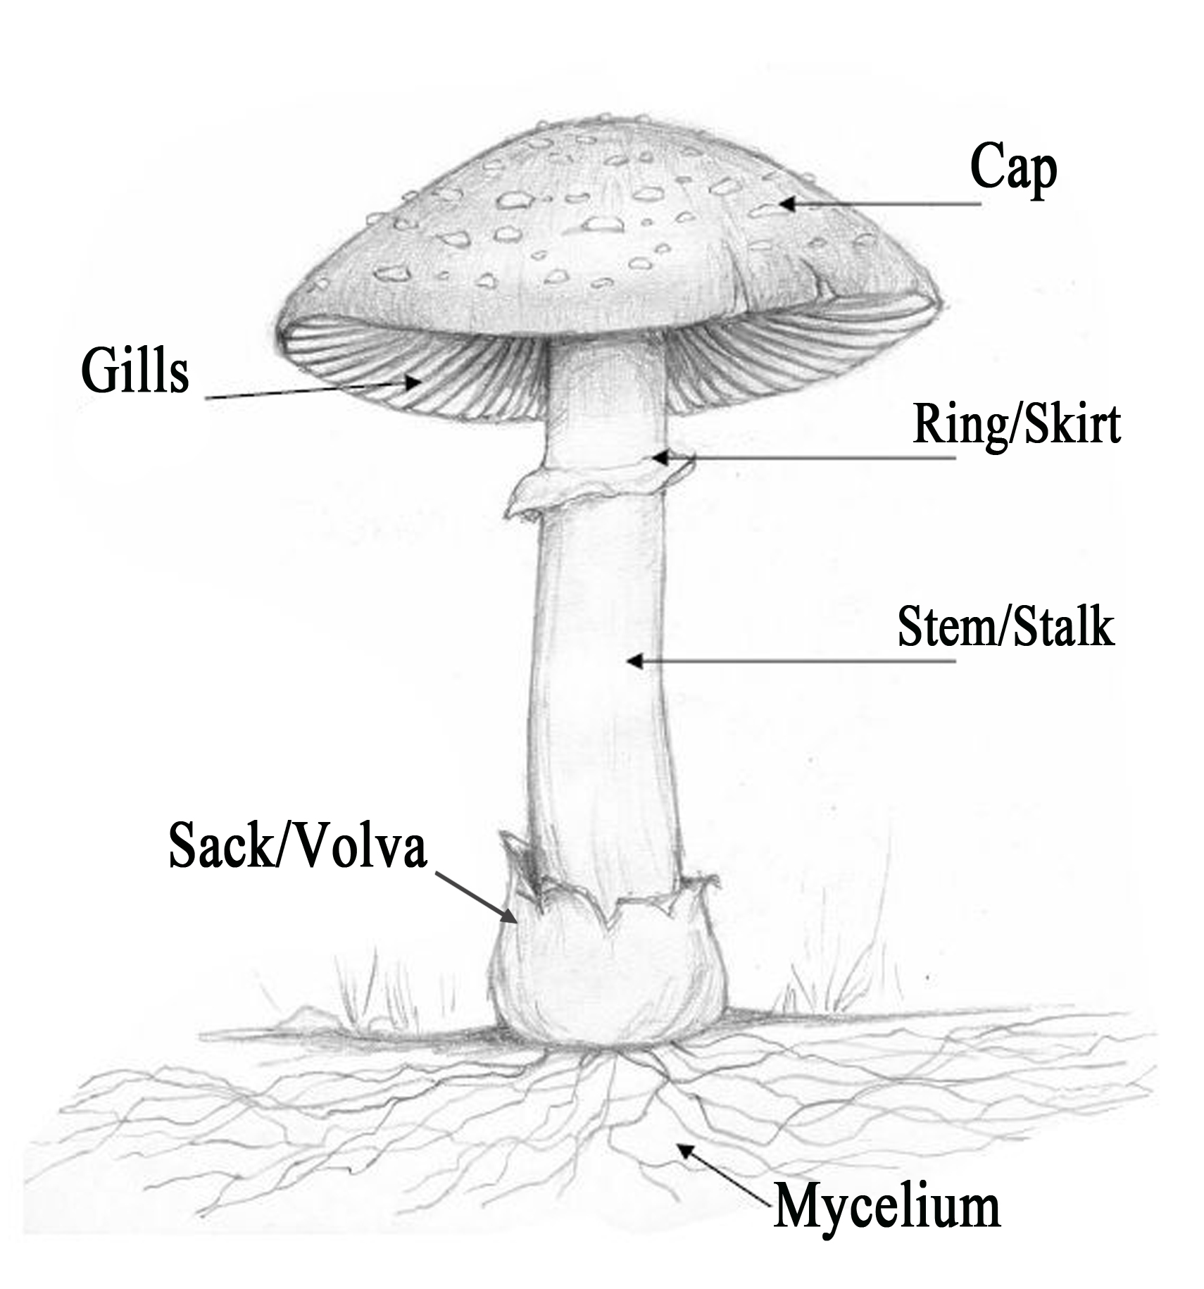
Category-Specific Histogram of Stem Width

Slide 7
Splitting
The ratio of target variable (classification) is about 4:6 for edible and poisonous respectively.
Use general train_test_split to set 20% of the dataset as test set and the rest 80% as other for Kfold Cross Validation.
The shape of each train, val, and test set are the following: X_other: (48855, 20), X_test: (12214, 20) y_other: (48855,) , y_test: (12214,)

Slide 8
Preprocessing
2 preprocessors are used: (i) Unorder categorical data: one-hot encoder (ii) Continuous features: Standard Scalar
Most of the features are categorical data and unordered: e.g. color, shape, surface, etc.
Two binary features - does-bruise-or-bleed and has-ring – will not perform any encoders

Slide 9
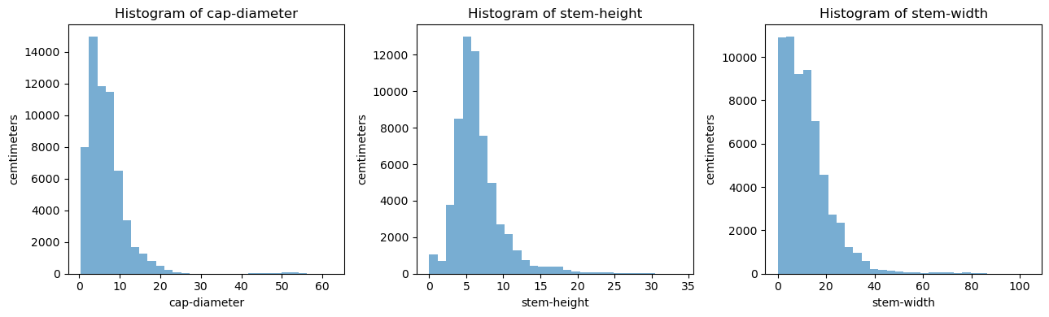
Standard Scalar
'cap-diameter', 'stem-height‘,'stem-width'
The features are heavy tailed, thus choose standard scalar

Slide 10
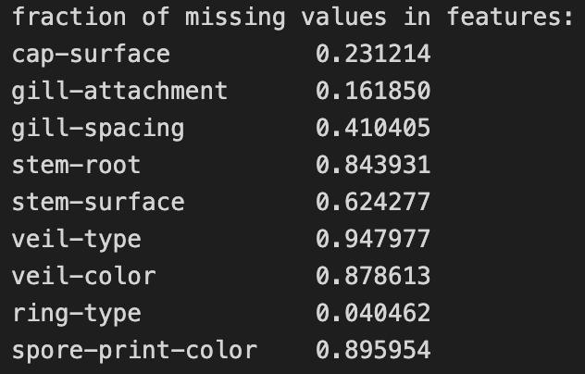
Missing Value
Among 20 features, 9 features contains missing values.
All the missing values are categorical data.
cap-surface, gill-attachment, gill-spacing, ring-type have less than 50% of missing
stem-root, stem-surface, veil-type, veil-color, spore-print-color have more than 50% of missing

Slide 11
After Splitting and Preprocessing…
Number of features before transformation: 20 Number of features after transformation: 124
Most of the features are categorical data, thus the number of features after preprocessing increases
No features contain missing values after transformation

Slide 12

Thanks for listening!

