Slide 1
Decision Trees, Random Forests, and Boosting

Slide 2
Agenda
Overview/contents
Regression
Describe Student Performance data set
Regression tree
Random forest
Boosting
Comparison of methods
Regression tree
Random forest
Boosting
Linear methods (least squares, ridge, lasso regression)
Classification
Describe Cervical Cancer data set
Classification tree
Random forest
Boosting
Comparison of methods
Classification tree
Random forest
Boosting
Linear methods (LDA, logistic regression, SVM)

Slide 3
Overview of Trees / Random Forrests

Slide 4
Overview of Boosting
Boosting is an supervised ensemble algorithm
Converts combination of weak learners to a strong learner
AdaBoost
Gradient Boosting

Slide 5
Pros
Decision Trees
Easy to interpret
Existing implementation to handle missing and multi-class categorical data
Random Forest
Better prediction than decision trees
Boosting

Slide 6
Cons
Decision Trees
Unstable predictions
Can perform worse than linear models when underlying relationship is in fact linear
Random Forest
Hard to interpret
Popular implementations cannot handle missing data
Boosting

Slide 7
Regression: Dataset
Describe Student Dataset

Slide 8
Regression: Decision Tree
Fit full tree with reasonable stopping rules
Tune complexity parameter based on cross-validation error
reg_t1 <- rpart(formula = medv ~ .,
data = house_train,
method = "anova",
control = rpart.control(minsplit = 10,
minbucket = 5,
cp = 0,
xval = 10))

Slide 9
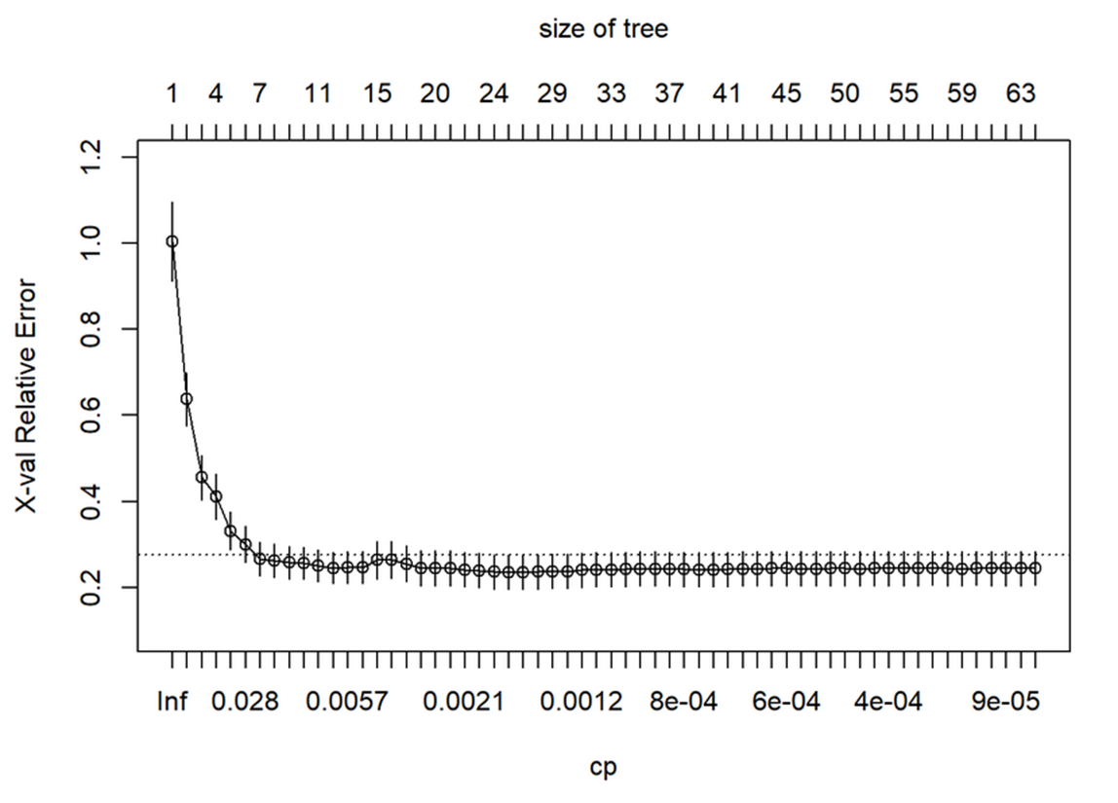
Regression: Decision Tree
A tree with 7 leaves (terminal nodes) appears to be optimal

Slide 10
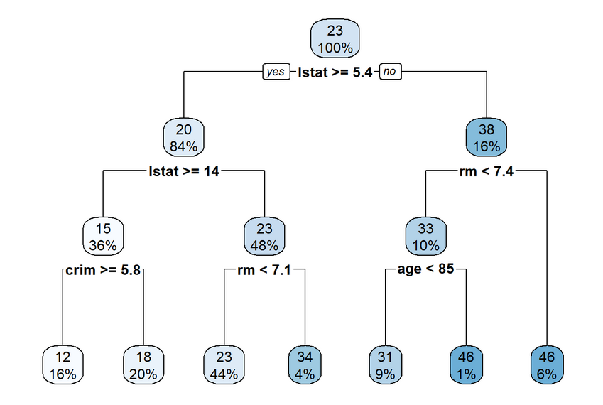
Regression: Decision Tree
Visual representation of pruned tree with 7 leaves

Slide 11
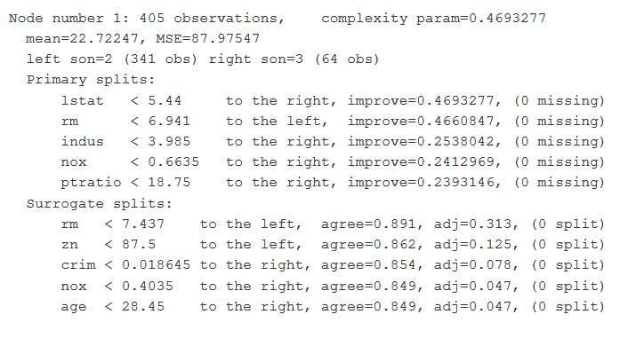
Regression: Decision Tree
rpart provides details on each split

Slide 12
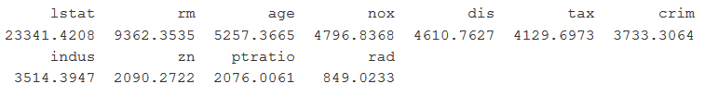
Regression: Decision Tree
Variable importance (ADD GRAPH)
Testing R-squared: 0.81
Training R-squared: 0.64

Slide 13
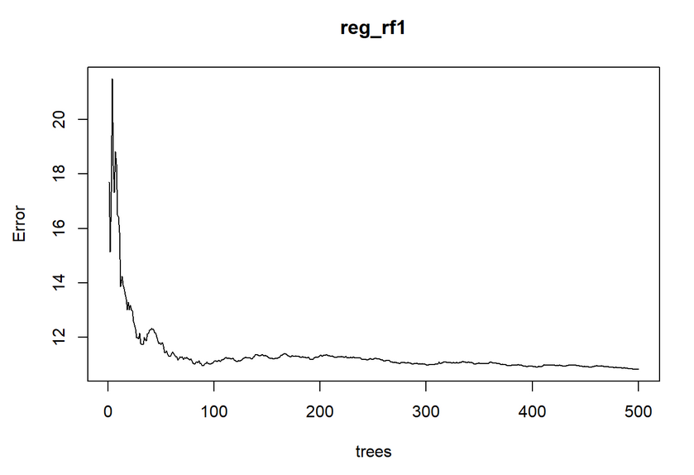
Regression: Random Forest
OOB error vs. number of trees using D/3 predictors for each tree
OOB error stabilizes after about 100 trees

Slide 14
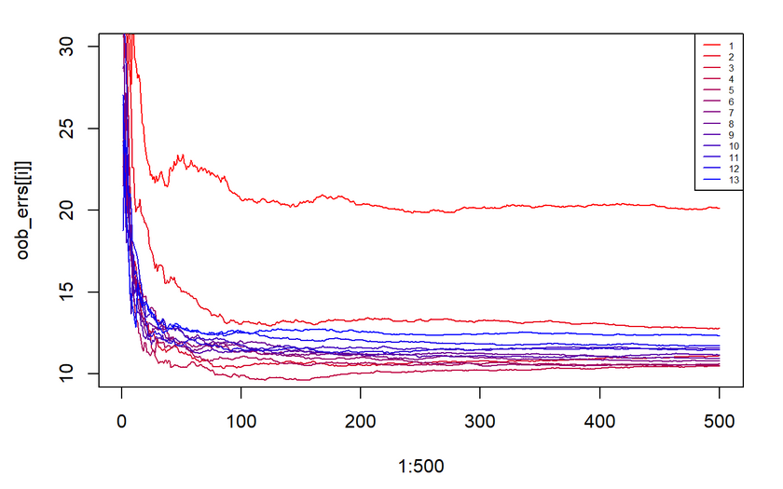
Regression: Random Forest
OOB error vs. number of trees using different numbers of predictors
The default, D/3 ~ 4 appears to be a good choice

Slide 15
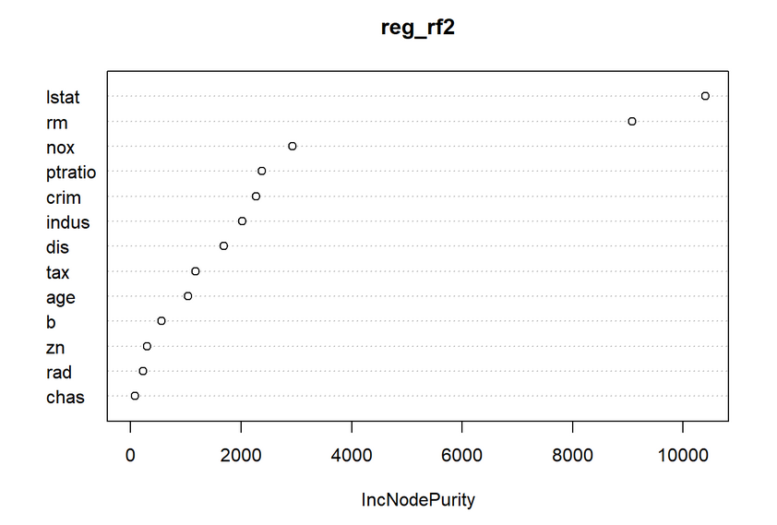
Regression: Random Forest
Variable importance
Training R-squared: 0.98
Testing R-squared: 0.81

Slide 16
Regression: Boosting

Slide 17
Regression: Model Comparison

Slide 18
Classification: Dataset
Cervical Cancer Dataset
Found here at UCI Machine Learning Repository
Contains Demographics, habits and historical medical records for 858 patients
Continuous: Age, # sexual partners, pregnancies, # STD’s, etc.
Binary: HPV, HIV, AIDS, Smoker, etc.

Slide 19
Classification: Decision Tree
Describe Student Dataset

Slide 20
Classification: Random Forrest
Describe Student Dataset

Slide 21
Classification: Boosting
Describe Student Dataset

Slide 22
Classification: Model Comparison
Describe Student Dataset

