Slide 1
Apache Commons Validator Library
Software Dependability – UNISA – February 2024.
Prof. Dario Di Nucci
{
Software Dependability Analysis
}
Katia Melanie Perchet

Slide 2
Content
01
02
03
Project Goals
Apache Commons Validator
Analysis SonarCloud
04
Code Coverage
05
Mutation Testing
06
Benchmarking Tools
07
Automated Tests
08
Software Vulnerabilities

Slide 3

Project Goals
It is aim to provide a comprehensive evaluation of the Apache Commons Validator library's dependability, addressing aspects of code quality, test coverage, security, and performance.
}
..

Slide 4

Apache Commons Validator
Is an open-source Java library which provides the ability to verify the integrity of incoming data, both client-side and server-side.
}
..

Slide 5
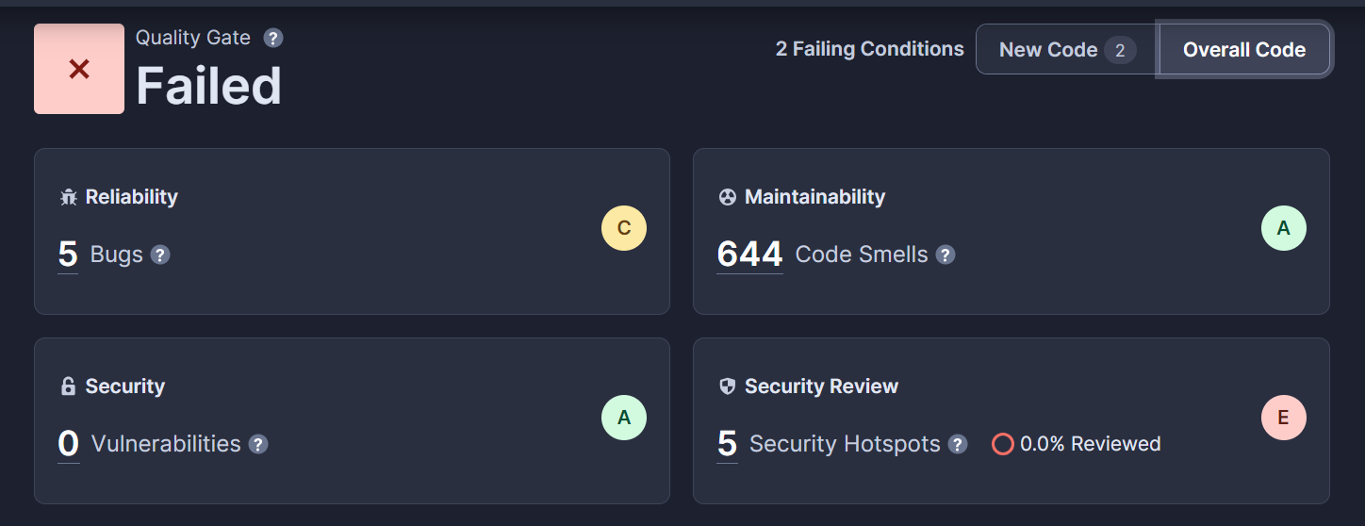
SonarCloud Analysis
{
Issues
After a thorough analysis of the project, the report revealed an extensible list of issues.
}

Slide 6
Issues Found
36
168
480
*
HIGH
MEDIUM
LOW
- Clone methods
- Serializable or transient variables
- Empty methods
- Absence of assertions in tests
- Extensive ReGex
- Nested try-catch - Inappropriate constructor’s visibility
- Wrong of method arguments
- Deprecated and commented code.
- Singleton Pattern
- Boolean literals
- Public modifiers in Tests

Slide 7

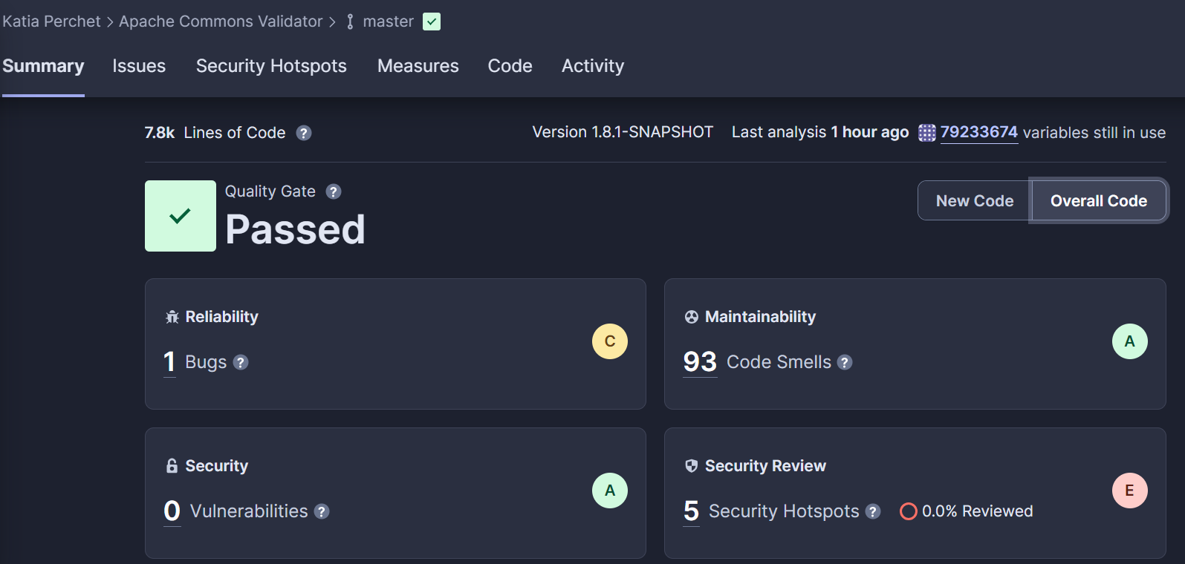
Issues Fixed
Addressed the majority of issues, of which four of the bugs were fixed and five hundred and fifty-one code smells
*

Slide 8

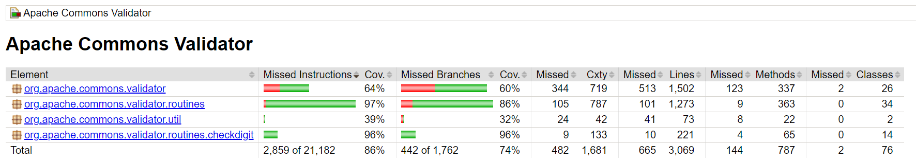
Code Coverage
It generated comprehensive report that points to specific sections of the code exercised by the tests.
JaCoCo
Report

Slide 9
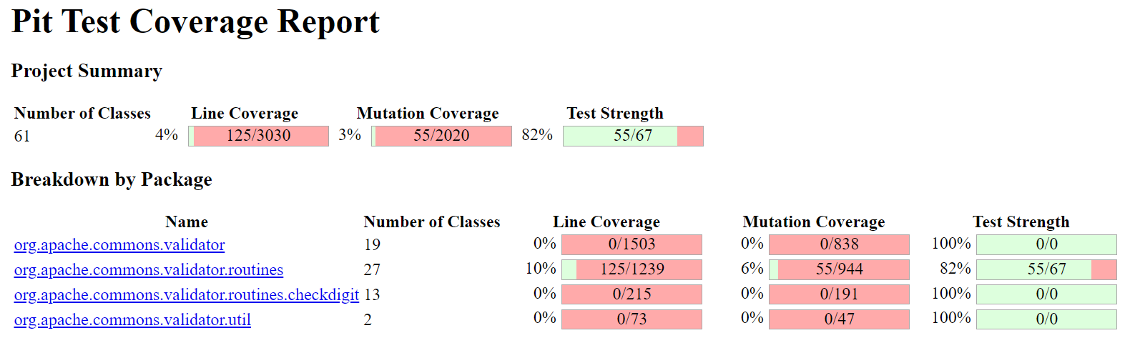
Mutation Testing
{
..
It aims to enhance test adequacy and pinpoint defects within the codebase by revealing weaknesses in test coverage.
PiTest
Report
*
}

Slide 10

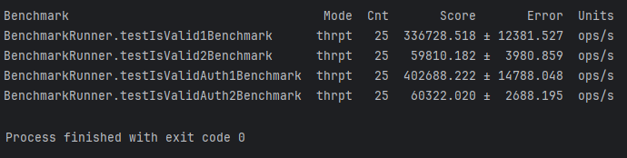
Benchmarking Tools
Java Microbenchmarking Harness (JMH)
Tool designed for the precise and dependable benchmarking of Java code, facilitating accurate measurement and analysis within a controlled and well-defined framework.
..

Slide 11

Automated Testing Generation
EvoSuite
Generated test suites with two primary goals: maximizing a specified coverage criterion and minimizing the suite's size in terms of the number of tests and statements.
Results
This process resulted in the creation of 129 new tests for enhanced code coverage. Each class was equipped with two types of tests: the primary test and accompanying scaffolding classes.
*

Slide 12

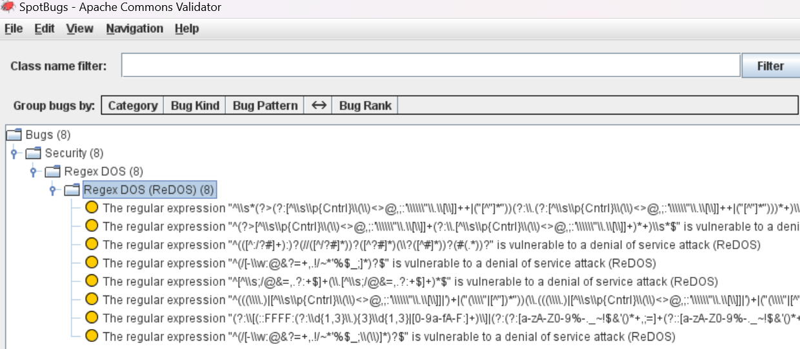
Software Vulnerabilities
FindSecBugs
Automated security analysis tool, leveraging its capabilities to scrutinize Java code comprehensively.

Slide 13
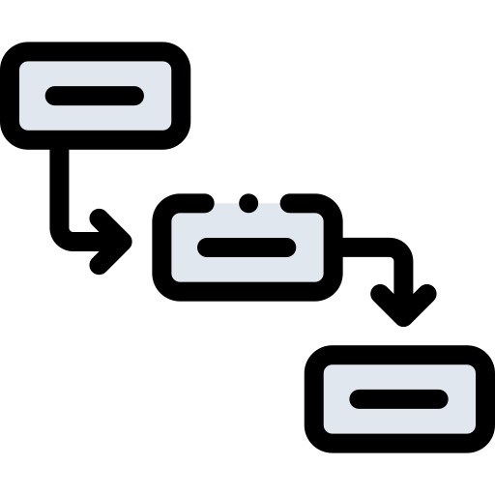
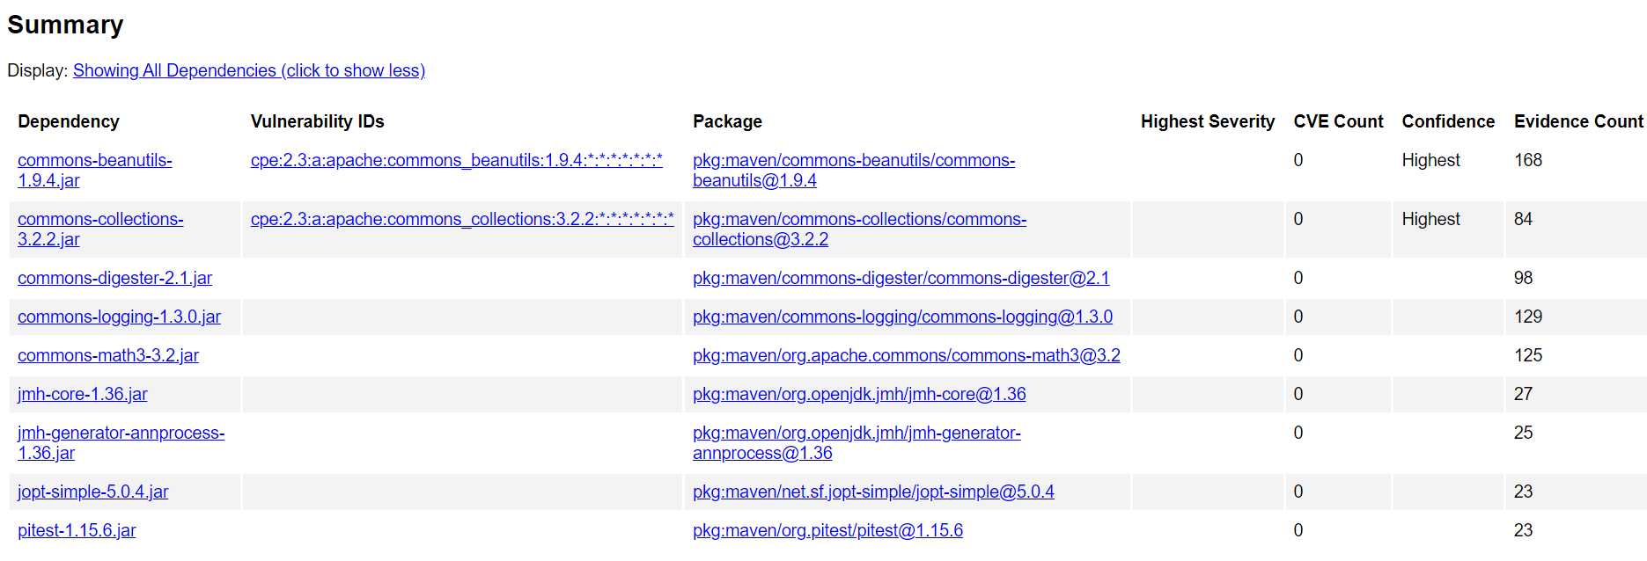
Software Vulnerabilities
OWASP Dependency Check
Helped to identify and mitigate security risks associated with third-party dependencies.

Slide 14

Conclusion
{
..
The implementation of these tools has significantly elevated the Apache Commons Validator project's dependability, significantly enhanced its overall quality, reliability, and security.
Adopting these practices as part of a continuous improvement strategy will fortify the existing project and promote a culture of excellence and resilience in software engineering.
}
..

Slide 15
Thank you.
{
..
}
..

