Slide 1
Welcome to class!

Slide 2
Good Charts

Slide 3
Chapter 6: Refine to Persuade
You are trying to reveal truths dormant in the data; to make a case; compete for attention.
It is often the [data scientists] job to show all the data - to be as objective as possible.
There is a difference between:
Data presentation
Data analysis
Persuasion with data

Slide 4
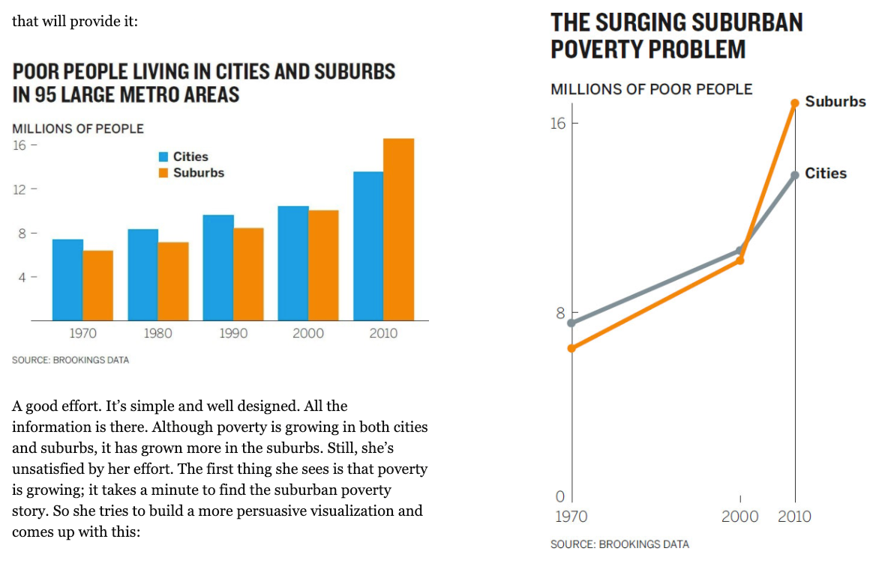
Chapter 6: Line Charts vs. Bar Charts

Slide 5
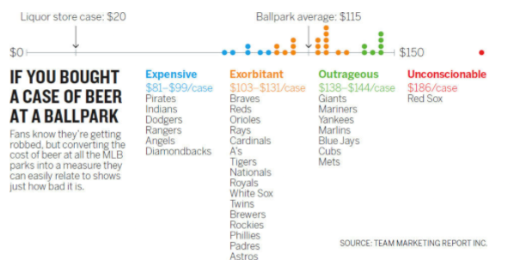
Chapter 6: Heighten the effect

Slide 6
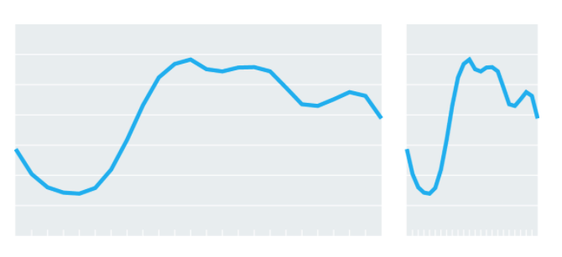
Chapter 6: Every chart is a manipulation

Slide 7
Chapter 6: Every chart is a manipulation
“Perfectly objective visualizations don’t exist, because perfectly objective brains don’t exist.”

Slide 8
Supplemental Reading

Slide 9
Editing your graphic in Tableau: Part 2
Sorting
Filters
Tooltips
Annotations
Grouping

Slide 10
Tools Activity
Can you make this chart?

Slide 11
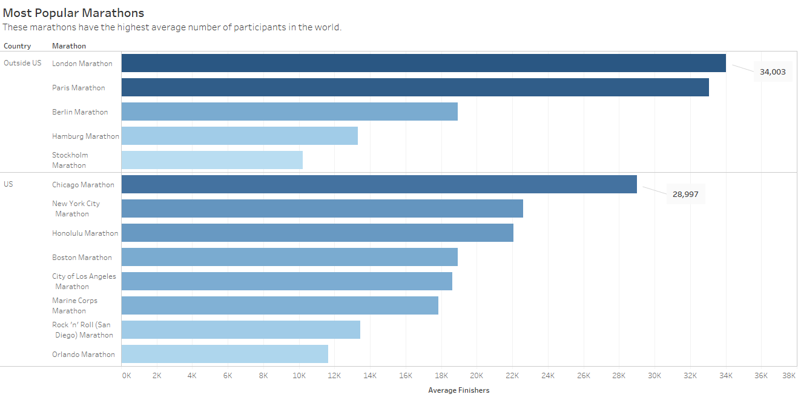

Slide 12
Case Study

