Slide 1
ImPro Professional Image Processing Application for Analytic Color Filtering
Final Presentation
Lab on Apps Development for Android
Ecole Polytechique Fédérale de Lausanne
Katie Jones and Frederike Dümbgen 29.01.2016

Slide 2
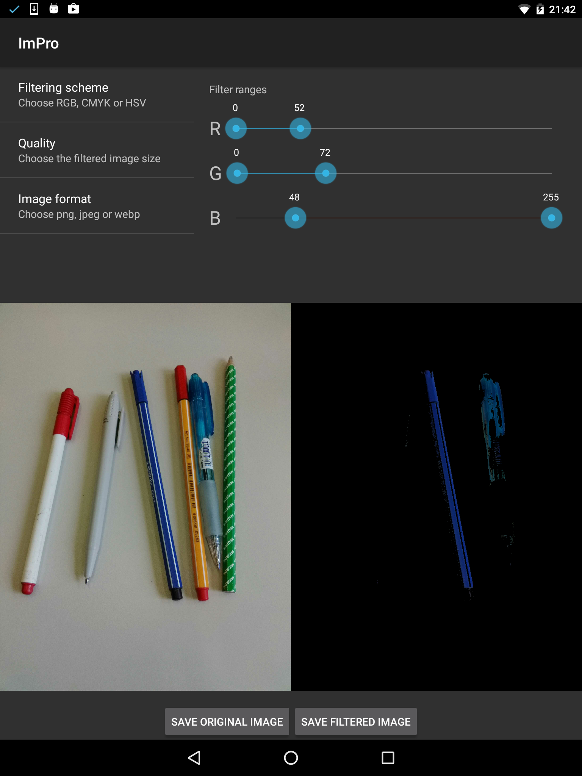
Introduction Application Idea

Slide 3
Global Structure Image capture
LiveFragment
MainActivity
AutoFit Textureview
FileOpener Fragment
MainFragment
Load image from external storage
StillFragment
Save image
filtered + textfile
original + SQL
Image View
Original
Image View
Filtered
FileNamePicker Fragment

Slide 4
Global Structure Filtering setup
Menu Fragment
Colorbar Fragment
MainActivity
Filtering Scheme
RGB
CMYK
HSV
Quality
5-100%
Image format
.png
.jpeg
.webp
Filter range
for each component
MainFragment

Slide 5
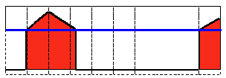
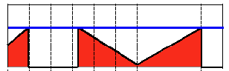
Important Aspects Image Processing
Color Conversion RGB/HSV/CMYK
OpenCV for common RGB/HSV
Own implementation for unsupported format CMYK
Thresholding
Local, pixelwise implementation
Filtering Intent created to run in background
Pictures saved as png, jpg or webp. Applied filter

Slide 6
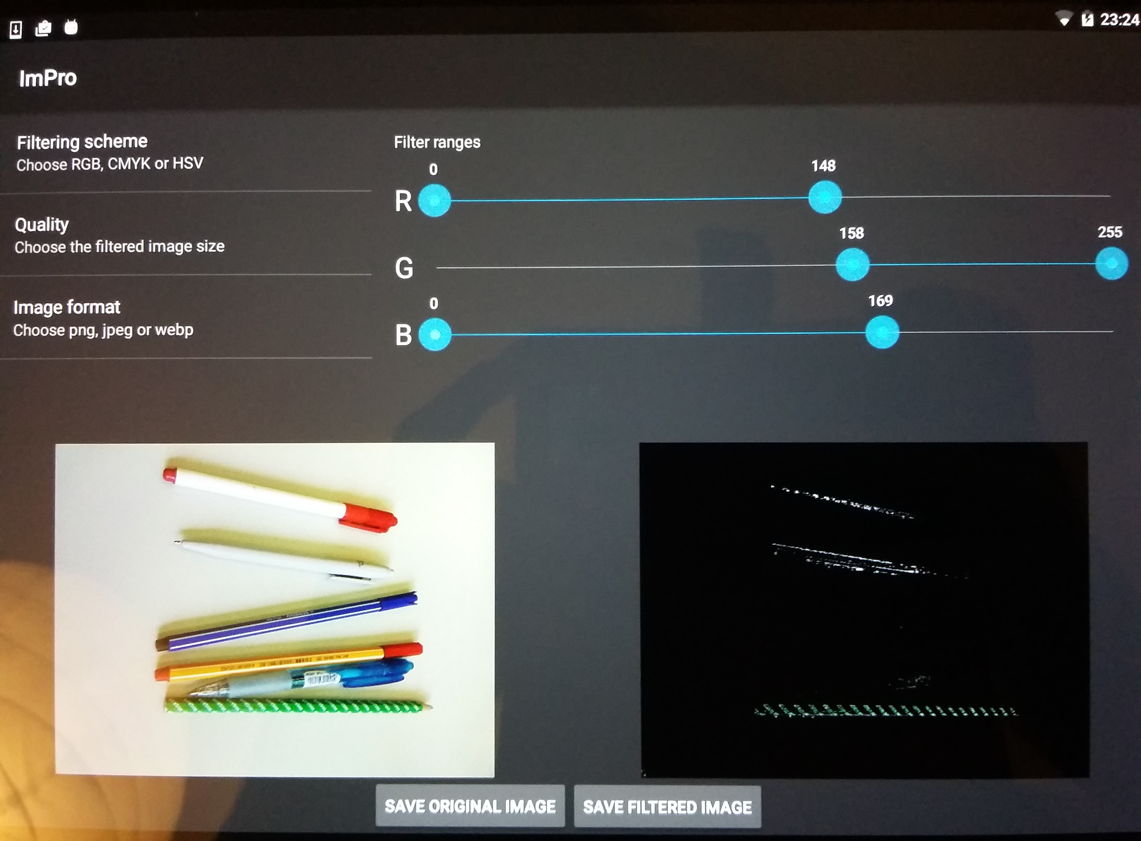
Important Aspects Camera Handling
android.hardware.camera2 interface to handle cameras
Camera view adapts to scale and rotation of screen

Slide 7
Important Aspects SQLite Database
Allows to save filter parameters together with original image.
When original image loaded, corresponding filter and compression are directly applied.
Saved values:
filename
quality
type
filtersettings
id

Slide 8
Conclusion Suggested Improvements
Filtering
Filter range from max to min (e.g. 150 to 20)
Live filtering in addition to still filtering
Layout
Change fragment layout for smartphones
Use back button to switch between fragments
Help buttons for user comfort

Slide 9
Thank you

