Slide 1

Click-Through Rate Predictions for Product Email Campaigns
Katie Adams
DSC 680 – Capstone
Winter 2022/23

Slide 2

Email Campaigns
"An email campaign is a sequence of marketing efforts that contacts multiple recipients at once. Email campaigns are designed to reach out to subscribers at the best time and provide valuable content and relevant offers." (SendPulse, 2022)
Notes:
Email campaign success is measured on how often the end user opens the email campaign email and clicks on the call to action (CTA) link embedded in the email.

Slide 3
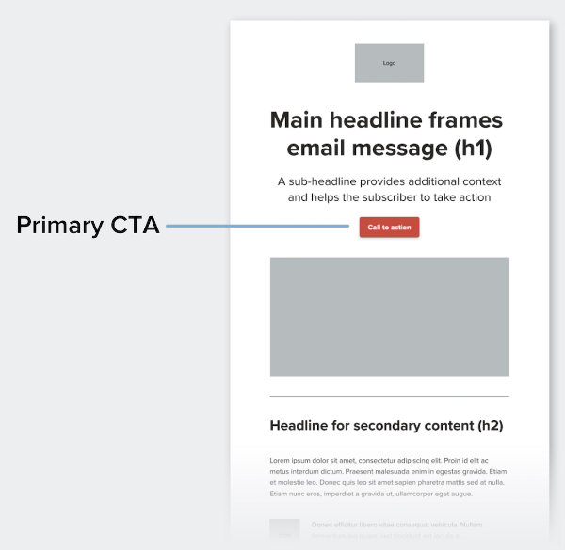
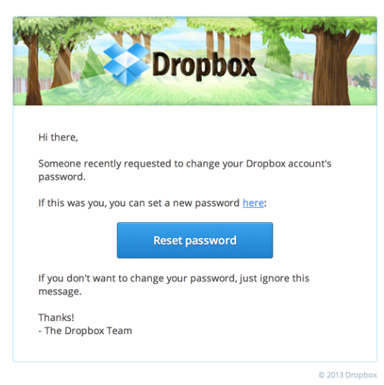
Call to Action (CTA)
Within an email campaign there are embedded calls to action (CTA), which can include things like requesting that the end user reboot their device or complete a survey on the quality of the device remediation (e.g., how the device is performing after a BIOS update or Antivirus enablement)
Notes:
To measure the success of the email campaign, Click Through Rate (CTR) of the CTA is used, where the higher the CTR the better the email campaign is
A good email click-through rate will vary by industry and type of email, but on average a good click-through rate is about 2.5%

Slide 4
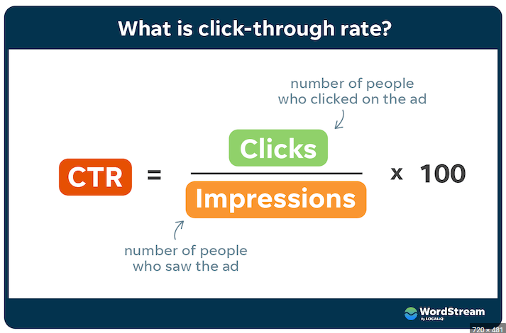
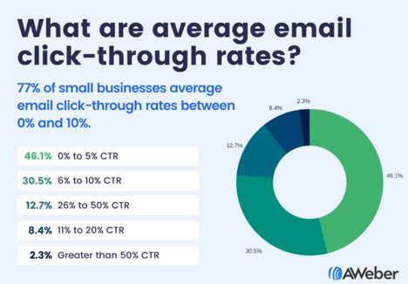
Click-Through Rate (CTR)
“In Internet marketing, CTR stands for click-through rate: a metric that measures the number of clicks advertisers receive on their ads per number of impressions." (Wordstream, 2022)
Notes:
“The formula for CTR looks like this: (Total Clicks on Ad) / (Total Impressions) = Click-Through Rate... A high CTR means that a high percentage of people who see your ad click it.” (Wordstream, 2022)

Slide 5
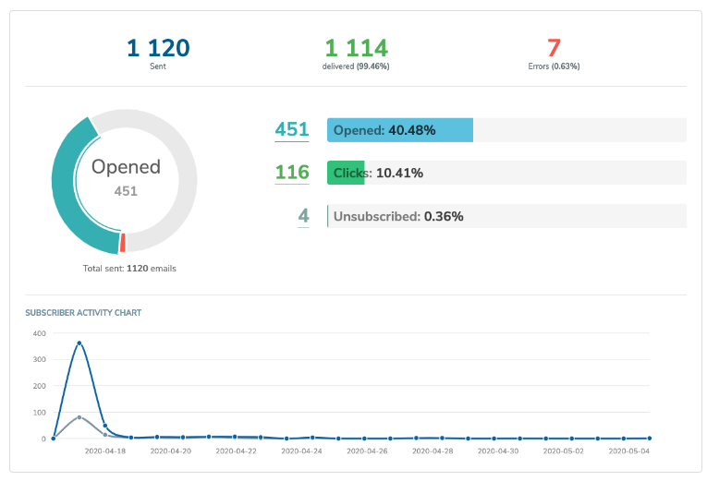
Predicting CTR
As a Product Team, we rely on email campaigns to communicate with our end users about how successful a recent feature implementation, defect or bug fix, and software upgrade is
We measure that success by calculating the CTR of the CTA
Notes:
In looking at past CTRs of email campaigns, we can use statistical modeling to predict the CTRs and if the model performance is acceptable, use it for email campaigns going forward.

Slide 6
Dataset Features
Predicting CTR
Feature Name | Feature Description
campaign_id | Unique identifier of a campaign
sender | Sender of an e-mail
subject_len | No. of characters in a subject
body_len | No. of characters in an email body
mean_paragraph_len | Average no. of characters in paragraph of an email
day_of_week | Day on which email is sent
is_weekend | Boolean flag indicating if an email is sent on weekend or not
times_of_day | Times of day when email is sent: Morning, Noon, Evening
category | Category of the product an email is related to
product | Type of the product an email is related to
no_of_CTA | No. of Call To Actions in an email
mean_CTA_len | Average no. of characters in a CTA
target_audience | Cluster label of the target audience
is_image | No. of images in an email
is_quote | No. of quotes in an email
is_personalised | Boolean flag indicating if an email is personalized to the user or not
is_discount | Boolean flag indicating if an email contains a discount or not
is_urgency | Boolean flag indicating if an email contains urgency or not
is_timer | Boolean flag indicating if an email contains a timer or not
is_price | Nominal price listed in email body
click_rate | Click Through Rate, (Total Clicks on CTA) / (Total Impressions)
To understand what email campaign factors are most related to or most predictive of click-through rate (single characteristics and interactions) an open-source dataset from Kaggle was used with 1888 rows and 22 columns of past email campaigns
Notes:
Each dataset column represents a factor or feature that is a measurable piece of data that can be used in this analysis

Slide 7
Discovery
The majority of email campaigns:
Have 50-100 characters in a subject, a mean character count of 10-50, between 0 and 5 Call to Actions, a target audience of cluster number 12, and an average mean character length between 40-50
Are related to product category 15 and product type 9, 5, and 34
Were sent on Tuesday-Thursday (weekdays) and in the evening
Contained 0-2 images, 0-3 quotes, no emoticons, no personalizations, no discounts, no urgent flags and all contained email timers
Email campaigns related to products 3, 22, 27, 36 and 40, flagged as urgent, have an embedded price between 0 and 1500, have a discount embedded, 0-5 Calls to Action (CTA), and Product 27 have the highest click-through rate (CTR)
Correlations
Positively correlated features: mean_paragraph_length, day_of_week, is_weekend, and product
Negatively correlated features: subject_len, body_len, category, and no_of_CTA
Chi-Squared
These are the Chi-Squared 5 Best Features: is_emoticons, is_discount, is_price, is_urgency, target_audience
Notes:
In simple words, higher the Chi-Square value the feature is more dependent on the response and it can be selected for model training." (Gajawada, 2022)

Slide 8
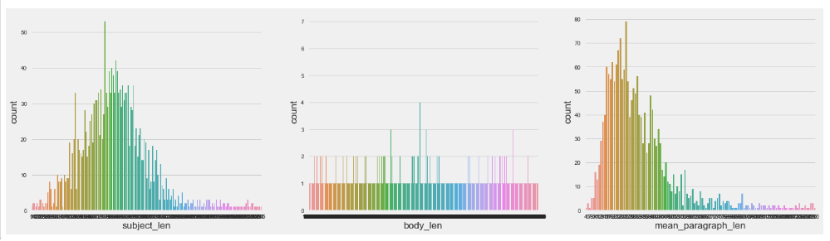
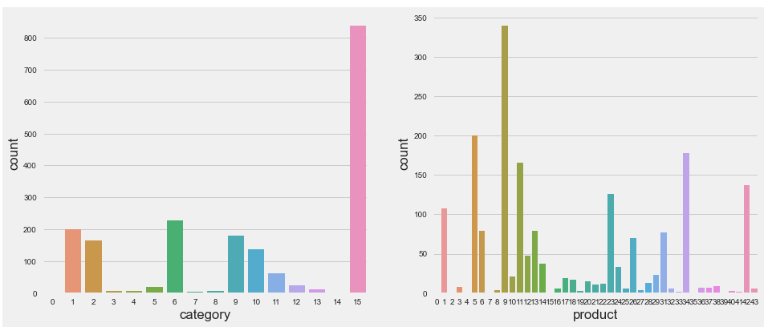
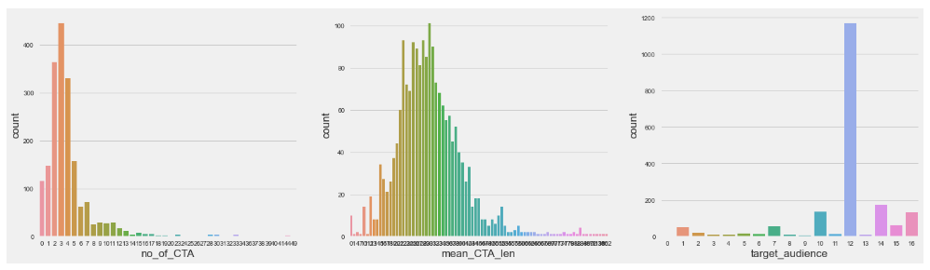
Discovery: Single Features

Slide 9
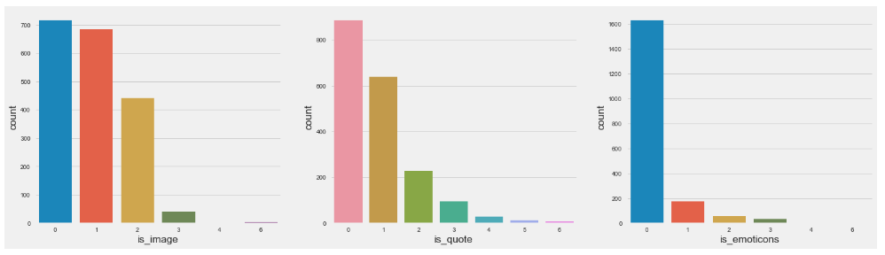
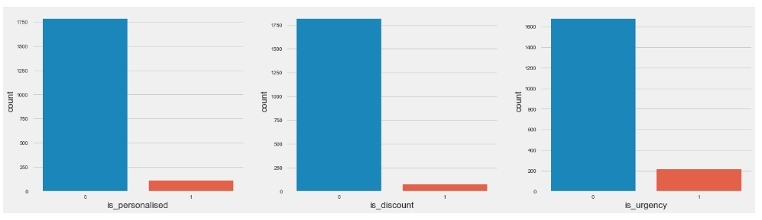
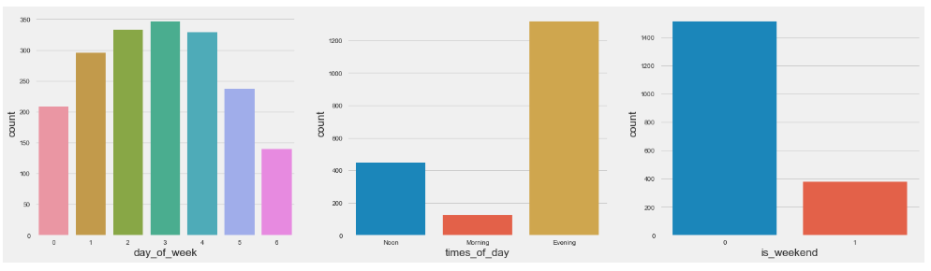
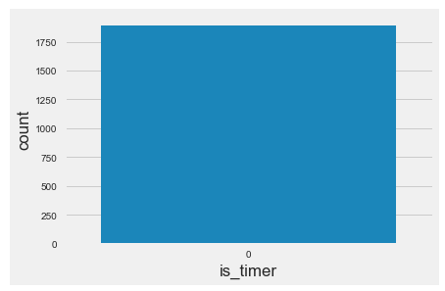
Discovery: Single Features

Slide 10
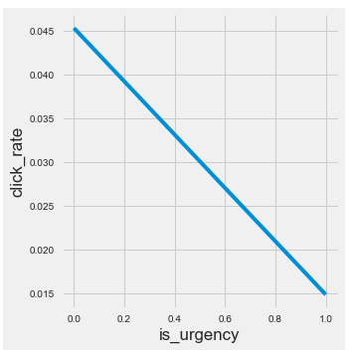
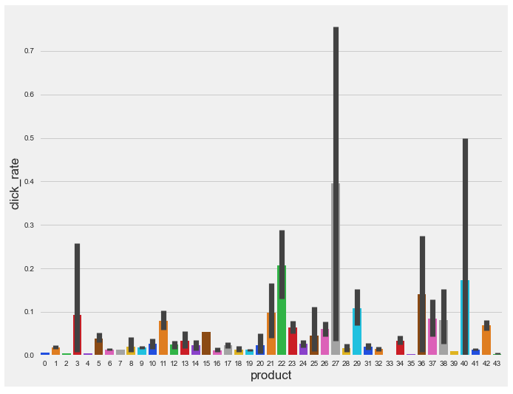
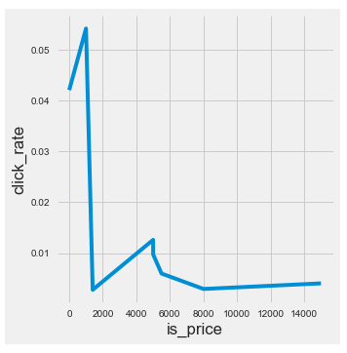
Discovery: Multiple Features

Slide 11
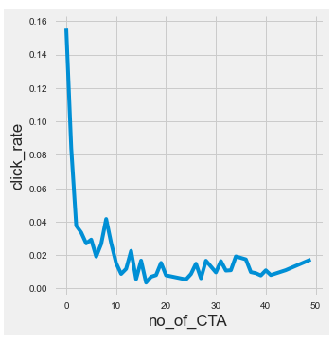
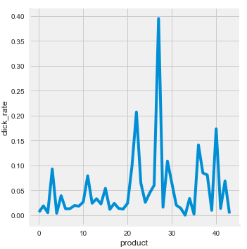
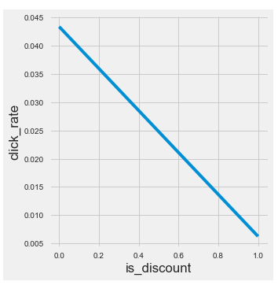
Discovery: Multiple Features

Slide 12
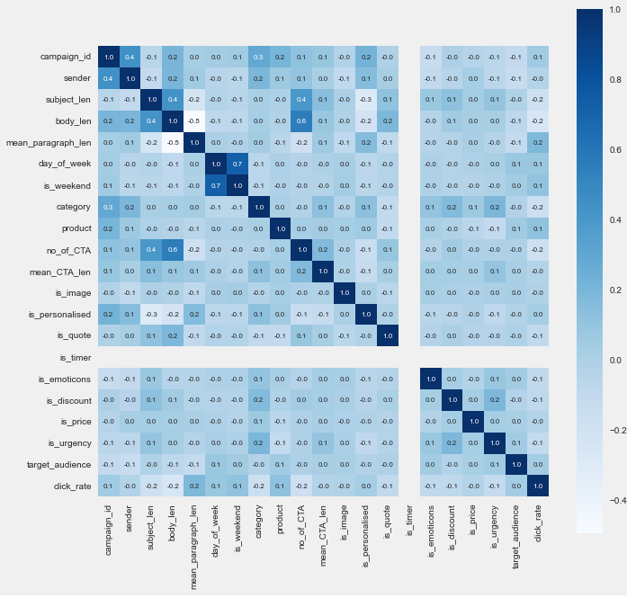
Discovery: Multiple Features

Slide 13
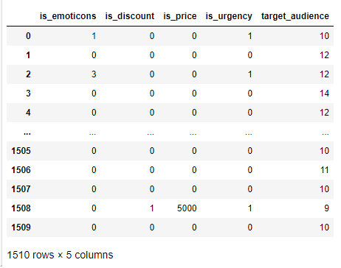
Discovery: Multiple Features
Notes:
In simple words, higher the Chi-Square value the feature is more dependent on the response and it can be selected for model training." (Gajawada, 2022)

Slide 14
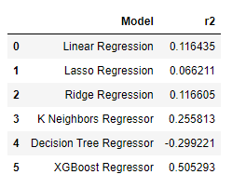
To determine how click-through rate (CTR) can be best predicted, the R2 (performance) value of regression models were compared to each other The model with the best R2 value was selected, which was XGBoost Regressor
Methods

Slide 15
Linear Regression has different performance metrics than Logistic Regression, and they are:
Mean Squared Error (MSE)
Mean Absolute Error (MAE) Root Mean Squared Error (RMSE) R-squared or Coefficient of Determination
Methods

Slide 16
Results
Model | Cross Validation Score | K-Fold CV Average | MSE | RMSE | R2
XGBoost Regressor all Features | 0.33 | 0.43 | 0.00 | 0.06 | 0.56
XGBoost Regressor all Features click_rate transformed to its log | 1.00 | 1.00 | 0.00 | 0.00 | 1.00
XGBoost Regressor 5 Best Features click_rate transformed to its log | 0.08 | 0.10 | 0.00 | 0.07 | 0.07

Slide 17
Results
The XGBoost Regressor model with the target variable and all features performed well, with an R2 of 0.56
The XGBoost Regressor model with the target variable and the 5 best features from chi squared did not perform well, with an R2 of 0.07
The XGBoost Regressor model with the target variable transformed to its log and all features performed the best, with an R2 of 1.00
This will be the model of choice to implement with the Product Team to predict the click-through rate of the email campaigns
Notes:
Reason why 5 best Features didn't perform well: In this dataset, the subjects were not selected randomly so this is most likely why the model performance was lower than expected

Slide 18

Recommendations
When advising the Product Team on how to develop a successful email campaign, these are the recommendations:
The XGBoost regression model with click_rate (target variable) transformed to log should be moved forward as the model of choice as the model performance (R2) was excellent
When creating new email campaigns and before sending them out, it is advised to enter in the email campaign feature information into the model and review the predicted click-through rate and ensure the rate is 2.5% or above
Notes:
If the predicted click-through rate is 2.5% or above (as described above as a good click-through rate), the email campaign should be sent out as-is. If the click-through rate is below 2.5%, then the email campaign features should be adjusted starting with the positively correlated features and then rerun through the model to determine the predicted click-through rate.

Slide 19
Recommendations
It is also recommended to focus on the features that are positively correlated with click-through rate when creating new email campaigns:
Mean Paragraph Length of email body
Day of the week the email campaign is sent
Type of Product

Slide 20

Ethical Implications
Ethically, it's important to not emphasize click-through rate so much that it causes the Product Team to inflate CTR, “Online advertising is facing a new form of challenge – the artificial inflation of click-through rates. We call this practice ‘cyber-rigging’.” (Fisher, 2006).
In analyzing this data, it's important to mention that the results should not be used to increase cyber-rigging and the Product Team should be made aware of this unethical practice

Slide 21

Next Steps
Step 1:
Do a real-life beta test using email campaign data from the Product Team and input the dataset into the XGBoost model with click_rate (target variable) transformed to log
Notes:
This will ensure that more real-world scenarios that relate or do not relate to click-through rate are captured in the dataset

Slide 22
Next Steps
Step 2:
Interview Product Team members for possible methods of improvement. Examples of feedback include different data repositories, new features/measurements from email campaigns (e.g., email campaign scheduled delivery, geographic location of receiver), possible anecdotal features that Product Team members have observed in the field

Slide 23

References
Wordstream. (2022, November 17). Click-through rate (CTR): Understanding CTR for PPC. WordStream. Retrieved December 4, 2022, from https://www.wordstream.com/click-through-rate
Fisher, J. (2006). Cyber-rigging click-through rates: Exploring the ethical dimensions. Retrieved December 20, 2022, from https://www.researchgate.net/publication/45436601_Cyber-rigging_click-through_rates_Exploring_the_ethical_dimensions
Yashwanth, N. V. S. (2021, January 1). Evaluation metrics & model selection in linear regression. Medium. Retrieved December 21, 2022, from https://towardsdatascience.com/evaluation-metrics-model-selection-in-linear-regression-73c7573208be
Dhinakaran, A. (2022, December 9). Best practices in ML observability for click-through rate models. Medium. Retrieved December 20, 2022, from https://towardsdatascience.com/best-practices-in-ml-observability-for-click-through-rate-models-8a0c6755a49a \
Zach. (2020, April 24). What is a good R-squared value? Statology. Retrieved December 20, 2022, from https://www.statology.org/good-r-squared-value/ \
Gajawada, S. K. (2022, September 28). Chi-square test for feature selection in machine learning. Medium. Retrieved December 22, 2022, from https://towardsdatascience.com/chi-square-test-for-feature-selection-in-machine-learning-206b1f0b8223
Forst, K. (2022, January 7). Improve your click-through rate: 14 powerful tactics. AWeber. Retrieved December 22, 2022, from https://blog.aweber.com/email-marketing/14-powerful-tactics-to-increase-your-email-click-through-rates.htm
SendPulse. (2022, December 1). What is an Email Campaign: Definition and Guide. SendPulse. Retrieved December 22, 2022, from https://sendpulse.com/support/glossary/email-campaign

