Slide 1


Term Paper Presentation: Major League Baseball
Katie Adams
DSC 530
Summer 2021

Slide 2
Statistical Question
What Major League Baseball (MLB) team stats impact team wins the most?

Slide 3
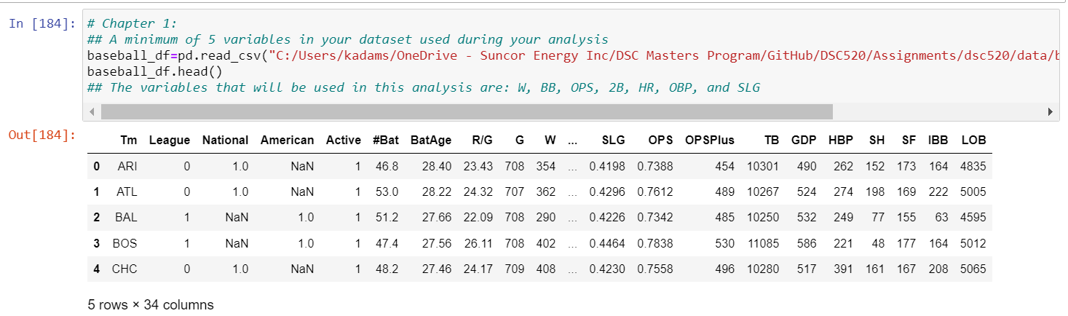
Dataset Variables
W: Number of Wins
BB: Bases on Balls/Walks
OPS: On Base+Slugging Percentage
Double: Doubles
HR: Home Runs
OBP: On Base Percentage
SLG: Slugging Percentage
Notes:
1. The implications of these findings to the MLB team scouts looking to recruit new baseball players is that they should look generally at the highly correlated variables of the model: R/G (Runs Scored Per Game), PA (Plate Apperances), R (Runs Scored/Allowed), 2B (Doubles), HR (Home Runs), RBI (Runs Batted In), BB (Bases on Balls/Walks), OBP (On Base Percentage), SLG (Slugging Percentage), OPS (On Base+Slugging Percentage), OPS+ (On Base+Slugging Percentage adjusted to player's ballpark), and TB (Total Bases). Also, they should highly focus of BB (Bases on Balls/Walks) as it is highly statistically significant within the linear regression model.
2. For the current 2021 MLB season, we can expect that the variable OPS (On Base+Slugging Percentage) will have a larger positive effect on the number of Team wins, where SLG (Slugging Percentage) and OBP (On Base Percentage) have a larger negative effect on number of wins. In looking at the current MLB Team Standing data for 2021 (in which the MLB season is halfway done), we can expect that MLB teams the Boston Red Sox, Toronto Blue Jays, and Houston Astros have the highest probability of winning more games as they have the highest team OPS.

Slide 4
Description of Dataset Variables
W (Wins): Number of Team Wins
BB (Bases on Balls/Walks): A walk (or base on balls) occurs when a pitcher throws four pitches out of the strike zone, none of which are swung at by the hitter. After refraining from swinging at four pitches out of the zone, the batter is awarded first base
OPS (On Base+Slugging Percentage): Adds on-base percentage and slugging percentage to get one number that unites the two. It's meant to combine how well a hitter can reach base, with how well he can hit for average and for power
Doubles (Double): When batter hits the ball into play and reaches second base without the help of an intervening error or attempt to put out another baserunner
HR (Home Run): When a batter hits a fair ball and scores on the play without being put out or without the benefit of an error
OBP (On Base Percentage): How frequently a batter reaches base per plate appearance (hits, walks and hit-by-pitches). Does not include errors, times reached on a fielder's choice or a dropped third strike
SLG (Slugging Percentage): Total number of bases a player records per at-bat (does not include walks and hit-by-pitches in its equation)

Slide 5
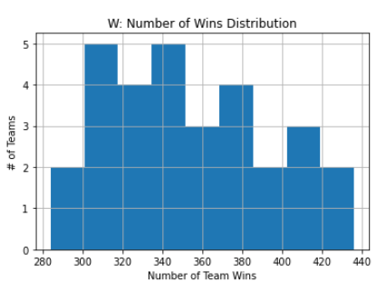
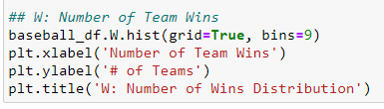
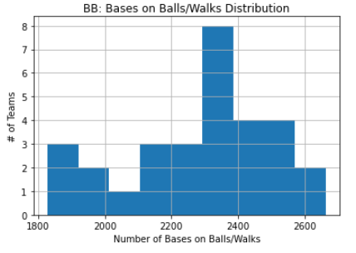

Histograms of Variables
In this particular dataset, all the values sit very close to each other, so the histograms do not show outliers clearly (if there are any)
To double check for outliers, a boxplot was created to confirm the outliers that the histogram could not show easily

Slide 6
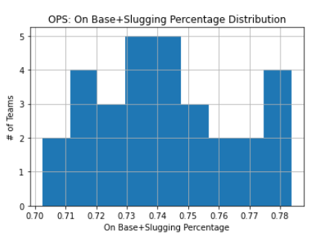
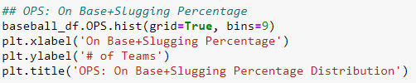
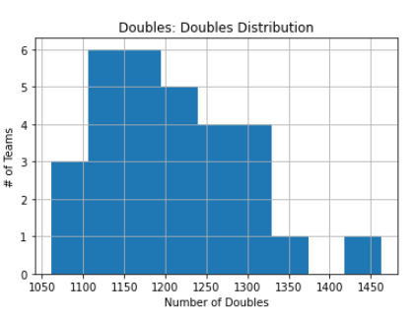
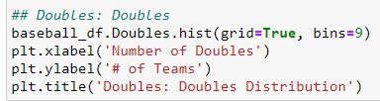
Histograms of Variables
In this particular dataset, all the values sit very close to each other, so the histograms do not show outliers clearly (if there are any)
To double check for outliers, a boxplot was created to confirm the outliers that the histogram could not show easily

Slide 7
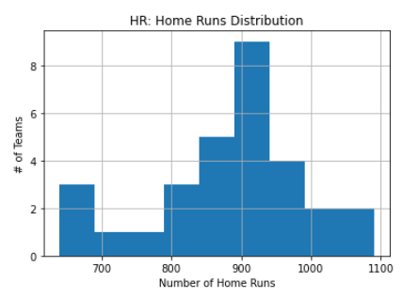
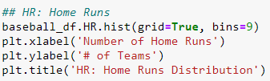
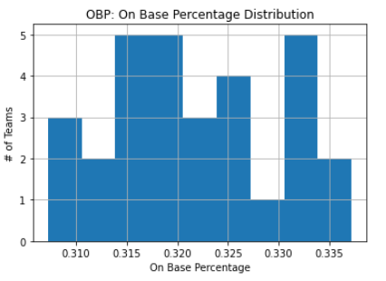
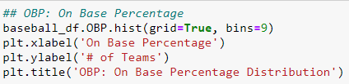
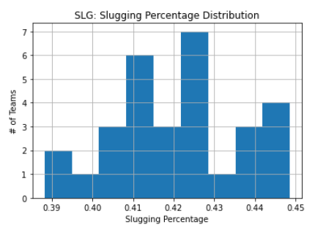
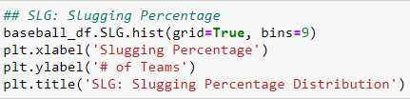
Histograms of Variables
In this particular dataset, all the values sit very close to each other, so the histograms do not show outliers clearly (if there are any)
To double check for outliers, a boxplot was created to confirm the outliers that the histogram could not show easily

Slide 8
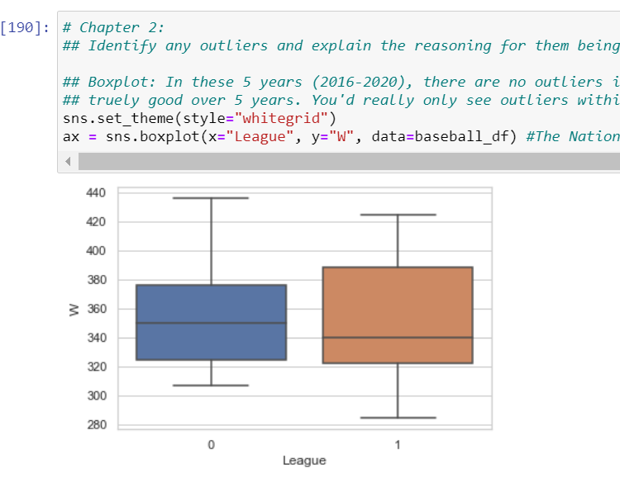
Boxplot of MLB Leagues & Number of Wins
In this 5-year dataset (2016-2020), there are no outliers in this dataset because no team is going to be truly bad or truly good over a 5-year span
Outliers would only be seen in single 1 season

Slide 9
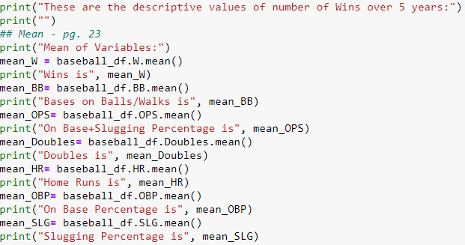
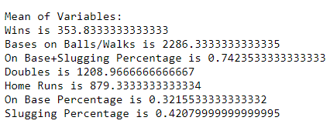
Descriptive variable characteristics: Mean
These are the Mean values over 5 years:

Slide 10
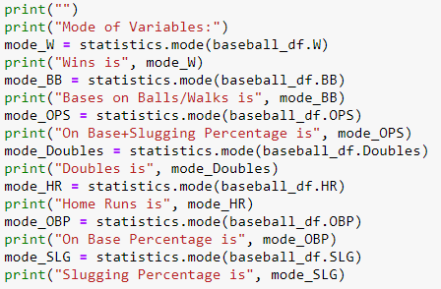
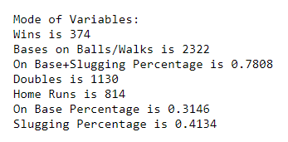
Descriptive variable characteristics: Mode
These are the Mode values over 5 years:

Slide 11
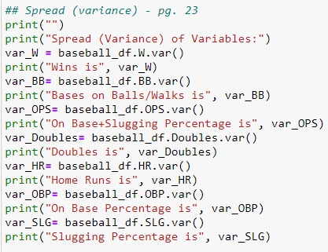
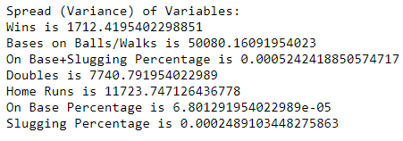
Descriptive variable characteristics: Spread
These are the Spread values over 5 years:

Slide 12
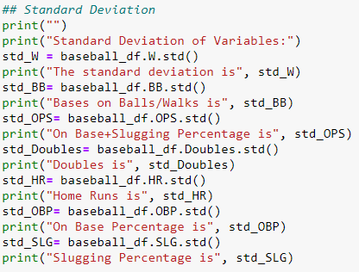
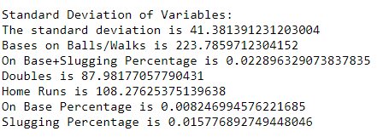
Descriptive variable characteristics: Standard Deviation
These are the Standard Deviation values over 5 years:

Slide 13
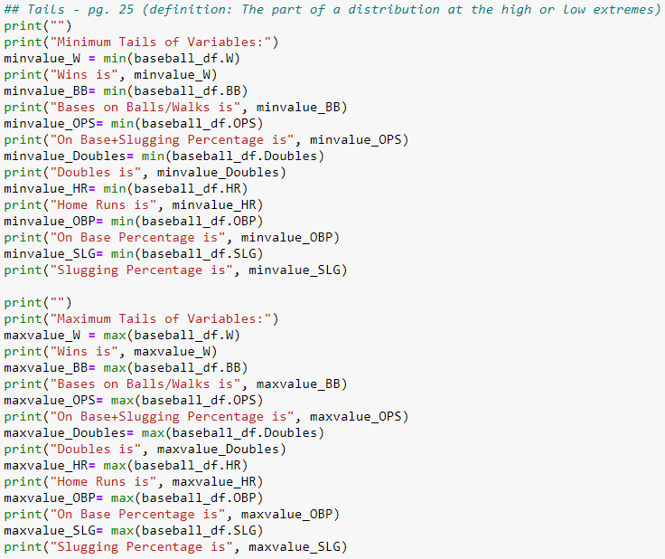
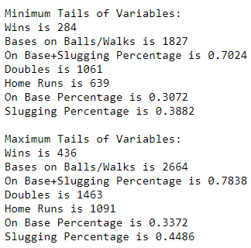
Descriptive variable characteristics: Tails
These are the Tail values over 5 years:

Slide 14
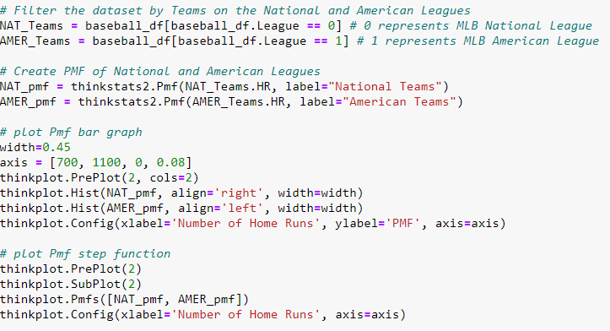
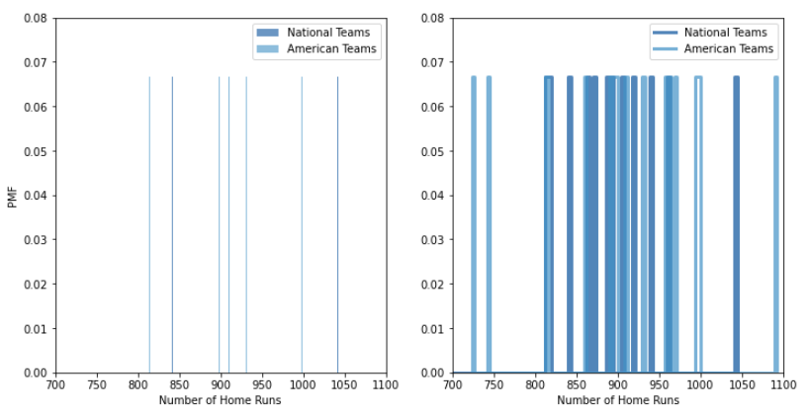
PMF: Comparing Two Scenarios
In this analysis, two distributions of the sample are compared: The number of home runs in the MLB American and National Leagues
Results: The PMF shows that over 5 years, there is very little difference in the number of home runs between the American and National Leagues

Slide 15
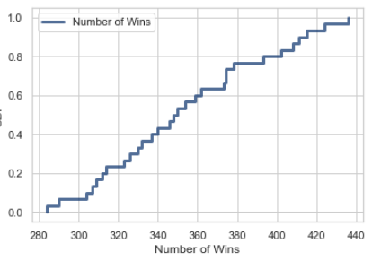
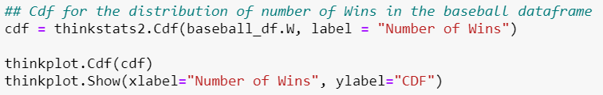
CDF With 1 Variable
The CDF shows that the variable's (Team Wins, W) mode (374) is clearly visible, with about 10% of the Teams have less than 300 wins, about 10% have more than 420 wins, and about 90% have less than 420 wins over 5 years.
The question of this term paper is "What Major League Baseball (MLB) team stats impact team wins the most?"
Results: So, in this case, since we are only looking at the CDF of 1 of the variables, it is not possible to answer the question at this point since it depends on comparing Wins to another variable in the dataset.

Slide 16
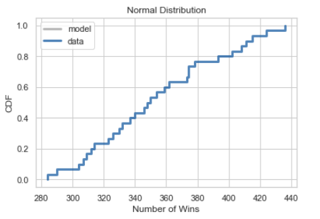
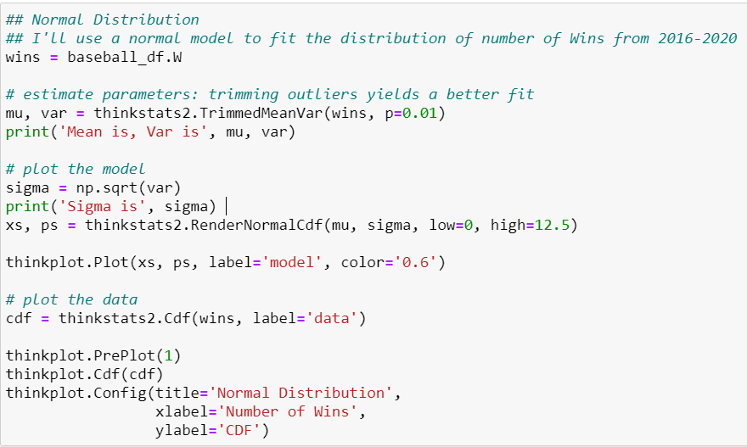
Analytical Distribution Plot
Normal Distribution

Slide 17
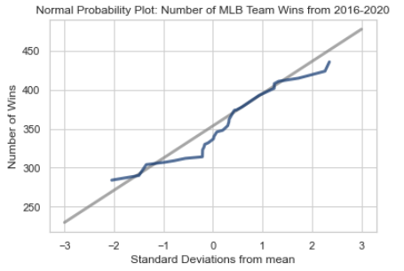
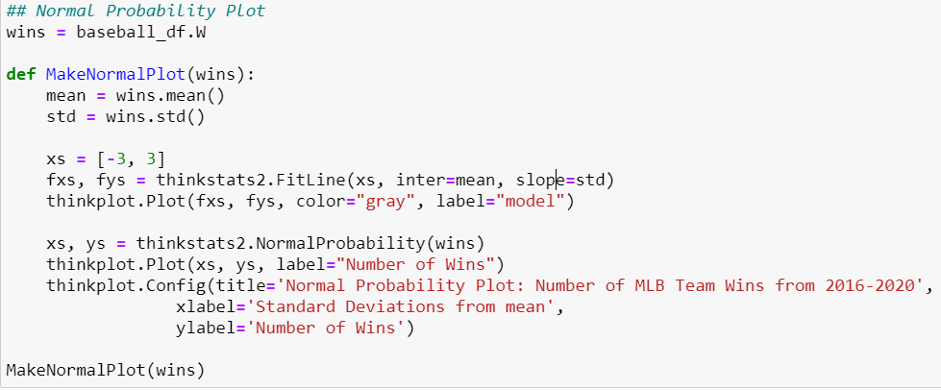
Analytical Distribution Plot
Normal Probability Plot

Slide 18
Analytical Distribution Plots
Results: These two analytical distribution plots (Normal CDF, Normal Distribution, Normal Probability Plot) tell us that the dataset is normally distributed
This normal distribution is to be expected as this was a large dataset (Central Limit Theorem)

Slide 19
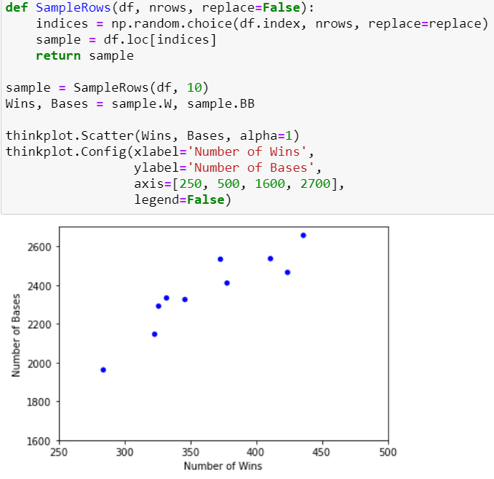
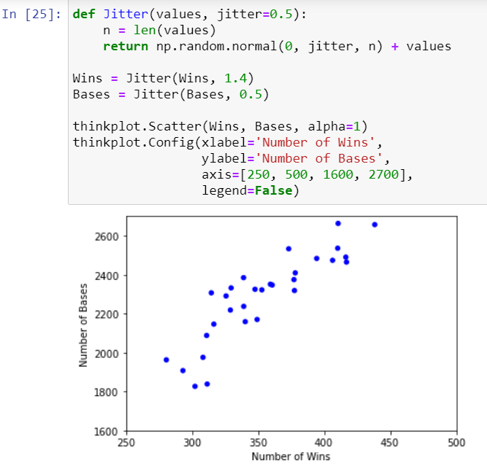
Scatterplots
The covariance between Wins and BB: Balls/Walks is 7741.855555555556
The Pearson's correlation between Wins and BB: Balls/Walks is 0.8648292618009141
The Spearman's correlation between Wins and BB: Balls/Walks is 0.8861942428849995
Results: Looking at the scatterplot, the relationship between Wins and Bases on Balls/Walks is linear
Results: With a Pearson's correlation of 0.86, which means there's a positive correlation between Team Wins and Bases on Balls/Walks
Results: In terms of causation, BB (Bases on Balls/Walks) is a way to get runs, and runs leads to more Team Wins

Slide 20
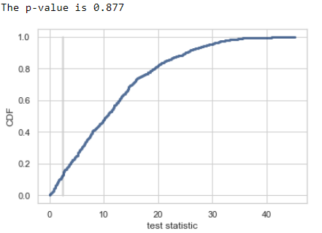
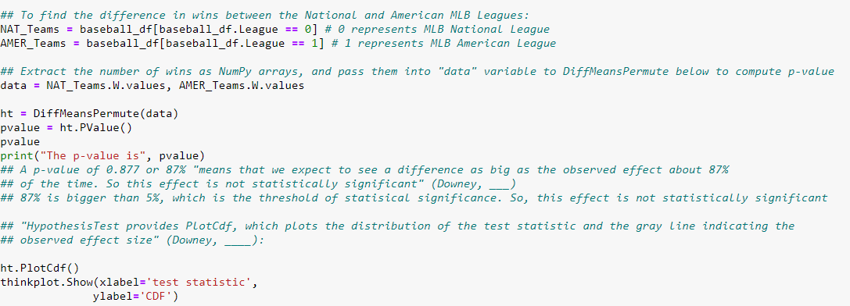
Hypothesis Test
Results: In looking at the difference in wins between the American and National Leagues, a p-value of 0.877 or 87% was found which "means that we expect to see a difference as big as the observed effect about 87%of the time. So, this effect is not statistically significant" (Downey, 2021)
87% is bigger than 5%, which is the threshold of statistical significance. So, this effect is not statistically significant

Slide 21

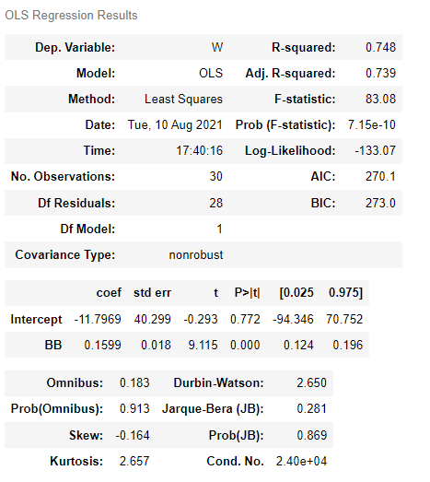

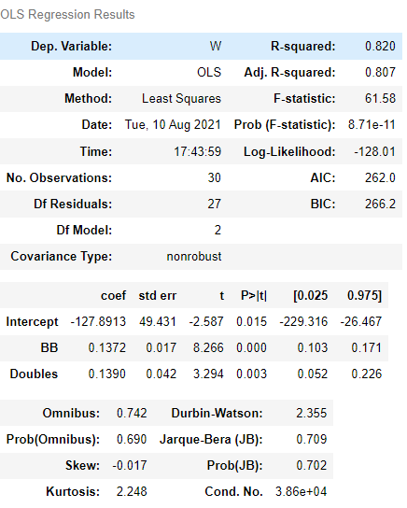
Regression Analysis
Results: When we control for BB and Doubles, R-Squared increases from 0.75 (single regression) to 0.82 (multiple regression)
These results suggest that the apparent difference in Team Wins being may be explained by the number of Bases on Walks/Balls and Doubles (strong correlation)

Slide 22
References
Downey, A. (2011). Think stats: Probability and statistics for programmers. O'Reilly.

