Slide 1
Diffie Hellman Key Exchange

Slide 2
it is a public key cryptography
A way of generating a shared secret(key) between 2 people.
The key exchange can be made even in public.
They key can be used for any cryptographic encryption.
it is secure because if you try to break it, it will be computationally infeasible as it a discrete log problem.
What is Diffie Hellman Key Exchange

Slide 3


< g, p > are publicly known
P is a large prime and g < p
Alice selects her secret key ‘a’ and sends (g)ª
Bob selects his secret key ‘b’ and sends (g)^{b}
Shared key is (g^{b})ª = (gª)^{b}
All the calculations are in (mod p) system

Slide 4
A number prime ‘p’ is called a Sophie Germain prime if 2p+1 results into another prime.
A prime number (2p+1) generated from Sophie Germain prime is called safe prime.
Also according to the textbook if (p-1)/2 results in another prime then it is a safe prime.
What is a “Safe Prime”

Slide 5
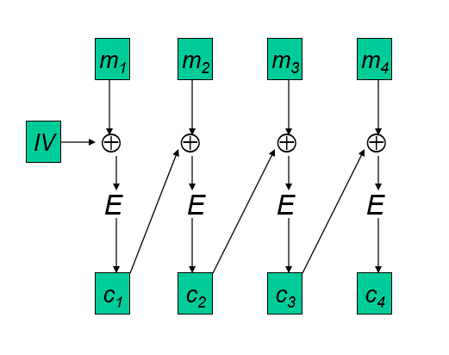
What is Cipher Block Chaining

Slide 6
References
Network Security: Private Communication in a Public World, Charles Kaufman, Radia Perlman and Mike Speciner
https://en.wikipedia.org/wiki/Sophie_Germain_prime

