Slide 1
ParkingGenie Application Development
CS 3450 - Group 4
Katie Corcoran, Noah Hammons, Jontay Reaves, & Ben Richards

Slide 2
ParkingGenie Application Overview
Major Design Decisions
Split users into lot owner, employee, and user to accomplish different application tasks
Using foreign keys to accomplish the Events -> Lots/Spaces -> Reservations flow
Agile Practices
Short stand-up meetings to stay up-to-date on each other’s progress
Splitting work into sprints, and ensuring that assigned work is completed within each sprint
Deployment
Unit tests that ensure each page is loaded correctly and submits any forms successfully
Comprehensive system testing steps to validate user experience
Notes:
(Katie)

Slide 3
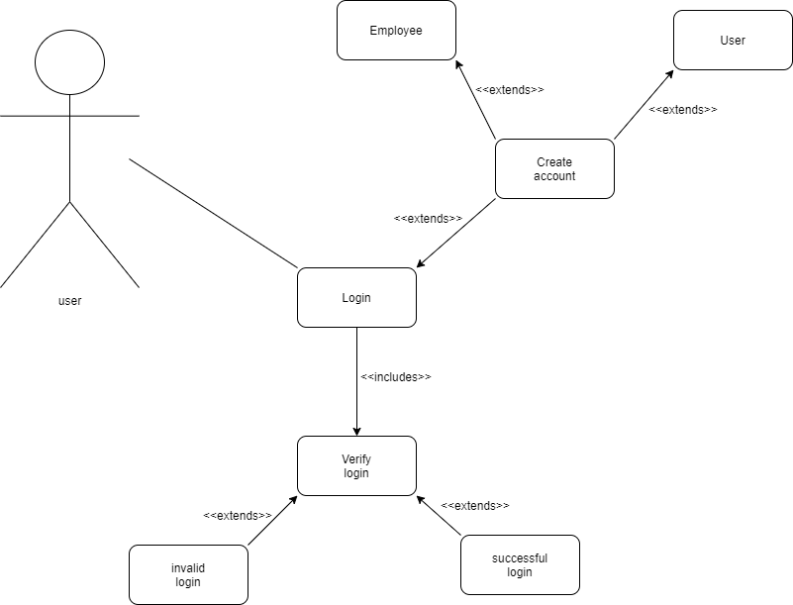
Requirement 1: User Authentication
The user authentication requirement includes signing up new users, logging in, and logging out, as well as differentiating users between employee, lot owner, and standard user.
This requirement was a must-have functional requirement in our application, and its design heavily influenced how our application runs.
Notes:
(Katie)

Slide 4
Requirement 1: User Authentication
Jontay implemented this requirement. He split the requirement into three main tasks over the course of two sprints:
Authentication: Logging in/out
Sign Up: UI elements to register new users
Differentiation: Split users into groups based on permissions

Slide 5
Requirement 1: User Authentication
Requirement Unit Testing
The user authentication requirement is tested in the Views Test Case, test_user_views test. This test first signs up a new user, logs in as that user, adds spaces to reserve, then makes a reservation under that user.

Slide 6
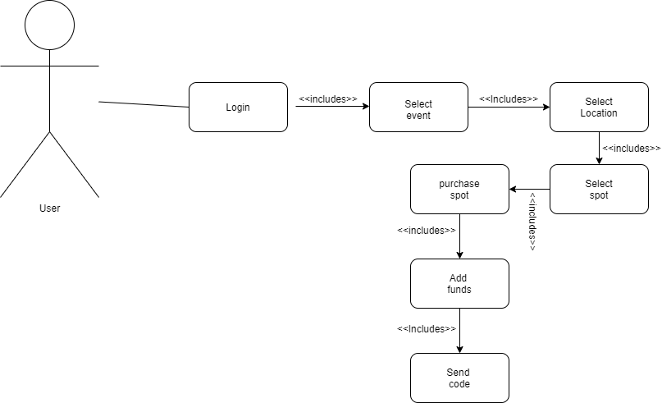
Requirement 2: Reservations
The reservations requirement involved creating a form for users to fill out to reserve a space in a lot for an event, saving those reservations, and tying them to a user if the user is logged in.
The reservation requirement is the core purpose of our application. It is important that the reservation functionality performs reliably at all times.

Slide 7
Requirement 2: Reservations
Katie implemented the reservation logic. The requirement was split into three main categories over the course of two sprints:
Implement Lots and Events
Create the reservation form and save reservations, tying each to a Lot.
Tie a user to a reservation if one is logged in

Slide 8
Requirement 2: Reservations
Requirement Unit Testing
The reservation requirement is tested in the Views Test Case, in both test_reservation_process and test_user_views. The first test posts a reservation form without a logged in user, and the second test posts a reservation with a user. The reservation should save successfully in both instances.

Slide 9
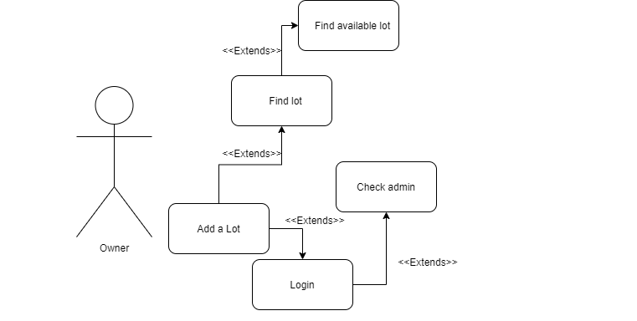
Requirement 3: Add a Lot
The add a lot requirement allows a user with an owner role to add a new lot for an event via the UI.
This requirement was a should-have functional requirement in our application. It makes the process of an owner making their parking spaces available for an event run smoothly.

Slide 10
Requirement 3:
Add a Lot
Noah implemented this requirement. He split the requirement into two tasks over one sprint:
Form: Create a form to allow the user to submit the new lot
Authentication: Only allow users with owner permissions to create new lots

Slide 11
Requirement 3:
Add a Lot
Requirement Unit Testing
The add lot requirement is tested in the Views Test Case, in test_user_views. This test creates a user with owner permissions, then verifies they can create a lot using the UI form.

Slide 12
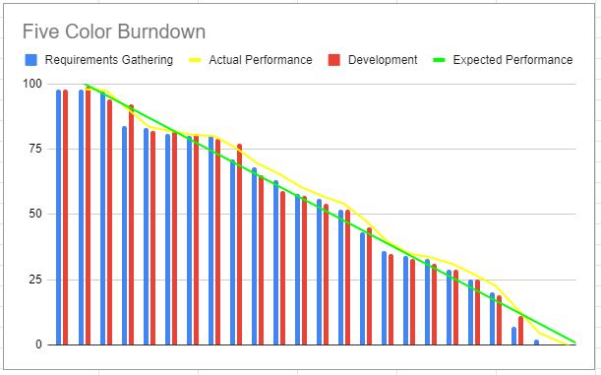
Burn Down Chart

Slide 13
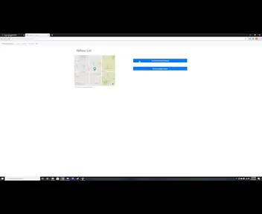
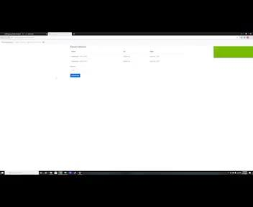
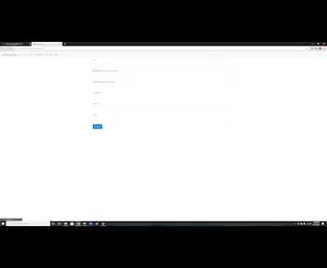
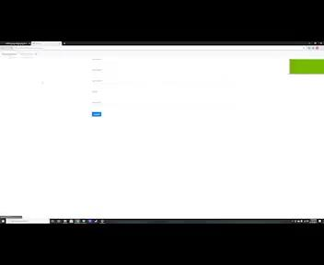
Use case videos
Buying a lot use case
Adding Funds
Adding a lot
Login

Slide 14
Resources
Freitas, V. (2018, August 13). How to Use Bootstrap 4 Forms With Django. Simple Is Better Than Complex. https://simpleisbetterthancomplex.com/tutorial/2018/08/13/how-to-use-bootstrap-4-forms-with-django.html
Freitas, V. (2016, July 26). How to Reset Migrations. Simple Is Better Than Complex. https://simpleisbetterthancomplex.com/tutorial/2016/07/26/how-to-reset-migrations.html
Writing your first Django app, part 1 | Django documentation | Django. (2021). Django. https://docs.djangoproject.com/en/3.2/intro/tutorial01/
Django Tutorial Part 8: User authentication and permissions - Learn web development | MDN. (2021, March 23). MDN Web Docs. https://developer.mozilla.org/en-US/docs/Learn/Server-side/Django/Authentication
Django Tutorial Part 9: Working with forms - Learn web development | MDN. (2021, March 18). MDN Web Docs.
https://developer.mozilla.org/en-US/docs/Learn/Server-side/Django/Forms

