Slide 1

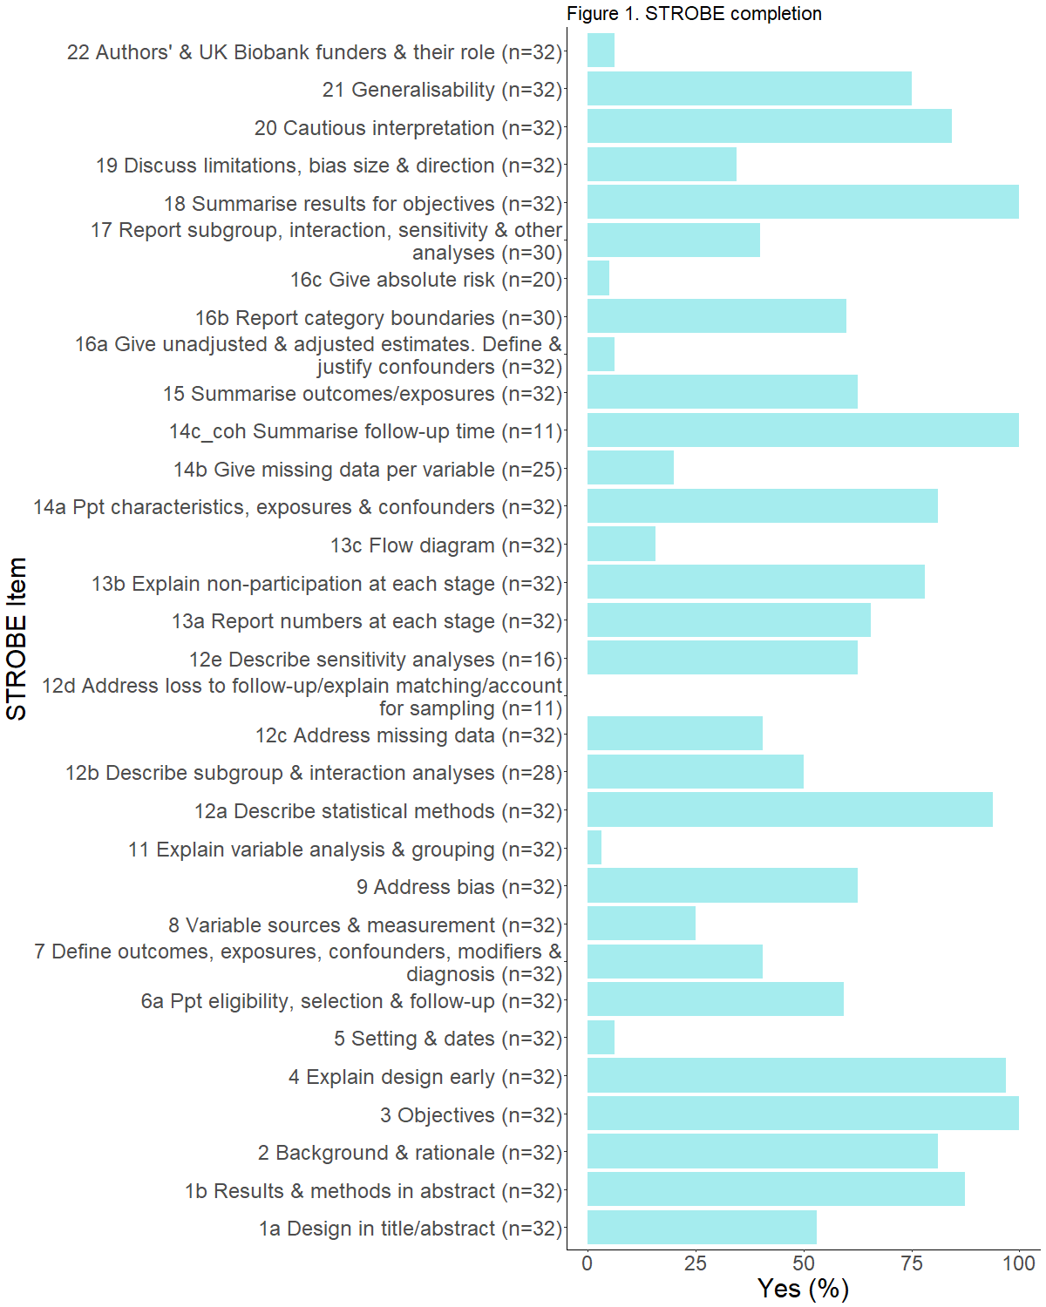




The UK Biobank study: systematic review of the reporting quality in UK Biobank studies
TARG Meta-Research Group¹, George Davey Smith ² ³, Rebecca Richmond ² ³, and Benjamin Woolf ¹ ²
Corresponding author: Katie Drax
¹ School of Psychological Science, University of Bristol, UK. ² MRC Integrative Epidemiology Unit, University of Bristol, UK. ³ Population Health Sciences, Bristol Medical School, University of Bristol, UK
Background
Exploratory results
The UK Biobank (https://www.ukbiobank.ac.uk/) is a prospective cohort study of over 500,000 people. It is available, at a cost, to researchers conducting research in the public interest. Data sharing like the UK Biobank offers researchers new opportunities but its impact on the reliability of research findings is uncertain.
By establishing the reporting quality of UK Biobank studies this systematic review marks the first step in a larger project that aims to determine how replicable UK Biobank studies are.
The STROBE guidelines contain 22 items. Figure 1 contains 20 items because 2 did not apply to any of the articles
All, or almost all, articles reported study objectives, explained the design early on, summarised results and described their statistical methods.
Almost no studies fully reported their: results, rationale for confounders, variable handling in analyses, funding or the setting. Few gave absolute risk estimates.
Though most cohort studies summarised follow-up time none reported loss to follow-up. This may be because there was none.
Objectives
Assess the completeness of UK Biobank study reporting,
identify articles that are suitable for replication,
inform reporting guidelines for other articles using the UK Biobank and similar resources.
Methods
Searched for research articles that report analyses of UK Biobank data on 15 Jan 2019. After screening we classified articles as ´observational epidemiology´ ´Mendelian randomisation´ or ´other´ based on their abstracts (see flow diagram).
Records identified via databases (n = 2480 )
Deduplicated records screened (n = 1233)
Records excluded
(n = 475)
Full-text articles assessed for eligibility (n = 758)
Full-text articles excluded (n = 190)
Not UK Biobank n = 66
Review n = 48
Summary data n = 29
Pooled cohorts n = 24
Other n = 23
Studies classified (n = 564)
Observational epidemiology studies (n = 178)
Random sample (n = 90)
Studies misclassified
(n = 6)
Prediction models n = 5
Genetic data n = 1
We identified the study designs in the observational epidemiology articles and will assess the reporting quality of 90 articles using the STROBE guidelines (von Elm et al., 2017). KD and MG screened, classified and will extract data on reporting. RR resolved disagreements between them.
The data here are from 32 articles KD assessed. They may change after duplicate extraction. Designs include 2 case-control, 11 cohort,18 cross-sectional and 1 with cohort and cross-sectional analyses. 27 had UK based corresponding authors with the other 5 across different countries. 4 articles were published in 2014, 4 in 2015, 8 in 2016, 13 in 2018 and 1 in 2019.
Insights so far
 | N = Yes (%)
Used STROBE | 3 (9.4)
Cited STROBE if used | 1 (33.3)
Registered analyses | 0 (0)
Provided any UK Biobank variable IDs | 5 (15.6)
Credited the UK Biobank correctly = Yes/Almost | 27 (84.4)
Shared analysis code | 2 (6.2)
Has supplementary material | 25 (78.1)
Open access at journal site | 25 (78.1)
Freely available elsewhere if not open access | 4 (57.1)
Has correction | 2 (6.2)
Provides UK Biobank application number | 15 (46.9)
Author keywords provided | 18 (56.2)
Conflict of Interest statement | 29 (90.6)
Releasing ‘adherence checklists’ with reporting guidelines would help reporting assessments
Poor reporting on the UK Biobank’s funding sources and setting unlikely to be problematic since detailed information is publicly accessible elsewhere.
Good reporting of statistical methods will aid replications of the main results. Comparing replication results to the original may be difficult given the poor reporting of unadjusted results. The lack of shared code will also make replications more difficult.
Introduction sections often included discussion of confounders, but authors rarely gave explicit justification for their inclusion.
References
von Elm, E., et al.(2007). BMJ, 335 (7624), 806–808. https://doi.org/10.1136/bmj.39335.541782.AD
Moher, D., et al. (2009). PLoS Med 6(7): e1000097. https://doi.org/10.1371/journal.pmed.1000097
OPEN RESEARCH DISLAIMER
OSF project: https://osf.io/jfk24/. Preregistration: study protocol preregistered on the OSF before screening began. We registered two subsequent deviations from our protocol on the OSF. Analysis type: exploratory. Sharing: all key materials, code and data will be shared according to the FAIR principles on the OSF, if possible. Conflicts of interest: none. Authors: Katie Drax, Mark Gibson, Marcus Munafò and Robert Thibault from the TARG Meta-Research Group contributed. Funding: Thanks to the John Climax Benevolent Fund for funding this work and to TARG. The funder has no role in this work.
@katiedrax katie.drax@bristol.ac.uk 0000-0002-2838-6211

