Slide 1

Rockbuster Stealth
By. Katie Goyal

Slide 2
OVERVEIW
Rockbuster is a video rental company with stores around the world. Due to the rise of video streaming platforms, in-store video rentals are becoming obsolete. The goal of this data analysis is to evaluate Rockbuster's current position and identify strategies to improve their market presence.

Slide 3

Key Questions
What movies contributed to the most and least revenue?
What countries are our customers located in?
Which country had the highest sales?
Do sales vary depending on location?

Slide 4

Key Data
Replacement cost Average = $20
Average rental duration = 5 Days
Average Rental rate = $3
Average Rating PG 13
Customers = 599
Films= 1000
Total Revenue = $61,312

Slide 5
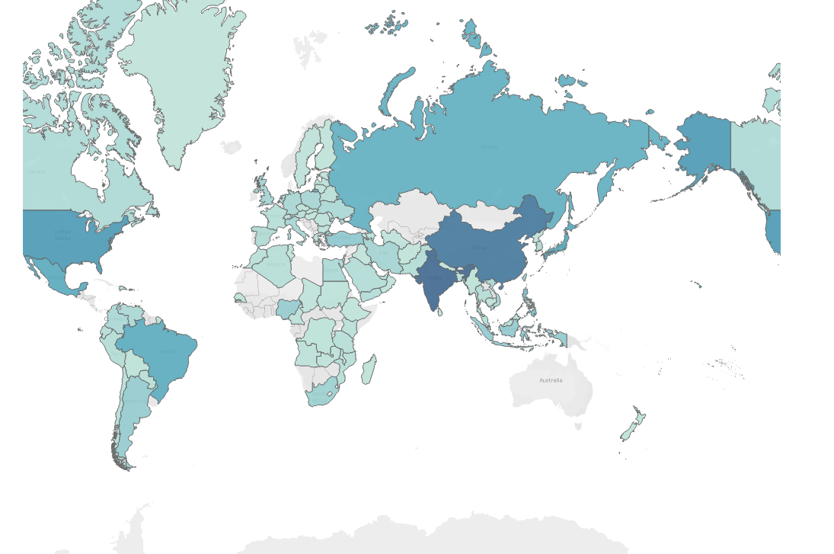
Which Countries are Rockbuster’s customers based in
This graph shows the world map that has highlighted all the countries where Rockbuster is located in.
Rockbuster is located in 108 countries

Slide 6
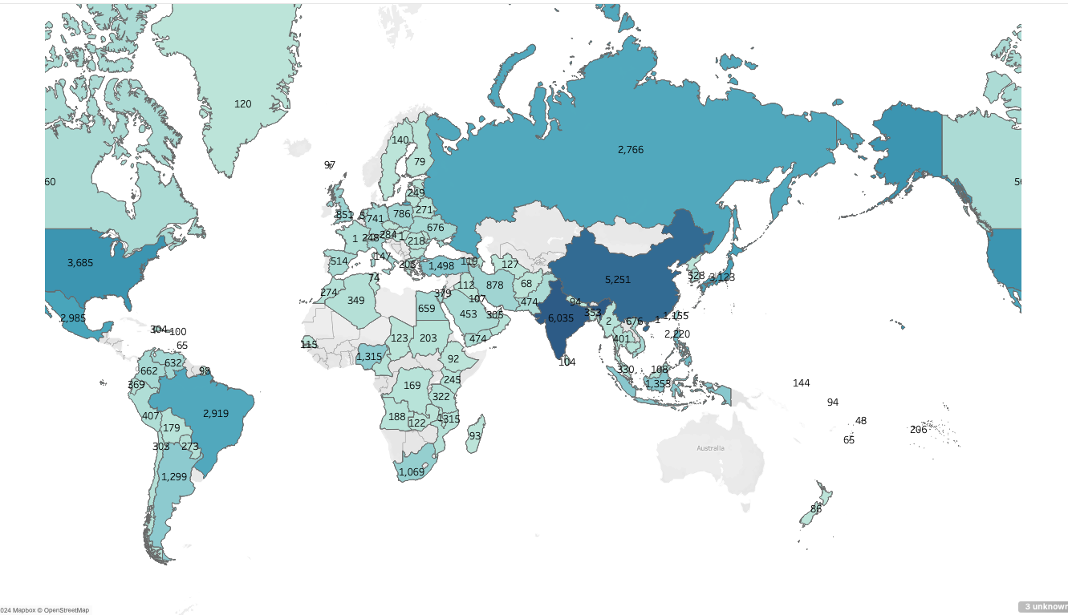
Which Country has the highest sales
This Graph shows the world map that includes the total of payments made in each country.
The top 5 countries include
India
China
United States
Mexico
Brazil

Slide 7
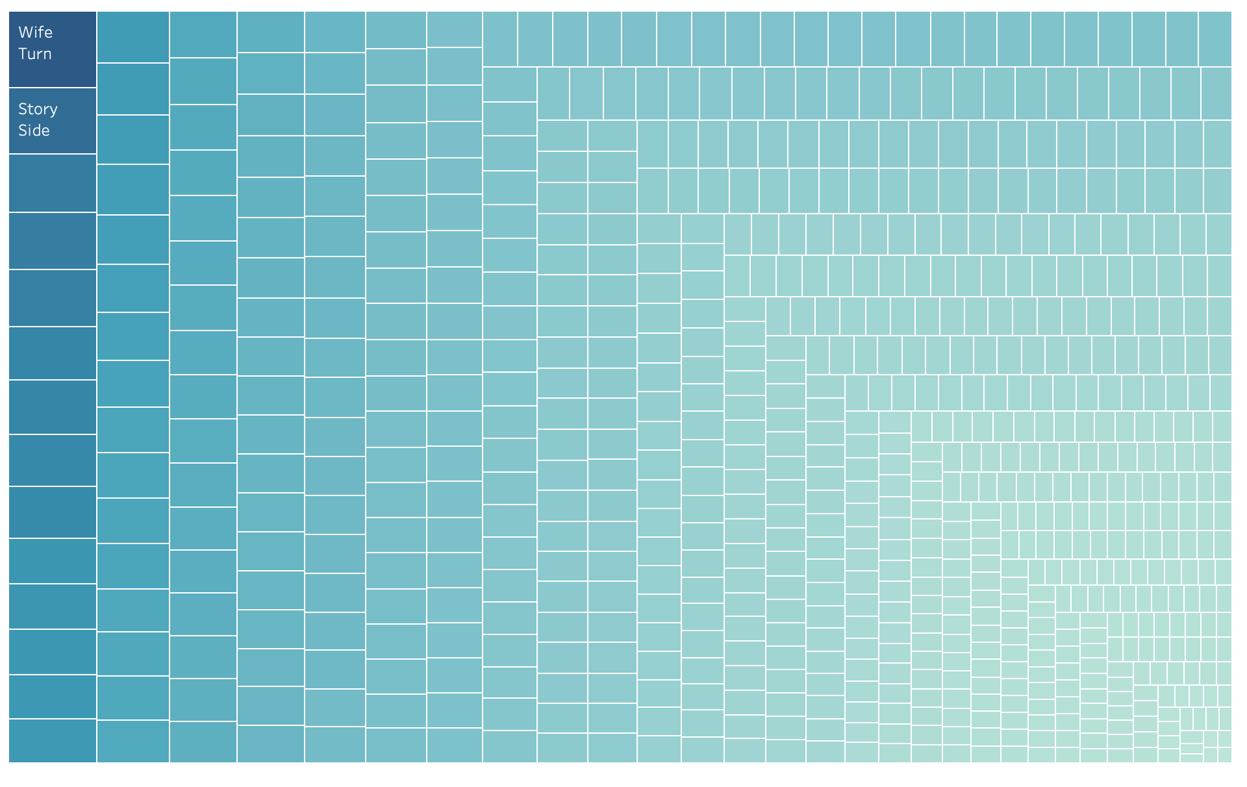
Which Films have contributed to the most/least sales
Top 5 films rented
Wife Turn
Story Side
Vinginina Pluto
Suspect Quills
Sleuth Orient
Least 5 films rented
Youth Kick
Victory Academy
Treatment Jekyll
Secretary Rouge
Kramer Chocolate

Slide 8

Understanding the Data
Rental time
The average rental time period is 5 days. This means that most people are renting and returning the videos in a normal amount of time and helps with profit by getting more videos out.
Top 5 rented videos
The top 5 rented videos sum the amount is $5,864. This accounts for 9% of the total sales from Rockbuster.
The least 5 rented videos
The least 5 videos rented sum amount is $240. This accounts for 2% of total sales from Rockbuster.
Countries with Rockbuster rentals
Rockbuster is located in 108 countries. There are 195 countries in the world meaning Rockbuster could up profits by getting into the other 87 countries
Countries with the most rented videos
The countries with the top amount of videos rented are also some of the countries with the largest population as well as the largest amount of disposable income.

Slide 9
Key take aways
Get rid of low-rented videos
Increase countries that Rockbuster is located in
Get new videos that are popular in renting countries
Do more research in why some countries are low-renting, not taking into account population but the overall percentage of people renting videos.
Tableau https://public.tableau.com/app/profile/katie.goyal/viz/kg3_10/Sheet3?publish=yes

