Slide 1

GREEN TEAM
Nashville Rock-and-Roll Marathons:
Race Results, 2016-2019
Presented by Heather, Jeff, Katie, Sreyas

Slide 2
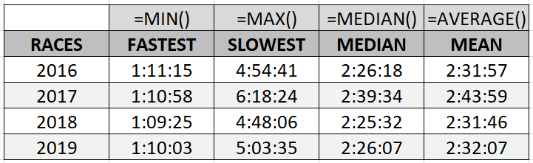
Half Marathon
Race Stats Overview
Fastest, Slowest, Median, and Mean Times
Mean Half Marathon Time 2016-2019: 2:35:15
Median Half Marathon Time 2016-2019: 2:29:38

Slide 3
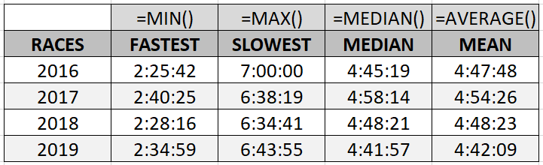
Marathon
Race Stats Overview
Fastest, Slowest, Median, and Mean Times
Mean Marathon Time 2016-2019: 4:48:27
Median Marathon Time 2016-2019: 4:48:53

Slide 4
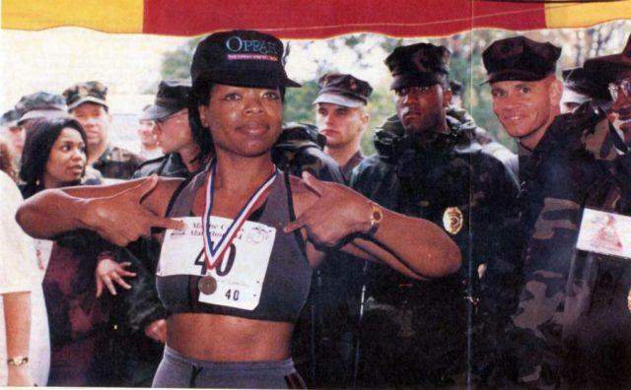
Oprah Winfrey’s 1994
Marine Corps Marathon Time
04:29:20

Slide 5
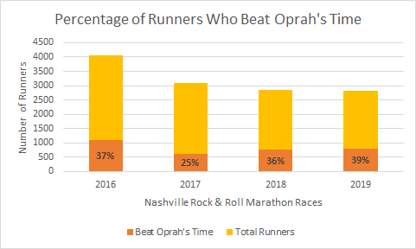
Time to Beat: 04:29:20!

Slide 6
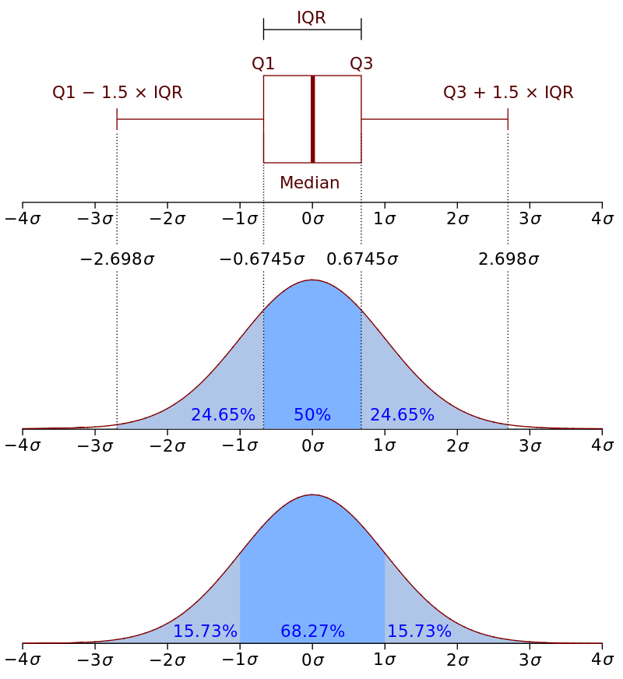

Quartiles

Slide 7
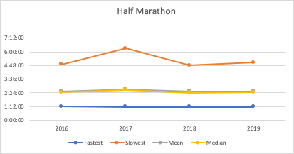
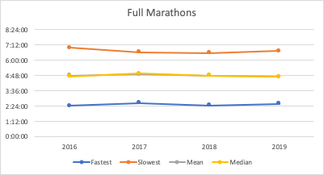
Run Times (Year-to-Year Trend Lines)
Graphs show biggest time change occurred in 2017
Text Here
Text Here
Text Here

Slide 8
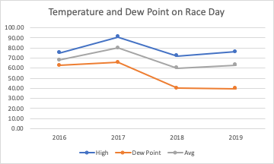
Weather Hypothesis

Slide 9
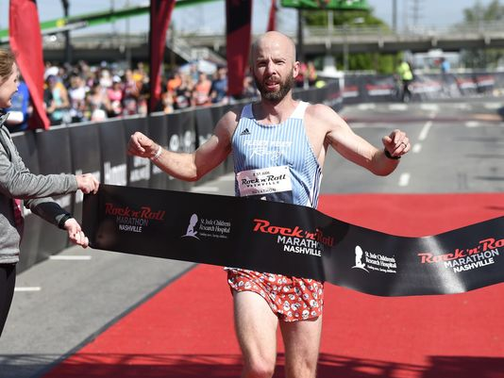
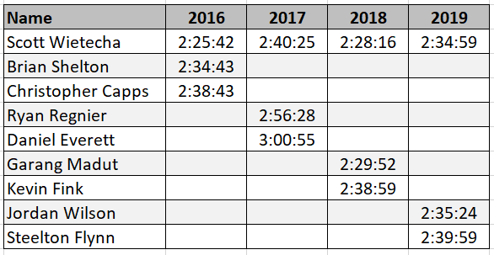
Top 3 Marathon Finishers
Scott Wietecha

Slide 10
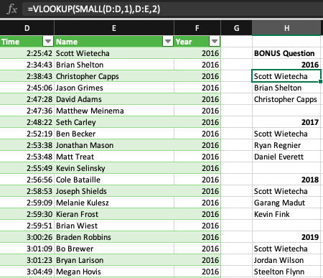


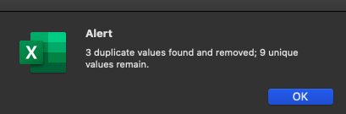
BONUS METHOD
Step 1
Reorder columns for VLOOKUP
Step 2
VLOOKUP with SMALL() function
Step 3
Remove Duplicates

Slide 11
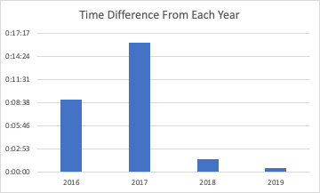
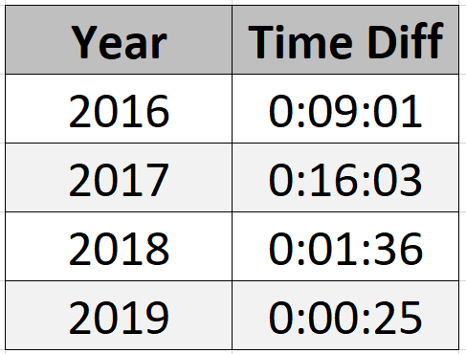
Comparing Scott’s Time with Runner Up

Slide 12
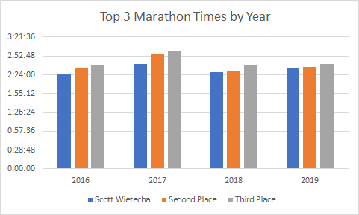

Slide 13
Questions?
Presented by Heather, Jeff, Katie, Sreyas

