Slide 1
[IGP 484] Quantitative Biology:
Data Analysis for Life Scientists
Dr. Katie Evans
🕜 Tu/Th 1:30-3:00, Hughes Auditorium
💻 github.com/katiesevans/IGP_biostatistics

Slide 2
🕜 Tu/Th 1:30-3:00, Hughes Auditorium*
💻 github.com/katiesevans/IGP_biostatistics
Weekly homework assignments (40%)
Class participation (5%)
Midterm exam (15%)
Final exam (15%)
Final project (25%)
*9/23 and 11/11 – Class will meet in Daniel Hale Williams, McGaw 2-320

Slide 3
🕜 Tu/Th 1:30-3:00, Hughes Auditorium
💻 github.com/katiesevans/IGP_biostatistics
Homework assignments:
Must be completed using R
Make sure to show ALL your work for credit
Submitted electronically as PDF or markdown

Slide 4



Meet the class TAs
Saya Dennis
Yidan Wang
Samuel Hamilton
🕜 Office hours TBD

Slide 5
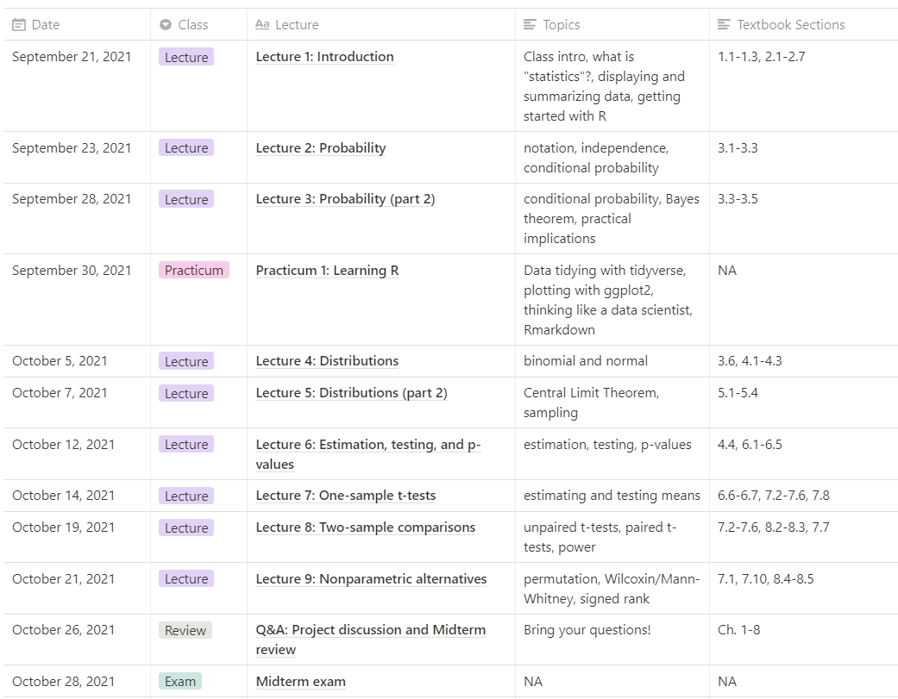

Slide 6
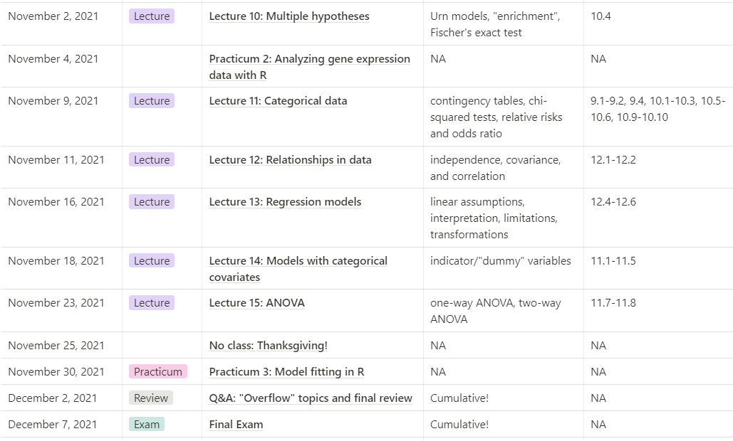

Slide 7
Outline for today:
What is statistics and why is it important?
  Sampling
  XXX
Some R basics to get you started

Slide 8


Science, variability, and statistics
Response of sheep to anthrax
Incidence of liver tumors in mice
Response | Vaccinated | Not vaccinated
Died of anthrax | 0 | 24
Survived | 24 | 0
Total | 24 (100%) | 0 (0%)
Response | E. coli | Germ free
Liver tumors | 8 | 19
No liver tumors | 5 | 30
Total | 13 (62%) | 49 (39%)
Significant!
Significant?
Notes:
Anthrax: 24 sheep vax, 24 sheep not, all 48 inoculated with anthrax.
Liver tumors: study effect of bacteria on tumor development using mice with high incidence of liver tumors
Liver tumors show variation, how can we know for sure if the difference in treatment is responsible for difference in response?

Slide 9
Science, variability, and statistics
Notes:
Figure to show distinguishing signal from noise – was treatment responsible for difference in responses or just chance to see such a wide split?

Slide 10
Science, variability, and statistics
Response of sheep to anthrax
Incidence of liver tumors in mice
Response | Vaccinated | Not vaccinated
Died of anthrax | 0 | 24
Survived | 24 | 0
Total | 24 (100%) | 0 (0%)
Response | E. coli | Germ free
Liver tumors | 8 | 19
No liver tumors | 5 | 30
Total | 13 (62%) | 49 (39%)
3
3
3
Significant?
Significant?
Notes:
Sample size matters

Slide 11
Observational studies vs. experiments

Slide 12
Controls: an essential part of any experiment

Slide 13
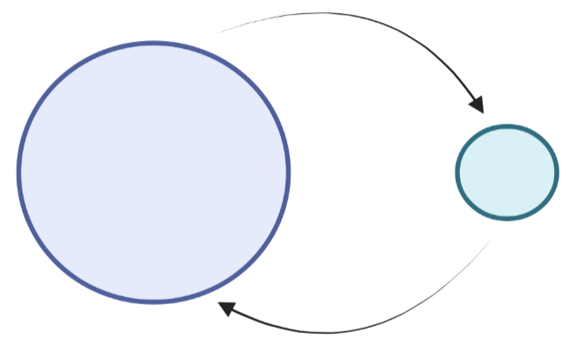
Population and sampling
Random sampling
Population
Sample
Inference
Notes:
We usually can’t observe the entire population, so we need to get a sample and then generate inferences to the population

Slide 14
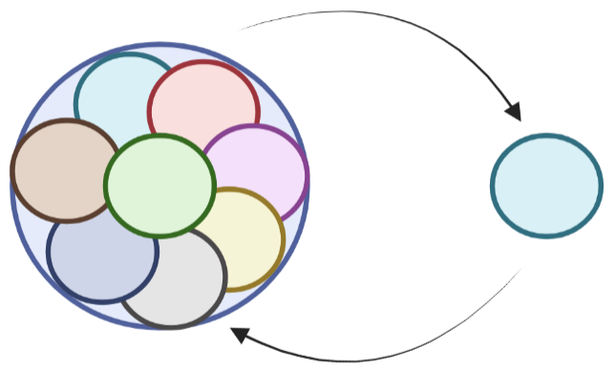
Population and sampling
Random sampling
Population
Biased sample
Inference
Notes:
Correct sampling is necessary to avoid obtaining a biased sample

Slide 15
Simple random sample
Every member of the population has the same chance of being included in the sample
Members of the sample are chosen independently of each other
  Not dependent on which other members are chosen

Slide 16
Simple random sample

