Slide 1

TypeScript 101

Slide 2
What is it?
Superset of JavaScript
JS is valid TS (but fails linting)
TypeScript compiles down to JavaScript

Slide 3

Static vs dynamic typing
JavaScript is dynamically typed
Variable type is defined at runtime (by the value itself)
TypeScript is statically typed
Variable type is defined at compile time
The pros and cons of TypeScript are similar to those of any statically typed language.

Slide 4
Why use TypeScript?
So how does it work?
Top 10 JS errors (from 1000 projects)

Slide 5
Why use TypeScript?
Typing: a contract between a function
or variable & its consumer/s

Slide 6
Why use TypeScript?
Typed code is:
More readable
More robust
Faster to onboard
Great for large projects
No longer need to make assumptions about:
Data type of a variable
A function’s return value (helpful with functions from libraries)
What attributes an object has
Highlights errors early on (when code breaks contracts)
Saves debugging time

Slide 7

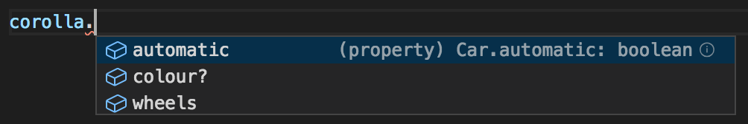
Why use TypeScript?
Some added bonuses:
Libraries for auto-mocking values in tests (not possible in JS)
Editor addons to make TS dev easier:

Slide 8
Downsides 😢
Needs to be compiled (down to JS)
Often results in more lines of code
Takes more thought initially to define types

Slide 9
Worked Example
(see https://github.com/katiewoolston/typescript-workshop-example)

Slide 10
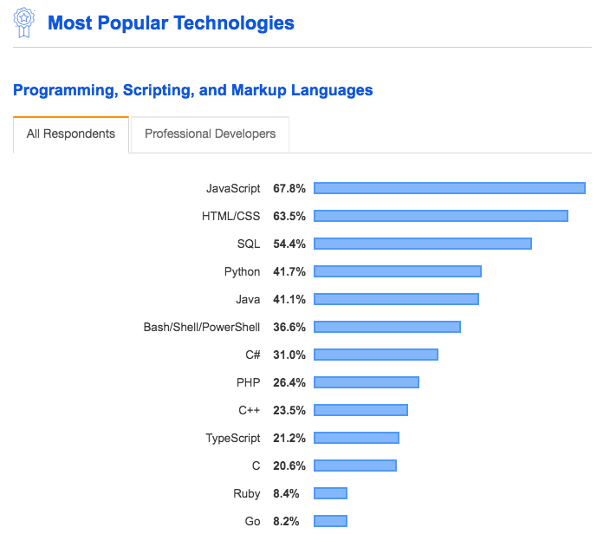
Current Trends
Stack Overflow 2019 survey:

Slide 11
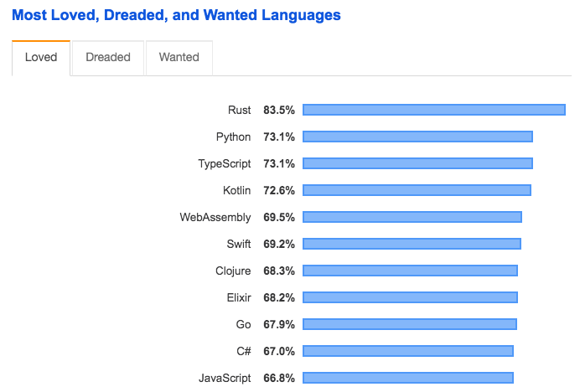
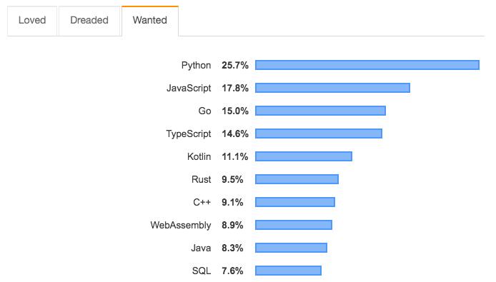
Current Trends
Stack Overflow 2019 survey:
Increasingly popular, so worth knowing how to use it!

Slide 12
Current Trends
Great for backend
This is how we use TS at Genie
Helpful when saving to a database, to make sure you’re saving what you want to
Increasingly popular with frontend applications, incl. React

Slide 13
Converting JS project -> TS
It’s possible to slowly convert a project from JavaScript to TypeScript
Start by converting a few files
Include these in the tsconfig.json
Slowly increase the coverage

Slide 14
Gotchas
It doesn’t replace tests!
Types are written by a human, so aren’t foolproof
Type checking only happens at build time (not runtime)
Any npm packages you import need types.
TS libraries should have them
JS libraries:
If a package doesn’t come with types, try running: npm install @types/<package-name>
See the DefinitelyTyped repo: https://github.com/DefinitelyTyped/DefinitelyTyped

Slide 15
Gotchas
TypeScript doesn’t validate everything
-> For best results, use a linter too
Configure to extend TS lint rules
Set up the linter in your IDE if possible, to catch problems quickly
E.g. functions should always have a return type, but TypeScript doesn’t enforce this. A linter will help.

Slide 16
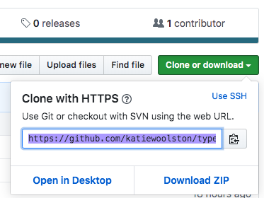
TypeScript Exercises
Go to: https://github.com/katiewoolston/typescript-workshop-exercises
Copy the URL:
Run: git clone <url>

Slide 17
Further exercises
Write tests for the TypeScript exercise scripts
OR
Convert one of your own JS projects to TS
Run tsc --init in your project folder to initialize
Modify the ‘include’ array in the tsconfig.json file to add each file as you convert it to JS.

Slide 18
References & Other Helpful Links
Top 10 JS errors infographic: https://codeburst.io/top-10-javascript-errors-from-1000-projects-and-how-to-avoid-them-2956ce008437
Worked example: https://github.com/katiewoolston/typescript-workshop-example
Helpful links:
TypeScript tutorial (including some more TS features than I covered in this presentation): https://www.valentinog.com/blog/typescript/
What is TS!? https://medium.com/faun/typescript-what-2a1dbca374ce
How does it help? https://medium.com/@jtomaszewski/why-typescript-is-the-best-way-to-write-front-end-in-2019-feb855f9b164

