Slide 1

Flycatcher
Catching information on the fly

Slide 2



Who we are
Vaggelis
Afroditi
Antonis
Developer
Analyst
Imaging Scientist

Slide 3
Frequent flyer
Very NERVOUS flyer
Frequent flyer
Vaggelis
Afroditi
Antonis
Developer
Analyst
Imaging Scientist

Slide 4






Why
8000000
People fly every day
Popular activities
1 out of 3
Nervous flyers
Can we change a seemingly idle time?

Slide 5



What
History
Satellite images
News
Facts
GPS-based
Interactive Application
Discover the areas you fly above

Slide 6
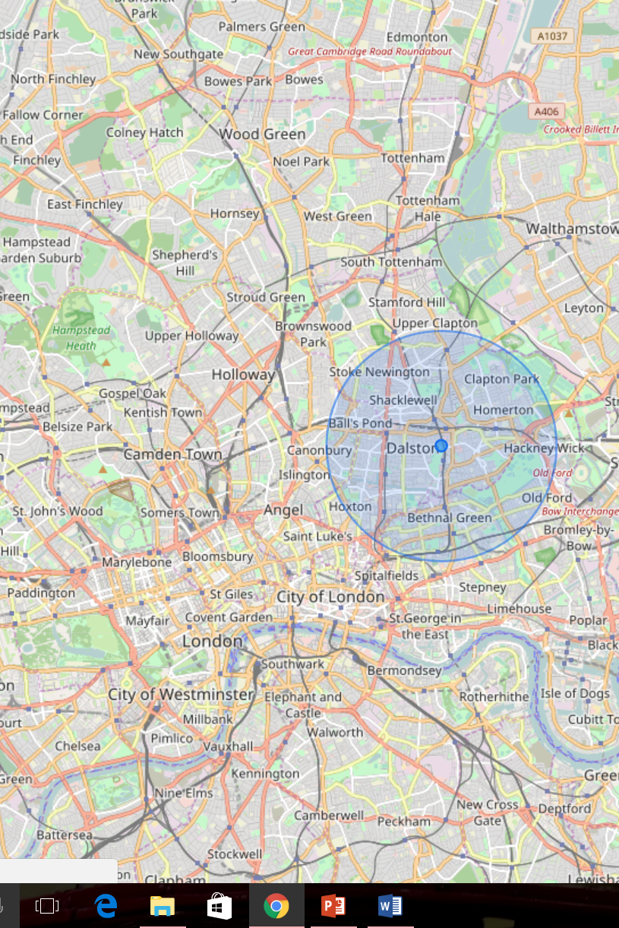
Example
Where am I?
Resources
Open Street Maps
OSM Buildings
3D Landscape

Slide 7
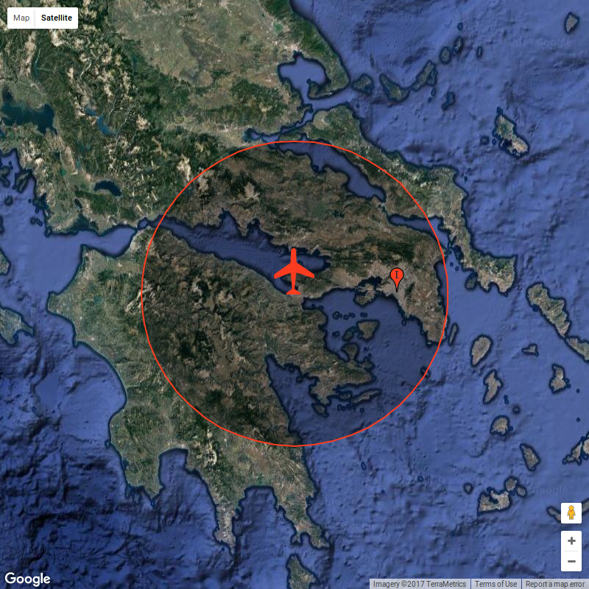
Example
Which is the biggest city below me right now?
Resources
NASA’s population data (GPW)
Google maps
GPS
Python

Slide 8




In the future
Personalisation
Link your activity to your seat number or e-mail address to save your progress
Gamification
Solve quizzes, unlock awards and win freebies in your next flight
Inform & Educate
Discover local news, learn new words of a foreign language, plan your next holiday, find some local recipes
3D Visualisation
Combine it with VR to bring earth to life

Slide 9
Credits
Slide 4 | flying stats: http://www.iata.org/pressroom/pr/Pages/2013-12-30-01.aspx
Slide 4 | nervous flier stats: http://flyfright.com/statistics/
Slide 6 | Data: http://sedac.ciesin.columbia.edu/data/set/gpw-v4-population-count
All icons made by Freepik from www.flaticon.com | Except from:
Slide 5 (route): made by MadeByOliver, from flaticon.com
Slide 5 (startup, smartphone): made by Gregor Cresnar, from flaticon.com
Slide 4 (nervous): made by MadeByOliver, from flaticon.com

Slide 10
Thank you!

