Slide 1

Flycatcher
Catching information on the fly

Slide 2



Who we are
Vaggelis
Afroditi
Antonis
Developer
Analyst
Imaging Scientist

Slide 3
Frequent flyer
Very NERVOUS flyer
Frequent flyer
Vaggelis
Afroditi
Antonis
Developer
Analyst
Imaging Scientist

Slide 4






Why
8000000
People fly every day
Popular activities
1 out of 3
Nervous flyers
Can we change a seemingly idle time?

Slide 5
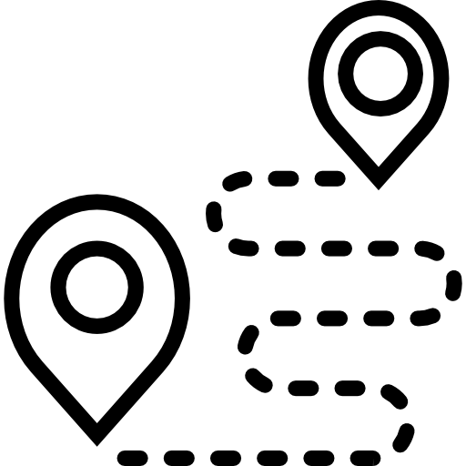



What: Flycatcher
History
Satellite images
News
Facts
GPS-based
Interactive Application
Discover the areas you fly above
Engaged & happy passenger
Changes in time

Slide 6
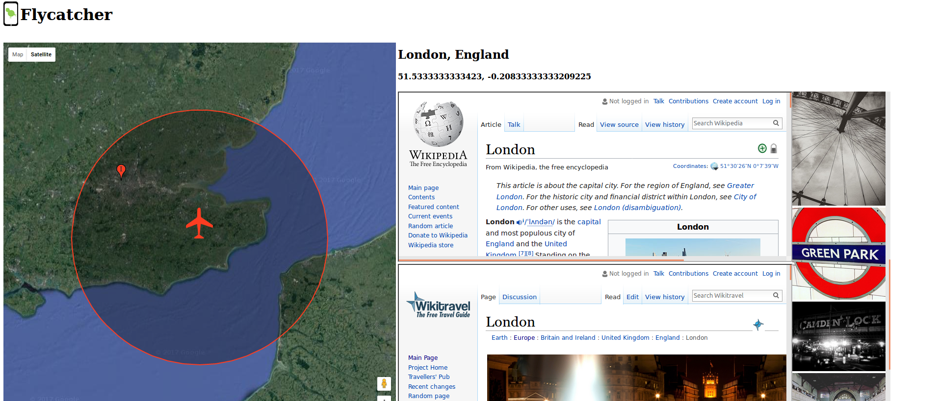
Example: Which is the biggest city below me right now?
Resources: NASA’s population data (GPW), Google maps, GPS, Python, Wikis, Flickr

Slide 7
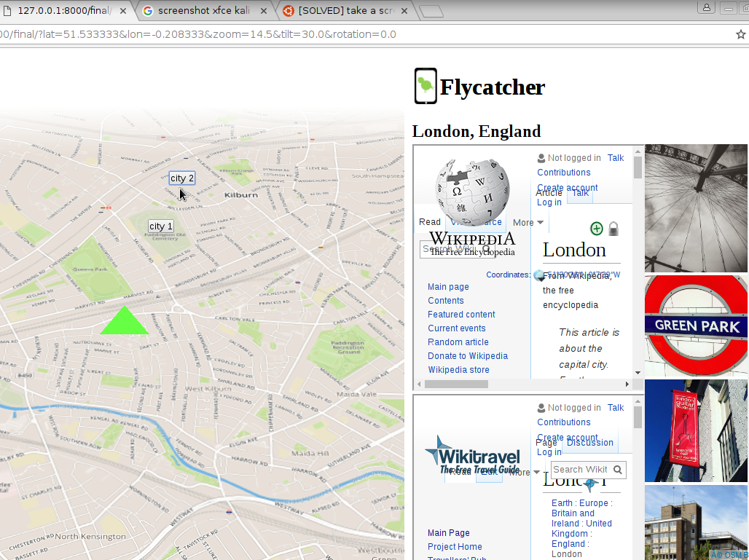
DEMO
Resources
Open Street Maps
OSM Buildings
3D Landscape

Slide 8




In the future
Personalisation
Link your activity to your seat number or e-mail address to save your progress
Gamification
Solve quizzes, unlock awards and win freebies in your next flight
Inform & Educate
Discover local news, learn new words of a foreign language, plan your next holiday, find some local recipes
3D Visualisation
Combine it with VR to bring earth to life
Future Resources
NASA images, TripAdvisor, Foursquare, Wikis, Crowdsourced information
Fine print
Available offline but enhanced if on the wifi

Slide 9
Credits
Slide 4 | flying stats: http://www.iata.org/pressroom/pr/Pages/2013-12-30-01.aspx
Slide 4 | nervous flier stats: http://flyfright.com/statistics/
Slide 6 | Data: http://sedac.ciesin.columbia.edu/data/set/gpw-v4-population-count
All icons made by Freepik from www.flaticon.com | Except from:
Slide 5 (route): made by MadeByOliver, from flaticon.com
Slide 5 (startup, smartphone): made by Gregor Cresnar, from flaticon.com
Slide 4 (nervous): made by MadeByOliver, from flaticon.com

Slide 10
Thank you!

