Slide 1
CS 35L – Week 3 Part 1

Slide 2
How to Install Software
Windows
  Installshield
  Microsoft/Windows Installer
Linux
    Package Management systems – packages contain source or binaries, dependency list, and install scripts. Install software with one command.
    RedHat Linux (.rpm) – RPM, yum
    Debian Linux, Ubuntu Linux (.deb) – apt, dpkg
    Good old build process
      configure, make, make install

Slide 3
Decompressing Files
Generally you would get Linux software in the zipped tar format (tar.gz)
Decompress file in current directory:
tar –xzvf filename.tar.gz
  Option –z: --gzip
  Option –x: --extract, --get
  Option –v: --verbose
  Option –f: --file

Slide 4
Decompressing Files (cont’d)
Tar gzip: Windows equivalent – WinRar
Unzip
  tar -xvf <archive_file.tar>
  tar –zxvf archive_file.tar.gz
  gzip –d archive_file.gz
  tar –Jxvf archive_file.xz
  Zip
  tar -czvf <output_archive.tar.gz> <file1> <directory2> < file3>
    c = create
    z=gzip

Slide 5
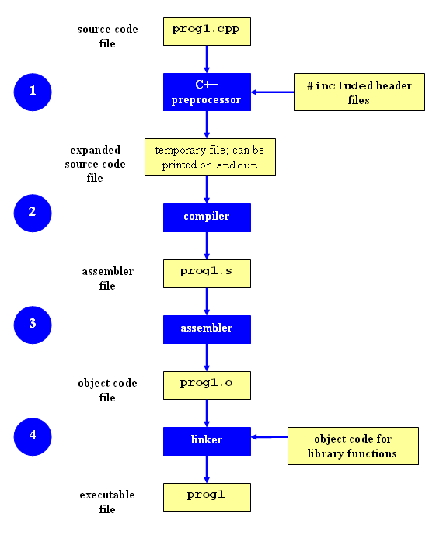
Compilation Process
Compilation

Slide 6
Make
  Utility for managing large software projects
  Automates build process
  Build not invoked unless needed to be
    > efficient

Slide 7
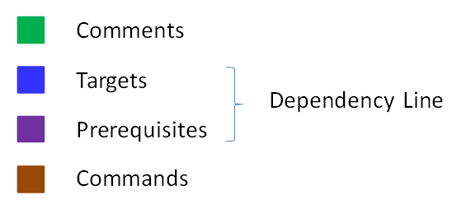
Makefile Example
# Makefile - A Basic Example
all : shop #usually first
shop : Item.o ShoppingList.o shop.o
g++ -g -Wall -o shop Item.o ShoppingList.o shop.o
Item.o : Item.cpp Item.h
g++ -g -Wall -c Item.cpp
ShoppingList.o : ShoppingList.cpp Item.h ShoppingList.h
g++ -g -Wall -c ShoppingList.cpp
shop.o : shop.cpp Item.h ShoppingList.h
g++ -g -Wall -c shop.cpp
clean :
rm -f Item.o ShoppingList.o shop.o shop

Slide 8
Build Process
configure
  Check details about the machine before installation
  Dependencies between software
  Creates ‘Makefile’
make
  Requires ‘Makefile’ to run
  Compiles all the program code and creates executables in current directory
make install
  make utility searches for a label named install within the Makefile, and executes only that section of it
  executables are copied into the final directories (system directories)

Slide 9
Lab 3
Coreutils 7.6 ls program has a problem
  Different users see different date formats
  ls –l /bin/bash
    -rwxr-xr-x 1 root root 729040 2009-03-02 06:22 /bin/bash
    -rwxr-xr-x 1 root root 729040 Mar 2 2009 /bin/bash
Why?
  Different locales
Want the traditional Unix format for all users
Fix the ls program

Slide 10
Getting Set Up
Download coreutils-7.6 to your home directory
  Use ‘wget’
  http://ftp.gnu.org/gnu/coreutils/coreutils-7.6.tar.gz
Untar and Unzip it
  tar –xzvf coreutils-7.6.tar.gz
Make a directory coreutilsInstall in your home directory (this is where you’ll be installing coreutils)
  mkdir ~/coreutilsInstall

Slide 11
Building coreutils
Go into coreutils-7.6 directory. This is what you just unzipped.
Read the INSTALL file in how to configure “make”, especially --prefix flag
Run the configure script using the prefix flag so that when everything is done, coreutils will be installed in the directory ~/coreutilsInstall
Compile it: make
Install it: make install (usually must be root; won’t work on Linux server without proper prefix!)

Slide 12
Patching
A patch is a piece of software designed to fix problems with or update a computer program.
It’s a diff file that includes the changes made to a file
A person who has the original (buggy) file can use the patch command with the diff file to add the changes to their original file

Slide 13
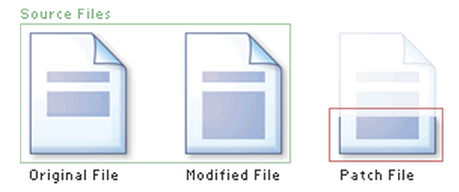
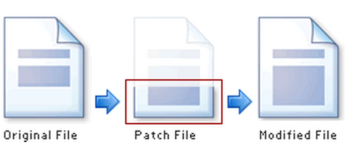
Applying a Patch

Slide 14
diff Unified Format
--- path/to/original_file
+++ path/to/modified_file
@@ -l,s +l,s @@
  @@: beginning and end of a hunk
  l: beginning line number
  s: number of lines the change hunk applies to for each file
  A line with a:
    - sign was deleted from the original
    + sign was added in the new file
    ‘ ‘ stayed the same

Slide 15
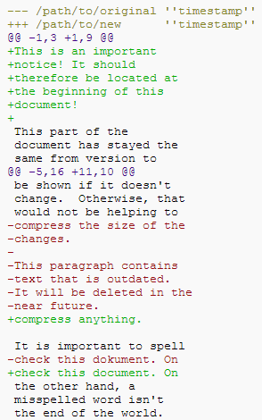

Slide 16
Patching
cd coreutils-7.6
vim or emacs patch_file: copy and paste the patch content
patch –pnum <patch_file
  ‘man patch’ to find out what pnum does and how to use it
cd into the coreutils-7.6 directory and type make to rebuild patched ls.c

