Slide 1
CS 35L – Lab 4a

Slide 2
Change Management
Lab 4

Slide 3
What Changes Are We Managing?
Software
  Planned software development
    team members constantly add new code
  (Un)expected problems
    bug fixes
  Enhancements
    Make code more efficient (memory, execution time)
“The only constant in software development is change”

Slide 4
How Do We Manage Changes?
Version Control Tools: track and control changes to files
  What changes were made?
  When were changes made?
  Who made the changes?
  Revert back to a previous version
Popular Tools: Subversion, Git, Bazaar

Slide 5
Centralized vs. Distributed VCS
Single central copy of the project history on a server
Changes are uploaded to the server
Other programmers can get changes from the server
Examples: SVN, CVS
Each developer gets the full history of a project on their own hard drive
Developers can communicate changes between each other without going through a central server
Examples: Git, Mercurial, Bazaar, Bitkeeper

Slide 6
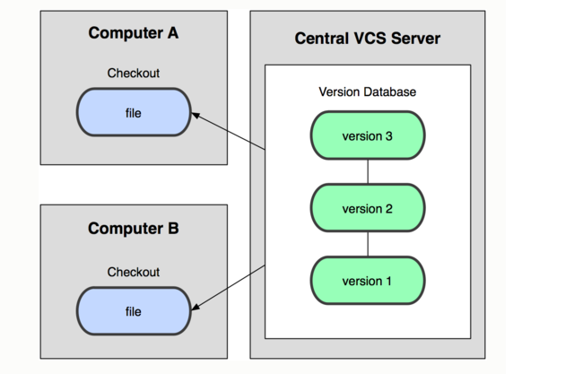
Centralized

Slide 7
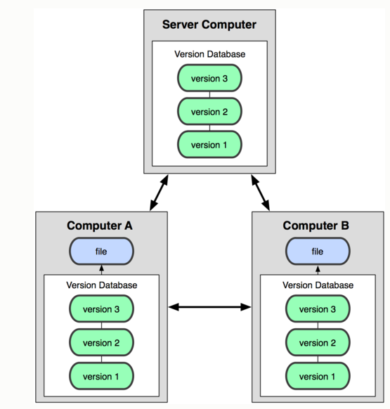
Distributed

Slide 8
Centralized: Pros and Cons
“The full project history is only stored in one central place.”
Pros
Everyone can see changes at the same time
Simple to design
Cons
Single point of failure (no backups!)

Slide 9
Distributed: Pros and Cons
“The entire project history is downloaded to the hard drive”
Pros
Commit changes or revert to an old version while offline
Commands run extremely fast because tool accesses the hard drive and not a remote server
Share changes with a few people before showing changes to everyone
Cons
long time to download
A lot of disk space to store all versions

Slide 10
Version Control Terminology
Repository
  A data structure usually stored on a server that contains:
    A set of files and directories
    The full history and different versions of a project
Working Copy
  A local copy of files from a repository at a specific time or revision

Slide 11
More Terminology
Check-Out
  The act of creating a local working copy from the repository. A user may specify a specific revision or obtain the latest one
Commit
  The action of writing the changes made in the working copy back to the repository

Slide 12
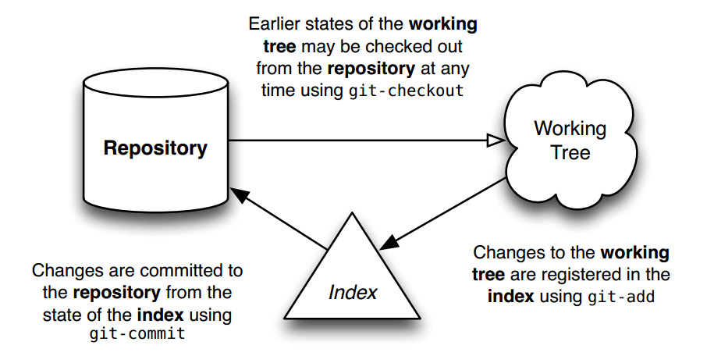
Git Workflow

Slide 13


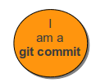

Git Architecture
git has 4 object types:
  Blobs
    Like file system files (sequence of bytes)
    Stored in .git/objects
    Indexed by unique hash
  Trees
    Like file system directories
    Can include other git trees or blobs
  Commits
    Created when “git commit” is executed
    Points to the most recent tree at the time of the commit
    Contains name of committer, time of commit and hash of current tree
  Tags
    Give names to commit objects
    Include tag name, the commit referred to, tag message, tagger info

Slide 14
Git Architecture cont’d
head
  A reference to a commit object
  A repository can contain any number of heads
HEAD
  Refers exclusively to the currently active (checked out) head
Branch
  Refers to a head and the entire history of ancestor commits preceding that head
Master
  The default head name that refers to the default branch created in the repository

Slide 15
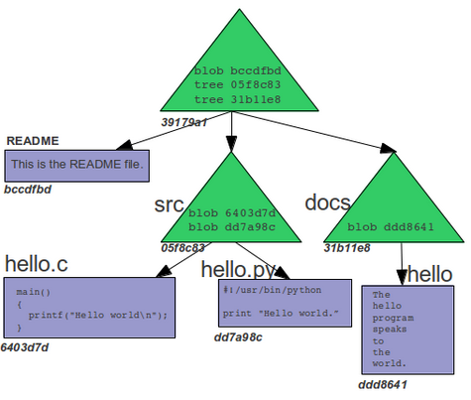
Git Object Store w/o Commits

Slide 16
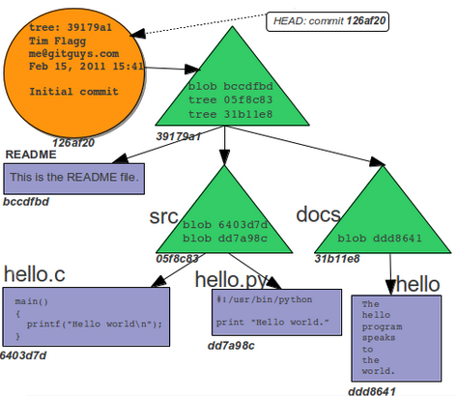
Git Object Store w/ First Commit

Slide 17
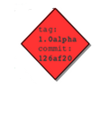
Git Object Store w/ First Commit

Slide 18
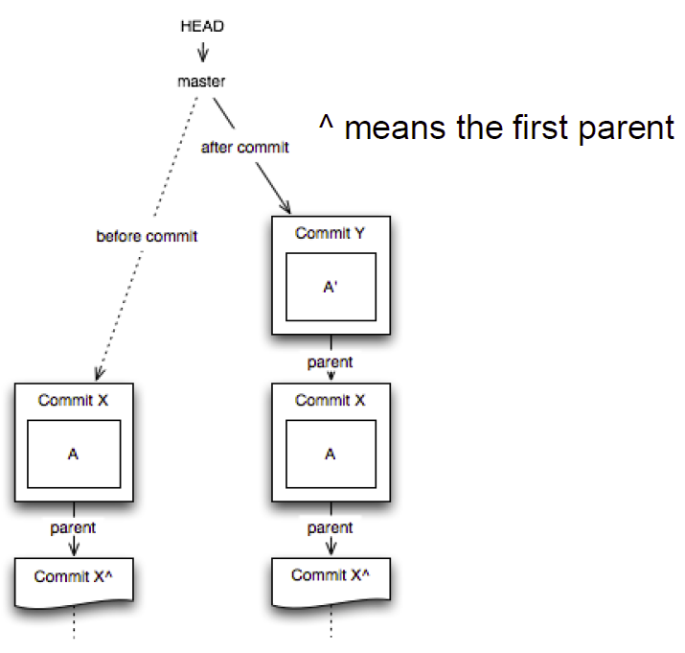
Git Architecture cont’d

Slide 19
Some git Commands
Getting a Repository
  git init //creates new repository
  git clone //gets a copy of an existing repository
Commits
  git add //adds files to the index
  git commit // changes are added to the repository
Getting information
  git help, git status, git diff, git log, git show

Slide 20
First Git Repository
$ mkdir gitroot
$ cd gitroot
$ git init
  creates an empty git repo (.git directory with all necessary subdirectories)
$ echo “Hello World” > hello.txt
$ git add .
  Adds content to the index
  Must be run prior to a commit
$ git commit –am ‘Check in number one’

Slide 21
Working With Git
$ echo “I love Git” >> hello.txt
$ git diff
  Shows changes we made compared to index
$ git status
  Shows list of modified files
$ git add hello.txt
$ git diff
  No changes shown as diff compares to the index
$ git diff HEAD
  Now we can see changes in working version
$git commit –m ‘Second commit’

Slide 22
Undoing What Is Done
git checkout
  Used to checkout a specific version/branch of the tree
git reset
  Moves the tree back to a certain specified version
  Use the --force to ignore working changes
git revert
  Reverts a commit
  Does not delete the commit object, just applies a patch
  Reverts can themselves be reverted!
Git never deletes a commit object
  It is very hard to lose data

Slide 23
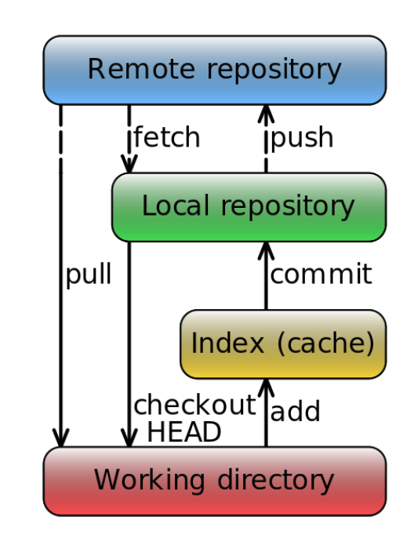
Overview

Slide 24
Lab 4
GNU Diffutils uses “ ` “ in diagnostics
  Example: diff . –
  Output: diff: cannot compare `-' to a directory
  Want to use apostrophes only
Diffutils maintainers have a patch for this problem called “maint: quote 'like this' or "like this", not `like this'”
Problem: You are using Diffutils version 3.0, and the patch that you want is not for version 3.0

Slide 25
Backporting
Taking a certain software modification (patch) and applying it to an older version of the software than it was initially created for.

Slide 26
Steps
Installing Git
  Ubuntu: $ sudo apt-get install git
  SEASnet
    Use servers that are not lnxsrv07 and lnxsrv09
    Git is installed in /usr/local/cs/bin
    Add it to PATH variable or use whole path
    export PATH=$PATH:/usr/local/cs/bin
Make a directory ‘gitroot’ and get a copy of the Diffutils Git repository
    $ mkdir gitroot
    $ cd gitroot
    $ git clone git://git.savannah.gnu.org/diffutils.git
3) Follow steps in lab and use man git to find commands

