Slide 1
CS 35L – Week 5b

Slide 2
Basic Data Types
int
  Holds integer numbers
  Usually 4 bytes
float
  Holds floating point numbers
  Usually 4 bytes
double
  Holds higher-precision floating point numbers
  Usually 8 bytes (double the size of a float)
char
  Holds a byte of data, characters
void
Pretty much like C++ basic data types, but NO bool

Slide 3
Pointers
Variables that store memory addresses
Declaration
<variable_type> *<name>;
  int *ptr; //declare ptr as a pointer to int
  int var = 77; // define an int variable
  ptr = &var; // let ptr point to the variable var

Slide 4
Dereferencing Pointers
Accessing the value that the pointer points to
Example:
  double x, *ptr;
  ptr = &x; // let ptr point to x
  *ptr = 7.8; // assign the value 7.8 to x

Slide 5
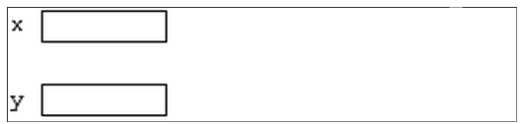
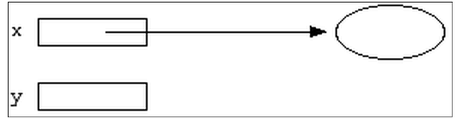
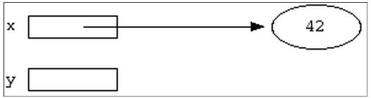
Pointer Example
int *x;
int *y;
int var; x = &var;
*x = 42;

Slide 6
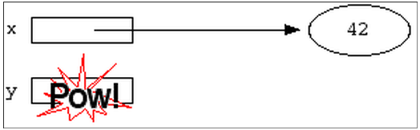
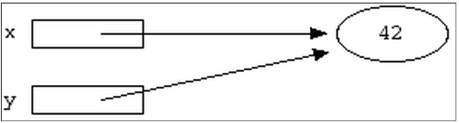
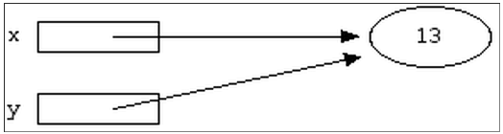
Pointer Example
*y = 13;
y = x;
*x = 13; or
*y = 13;

Slide 7
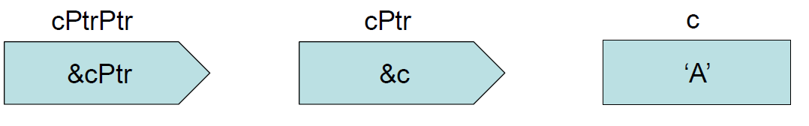
Pointers to Pointers
char c = ‘A’ *cPtr = &c **cPtrPtr = &cPtr

Slide 8
Pointers to Functions
Also known as: function pointers or functors
double (*func_ptr) (double, double);
double result;
func_ptr = pow; // func_ptr points to pow()
// the expression *func_ptr now // yields the function pow()
result = (*func_ptr)( 1.5, 2.0 ); // Call the function // referenced by func_ptr
result = func_ptr( 1.5, 2.0 ); // The same function call

Slide 9
Structs
No classes in C
Used to package related data (variables of different types) together
Single name is convenient
struct Student { typedef struct {
char name[64]; char name[64];
char UID[10]; char UID[10];
int age; int age;
int year; int year;
}; } Student;
struct Student s; Student s;

Slide 10
C structs vs. C++ classes
C structs cannot have member functions
There’s no such thing as access specifiers in C
C structs don’t have constructors defined for them
C++ classes can have member functions
C++ class members have access specifiers and are private by default
C++ classes must have at least a default constructor

Slide 11
Dynamic Memory
Memory that is allocated at runtime
Allocated on the heap
void *malloc (size_t size);
  Allocates size bytes and returns a pointer to the allocated memory
void *realloc (void *ptr, size_t size);
  Changes the size of the memory block pointed to by ptr to size bytes
void free (void *ptr);
  Frees the block of memory pointed to by ptr

Slide 12
Reading/Writing Characters
int getchar();
  Returns the next character from stdin
int putchar(int character);
  Writes a character to the current position in stdout

Slide 13
Formatted I/O
int fprintf(FILE * fp, const char * format, …);
int fscanf(FILE * fp, const char * format, …);
  FILE *fp can be either:
    A file pointer
    stdin, stdout, or stderr
  The format string
    int score = 120; char player[] = “Mary”;
    printf(“%s has %d points.\n”, player, score);

Slide 14
Compiling a C program
gcc –o FooBarBinary -g foobar.c
  gcc is the name of the compiler
  The –o option indicates the name of the binary/program to be generated
  The –g option includes symbol and source-line info for debugging
  foobar.c is the source code to be compiled

Slide 15
Homework 5
Write a C program called sfrob.c
  Sort encoded data without decoding and encoding
  Write a function frobcmp
    Byte-by-byte lexicographic comparison
    frobnicated
  Reads from stdin, write to stdout
    File is growing
    Empty file
    Large file
Example:
  printf '*~BO *{_CIA *hXE]D *LER #@_GZY #E\\OX #^BO #FKPS #NEM\4’ | ./sfrob |od -ta

Slide 16
Things You’ll Need
Use lexicographic byte comparison to compare each byte, in style of memcmp
stdio.h for I/O
malloc, realloc, free to allocate storage
qsort to sort the data
Errors should be reported to stderr and should cause the program to exit with status 1

