Slide 1
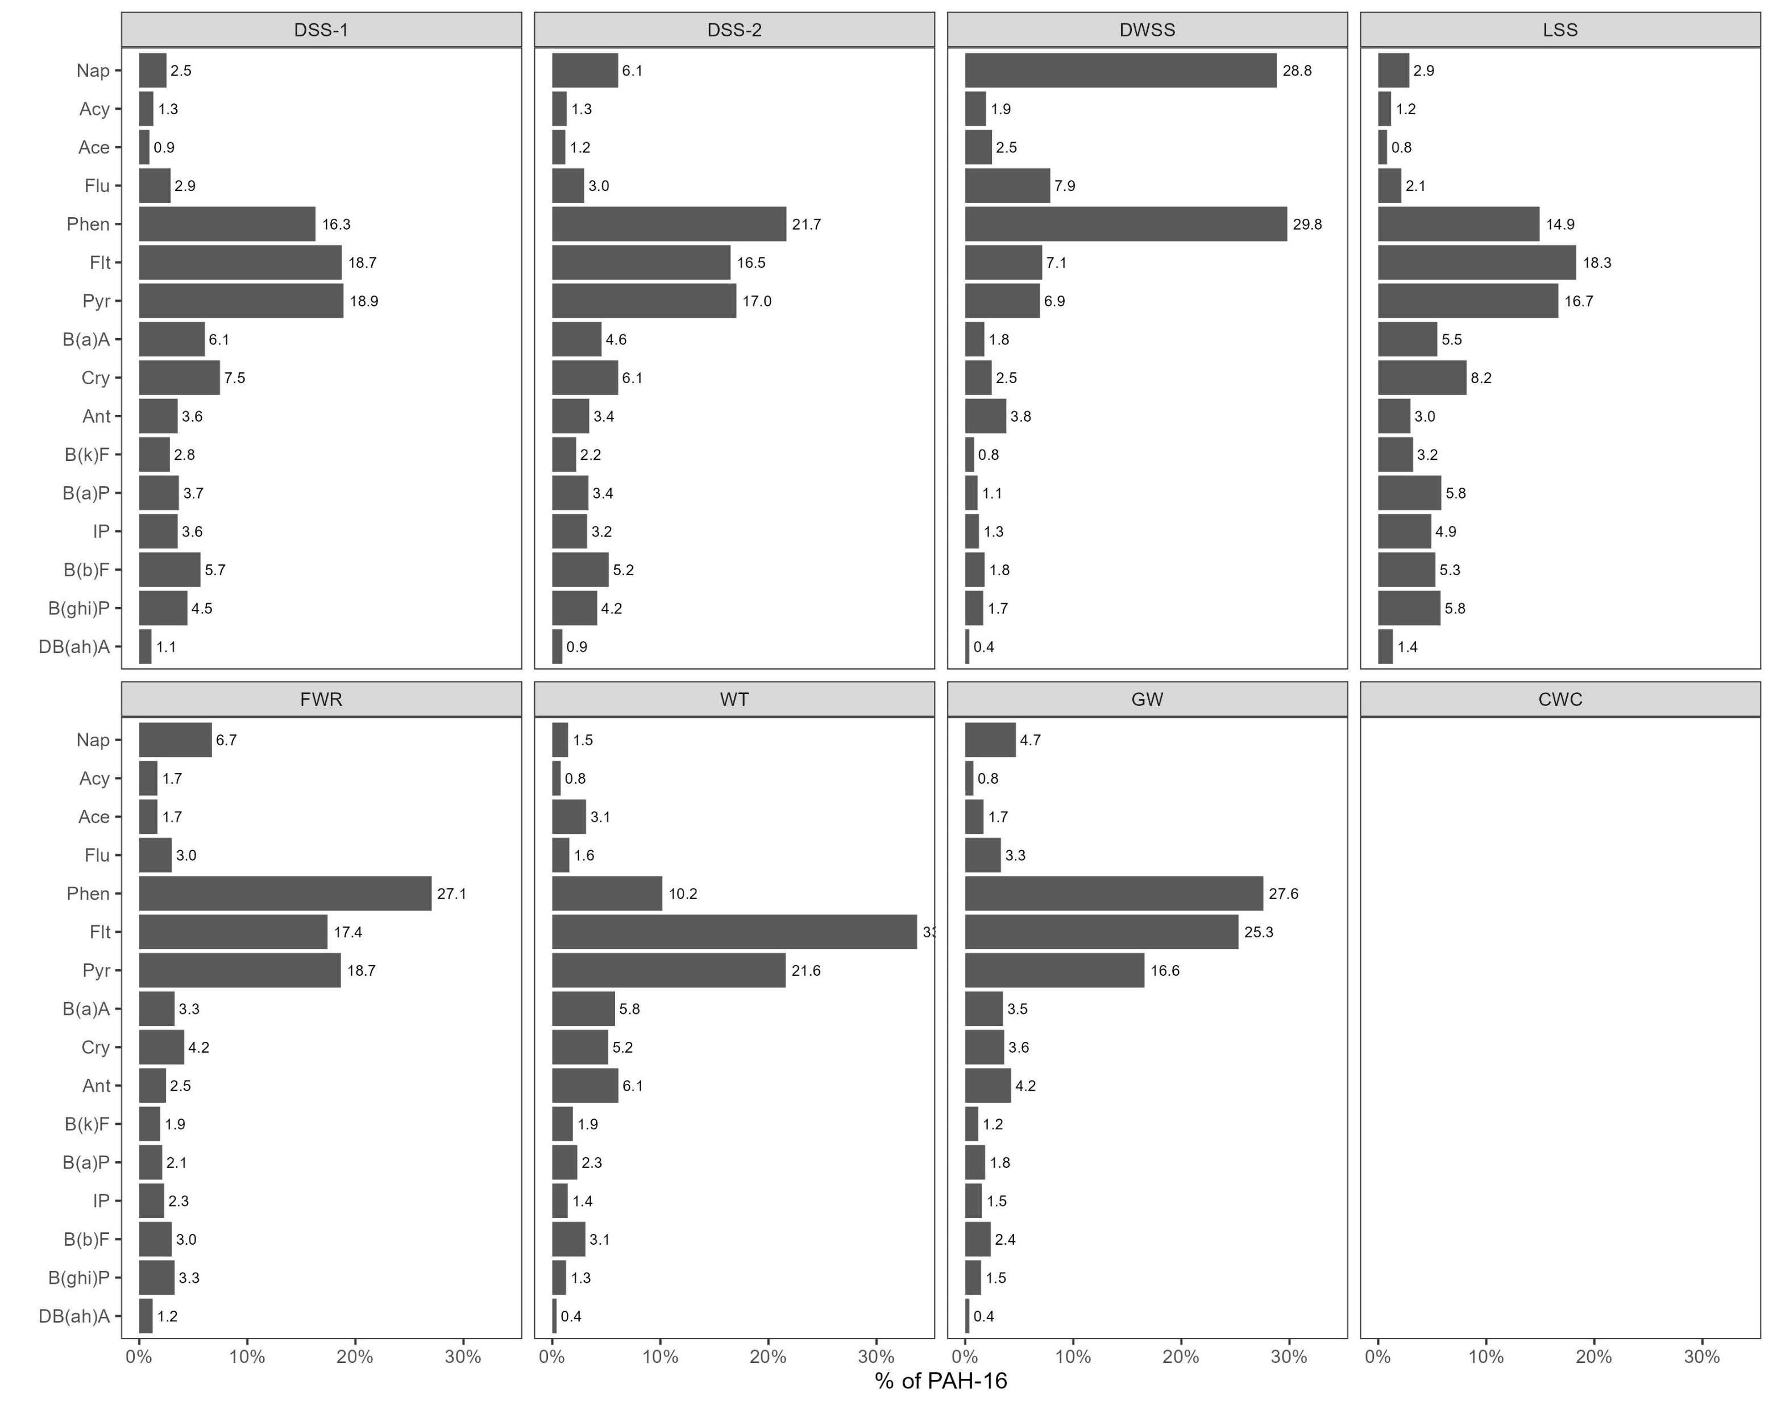
PAH-16 = 1.48 ± 0.03 µg g⁻¹
TEQ = 0.10 ± 0.06 µg g⁻¹
PAH-16 = 0.50 ± 0.02 µg g⁻¹
TEQ = 0.03 ± 0.02 µg g⁻¹
PAH-16 = 1.26 ± 0.03 µg g⁻¹
TEQ = 0.03 ± 0.02 µg g⁻¹
PAH-16 = 0.98 ± 0.03 µg g⁻¹
TEQ = 0.09 ± 0.06 µg g⁻¹
PAH-16 = 0.38 ± 0.01 µg g⁻¹
TEQ = 0.02 ± 0.01 µg g⁻¹
PAH-16 = 5.05 ± 0.09 µg g⁻¹
TEQ = 0.21 ± 0.12 µg g⁻¹
PAH-16 = 0.89 ± 0.02 µg g⁻¹
TEQ = 0.03 ± 0.02 µg g⁻¹
PAH-16 < LOQ (0.01-0.05 µg g⁻¹)

Slide 2
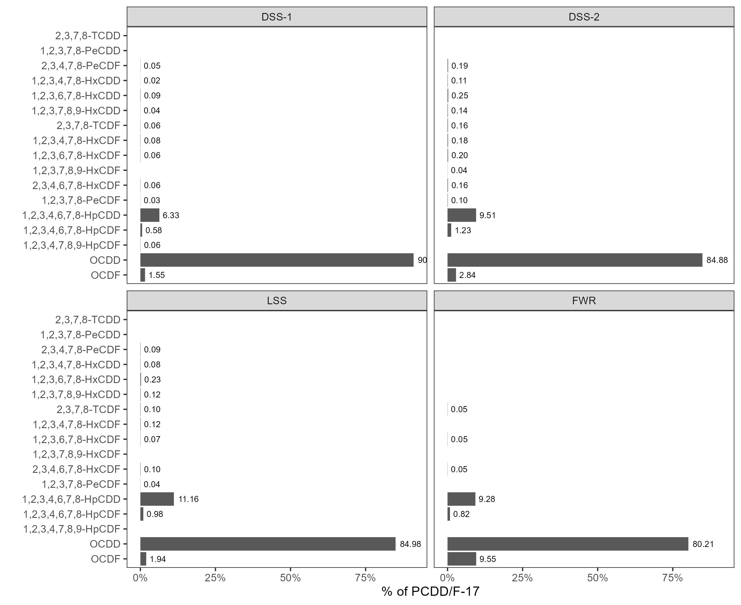
PCDD/F-17 = 2011 ± 118 pg g⁻¹
TEQ = 8.3 ± 0.2 pg g⁻¹
PCDD/F-17 = 302 ± 6 pg g⁻¹
TEQ = 1.8 ± 0.1 pg g⁻¹
PCDD/F-17 = 589 ± 29 pg g⁻¹
TEQ = 3.0 ± 0.1 pg g⁻¹
PCDD/F-17 = 323 ± 14 pg g⁻¹
TEQ = 1.2 ± 0.1 pg g⁻¹

Slide 3
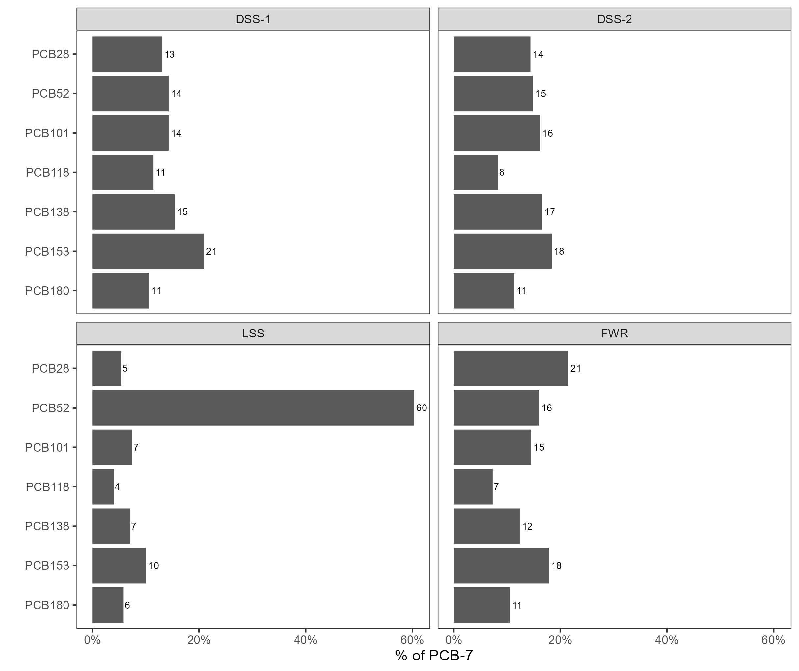
PCB-7 = 20.7 ± 0.6 ng g⁻¹
PCB-7 = 7.6 ± 0.6 ng g⁻¹
PCB-7 = 16.6 ± 1.0 ng g⁻¹
PCB-7 = 9.2 ± 0.4 ng g⁻¹

