Slide 1

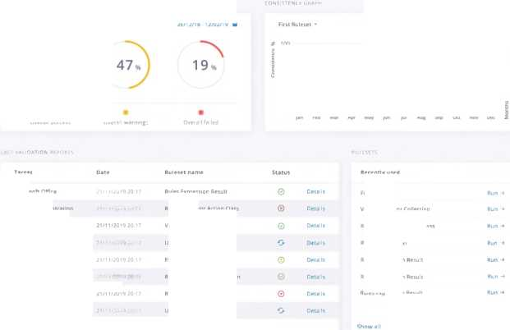




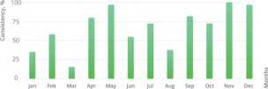

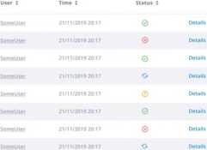








apivisor
Dashboard
visor
My Space ■
My Project *
Validation -
26/12/18 -12/02/19 M
Oliver Sykes
About
Apivisor is building the service to make the api governance part of your design and build process, so the team can build great apis faster.
Overall success
Overall warning;
26/12/18-12/02/19 В
Microsoft Office
Rules Express,
Recently usee
Facebook Registration
Rule statement Action Class
First Ruleset
Ashlyn Browning
21/11/2014
Validation Error Collection
Validation Error Collection
Google Calendar API
updated Condition Action
YEAR MONTH
2019 01
Map
First Ruleset
Google Watcher API
Ruleset Validation Exception
Rules Expression Result
Storage Google API
21/11/2019
RulePathQuallfier
Google Calendar API
Updated Condition Action
© Create new
Show all
Color
Typography
Open Sans
Abe
Regular SemiBold Bold
?------------
visor
MySpace • / My Project * / Validation *
Dashboard
Oliver Sykes *
П Dashboard
$ Reports
26/12/18 -12/02/19 В
л >
47%) 19%
INSISTENCY Gf
My Space -
My Space
Experiment
Hitach
Cloud
IOTA
All Spaces
Overall success
Overall warnings
First Ruleset •
26/12/18 -12/02/19 id
Target
Microsoft Office
Facebook Registration
Ashlyn Browning
Google Calendar API
Google Watcher API
Storage Google API
Google Calendar API
Ruleset name
Rules Expression Result
Rule Statement Action Class
Validation Error Collection
Updated Condition Action
First Ruleset
RuleSet Validation Exception
RulePathQuallfier
Updated Condition Action
Recently used
21/11/2019 20:17
0 |  | First Ruleset
® | Details | Validation Error Collection
0 | Details | Rule Statement Action Class
О | Details | RulePathQuallfier
 | Details | Rules Expression Result
0 | Details | Rules Expression Result
 | Details | Rules Expression Result
 | Details | © Create new
 |  | Show all
21/11/2019 20:17
21/11/2019 20:17
Show all
21/11/2019 20:17
My Space • / My Project * / Validation •
Reports
Oliver Sykes «
My Space * / My Project - / Validation •
MyFirst Set of Rules .asd sa. asd as. asd sa
MyFirst Set of Rules .asd sa . asd
Dramatically
MyFirst Set of Rules .asd sa. asd as. asd sa
MyFirst Set of Rules .asd sa
MyFirst Set of Rules .asd sa. asd as. asd sa
MyFirst Set of Rules .asd sa
Proactively Seamlessly envisioneer mission
MyFirst Set of Rules .asd sa. asd as. asd sa
MyFirst Set of Rules .asd sa
MyFirst Set of Rules .asd sa. asd as. asd sa
MyFirst Set of Rules .asd sa. asd as. asd sa
MyFirst Set of Rules .asd sa. asd as. asd sa
MyFirst Set of Rules .asd sa . asd as. asd sa
MyFirst Set of Rules .asd sa
MyFirst Set of Rules .asd sa . asd
MyFirst Set of Rules .asd sa. asd
MyFirst Set of Rules .asd sa
Globally
Quickly
Monotonically
MySpace • I My Project • / Validation •
Rulesets
First Ruleset
4- Example Of Tamplete Rule
Oliver Sykes ^{v}
Ö Disable
4- Example Of Tamplete Rule
Co Duplicate
© Add ruleset
4- Some Rule
© Move to ruleset
IÜJ Delete
4- Another Rule
< Move to ruleset x
First Ruleset
Second Ruleset
Third Ruleset
4* Validate It
4- Rule To Validate Someting Else
4- Another Rule
■I- Validate It
4- Rule To Validate Someting Else
4' Validate It
© Add rule
My Project - / Validation -
First Rules
'glossary": { "title": "exampleglossary".
“GlossDiv": {
"title": “S”,
"GlossList": {
"GlossEntry" {
"ID": "SGML",
"SortAs": "SGML",
"GlossTerm": "Standard Generalized Mark "Acronym": "SGML",
"Abbrev" "ISO 8879 1986".
"GlossDef": {
"para": "A meta-markup language, used t "GlossSeeAlso": [
"GML“.
“XML"
Second Rules
Third Rules
Facebook ruleset
Google ruleset
Some ruleset
Twilio
Fifth Rules
"GlossSee": "markup"
Twilio Rules
Register & Sign In
Registration
Name
apivisor
Sign in
Email
Email
Password
Forgot password?
Password
By creating an account you agree to the Terms of Service and Privacy Policy
Don't have an account? Sign up
Create account
Already a customer? Sign in
Email has been sent
Please check you email and follow instructions to reset your password.
Email
Forgot your password?
Enter your email address below to reset password
to Sign in
Request reset link
Back to Sign in
apivisor
Space
Oliver Sykes *
MySpace |  | Second SDace
Space owner: | You | Space owner: | JohnJay
Access: | Owner |  | Read only
Type: | Validation | Type: | Validation
3 | 2 | 7 | 3
« Projects | ä Users | Business
Subscription I 30 days trial 1 | Change plan |  | | Change pl | ■
. Third Name of ф Next Space
« Space - Long Name
Space owner: | You | Space owner: | John jay
Access: | Owner | Access: | Read only
Type: | Validation | Type: | validation
4 • Projects | 1 A Users | 7 | 3 Ж Users
Subscription Individual | I Change plan Hl | Business | | Change plan ]
Some Space
Space owner: Type: | John jay Read only Validation | Space owner: You Access: Owner Type: Validation | О
2 g Projects | 1 Ä, Users | 1 5 0 Projects ä Users | Create new
Business | Change plan ф | Individual ___ _
X
Space owner:
Access:
Type:
{®} Settings
S Billing details
Delete
validation
3
2
S Projects
Ä Users
Subscription
Change plan
30 days trial
Onboarding
Space name
Project name
Please enter your project name to continue
Choose action
Please enter your space name to continue.
Name your space
Next
Name your project
VALIDATION TESTING SECURITY
Tutorial
Back
Next
Tutorial
Tutorial
Thank You
For Watching!

