Slide 1

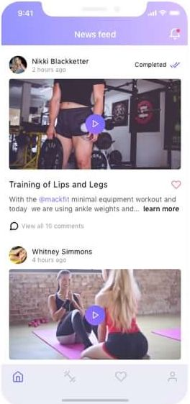
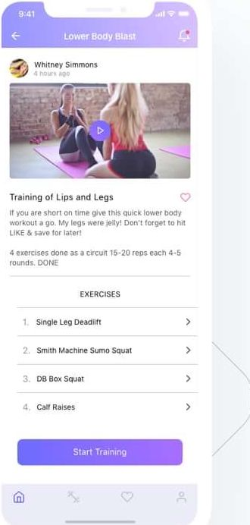
HeeroFit
Screens for trainers
Color and typography
San
Francisco
Aa
Training steps

